Slide 1
CELL AND TISSUES-THE BASIC STRUCTURE OF THE BODY
LESSON -3
BY
AMANDEEP KAUR
ASI/ANM

Slide 2
OBJECTIVES
Upon completion of this lesson you will be able to:
Describe Structure, Properties & Functions of Cells
Describe Structure, Properties & Functions of various Tissues
To know about organs & their types
To know about various Systems & their brief roles.

Slide 3
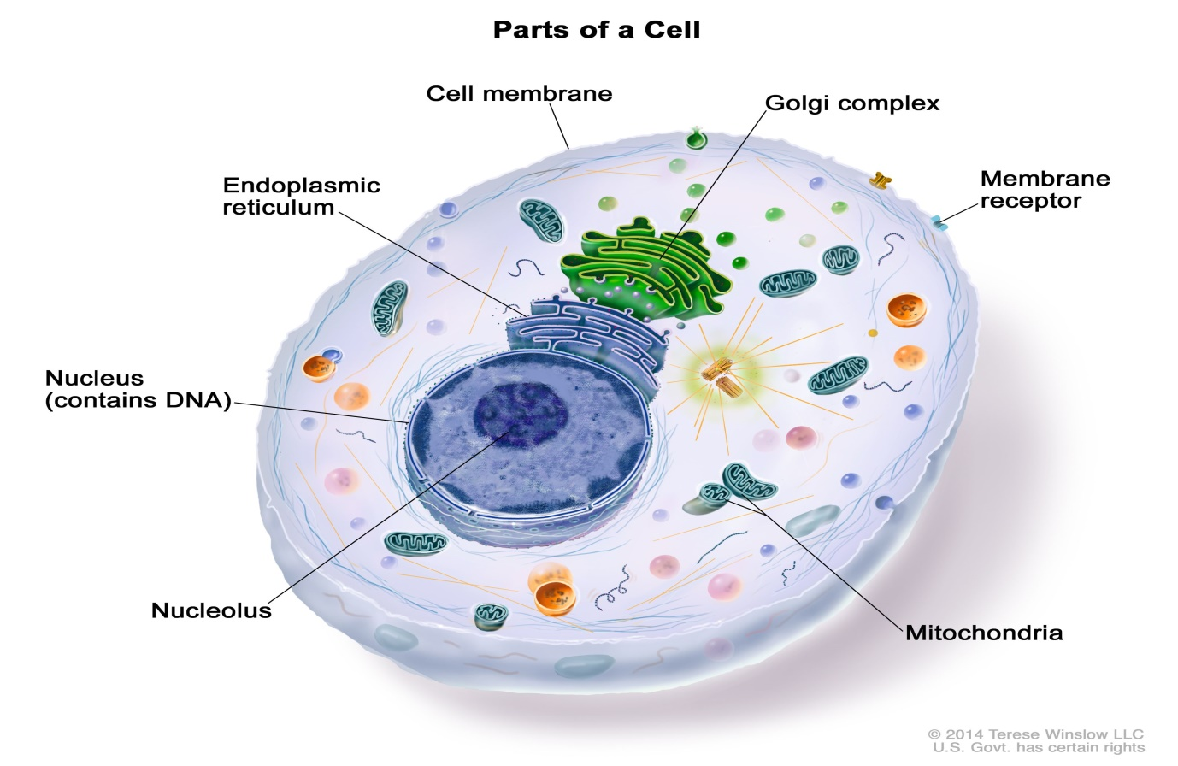
WHAT IS A CELL?
CELL IS THE STRUCTURAL AND FUNCTIONAL UNIT OF BODY.
A cell is defined as the smallest, basic unit of life that is responsible for all of life's processes.” Cells are the structural, functional, and biological units of all living beings. A cell can replicate itself independently.

Slide 4
STRUCTURE OF A HUMAN CELL
CELL MEMBRANE
Composed of protein threads with lipid in between
Semi-permeable
    Minute molecules by diffusion through pores
    Nutrient materials by dissolving in lipid
    Actively by carriers
B. PROTOPLASM
NUCLEOPLASM: Encapsulated by the Nuclear Membrane
CYTOPLASM: Protoplasm between the nuclear membrane & cell membrane. The ground substance in which all organelles are suspended is called “Cytoplasmic Matrix”.
  All living cells are made up of a substance called “Protoplasm”, which is the material of physical basis of all life.
  Slightly opaque; Colourless; Jelly-like appearance

Slide 5
  Consists of
    Water
    In solution/ suspension – Organic/Inorganic Salts; Glucose; Lipids (Fats); Protein complexes; Nitrogenous compounds
Constituents:
Mitochondria -Powerhouses-involved in oxidative reactions; act as store-houses for nutrient material
Vacuoles-Contains waste-material & secretions
Centrosome-Consists of 2 centrioles - involved in cell-division
Endoplasmic Reticulum-Skeleton of the cytoplasm- involved in manufacture of protein
Golgi Apparatus-Packaging area for secreted protein for transportation to

Slide 6
  the cell surface for release
Ribosomes-A ribosome is an intercellular structure made of both RNA and protein, and it is the site of protein synthesis in the cell.
RNA – act as messengers-
Lysosomes-Cell digestive system– contains powerful digestive enzyme
C. NUCLEUS:
Central, globular mass
Consists of cell membrane, nucleoplasm & a dense nucleolus.
Directs work of the cell (acts as manager) & responsible for cell-division

Slide 7
PROPERTIES & FUNCTIONS OF CELLS:
Since cells are living structures, they have the same properties of which are common to all living things.
METABOLISM:
  To build up & repair protoplasm
  To produce secretion
  To provide heat & energy
RESPIRATION:
  Oxygen absorbed through semi-permeable membrane is used for oxidation of nutrient material, thus providing heat & energy

Slide 8
GROWTH:
  Ability to grow till they are mature & ready to reproduce
EXCRETION:
  Waste-products produced during metabolism, which may cause damage if retained, are excreted through the semi-permeable membrane
MOVEMENT:
  Ability to move in part or whole
IRRITABILITY:
  Responds to physical, chemical or thermal stimulus

Slide 9
REPRODUCTION:
  Ability to reproduce by cell-division on maturity of growth
TISSUE
A group of similar cells bound together by inter-cellular substance
ELEMENTARY TISSUES
Epithelial
Connective
Muscular
Nervous
EPITHELIAL TISSUE:
Consists of cells forming the cover for body & mucous membrane. It forms the lining of various hollow organs, blood vessels, air sacs in the lungs, etc.

Slide 10
TYPES
(BASED ON SHAPE AND LAYERS OF CONSTITUENT CELL)
SIMPLE
COMPOUND
Functions:
Protection of deeper tissue & organs (eg. skin; nuclear membrane)
Secretion of enzymes & hormones (eg. gastric secretions)
Diffusion of gases (eg. lung tissue)
Sensory (eg. skin)

Slide 11
CONNECTIVE TISSUE:
As the name suggests, it forms connections between cells, tissues & organs. Also acts as covering for some glands.
Functions:
Mechanical
  Supporting
  Packing material to fill up hollow spaces around organs to keep them in place
  Covering for glands and vital organs
  Binding of bones in joints
  Barrier between different types of cells & tissues
Reparative
  Helps in healing by laying down of fibrous tissue

Slide 12



MUSCULAR TISSUE:
It has the property of contractility (shortening of length), by means of which movements are performed.
TYPES
(based on functionality)
$$→$$
$$→$$
$$→$$
VOLUNTARY
INVOLUNTARY
Muscles which act only under own will.
Ex, Muscles of the arms & legs
Muscles which act continuously without any conscious will.
Ex, Cardiac Muscles; Respiratory

Slide 13
TYPES
(BASED ON STRUCTURE)
STRIATED
(VOLUNTARY)
NON-STRIATED
(INVOLUNTARY)
CARDIAC
(INVOLUNTARY)
Functions:
Movement
Posture
Vital functions (Cardiac; Respiration)

Slide 14
NERVOUS:
Highly specialized tissue having the ability to conduct impulses to & from cells.
TYPES
GRAY MATTER
CONSISTS OF NERVE-CELLS
WHITE MATTER
CONSISTS OF NERVE-FIBRES
NEUROGLIA
CELLS WHICH SUPPORTS CELLS AND FIBRES

Slide 15
Functions:
Sensory
Motor
Autonomic - controls all involuntary functions of the body
ORGANS
Organs are distinct parts of the body which carry out specific functions and are made up of one or more tissues
TYPES
SOLID
Ex-LIVER,SPLEEN,PANCREASE
HOLLOW
Ex-UTERUS,STOMACH,GALL BLADDER

Slide 16
Functions:
Mechanical
  In digestion - Stomach, Small intestines
  In circulation - Heart
  In excretion – Urinary bladder
Secretory
  In digestion - Stomach, Liver, Pancreas
Filtration
  In excretion - Kidneys

Slide 17
Diffusion
  In respiration – Exchange of gases in Lungs
Endocrine
  Pancreas (Insulin)
Reproductive
  Uterus, Testis
Sensory
  Eye, Ear

Slide 18
ANY QUESTION ?

Slide 19
THANK YOU

