Slide 1
ENVIRONMENTAL EMERGENCIES
LESSON-26
BY
JITENDER YADAV
INSP/PH

Slide 2
OBJECTIVES
Upon completion of this lesson, you will be able to:
List signs and symptoms of heat cramps, heat exhaustion and heat stroke. Describe their management.
List the differentiating features between three heat emergencies.
Explain dehydration and list the causes.
Enumerate the signs and symptoms of dehydration and explain its management.
Cont…

Slide 3
ENVIRONMENTAL EMERGENCIES
Exposure to excessive heat can produce serious health conditions especially in patients not acclimatized to heat

Slide 4
ENVIRONMENTAL EMERGENCIES
Heat cramps
Heat exhaustion
Heat stroke

Slide 5
1) HEAT CRAMPS
Heat cramps consist of pain and muscle spasms that occur when the body loses a large quantity of salt through excessive sweating.
The core temperature of the body is not altered

Slide 6
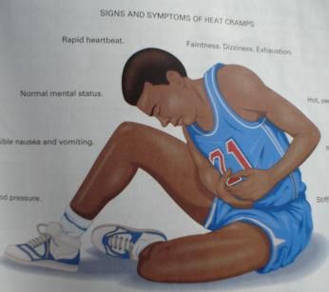
SIGNS AND SYMPTOMS OF HEAT CRAMPS
Severe muscle cramps.
Exhaustion.
Nausea and vomiting.
Periods of fainting.

Slide 7
MANAGEMENT FOR HEAT CRAMPS
Move the patient to a cool area.
Give the patient water. The patient needs the water more than the salt, Do not delay giving water to look for salt.
Commercial electrolytes or oral rehydration solution (ORS) are the best if patient is conscious; if unconscious do not give anything by mouth; start IV DNS or NS and evacuate the patient.

Slide 8
2) HEAT EXHAUSTION
Heat exhaustion can occur when a person in poor physical condition exerts himself or herself during physical activity in a very hot environment, causing blood flow to be affected.
The body core temperature rises between 37 to 40° C

Slide 9
SIGNS AND SYMPTOMS OF HEAT EXHAUSTION
Rapid, shallow breathing.
Weak pulse.
Cold, clammy, pale skin and mucous membranes, with a lot of sweating.
Weakness.
Dizziness, sometimes leading to fainting.

Slide 10
MANAGEMENT FOR HEAT EXHAUSTION
Move the patient to a cool place to rest.
Remove or loosen clothing as necessary to cool the patient without causing chills.
Place the patient in a supine position with
legs elevated 20 to 30 cm.
Administer oxygen high flow.
Give water if conscious.
If unconscious do not give anything by mouth; start IV DNS or NS and evacuate the patient.

Slide 11
3) HEAT STROKE
Heat stroke is a very serious life-threatening condition. The body becomes overheated and, in many cases, the patient stops sweating. If left untreated, brain cells will begin to die.
The core temperature of the body will be more than 40° C

Slide 12
SIGNS AND SYMPTOMS OF HEAT STROKE
Deep, rapid breathing.
Rapid strong pulse followed by rapid weak pulse.
Dry, hot skin, sometimes red.
Dilated pupils.
Possible loss of consciousness
Convulsions or muscular tremors.
Cont…

Slide 13
MANAGEMENT FOR HEAT STROKE
Cool the patient quickly in any way possible. Move the patient far fm the source of heat. Remove his garments and wrap the patient with wet sheets. Pour cold water on the sheets. This should normalize the patient’s core temperature and help prevent brain cells from dying.

Slide 14
MANAGEMENT FOR HEAT STROKE
Place cold bags or ice packs below each armpit , behind the knees and around the ankles, and one on each side of the neck.
Look for a large container or bathtub and submerge the patient in cold water up to the neck. Use ice to cool the water.

Slide 15
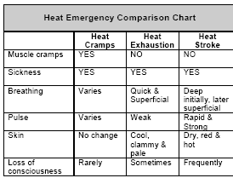

Slide 16
DEHYDRATION
Adult human body consists of 55-60% of body wt as water and it is distributed in various compartments like intracellular (70%), Extracellular (30% approx. 12 L). Of this extracellular water 75% is interstitial and 25% intravascular.
Water enter and leaves the body through the gastrointestinal tract and and is loss through the lungs, the skin and the kidneys

Slide 17
DEHYDRATION
Dehydration is a state where the body’s extra cellular fluid is lost with or without electrolyte loss.
Causes of ECF Depletion:
From GIT-
Vomiting
Diarrhea
Fistula
Intestinal obstruction

Slide 18
DEHYDRATION
From Kidneys:-
Diabetes Mellitus
Renal Diseases
Drugs like diuretics
From Skin:-
Sweating in hot environment, fever etc
From Kidneys:-
Burns
Ascites
Peritonitis
Acute Pancreatitis

Slide 19
SIGNS AND SYMPTOMS
Excessive thirst.
Concentrated urine & later reduced urine output.
Dizziness or fainting.
Weakness.
Hypotension especially postural hypotension
Loss of skin turgor.
Cont…

Slide 20
SIGNS AND SYMPTOMS
Rapid pulse rate.
Shallow rapid breathing.
Confusion, stupor.
Systolic BP <100 mmHg
Cold extremities and poor capillary return.
Cont…

Slide 21
MANAGEMENT FOR DEHYDRATION
In conditions where loss is expected as in diarrhea, working in hot environment, prophylactic measures with plenty of oral fluids is advised.
If patient is conscious and alert, oral rehydration solution should be given and continued till loss is controlled.

Slide 22
MANAGEMENT FOR DEHYDRATION
In moderate and severe dehydration and patients with altered mental status, IV fluid should be started preferably 0.9% NS and shift patient to hospital care for further evaluation.
Treatment of the underlying cause of dehydration.

Slide 23
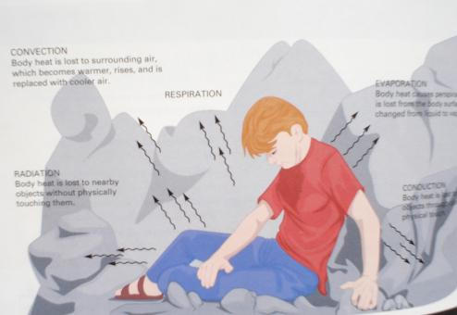
MECHANISMS OF HEAT LOSS
CONVECTION: Body heat lost to the surrounding air which is becomes warmer, rises, and is replaced with cooler air.
RESPIRATION
EVAPORATION
RADIATION: Body heat is lost to nearby objects without touching them
CONDUCTION: through direct physical touch to nearby objects.

Slide 24
ANY QUESTION
?

Slide 25
THANKS

