Slide 1
LESSON-22
CHILD BIRTH EMERGENCIES
BY
JITENDER YADAV
INSP/PH

Slide 2
Objectives
Upon completion of this lesson, you will be able to:
1. Explain the 3 stages of normal labour.
2. List the steps in pre-delivery assessment of
the mother.
3. Explain the steps in conduct of normal labour.
4. Explain the steps in delivery of the Placenta.
5. Explain APGAR score and management of
different scores.

Slide 3
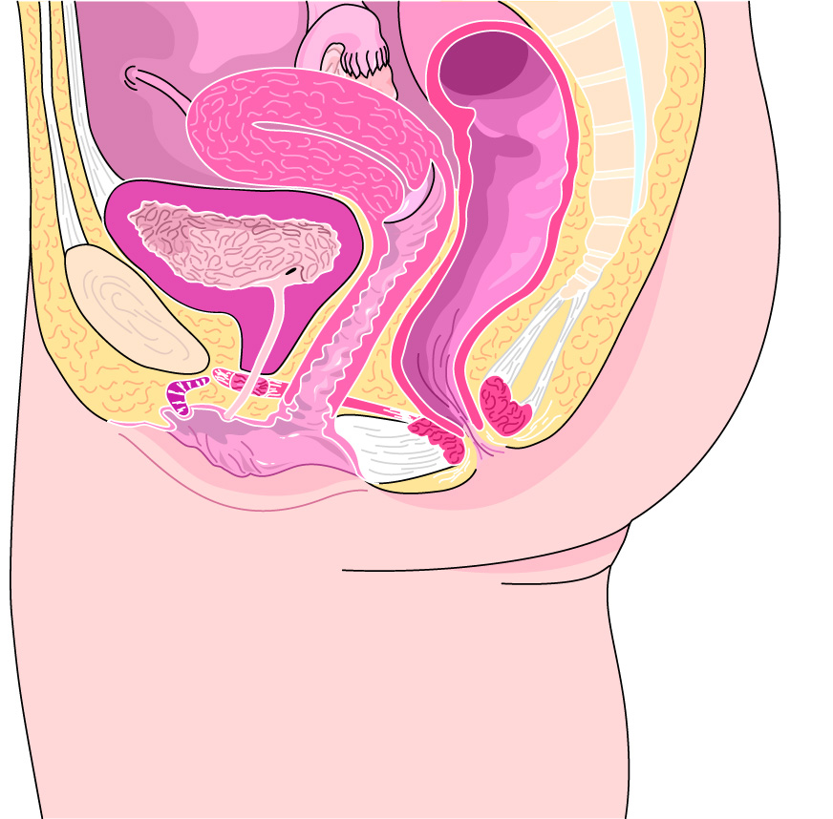
ANATOMY OF PREGNANCY
Rectum
Vagina (birth canal)
Perineum
Uterus
Symphysis
pubis
Urinary
bladder

Slide 4
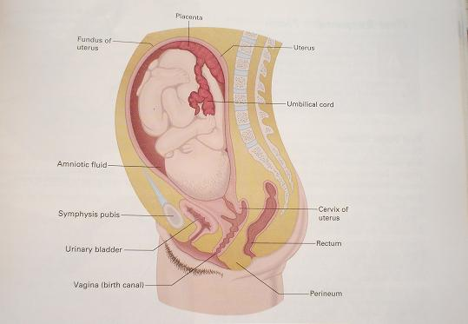
AnANATOMY OF PREGNANCY of Pregnancy
Placenta
Chtk.Mklu
Uterine walls xHkkZ’k;
Uterus
xHkkZ’k;
Umbilical cord
ukfHkukMh
Amniotic sac
,fEu;ksfVd lSd
Foetus Hkzw.k
Symphysis pubis
flafQfll I;wfcl
Cervix
lsfoZDl
Urinary bladder ew=k’k;
Rectum
eyk’k;
Vagina(birth canal);ksfu
Perineum ewyk/kkj
Medical first Responder NITSRDR, BTC,ITBP

Slide 5
GENERAL TERMINOLOGY USED:
Amniotic sac: A sac of fluid in which the foetus develops during pregnancy.
Cervix: The neck of the uterus in which the unborn infant passes into the vagina
Foetus: The unborn developing baby in the uterus.
Placenta: A disk-shaped organ on the inner lining of
the uterus. Rich in blood vessels, it supplies
nourishment and oxygen to the foetus during
pregnancy. It also absorbs waste from the
foetus into the mother’s bloodstream.

Slide 6
Umbilical cord: An extension of the placenta
through which the foetus receives nourishment
while in the uterus.
Uterus: The organ that contains the developing foetus or unborn infant. A special arrangement of smooth muscles and blood vessels in the uterus allow for great expansion during pregnancy and forcible contractions during labour and deliver
Vagina: Channel through which the infant passes to reach the outside.

Slide 7
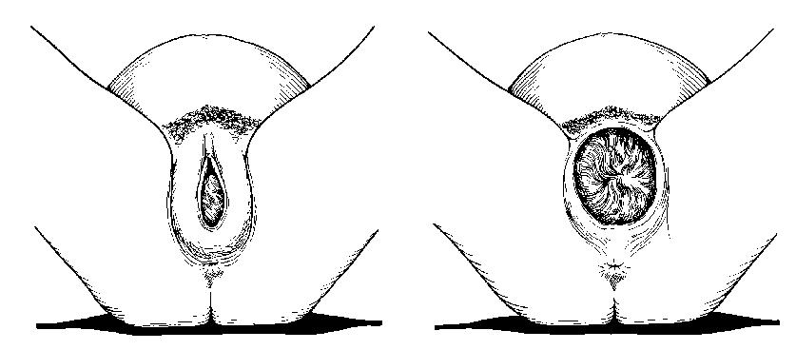
STAGES OF LABOUR
First stage (dilation): Begins with the mother’s contractions and ends when the infant enters the birth the canal. During this first and longest stage, the cervix becomes fully dilated (expanded).

Slide 8
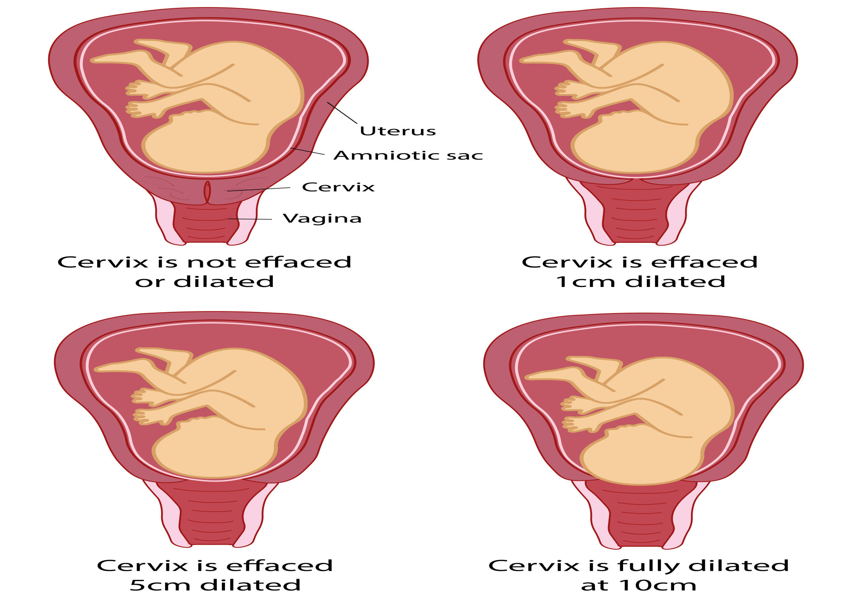
First stage (dilation):

Slide 9
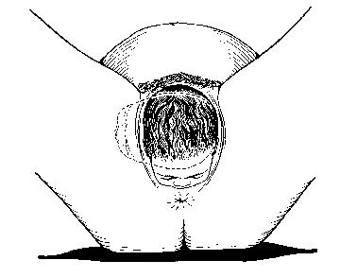
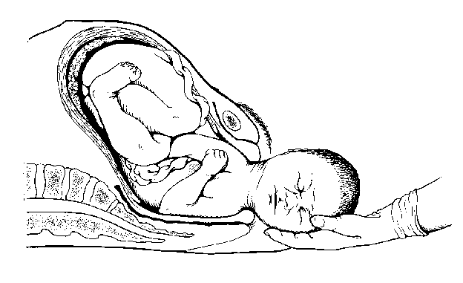
Second stage / expulsion: Begins the moment the infant moves into the birth canal. When the baby’s head appears at the opening of the birth canal, it is called “crowning”. The second stage ends with the birth of the infant.

Slide 10
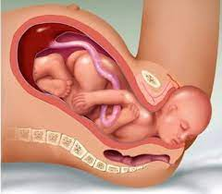
Second stage / expulsion

Slide 11
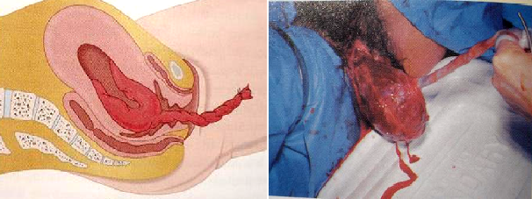
Third stage (placental): The placenta separates from the uterine wall. It is usually then spontaneously expelled from the uterus.

Slide 12

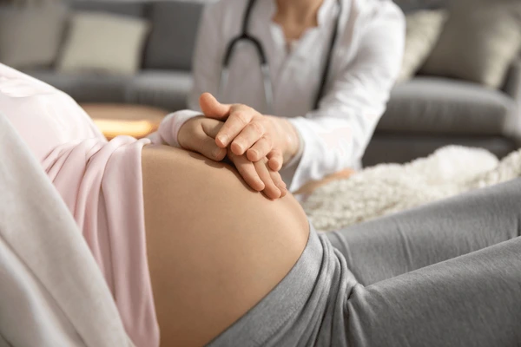
ASSESSMENT OF THE MOTHER

Slide 13
ASSESSMENT OF THE MOTHER
Use universal precautions and secure the scene.
Conduct initial assessment.
Verify prenatal care, get doctor’s information, ask about any difficulties with pregnancy, and whether delivery is to be normal. Ask when her due date is.
Ask the patient if it is her first pregnancy. If so, the labour process will usually last close to 18 hours. The duration of labour is considerably shorter with each subsequent birth (approximately 2-3 hours).

Slide 14
Determine when contractions began and if the amniotic sac (water bag) has ruptured.
Ask the patient if she feels any pressure being applied to pelvis or the urge for a bowel movement. Do not allow patient to sit on toilet.
Determine the frequency and duration of contractions. Use a gloved hand on the patient’s abdomen to feel for the involuntary tightening of the uterine muscles.

Slide 15
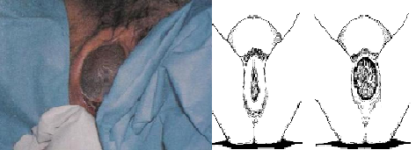
Visual evaluation: Check for crowning or bulging in the vaginal area. If no crowning, move to next step. If either the head or other part of the body is visible, prepare to deliver at the scene.

Slide 16
Determine if delivery will be at the scene or if there is time for transport:
If contractions are less than 2 minutes apart, prepare to deliver the baby at the scene.
If contractions are between 2 and 5 minutes apart, make a decision on several factors, such as whether this is the first pregnancy, if the patient feels an urge for a bowel movement, traffic and weather conditions, or other complication.
If contractions are 5 minutes or more apart, the mother usually has time for transport.
CAUTION: Do not allow the mother to cross or hold her legs together to delay delivery. Death or permanent injury to the infant may result.

Slide 17
PRE-HOSPITAL PREPARATION OF THE MOTHER
Use universal precautions and secure the scene. Make sure to use full personal protective equipment.
Ensure privacy for the patient (select an appropriate area).
Have the mother lie on her back with knees bent and legs spread. Elevate the buttocks. Inspect the vaginal area but do not touch it except during delivery of the baby.
Have O.B. (obstetrical) kit ready and opened.

Slide 18
Place a sheet or clean towel under the patient’s buttocks, another under the vaginal area and another covering the legs and abdomen.
Evaluate frequency and duration of contractions.
Check for crowning.
Comfort and reassure the mother. Encourage her to keep breathing slowly and comfortably. Stress the importance of relaxing between each contraction.

Slide 19
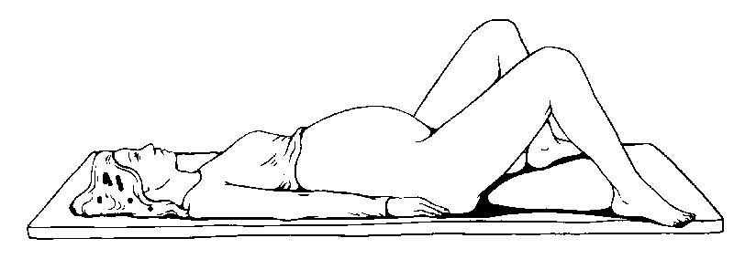
PREPARATION FOR DELIVERY

Slide 20
ITEMS IN OB KIT (OBSTETRICAL – BIRTH KIT)
Sheets & Towels, Sterile if possible.
01 Dozen 4” Square gauge pad.
2-3 Sanitary Napkins.
Rubber Syringe.
Baby Receiving Blanket.

Slide 21
Surgical Blade.
Cord Clamps.
Foil wrapped germicidal wipes.
Sterile thread or wide tape.
Large Plastic bags.

Slide 22
DELIVERY OF THE BABY
1) Apply very gentle pressure with the palm of your hand to prevent explosive delivery. Do not pull the infant from the vaginal opening.
2) If the amniotic sac (water bag) has not broken, tear it or pinch it open with your fingers and pull it away from the infant’s mouth and head. Do not delay this process. Never use a sharp instrument!
3) If the umbilical cord is around the infant’s neck, use two gloved fingers to slip the cord over the head. Only if you cannot dislodge the umbilical cord, attach two clamps three inches apart, then cut between the clamps.

Slide 23
4) Support the baby’s head. Wipe the mouth and nose with sterile gauze pads. Suction the baby’s mouth first, then the nose with a rubber bulb syringe. Compress the syringe every time before inserting it.
5) Continue to support the baby with both hands. Gently guide the baby’s head downward to assist the mother in delivering the baby’s upper shoulder. If the lower shoulder is slow to deliver, assist the delivery by gently guiding the baby’s head upward.

Slide 24
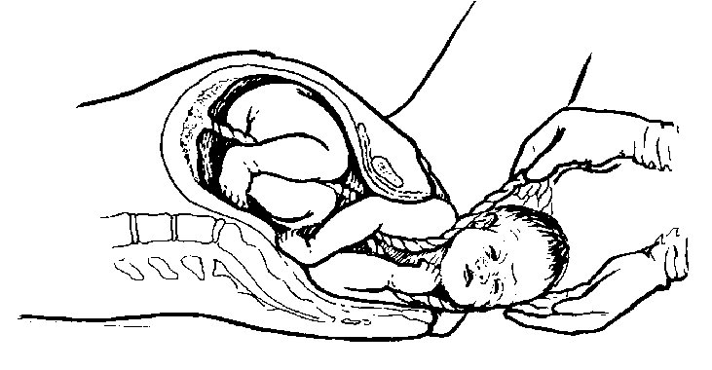

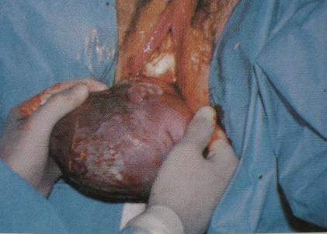
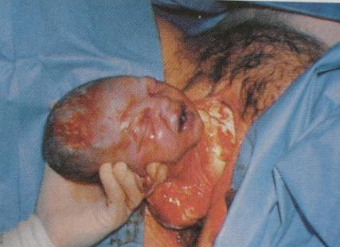
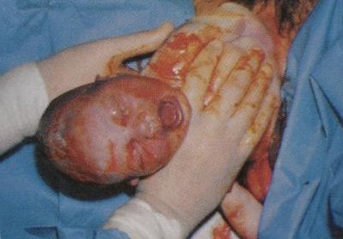

Slide 25
6) Support the baby throughout the entire process. Grasp the feet as they emerge. Position the baby level with the mother’s vagina until the umbilical cord is cut; otherwise the baby’s blood could return to the placenta. The new-born is very slippery — never lift the baby by the feet. Note exact time of delivery.
7) Position, dry and wrap the baby. Place the baby on his/her side with the head slightly lower than the body. Gently dry with clean towels and wrap the baby in clean warm blanket. Only the face should be exposed.

Slide 26
8) Assess the baby’s breathing. Suction the baby’s mouth and nose again, in that order. Usually the baby will start breathing on its own within 30 seconds of being born. If not, encourage breathing by providing tactile stimulation, rubbing the back gently but vigorously, or by snapping a finger against the sole of the baby’s foot. Do not lift the baby by its feet to slap its bottom! If assessment reveals shallow, slow or absent respiration, start artificial ventilation.

Slide 27
9) Clamp and cut the umbilical cord when it stops pulsating. Palpate the cord to make sure it is no longer pulsating before clamping;
do not clamp or cut the cord if it is still pulsating.
Position the first clamp approximately 25 cm. from the baby; then position the second clamp 8 cm. away from the first clamp toward the baby.
then cut the cord using surgical scissors.
10) Record the date, time and place of birth as noted in the step 6.

Slide 28
DELIVERY OF THE PLACENTA
Now two patients in your care: the mother as well as the baby.
Care for the mother includes helping her deliver the placenta, controlling vaginal bleeding, and making her as comfortable as possible.
The third stage of labor includes the delivery of the placenta with its section of umbilical cord, membranes of the amniotic sac, and some tissues lining the uterus.
All of these together are known as the afterbirth.

Slide 29
Observe for delivery of placenta. This begins with a brief return of labor pains that stopped when the baby was born. You may notice a lengthening of the cord.
Feel for contractions. Encourage the mother to bear down as the uterus contracts.
As the placenta appears, slowly and gently guide it from the vagina, but never pull. Save the placenta in a plastic bag. In most cases, the placenta is expelled within a few minutes of delivery, but could take up to 30 minutes. Take the placenta to the hospital for examination by the physician.

Slide 30
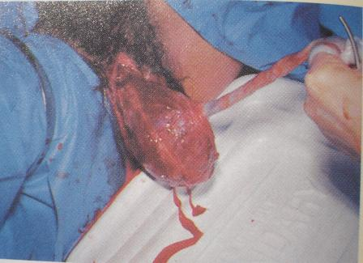
CONTROLLING VAGINAL BLEEDING AFTER DELIVERY.
Place sanitary napkin or towel on vaginal opening. Do not place anything inside the vagina.
Have the mother lower her legs and keep them together without squeezing. Elevate her feet.

Slide 31
Feel the mother’s abdomen below the navel until you feel a hard object the size of a grapefruit. This is the mother’s uterus. If bleeding appears to be excessive, massage the uterus using circular motions; this will cause the uterus to contract and control bleeding
Consider initiating breast-feeding to stimulate uterine contractions.
Conduct ongoing assessment.

Slide 32
COMPLICATIONS OF PREGNANCY
There are several types of pre-delivery emergencies that may arise in the pregnant patient prior to labor or childbirth that can threaten the life of both the mother and the baby. In most cases, definitive treatment is beyond the MFR’s level of training and immediate transport is required.

Slide 33
EXCESSIVE PRE-BIRTH BLEEDING
A number of conditions can cause excessive pre-birth bleeding. One such condition is placenta previa, in which the placenta is formed in an abnormal location (low in the uterus and close to or over the cervical opening) that will not allow for a normal delivery. As the cervix dilates, it causes the placenta to tear.

Slide 34
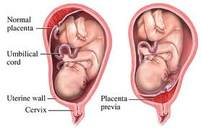
(Placenta previa)

Slide 35
EXCESSIVE PRE-BIRTH BLEEDING
Another condition is abruptio placentae in which the placenta separates from the uterine wall either partially or entirely. Either type of complication may occur in the third trimester and both are potentially life threatening to the mother and foetus.

Slide 36
PRE-HOSPITAL TREATMENT FOR PRE-BIRTH BLEEDING
1) Place the patient on her left side.
2) Treat for shock. Elevate the patient’s legs.
3) Place a sanitary napkin or towel at vagina opening but do not place anything inside the vagina. Replace any blood soaked napkins but do not discard them. All blood soaked items should be taken to hospital for examination.
4) Monitor all vital signs.
5) Transport the patient.

Slide 37
2) SPONTANEOUS ABORTION
For a number of reasons, the foetus and placenta may deliver before the 20th week of pregnancy, generally before the baby can live on its own. This occurrence is called an abortion.
When it happens naturally it is called a spontaneous abortion, or miscarriage. An induced abortion results from deliberate termination of the pregnancy, in either a legal or criminal setting.

Slide 38
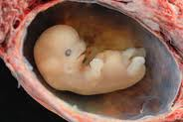
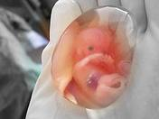
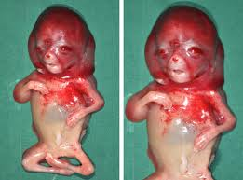
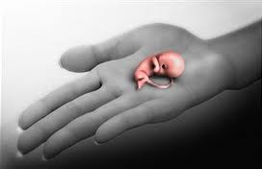
(Spontaneous abortion)
P Page No-173 CHILD BIRTH EMERGENCIES TR- 18-36

Slide 39
SIGNS AND SYMPTOMS OF SPONTANEOUS ABORTION
Vaginal bleeding, ranging from moderate to severe.
Pain in the lower abdomen, similar to menstrual cramps or first stage labour pain.
Noticeable discharge of tissue from the vagina.

Slide 40
PRE-HOSPITAL TREATMENT FOR SPONTANEOUS ABORTION
Treat for shock. Provide oxygen per local protocol.
Place a sanitary towel or something similar on the opening of the vagina. Do not place anything inside the vagina.
Keep all the bloodstained towels and any expelled tissue for examination.
Transport the patient.

Slide 41
3) ECTOPIC PREGNANCY
In a normal pregnancy, the fertilized egg will eventually implant on the wall of the uterus. In an ectopic pregnancy, the fertilized egg implants in an oviduct, in the abdominal cavity, or outside the uterus. These areas are not able to contain or support the growing embryo.

Slide 42
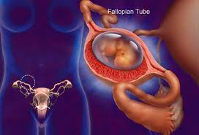
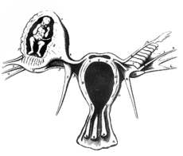
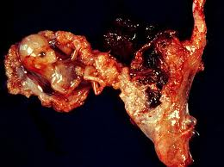
(Ectopic Pregnancy)

Slide 43
SIGNS AND SYMPTOMS OF ECTOPIC PREGNANCY
Acute abdominal pain, usually on one side.
Vaginal spotting or bleeding.
Signs of shock.

Slide 44
PRE-HOSPITAL TREATMENT FOR ECTOPIC PREGNANCY
Treat for shock. Provide oxygen per local protocol.
Keep all the bloodstained towels and any expelled tissue for examination.
Transport the patient.

Slide 45
COMPLICATIONS OF DELIVERY
Although most babies are born without difficulty, complications may also occur during delivery. As with complications of pregnancy, these can also threaten the life of both the mother and the baby, and in many cases definitive treatment is beyond the MFR’s level of training.

Slide 46
UNBROKEN AMNIOTIC SAC (WATER BAG)
If the amniotic sac (water bag) has not broken, tear it or pinch it open with your fingers.
Pull it away from the newborn’s mouth and head.
Do not delay this process.
Never use a sharp instrument!

Slide 47
2) BREECH BIRTH
This type is the most common abnormal delivery.
A breech birth involves a buttocks-first or both-feet-first delivery.
In addition, there is an increased risk for a prolapsed umbilical cord.
Whenever possible, the mother should be transported to a hospital immediately for birth.

Slide 48
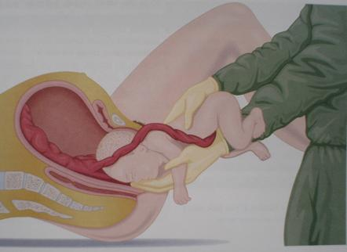
Breech Birth

Slide 49
PRE-HOSPITAL TREATMENT
FOR BREECH BIRTH
Position and prepare the mother for normal delivery.
Allow the buttocks or legs to deliver on their own — never pull.
Support the baby with the palm of your hand. The head should follow within three minutes.

Slide 50
If the head fails to deliver, maintain infant airway and transport immediately. Place the middle and index fingers of your gloved hand alongside the infant’s face. Your palm should be turned towards the face. Form an airway by pushing the vagina away from the infant’s face. With a finger, hold the baby’s mouth open a little so that the baby can breathe.

Slide 51
3) PROLAPSED UMBILICAL CORD
This is a situation in which the umbilical cord presents first (common in breech births) and is squeezed between the vaginal wall and the head of the baby.
This may cause oxygen supply to the baby to be totally interrupted.
If, upon viewing the vaginal area, you see the umbilical cord presenting, the cord is prolapsed.

Slide 52
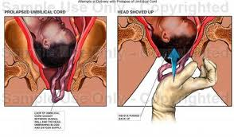
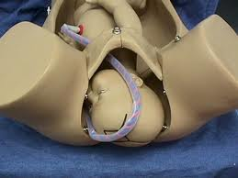
Prolapsed Umbilical Cord

Slide 53
PRE-HOSPITAL TREATMENT FOR PROLAPSED UMBILICAL CORD
Do not try to push the cord inside the vagina.
Position the mother. Have the mother lie down on her back, tilted to the left side (if possible). Elevate her hips, using a pillow or blankets under the buttocks.
Provide oxygen if needed.
Wrap the exposed cord with a clean moistened towel.

Slide 54
Insert a gloved hand into the vagina far enough to gently push on the baby’s head (or buttocks), to keep pressure off the cord. You may feel the cord pulsating when the pressure is released. Prepare to stay in this position throughout transport.
Transport the patient immediately.

Slide 55
4) LIMB PRESENTATION
When a single leg, an arm and a leg together, or an arm and shoulder, present first.
This is often accompanied by a prolapsed umbilical cord.
Limb presentations cannot be delivered in the pre-hospital setting.
Position the mother on her back with pelvis elevated, provide oxygen per local protocol and transport immediately.
If prolapsed cord is present, apply treatment as discussed previously.

Slide 56
5) MULTIPLE BIRTHS
Twins are delivered the same way as single babies; in fact, since twins are smaller, delivery is often easier.
Multiple birth may occur if the mother’s abdomen is unusually large before, or remains large after, delivery.
If labor contractions continue (usually within 10 minutes) after the first birth, the next delivery may be imminent.

Slide 57
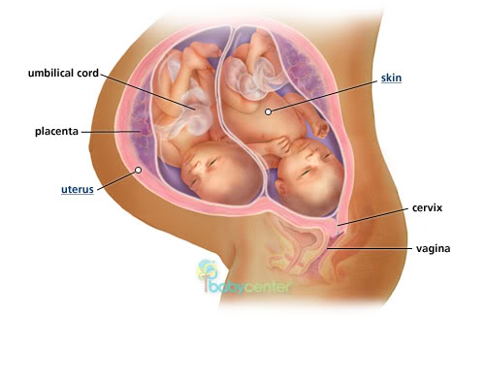
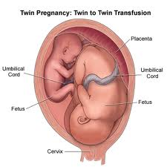
Multiple Birth

Slide 58
PRE-HOSPITAL TREATMENT FOR MULTIPLE BIRTHS
Clamp or tie the cord of the first baby before the second baby is born.
The second baby may be born before or after the placenta is delivered.
Provide care for the babies, umbilical cords, placenta(s), and the mother as in a normal delivery.

Slide 59
6) PREMATURE BIRTH
A premature infant is one who weighs less than 2.5 kilos (5.5 lbs.) or is born before the 36th week of pregnancy.
If not be able to weigh the baby, determine prematurity based on the mother’s information and the baby’s appearance.
The head of a premature baby is proportionately much larger, and the body is smaller and more reddish than a normal baby.
Premature babies are very susceptible to infection.

Slide 60
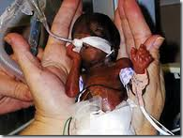
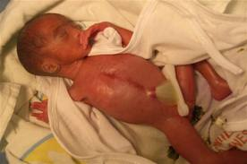
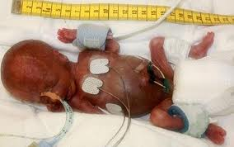
PREMATURE BIRTH

Slide 61
PRE-HOSPITAL TREATMENT FOR A PREMATURE BABY
Keep the baby warm.
Maintain open airway.
Watch the umbilical cord for bleeding.
Provide oxygen if needed.
Avoid contamination. Keep the baby away from people and avoid breathing directly onto the baby.

Slide 62
7) STILLBIRTH
This is a situation in which the baby dies in the womb hours, days, or even weeks before birth.
Signs of obvious death include the presence of blisters, foul odor, skin or tissue deterioration and discoloration, and a softened head.
At other times, the baby may be born in cardiac or pulmonary arrest but may survive with resuscitation.

Slide 63
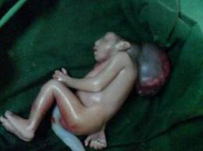
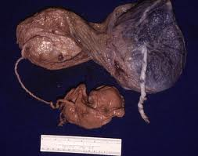
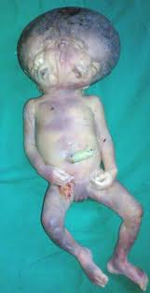

STILL BIRTH

Slide 64
MANAGING A STILLBIRTH
Do not revive the baby if it appears to have been dead for an extended period of time.
Offer emotional support for the mother and relatives .
A baby born in cardiac or pulmonary arrest should receive basic life support.
Do not lie to the mother regarding the baby’s condition, and do not prevent her from seeing the baby.
Comply with the mother’s religious beliefs and follow local customs, laws and protocols.

Slide 65
APGAR SCORING SYSTEM
 |  | Points | One minute | Five minutes
A | Appearance (skin color)
Blue or pale extremities |  | 0
Pink trunk and blue extremities |  | 1
Completely pink |  | 2
P | Pulse
Absent |  | 0
100 or less |  | 1
More than 100 |  | 2
G | Grimace (Irritability)
No response |  | 0
Grimace or whispers |  | 1
Actively cries |  | 2
A | Activity (Muscle tone)
Flaccid, Limp |  | 0
Some flexion of extremities |  | 1
Active extremity motion |  | 2
R | Respiratory effort
Absent |  | 0
Slow and irregular |  | 1
Strong cry |  | 2
Total Score

Slide 66
Ideally, scores are taken at one minute and
five minutes after birth.
If the neonate is not breathing, DO NOT withhold resuscitation for an APGAR score.
Total score indicates the following:
7-10:Indicates an active and vigorous newborn who requires routine care.
4-6: Indicates a moderately depressed newborn who requires oxygen and stimulation.
0-3: Indicates a severely depressed newborn who requires immediate resuscitation efforts.

Slide 67
ANY QUESTION
?

Slide 68
THANKS

Slide 70
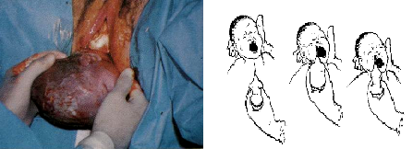

Slide 71
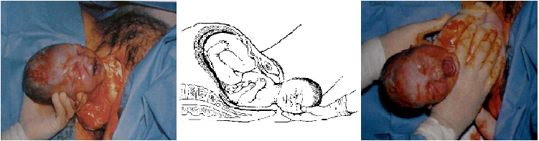

Slide 72
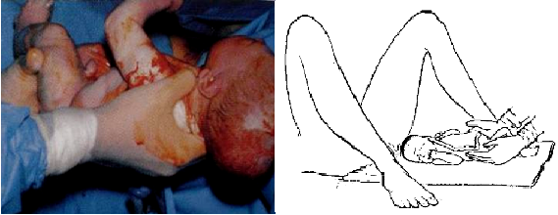

Slide 73
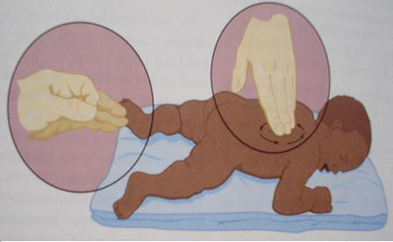
Tactile stimulation by snapping a finger against the sole of the baby’s foot rubbing the back gently but vigorously

Slide 74
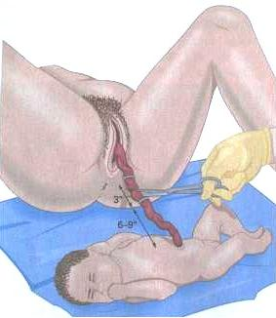
Second clamp 8 cm. away from the first clamp toward the baby
First clamp appx. 25 cm. from the baby.

Slide 75
ASSESSMENT OF THE MOTHER
Use universal precautions and secure the scene.
Conduct initial assessment.
Verify prenatal care, get doctor’s information, ask about any difficulties with pregnancy, and whether delivery is to be normal. Ask when her due date is.
Ask the patient if it is her first pregnancy. If so, the labour process will usually last close to 18 hours. The duration of labour is considerably shorter with each subsequent birth (approximately 2-3 hours).
Cont…

Slide 76
ANY QUESTION

Slide 77
THANKS

