Slide 1
What is ECG?
UNDERSTANDING ECG
LESSON -2
By
AMANDEEP KAUR
ASI/ANM

Slide 2
Contents
01. What is ECG
Basic definition and fundamental principles of electrocardiography
02. ECG Components
Understanding P waves, QRS complexes, and T waves
03. Clinical Applications
How ECG helps diagnose cardiac conditions
04. Normal vs Abnormal
Recognizing healthy and pathological patterns

Slide 3
What is ECG?
Electrocardiography Overview
ECG is a non-invasive diagnostic tool that records the electrical activity of the heart over time, providing crucial insights into cardiac health and function.
Electrical Activity
Measures electrical impulses that trigger heart muscle contractions
Real-time Monitoring
Continuous recording of heart rhythm and electrical patterns

Slide 4
ECG Wave Components
P Wave
Atrial depolarization - represents electrical activity in the upper heart chambers
QRS Complex
Ventricular depolarization - shows electrical activity in the lower heart chamber
T Wave
Ventricular repolarization - indicates recovery phase of heart muscle

Slide 5
ECG Recording Process
Patient Preparation
Clean skin, position electrodes at specific anatomical landmarks
Electrode Placement
Apply 10 electrodes in standard 12-lead configuration
Recording
Capture 10-second rhythm strip for analysis
Interpretation
Analyze waveforms, intervals, and rhythm patterns

Slide 6
Clinical Applications
Arrhythmia Detection
Identifies irregular heartbeats, bradycardia, and tachycardia
Ischemia Diagnosis
Detects signs of reduced blood flow to heart muscle
Myocardial Infarction
Diagnoses heart attacks by identifying characteristic changes
Monitoring
Tracks treatment effectiveness and disease progression

Slide 7
Normal ECG Parameters
PR Interval
120-200ms - represents atrioventricular conduction time
QRS Duration
60-100ms - indicates ventricular depolarization time

Slide 8
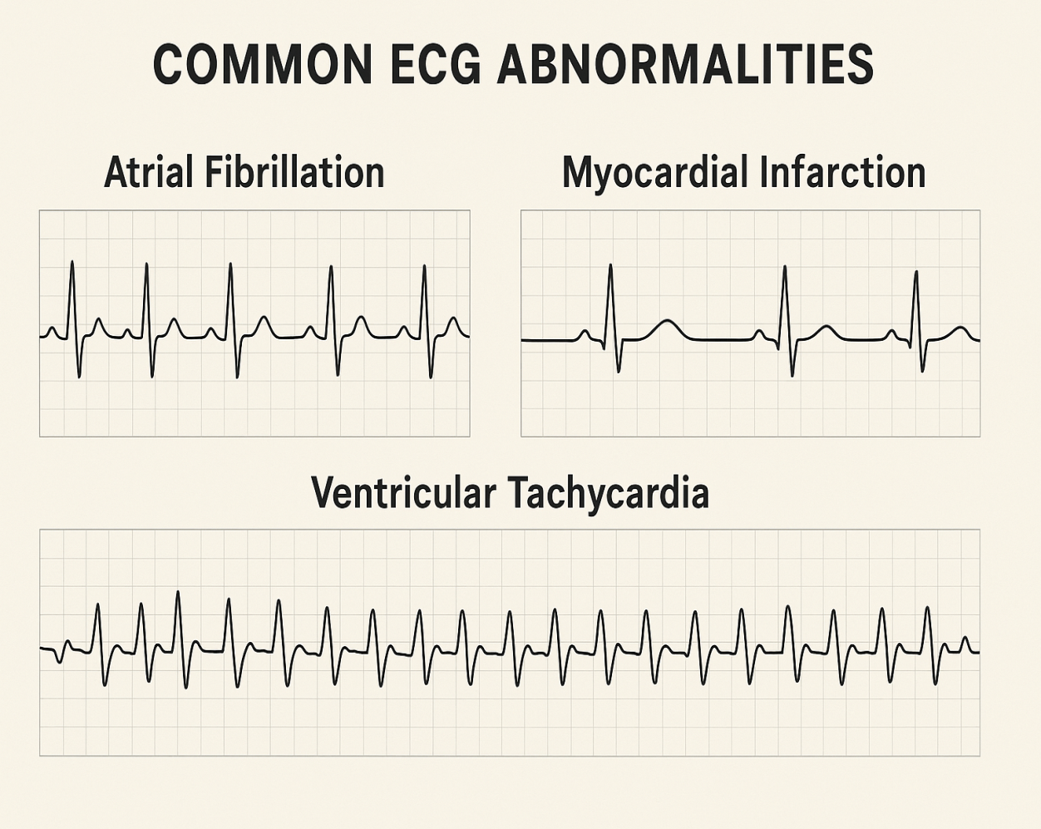
Common ECG Abnormalities
Atrial Fibrillation
Irregular R-R intervals
No distinct P waves
Chaotic baseline activity
Myocardial Infarction
ST-segment elevation
Pathological Q waves
T-wave inversions
Ventricular Tachycardia
Wide QRS complexes
Rate >100 bpm
No P wave association

Slide 9
ECG Interpretation Guidelines
Systematic Approach
Follow a consistent method: rate, rhythm, intervals, morphology, and clinical correlation
Calculate heart rate and rhythm
Measure all intervals and segments
Assess wave morphology and axis
Clinical Integration
Always correlate ECG findings with patient symptoms and clinical presentation
Compare with previous ECGs
Consider patient medications
Evaluate for acute changes
Professional Review
Complex cases require cardiologist consultation for accurate interpretation
Seek expert opinion when uncertain
Use decision support tools
Document findings clearly

Slide 10
ANY QUESTION
?

Slide 11
THANKS

