Slide 1
CORONARY HEART
DISEASE & CHF
LESSON-17
BY
JITENDER YADAV
INSP/PH

Slide 2
OBJECTIVES
Upon completion of this lesson you will be able to:
Define Angina pectoris and list the signs and symptoms.
Define Myocardial infarction and list the signs and symptoms
List the steps in treatment of suspected myocardial infarction by medic
Define congestive cardiac failure and list the signs and symptoms
Explain the management of congestive cardiac failure

Slide 3
HEART FUNCTION
The heart is a muscle that is oxygenated by the two coronary arteries.
Arteriosclerosis is a progressive narrowing of the arteries, in which deposits of fat attach to the internal walls of the arteries, reducing their diameter.
When the coronary arteries are narrowed, the amount of oxygen supplied to the muscle is reduced and the patient experiences chest pain. This pain is called angina pectoris.

Slide 4
HEART FUNCTION
When the coronary arteries are obstructed, oxygen cannot reach the muscle. This part of the muscle then dies, causing a condition called a myocardial infarction. It is the consequence of an occlusion of one or several of the coronary arteries.
If the patient loses too much of the heart muscle, the heart will be unable to pump enough blood to supply the rest of the body.
This leads to shock and soon after, death.

Slide 5
CARDIOVASCULAR EMERGENCIES
ANGINA PECTORIS (Chest Pain)
This condition is the result of reduced oxygen supply to the heart muscle (myocardium). It can be caused by diseased or narrowed arteries which reduce blood flow.
Angina is often brought on by exertion or stress, and rarely lasts longer than 3 to 5 minutes.

Slide 6
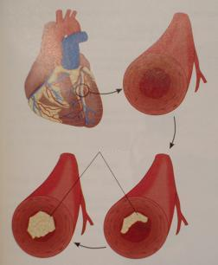
Fatty deposits buildup in the arteries, depriving the heart muscle of blood and oxygen
Fatty Occlusion

Slide 7
ANGINA PECTORIS (Chest Pain)
The pain is typically located in the center of the chest and may radiate to neck, jaw and upper arms; it is dull, constricting, choking or heavy and described as squeezing, crushing or aching and not sharp, stabbing or pricking pain

Slide 8
SIGNS AND SYMPTOMS:
• Chest pain
• Shortness of breath
• Profuse sweating
• Light-headedness
• Palpitations (sensation of fluttering of
the heart)
• Nausea, vomiting
• Pale, cool, moist skin

Slide 9
MYOCARDIAL INFARCTION
Definition: -Literally meaning “death of the heart,” caused by partial or total blockage of
blood flow to the heart, leading to death of cardiac muscle tissue.
Myocardial infarction is commonly known as “heart attack”.

Slide 10
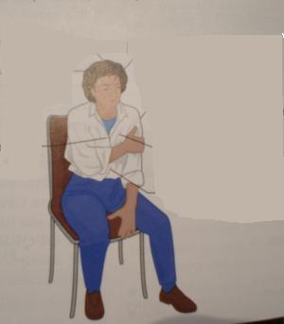
SIGNS & SYMPTOMS OF MI
fainting
Profuse sweating
anxiety
Chest discomfort
pain or heavy ness
Rapid, shallow
respirations
Shortness of breath
Abnormal pulse
Sudden weakness
Nausea or vomiting

Slide 11
MANAGEMENT FOR MI & ANGINA PECTORIS:
Use universal precautions and secure the scene.
1) Instruct the patient to stop all movement.
2) Place the responsive patient in a comfortable position, usually semi-reclining or sitting.
3) Maintain open airway.
4) Administer oxygen high flow. If needed, provide artificial ventilation or CPR.
5) Loosen restrictive clothing.

Slide 12
MANAGEMENT FOR MI & ANGINA PECTORIS:
Maintain body temperature as close to normal as possible.
7) Comfort and reassure the patient.
Continue to monitor the patient’s vital
signs.
If available, give Inj. Morphine 0.2mg IM stat
Evacuate the patient to next level of care immediately.

Slide 13
CONGESTIVE HEART FAILURE
Definition: A condition of excessive fluid build-up in the lungs and/or other organs due to inadequate pumping of the heart.
This condition is called “congestive” because the fluids congest, or clog, the organs. Congestive heart failure is often a complication of myocardial infarction, and can also be brought on by diseased heart valves, uncontrolled hypertension, severe anaemia, thyroid disorders and pulmonary diseases such as emphysema.

Slide 14
SIGNS AND SYMPTOMS OF CHF
Rapid Heart rate
Normal to high blood pressure
Shortness of breath made worse by lying flat
Increased Respiratory rate
Jugular vein distention
Anxiety
Swollen ankles
Cyanosis
Unexplained fatigue and effort intolerance .
Patient with CHF may not always experience chest pain.

Slide 15
MANAGEMENT FOR CONGESTIVE HEART FAILURE:
Use universal precautions and secure the scene.
Maintain open airway and monitor breathing. Provide artificial ventilation if needed.
Place the responsive patient in a comfortable position, usually sitting upright.
Give oxygen 1-5 L /min with nasal cannula.
Continuously monitor the patient and provide emotional support.
Transport the patient as soon as possible for hospital care
The patient needs assessment of electrolyte and biochemical status before administration of specific drugs to treat the condition.

Slide 16
BLOOD PRESSURE
This is the amount of pressure the surging blood exerts against the artery walls. It tells you if cells, organs and tissues are getting the blood necessary for their normal functions. A blood pressure cuff (sphygmomanometer) is used to measure blood pressure.
Systolic pressureis the result of a contraction of the heart, forcing blood through the arteries.
Diastolic pressureis the pressure during relaxation between contractions.

Slide 17
BLOOD PRESSURE
Both normally rise and fall together.
Blood pressure varies with age, gender and medical history of the patient. It is usually 10 mm/Hg lower in females than in males.

Slide 18
NORMAL BLOOD PRESSURE VALUES (MMHG)
Adult/ Child (up to 12 years old):
Systolic:100 +age; 80+(2 x age) [upto 150 mmHg]
Diastolic:60-90 mmHg; 50-80 mmHg
Hypertension literally means raised blood pressure corresponding to age and gender usually above 140/90mm Hg in adults
Hypotension means low blood pressure for age and gender, usually below 90/60mm Hg in adults

Slide 19
HYPERTENSION
Definition: Blood pressure that remains consistently above the normal values.
The target organs which are principally affected by hypertension include the blood vessels, central nervous system, the retina, the heart and the kidneys.

Slide 20
SIGNS AND SYMPTOMS
Most often may be asymptomatic
Headache
Feeling of sickness
Anxiety
Ringing in the ears
Seeing “stars”
Nosebleed
Diastolic blood pressure consistently above 90 mmHg.
Systolic blood pressure consistently above
140mm Hg
Tingling in the face or extremities

Slide 21
MEASUREMENT OF BP
Use a machine that is validated & well maintained
Measure BP in sitting position with the arm supported and additional standing BP in the elderly and diabetics
Remove tight clothing from the arm
Support the arm at the level of the heart and ensure there is no kinking of tube
Use cuff of appropriate size (bladder must encompass >2/3 of arm)
Lower mercury slowly (2mm/sec)
Read BP to the nearest 2mm Hg

Slide 22
Exercise, discomfort, unfamiliar surroundings, smoking 10-15 minutes before measurement can all affect the BP measurement readings
MANAGEMENT OF ACUTE HYPERTENSION
The sole objective of antihypertensive therapy is to reduce the incidence of adverse cardiovascular events, particularly coronary heart disease, stroke and heart failure
1) Maintain open airway.
2) Place the responsive patient in a comfortable position, usually sitting upright.
3) Provide emotional support.
4) Control nosebleed, if applicable.

Slide 23
5) Start with an anxiolytic (T. Diazepam 2 mg HS ) for mild hypertension; if systolic above 160mm Hg and diastolic above 120 mm Hg, then start T. Amlodepine 2.5 mg or T. Nifedipine 5mg stat and keep patient in bed for 2-3 hours at least to avoid postural hypotension
6) Continue to monitor BP after 2 hours and once stabilized, 6 hourly
7) The individual needs baseline investigations and therefore needs to be referred to nearest hospital.
Transport the patient as soon as possible.

Slide 24
MANAGEMENT OF KNOWN HYPERTENSIVE:
Often medics attend to troops who have been diagnosed as suffering from Essential Hypertension; it is the primary duty of the medic
to ensure that the individual is taking antihypertensives as prescribed;
BP should be monitored every week and recorded in his history sheet
If elevated levels(>140/90 mm Hg) in spite of regular medications found on more than two occasions, patient is to be referred back to unit hospital for further observation and management
Constant Counselling for quitting smoking and moderation in alcohol
Encourage moderate physical exercise and intervene if excessive physical exertion is undertaken

Slide 25
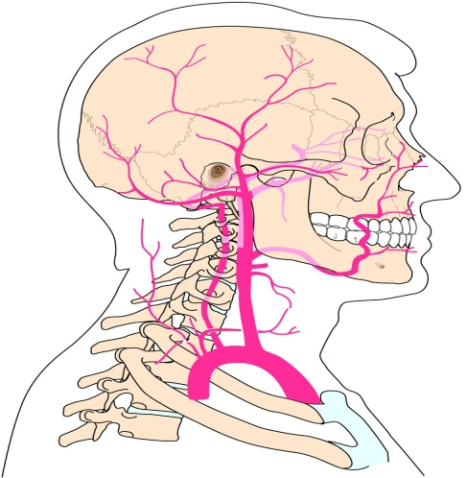
CEREBRAL VASCULAR ACCIDENT (CVA)
Definition: A sudden loss of blood supply to the brain.
CVA, commonly known as a “stroke,” is becoming the third commonest cause of death in the world after cancer and IHD.

Slide 26
CEREBRAL VASCULAR ACCIDENT (CVA)
Causes
• Cerebral thrombosis: The result of a clot obstructing a cerebral artery, preventing the flow of oxygenated blood to a portion of the brain
• Cerebral haemorrhage: The result of a cerebral artery breaking, leaving an area of the brain without blood supply. The blood that comes out of this artery creates intracranial pressure on the brain and interferes in the brain’s functions.

Slide 27
SIGNS AND SYMPTOMS OF CVA
These vary depending on the location and extent of damage:
• Headache – may be the first and only symptom; it may be severe and associated with vomiting and neck stiffness
• Fainting (syncope)
• Altered mental status

Slide 28
SIGNS AND SYMPTOMS OF CVA
• Tingling or paralysis of the extremities or face
• Difficulty speaking
• Blurred vision
• Convulsions and/or seizures
• Unequal pupils
• Loss of bladder or bowel control
• Hypertension (high blood pressure)

Slide 29
MANAGEMENT FOR CVA
Use universal precautions and secure the scene.
1) Instruct the patient to stop all movement.
2) Place the responsive patient in a comfortable position, usually semi-reclining or sitting.
3) If patient is unconscious, then take care to maintain an open airway
4) Administer oxygen high flow. If needed, provide artificial ventilation or CPR.

Slide 30
MANAGEMENT FOR CVA
Use universal precautions and secure the scene.
5) Loosen restrictive clothing.
6) Maintain body temperature as close to normal as possible.
7) Comfort and reassure the patient.
8) Continue to monitor the patient’s vital signs.
9) When immobilising the patient, protect the paralysed part.

Slide 31
10) In TIA, give T. Aspirin 300mg stat within 48hours and refer patient to hospital
11) Immediately after a completed stroke, patient may have difficulty in swallowing and may aspirate. Don’t give anything orally
12) Establish IV line if transport is delayed more than 6 hours and give maintenance fluid (5% D, if not a diabetic; if unsure about diabetic status don’t give any fluids)

Slide 32
13) Good nursing care to prevent pressure sores, chest congestion leading to pneumonia should be taken care of
14) Evacuate patient as early as possible for expert care.
!!! CAUTION
Don’t try to lower blood pressure immediately after stroke as it will do more harm

Slide 33
ANY QUESTION

Slide 34
THANKS

