Slide 1
Tachyarrhythmia
LESSON -14
By
AMANDEEP KAUR
ASI/ANM

Slide 2
Learning Objectives
By the end of this module, you will be able to:
• Define tachyarrhythmia and its clinical relevance
• Identify types and mechanisms of tachyarrhythmias
• Recognize ECG patterns associated with tachyarrhythmias
• Understand emergency management strategies
Notes:
Introduce the study of abnormally fast cardiac rhythms.

Slide 3
Introduction
Tachyarrhythmia refers to a heart rate >100 bpm caused by abnormal impulse formation or conduction.
Notes:
Define tachyarrhythmia and clinical importance.

Slide 4
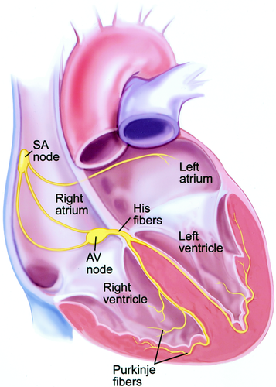
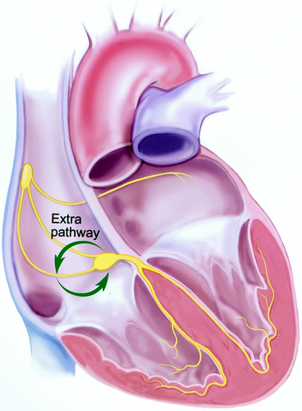
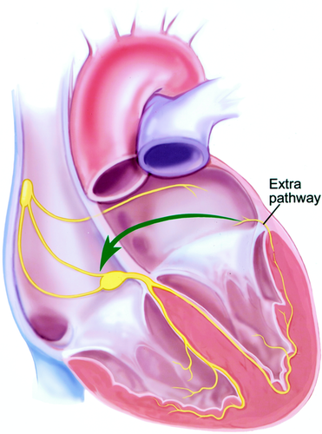
HEART
NORMAL HEART
TACHYARRHYTHMIA HEART

Slide 5
Classification
1. Supraventricular Tachyarrhythmias (SVT)
2. Ventricular Tachyarrhythmias
Notes:
Divide by site of origin.

Slide 6
Supraventricular Tachyarrhythmias
Originate above the ventricles (SA node, atria, AV node).
Examples:
• Sinus Tachycardia
• Atrial Fibrillation
• Atrial Flutter
• AVNRT / AVRT
Notes:
Explain SVT mechanisms.

Slide 7
Sinus Tachycardia
• Rate: >100 bpm
• Regular rhythm
• P wave before each QRS
• Common causes: exercise, stress, fever
Notes:
Differentiate physiologic vs pathologic tachycardia.

Slide 8
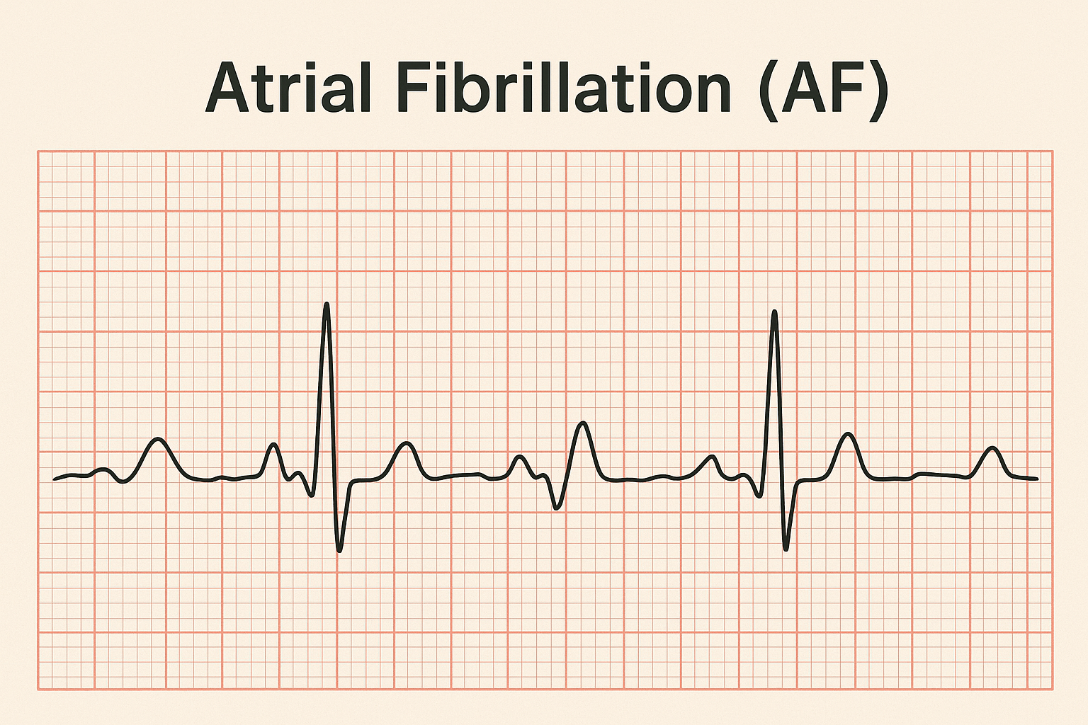
Atrial Fibrillation (AF)
• Irregularly irregular rhythm
• No distinct P waves
• Fibrillatory baseline
Notes:
Highlight risk of thromboembolism.

Slide 9
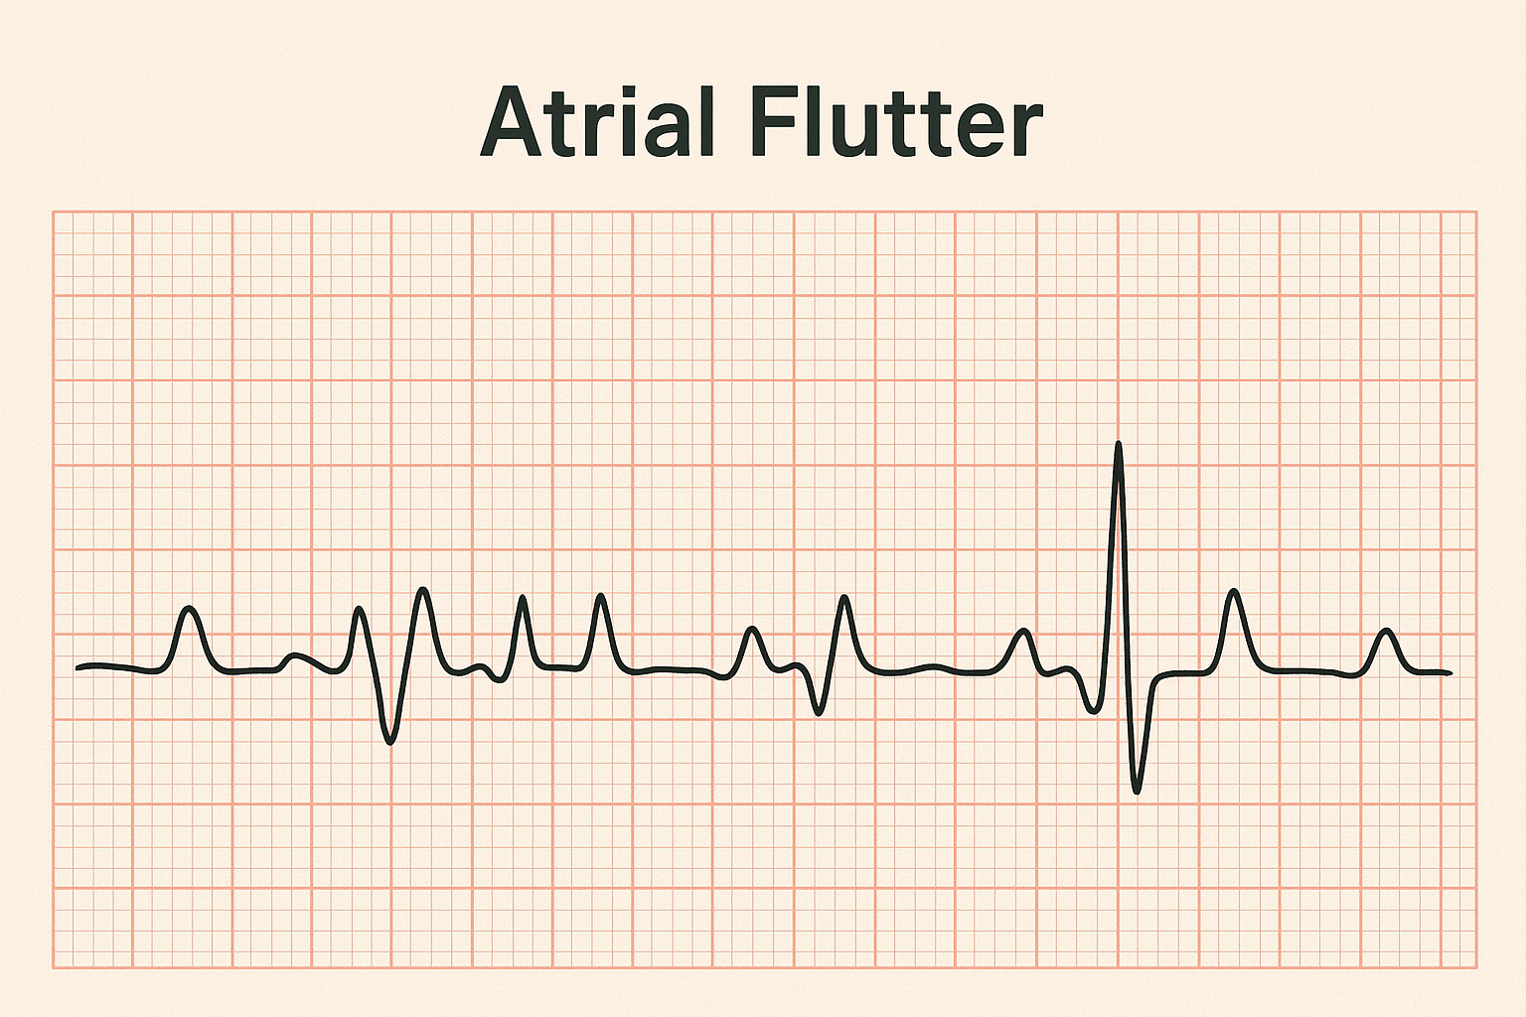
Atrial Flutter
• Sawtooth F waves
• Atrial rate: 250–350 bpm
• Ventricular response often regular (2:1 or 3:1)
Notes:
Describe flutter appearance.

Slide 10
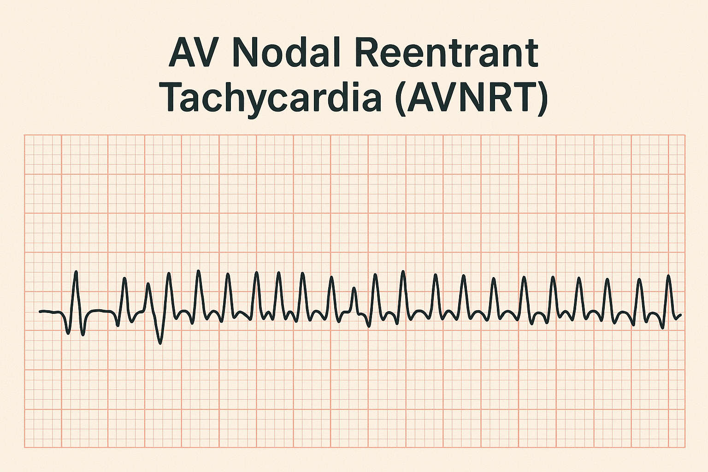
AV Nodal Reentrant Tachycardia (AVNRT)
• Narrow QRS complex
• Sudden onset/termination
• P wave hidden or inverted after QRS
Notes:
Explain reentry circuit mechanism.

Slide 11
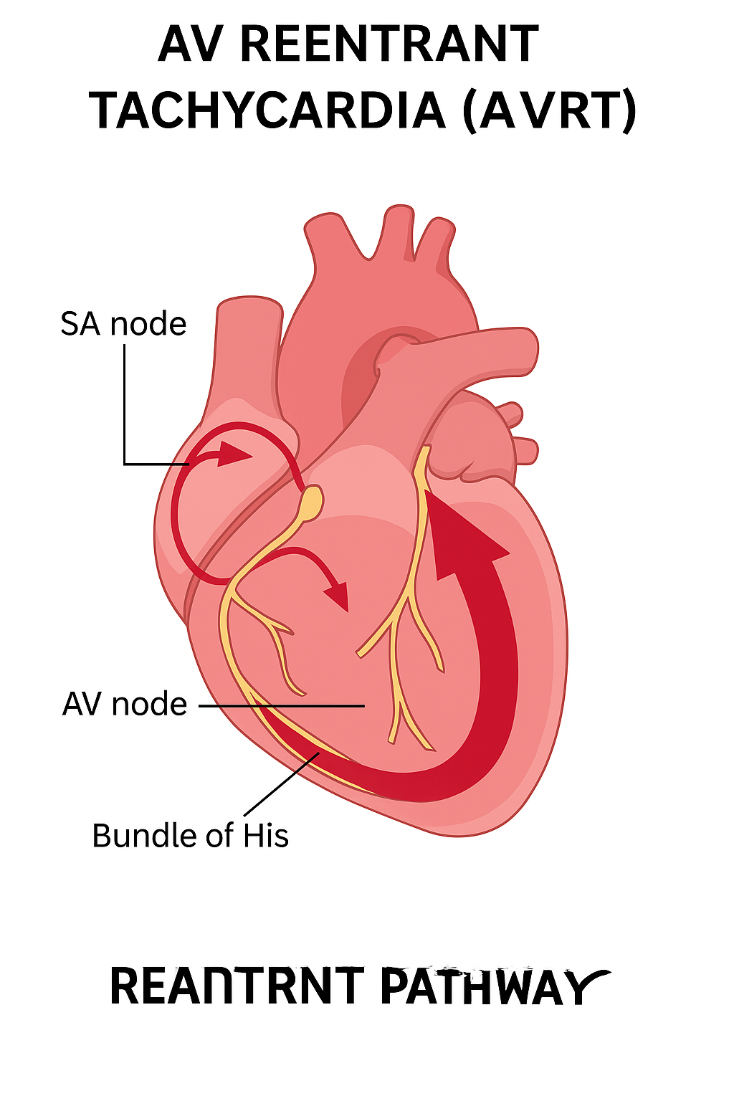
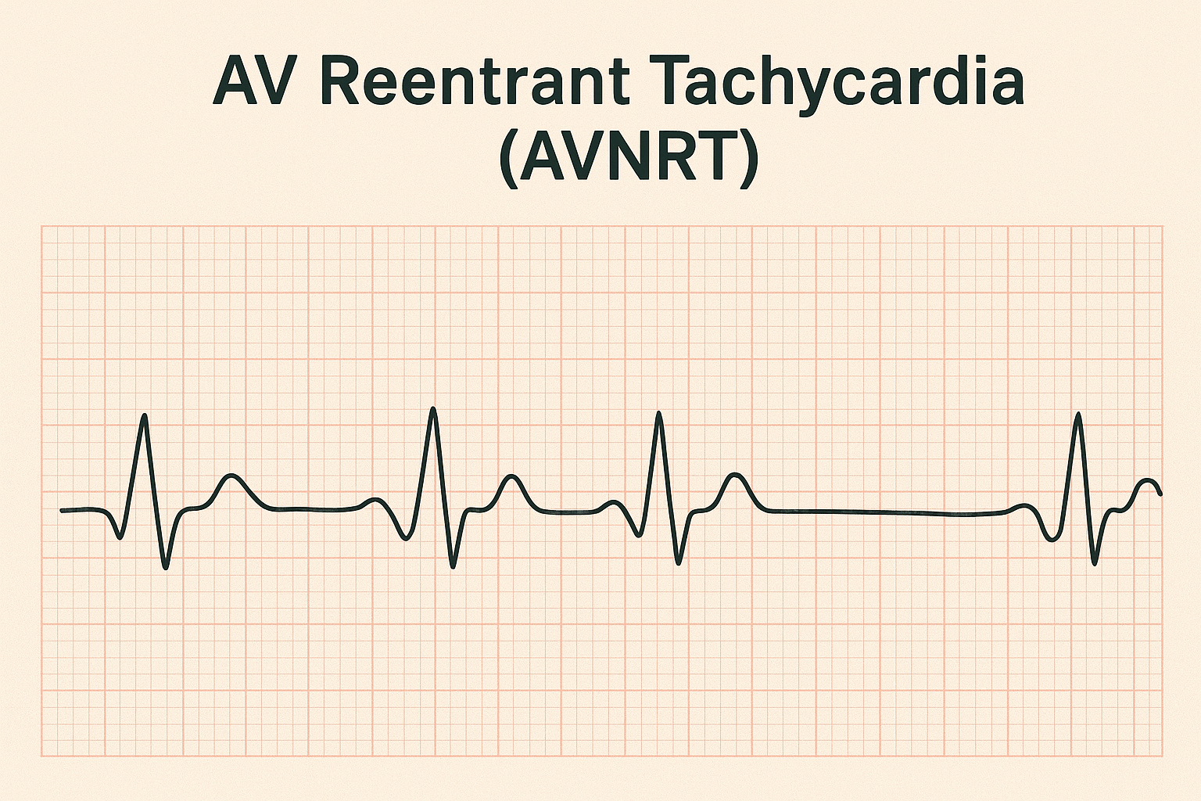
AV Reentrant Tachycardia (AVRT)
• Caused by accessory pathway (e.g., WPW)
• Short PR interval, delta wave
Notes:
Describe pre-excitation findings.

Slide 12
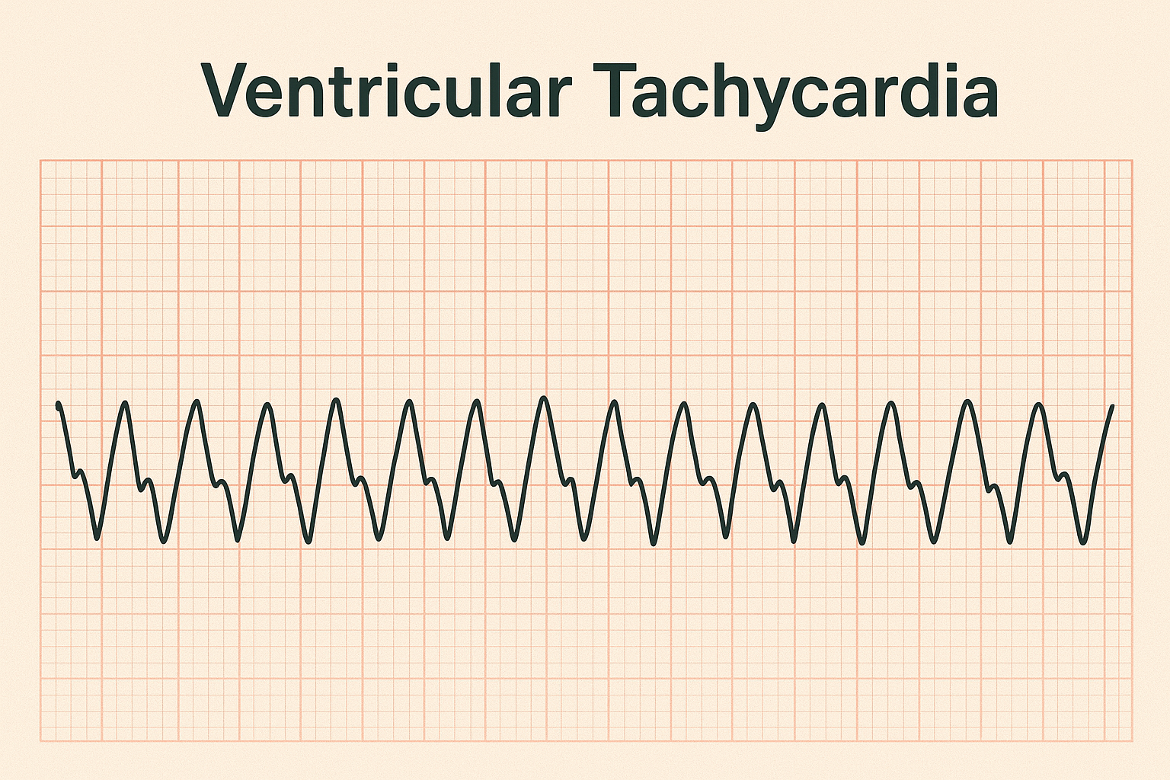
Ventricular Tachycardia (VT)
• Wide QRS (>0.12 sec)
• Rate 120–250 bpm
• AV dissociation
Notes:
Differentiate monomorphic vs polymorphic VT.

Slide 13
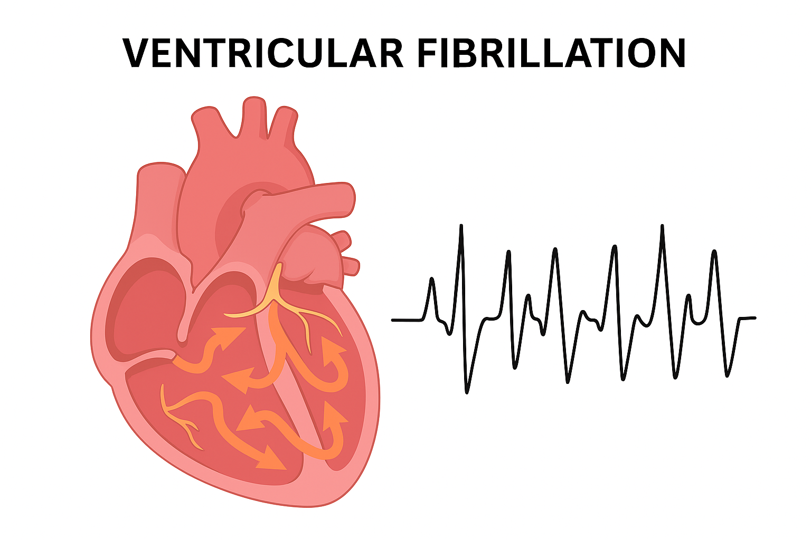
Ventricular Fibrillation (VF)
• Chaotic, irregular ECG with no identifiable QRS
• No pulse – cardiac arrest
Notes:
Discuss life-threatening emergency nature.

Slide 14
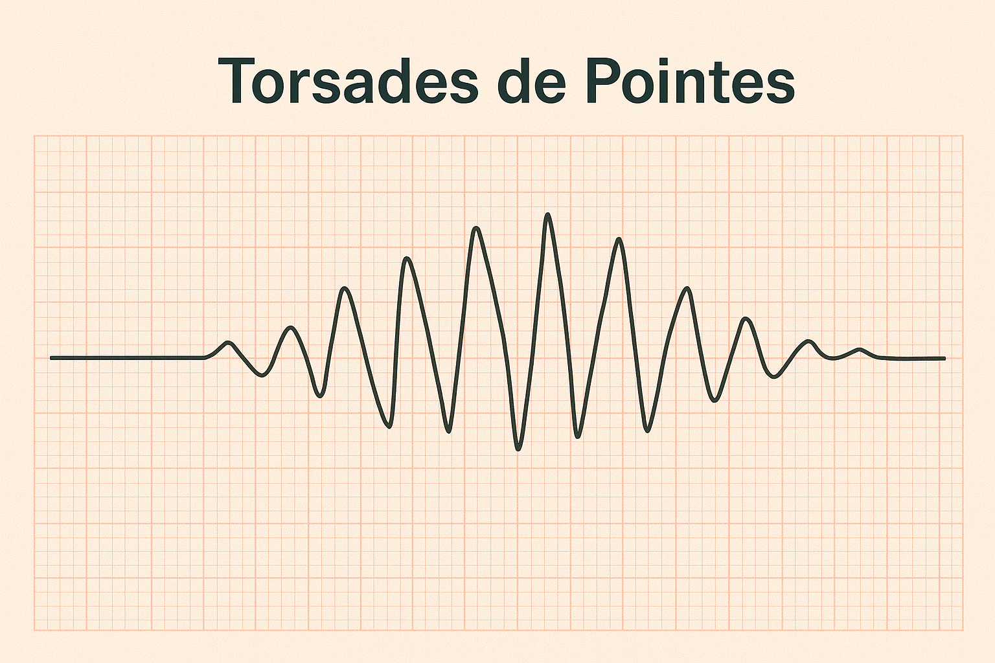
Torsades de Pointes
• Polymorphic VT with twisting QRS axis
• Often due to prolonged QT interval
Notes:
Mention link to hypomagnesemia and drugs.

Slide 15
TYPES OF TACHYARRHYTHMIA-
Because changes to your heart’s electrical conduction system can occur in a variety of places, it makes sense that there are different types of tachyarrhythmia. Examples of tachyarrhythmia include:
Atrial flutter
Atrial fibrillation
Ventricular tachycardia
Sinus tachycardia
Paroxysmal supraventricular tachycardia
Paroxysmal atrial tachycardia
Multifocal atrial tachycardia

Slide 16
SYMPTOMS OF TACHYARRHYTHMIA-
heart palpitations (specifically the sensation that your heart is racing and beating much faster than normal)
elevated pulse
lightheadedness
fainting
chest pain or tightness
shortness of breath

Slide 17
CAUSES AND RISK FACTORS-
The disruption to your heart’s electrical system can be triggered by seemingly harmless behaviors and mild health issues, as well as very serious medical issues. Anything that stresses the heart muscle can be problematic.
Conditions that can cause a rapid heart rate include:
Postural orthostatic tachycardia syndrome (POTS)
Wolff-Parkinson-White syndrome

Slide 18
SOME OF THE MORE COMMON RISK FACTORS FOR TACHYARRHYTHMIA INCLUDE:
age
anemia
diabetes
family history of tachyarrhythmia
heavy alcohol use
high blood pressure
sleep apnea
smoking
stress
thyroid disease

Slide 19
There are several tests a doctor may order to evaluate an elevated heart rate. This will help them look for any obvious problems with the heart that may have triggered your tachyarrhythmia. Some of these tests may include:
HOW IS IT DIAGNOSED-
Electrocardiogram (ECG)
Holter monitor
Cardiac event monitor
Implantable loop recorder
Mobile cardiac telemetry (live arrhythmia monitor)

Slide 20
ADDITIONAL FACTORS AND TESTS A DOCTOR MIGHT USE TO ASSESS YOUR CONDITION MAY INCLUDE:
complete blood count
electrolytes and urea
liver and thyroid function
blood glucose
arterial blood gas
drug screening

Slide 21
ECG Features Summary
SVT → narrow QRS
VT → wide QRS
VF → no organized QRS
Torsades → polymorphic twisting pattern
Notes:
Provide quick visual summary.

Slide 22
Clinical Manifestations
• Palpitations
• Dizziness, syncope
• Hypotension
• Chest pain or cardiac arrest
Notes:
Relate symptoms to cardiac output compromise.

Slide 23
Management Overview
• Identify rhythm origin
• Stable: vagal maneuvers, adenosine, beta-blockers
• Unstable: synchronized cardioversion
• VF/VT: defibrillation + CPR
Notes:
Outline treatment priorities.

Slide 24
Summary
• Tachyarrhythmias arise from abnormal impulse generation or reentry
• ECG is key for diagnosis and differentiation
• Rapid recognition and management save lives
Notes:
Conclude and transition to next module on bradyarrhythmias.

Slide 25
ANY QUESTION
?

Slide 26
THANKS

