Slide 1
MEDICAL EMERGENCIES
LESSON -13
BY
PRAVIN DUDHE
INSP/PH

Slide 2
Objectives
Upon completion of this lesson, you will be able to:
Define a medical emergency.
2. Define angina pectoris, list six signs and
symptoms, and describe pre-hospital treatment.
3. Define myocardial infarction, list nine signs and symptoms, and list eight steps for pre-hospital treatment.

Slide 3
Define congestive heart failure, list eight signs
and symptoms, and four steps for pre-hospital
treatment.
5. Define hypertension, list five signs and
symptoms and five steps for pre-hospital
treatment.
6.. List nine signs and symptoms for a
cerebral-vascular accident (CVA).

Slide 4
7. Describe the management of respiratory
distress
8. Describe anaphylactic shock and list the
causes and management.
LIST NINE SIGNS AND SYMPTOMS AND MANAGEMENT
FOR CEREBRAL-VASCULAR ACCIDENT (CVA).
List nine signs and symptoms of hypoglycemia ,
Hyperglycemia and describe pre-hospital treatment.

Slide 5
MEDICAL EMERGENCIES
A critical state caused by a wide variety of illnesses whose cause does not include trauma to the patient.
Such a state can be caused by pathogens (microorganisms), alteration in the functioning of organ, or foreign substances, such as poisons. In most cases, the problem is not a consequence of trauma.

Slide 6
If a patient presents with atypical vital signs, assume that
the patient has a medical emergency

Slide 7
DETECTION
Medical emergencies can create a situation leading to trauma and may remain unnoticed. Example: A person that has a myocardial infarction can lose consciousness and fall, suffering a traumatic injury. Always consider the possibility that an underlying medical emergency may have lead to the traumatic event.

Slide 8
Trauma can induce a medical emergency.
Example: the stress of an accident can produce a myocardial infarction, cerebral vascular accident or a seizure. Conduct an initial assessment and physical exam and continue monitoring the patient closely.

Slide 9
SIGNS OF A MEDICAL EMERGENCY
If the patient presents with atypical vital signs, assume that the patient has a medical emergency. Changes in any of the following can indicate a medical emergency:
Mental status (unconscious, confused, comatose).
Heart rate, rhythm and/or quality.
Breathing rate, rhythm, and/or quality.
Skin temperature, color and/or condition.

Slide 10
Pupil size, symmetry, and reactivity to light.
Condition and color of the mucous membranes (dryness, paleness, cyanosis).
Breath scent (alcohol, acetone).
Muscular activities (spasms and paralysis).
Vomiting.

Slide 11
In an adult patient, the following conditions may indicate a possible medical emergency:
- Heart rate above 100 or less than 60 bpm.
- Respiratory rate less than 12 or more than
20 rpm.

Slide 12
SYMPTOMS OF A MEDICAL EMERGENCY
Consider all patients’ complaints as valid. If the patient complains of not feeling well, assume that he/she is having a medical emergency.

Slide 13
SYMPTOMS OF A MEDICAL EMERGENCY
Pain.
Fever.
Stomach discomfort, nausea, atypical bowel or bladder activity.
Vertigo, fainting sensation, feeling of impending doom.
Shortness of breath or difficulty breathing.
Cont…

Slide 14
Chest or abdominal pain.
Excessive thirst, hunger or strange taste in the mouth.
Sensation of numbness and tingling.

Slide 15
CAUSES OF HEART DISEASES
The heart is a muscle that is oxygenated by the coronary arteries.
Arteriosclerosis is a progressive narrowing of the arteries, in which deposits of fat attach to the internal walls of the arteries, reducing their diameter.
Cont…

Slide 16
When the coronary arteries are narrowed, the amount of oxygen supplied to the muscle is reduced and the patient experiences chest pain. This pain is called angina pectoris.
Cont…

Slide 17
When the coronary arteries are obstructed, oxygen cannot reach the muscle. This part of the muscle then dies, causing a condition called a myocardial infarction. It is the consequence of an occlusion of one or several of the coronary arteries.
If the patient loses too much of the heart muscle, the heart will be unable to pump enough blood to supply the rest of the body. This leads to shock and soon after, death.

Slide 18
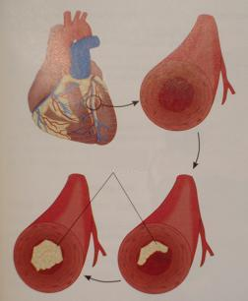
Fatty deposits buildup in the arteries, depriving the heart muscle of blood and oxygen
Fatty Occlusion

Slide 19
The most common cardiovascular medical emergencies are:
Myocardial infarction
Angina pectoris
Congestive heart failure
Hypertension

Slide 20
MYOCARDIAL INFARCTION
Literally meaning “death of the heart,” caused by partial or total blockage of blood flow to the heart, leading to death of cardiac muscle tissue.
Myocardial infarction is commonly known as “heart attack”.

Slide 21
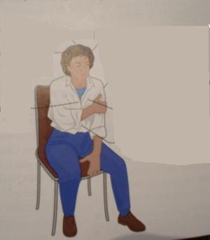
SIGNS & SYMPTOMS OF MI
fainting
Profuse sweating
anxiety
Chest discomfort
pain or heavy ness
Rapid, shallow
respirations
Shortness of breath
Abnormal pulse
Sudden weakness
Nausea or vomiting

Slide 22
If any of the above signs or symptoms is present, assume that the patient is having or will soon have a myocardial infarction.

Slide 23
PRE-HOSPITAL TREATMENT FOR MYOCARDIAL INFARCTION
Use universal precautions and secure the scene.
Instruct the patient to stop all movement.
Place the responsive patient in a comfortable position, usually semi-reclining or sitting.
Maintain open airway.
Administer oxygen . If needed, provide artificial ventilation or CPR.
Cont…

Slide 24
Loosen restrictive clothing.
Maintain body temperature as close to normal as possible.
Comfort and reassure the patient.
Continue to monitor the patient’s vital signs.

Slide 25
ANGINA PECTORIS CHEST PAIN
This condition is the result of reduced oxygen supply to the heart muscle (myocardium). It can be caused by diseased or narrowed arteries which reduce blood flow. Angina is often brought on by exertion or stress, and rarely lasts longer than 3 to 5 minutes.

Slide 26
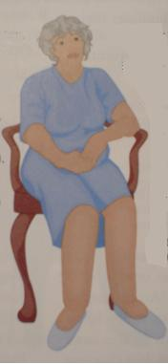
SIGNS AND SYMPTOMS OF ANGINA PECTORIS
Chest pain.
Shortness of breath.
Profuse sweating.
Light-headedness.
Palpitations (sensation of
throbbing or fluttering of
the heart).
Pale, cool, moist skin.
Nausea, vomiting.

Slide 27
It is impossible to distinguish between angina and the pain of a heart attack. Though it does not cause permanent damage to the heart, angina can eventually lead to a heart attack.
PRE-HOSPITAL TREATMENT FOR ANGINA PECTORIS
Pre-hospital treatment is the same as for myocardial infarction.

Slide 28
CONGESTIVE HEART FAILURE
A condition of excessive fluid build-up in the lungs and/or other organs due to inadequate pumping of the heart.
This condition is called “congestive” because the fluids congest, the organs. Congestive heart failure is often a complication of myocardial infarction, and can also be brought on by diseased heart valves, hypertension and pulmonary diseases such as emphysema.

Slide 29
SIGNS AND SYMPTOMS OF CONGESTIVE HEART FAILURE
Shortness of breath, worse by lying flat.
Rapid heart rate.
Anxiety.
Increased respiratory rate.
Normal to high blood pressure.
Jugular vein distension.
Swollen ankles.
Cyanosis.

Slide 30
The patient with congestive heart failure may not always experience chest pain.

Slide 31
PRE-HOSPITAL TREATMENT FOR CONGESTIVE HEART FAILURE
Use universal precautions and secure the scene.
Maintain open airway and monitor breathing. Provide artificial ventilation if needed.
Place the responsive patient in a comfortable position, usually sitting upright.
Give oxygen if needed.
Continuously monitor the patient and provide emotional support.
Transport the patient as soon as possible.

Slide 32
HYPERTENSION
Blood pressure that remains consistently above the normal values.

Slide 33
SIGNS AND SYMPTOMS OF HYPERTENSION
Headache.
Feeling of sickness.
Anxiety.
Ringing in the ears.
Seeing stars.
Nose bleed.
Diastolic blood pressure above 90 mmHg.
Tingling in the face of extremities.

Slide 34
PHT FOR HYPERTENSION
Use universal precautions and secure the scene.
Maintain open airway.
Place the responsive patient in a comfortable position, usually sitting upright.
Provide emotional support.
Control nosebleed, if applicable.
Transport the patient as soon as possible.

Slide 35
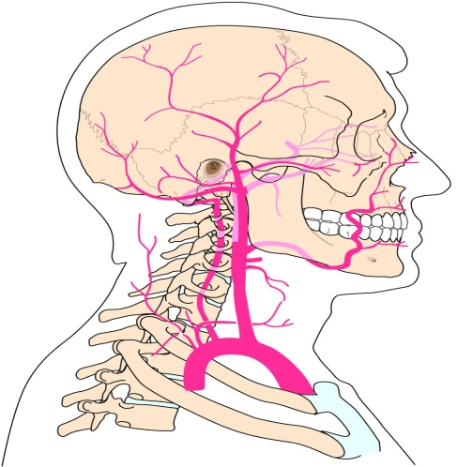
CEREBRAL VASCULAR ACCIDENT
A sudden loss of blood supply to the brain.
CVA, commonly known as a “stroke,” is also becoming known as “brain attack”.

Slide 36
CEREBRAL THROMBOSIS
The result of a clot obstructing a cerebral artery, preventing the flow of oxygenated blood to a portion of the brain.

Slide 37
CEREBRAL HEMORRHAGE
The result of a cerebral artery breaking, leaving an area of the brain without blood supply.
The blood that comes out of this artery creates intracranial pressure to the brain and interferes in the brain’s functions.

Slide 38
SIGNS AND SYMPTOMS
Headache (may be the first and only symptom).
Fainting.
Altered mental status.
Tingling or paralysis of the extremities or face.
Difficulty in speaking.
Cont…

Slide 39
Blurred vision.
Convulsions.
Unequal pupils.
Loss of bladder or bowel control.
Hypertension (High B.P.).
If any one of these signs or symptoms is present, assume that the patient is having or is about to have a cerebral vascular accident.
The risk of having a CVA increases with age.

Slide 40
PHT FOR CVA
Use universal precautions and secure the scene.
Instruct the patient to stop all movement.
Place the responsive patient in a comfortable position, usually semi-reclining or sitting.
Maintain open airway.

Slide 41
Administer oxygen . If needed, provide artificial ventilation or CPR.
Loosen restrictive clothing.
Maintain body temperature as close to normal as possible.
Comfort and reassure the patient.
Continue to monitor the patient’s vital signs.
When immobilizing the patient, protect the paralyzed part.

Slide 42
RESPIRATORY DISTRESS
Affects one’s ability to exchange oxygen and carbon dioxide.
Common signs and symptoms inherent to all types of breathing difficulties.
Characterized by quick, laboured breathing, shortness of breath and the sensation of unavailable air.
Produce a blue coloration of the skin and mucous membranes.

Slide 43
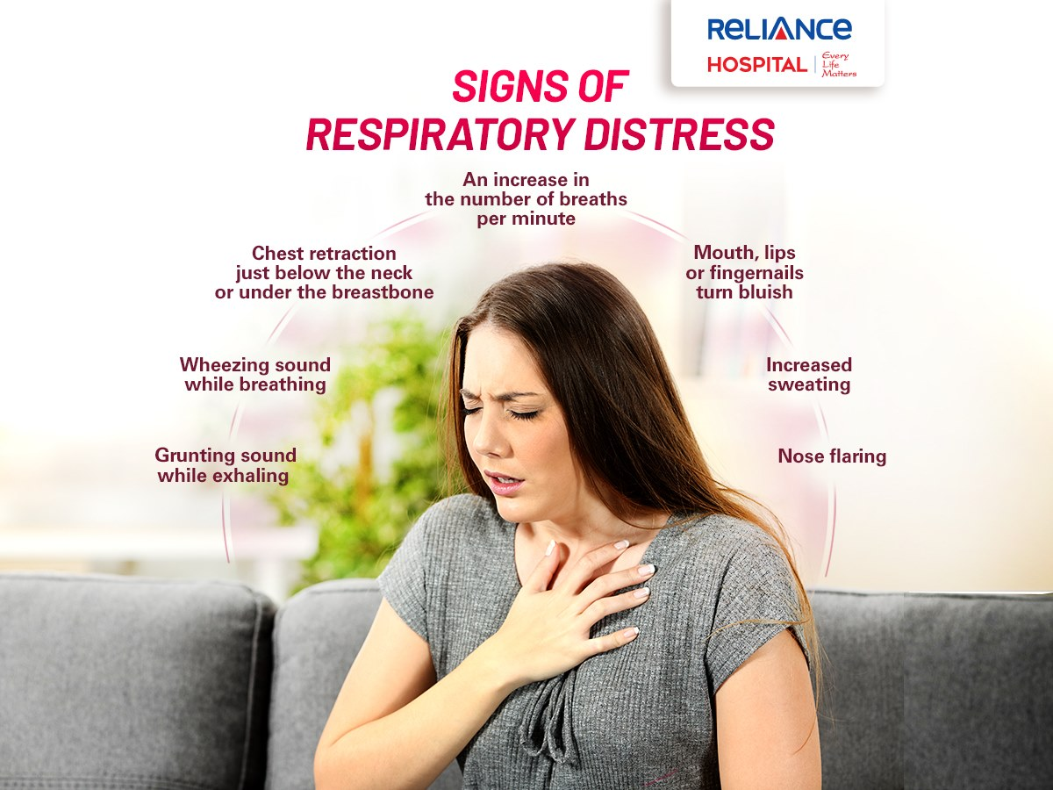

Slide 44
SIGNS AND SYMPTOMS
• Inability to speak in full sentences without
pausing to breathe
• Noisy breathing
• Use of accessory muscles to breathe
• Tripod positioning, leaning forward, sitting
upright
• Abnormal breathing rate or pattern
• Increased pulse rate
• Poor skin colour (cyanotic, pale or ashen)

Slide 45
Management for respiratory distress
Use universal precautions and secure the scene.
1) Move the patient away from the contaminated area (if the cause is toxic product inhalation).
2) Assess patient's breathing, to determine if adequate. Provide artificial ventilation if needed. Maintain open airway.
3) Position the responsive patient in a comfortable position, usually sitting upright.
4) Administer oxygen high flow.

Slide 46
5) Comfort and reassure the patient by providing emotional support.
6) If there is wheeze, then give nebulisation with 0.5ml Asthalin respirator solution + 1ml normal sline if available, otherwise give inj Deriphylline 1 amp intramuscular and inj devadon 1 vail im stat .
7) In case of COPD, start broad spectrum antibiotic like Cap.Amox500 mg 8 hrly or Cap.Augmentin625 mg 8 hrly.
Transport the patient as soon as possible.

Slide 47
Medical Causes of Respiratory Distress
The following conditions are among the more common respiratory problems one will encounter in the field.
1. Bronchial Asthma
Bronchial asthma is an episodic illness characterized by the narrowing of the large air passages called the bronchi. The patient experiences difficulty exhaling air out of the lungs. This is usually due to a spasm of thin muscle that lines the bronchial walls. Asthma is generally triggered by allergens, strong scents, irritating gases, smoke and weather changes.

Slide 48
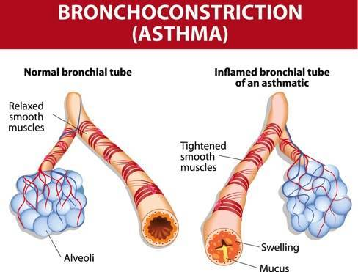

Slide 49
2. Chronic Obstructive Pulmonary
Disease (COPD)
Emphysema and chronic bronchitis are the most common forms of COPD.
Emphysema causes the alveoli to loose their elastic properties and become distended. This traps air and prevents the alveoli from working correctly. As more and more alveoli become affected, breathing becomes increasingly difficult for the patient.

Slide 50
Chronic bronchitis is characterised by excessive mucus becoming trapped in the large air passages of the bronchial tree. Patients diagnosed with this condition will suffer from a consistent productive cough. Patient who have COPD usually have a history of smoking; however, it is also common among people who live in areas of high air pollution.

Slide 51
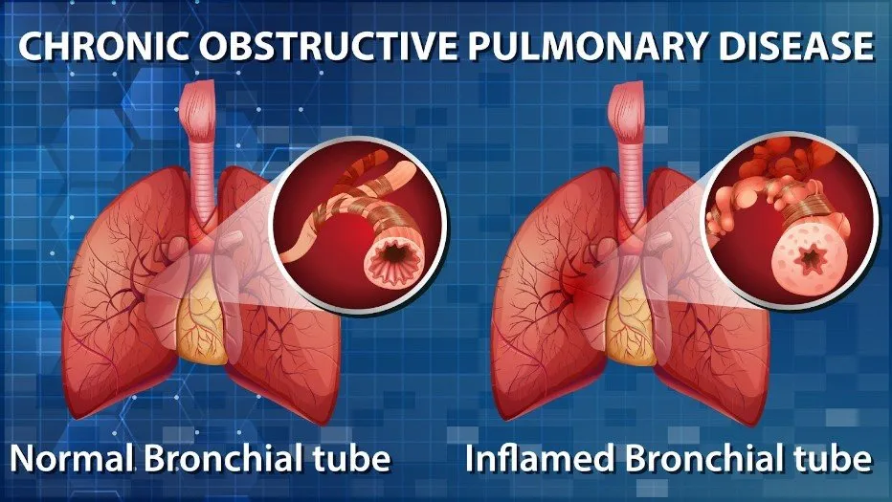

Slide 52
ANAPHYLAXIS
Anaphylaxis is an acute, severe allergic reaction that puts the patient’s life in immediate danger. The reaction may be triggered by many different routes of exposure, including direct skin contact, ingestion and inhalation. Exposure to the allergen will cause blood vessels to dilate rapidly and cause a dropin blood pressure (hypotension).

Slide 53
Many tissues may swell, including those lining the respiratory system. This swelling can obstruct the airway, leading to respiratory failure.
Signs and symptoms frequently observed are -
- urticaria,
oedema in the face,
lips and neck.
In extreme cases, oedema can appear in the larynx and glottis making it difficult for the patient to breath.

Slide 54


Slide 55
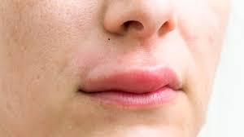

Slide 56
ANAPHYLACTIC SHOCK
Definition:
A life-threatening reaction of the body caused by something to which the patient is extremely allergic.
This condition represents a true emergency where immediate transportation to a medical centre is imperative.

Slide 57
Causes of anaphylactic shock
• Insect stings, including wasps and bees and ants
• Foods and spices (especially shellfish)
• Inhaled substances, including dust and pollen
• Chemicals inhaled or in contact with the skin
• Medications injected or taken by mouth, such as penicillin

Slide 58
SIGN & SYMPTOM
• Skin: May be swollen with burning and itching. Face and tongue may also be swollen (oedema).
• Breathing: Difficult and rapid breathing with possible wheezing.
• Pulse: Rapid, weak or not detected.
• State of consciousness: The patient may be restless and often may become unconscious.

Slide 59
Management for anaphylactic
shock
When interviewing the patient, ask about allergies to anything and if he or she was in contact with that substance.
As with any type of shock treat the patient with total care (see management for shock).
The patient needs medications to combat the allergic reaction.
Administer Inj Adrenaline 1 amp SC slowly taking
about 2 - 3 minutes. Take care as this medication
can cause very rapid heart rate and sudden
collapse of patient

Slide 60
Administer Inj. Avil 1 amp IM and Inj. Hydrocortisone Sodium Succinate 1 vial IV; Establish IV access
Administer Oxygen 10-15 l/min
Constantly monitor vital signs and be on the look out for airway obstruction by swelling of the soft tissues of upper airway
Transport the patient urgently

Slide 61
DIABETIC EMERGENCIES
Diabetes is an illness caused by deficient production of insulin in the body.
Your job as an MFR is not to diagnose or treat diabetes, but rather to identify and treat the conditions caused by improper management of diabetes.
These conditions are known as hyperglycemia (high blood sugar) and hypoglycemia (low blood sugar).

Slide 62
The most common indication that the patient may have either of these conditions is altered mental status.
Other clues, such a necklace, bracelet, medication or information provided by others, may also provide vital information.

Slide 63
Some hyperglycemic and hypoglycemic patients may appear to be alcohol intoxicated.
Always suspect a diabetic problem even in cases that appear to be only alcohol- or drug-related.
As we will also see, blood sugar problems are not always related to a diabetic condition.

Slide 64
HYPERGLYCAEMIA
Diabetics may suffer from increased blood sugar, or hyperglycemia. This condition is basically one of too much sugar and too little insulin.

Slide 65
COMMON CAUSES OF HYPERGLYCEMIA INCLUDE
Infection.
Failure of patient to take insulin, or takes insufficient amount.
Eating excessive sugar.
Increased or prolonged stress.

Slide 66
SIGNS AND SYMPTOMS:
Gradual onset.
Sweet, fruity breath.
Flushed, dry skin.
Hunger or thirst.
Rapid weak pulse.
Frequent urination.
Intoxicated appearance, staggering, slurred speech.

Slide 67
The onset of severe hyperglycemia is gradual.
In most cases it develops over a period of 12 to 48 hours.
At first, the patient experiences excessive hunger, thirst, and urination.
The patient appears extremely ill, becoming weaker and worsening as the condition progresses.
If left untreated, the patient may die.

Slide 68
Even with treatment, recovery is also gradual, occurring 6 to 12 hours after insulin and intravenous fluid are administered.
A hyperglycemic emergency is also called a ‘diabetic coma’, although the patient is not usually found in a coma.

Slide 69
PHT FOR HYPERGLYCAEMIA
Use universal precautions, secure the scene and alert local EMS.
Never give patients who cannot control their airways anything to eat or drink.
Perform initial assessment and obtain patient history.
Administer glucose. When in doubt, give sugar.
Reassess and transport the patient.
Position the patient appropriately.

Slide 70
HYPOGLYCEMIA
This condition consists of low blood sugar, and can be the result of one or two conditions.
One is too much insulin in the bloodstream.
The other is too little sugar in the bloodstream.
People with diabetes are not the only ones who can suffer from low blood sugar.
Alcoholics, anyone having ingested certain poisons, and people who are ill are also at risk.

Slide 71
COMMON CAUSES OF HYPOGLYCEMIA
Skipped meals particularly for diabetics.
Vomiting.
Strenuous exercise.
Physical stress from extreme heat or cold.
Emotional stress.
Accidental overdose of insulin.

Slide 72
The onset of severe hypoglycemia is sudden.
The most recognized cause of hypoglycemia is the accidental overdose of insulin by a patient with diabetes.
After time, diabetes cause visual impairment in patients.
This can make it very hard for patients to give themselves the proper amount of insulin.
The result is an insulin overdose and hypoglycemia.

Slide 73
SIGNS AND SYMPTOMS
Rapid onset of altered mental status.
Intoxicated appearance, staggering, slurred speech.
A typical behavior.
Combativeness and/or anxiety.
Rapid pulse rate.
Cool, clammy skin.
Hunger.
Headache.
Seizures.

Slide 74
COMPARISON CHART
 | Hyperglycemia | Hypoglycemia
Onset | Gradual, over a period of days. | Sudden, within minutes
causes | Insulin insufficiency due to failure to take any or enough insulin | Too much insulin, or inability to adjust to new dosage.
 | Eating too much food that contains sugar. | Inadequate food intake
 | Infection | Vomiting
 | Stress | Excessive exercise.
 |  | Emotional excitement.

Slide 75
CEREBRAL VASCULAR ACCIDENT
A sudden loss of blood supply to the brain.
CVA, commonly known as a “stroke,” is also becoming known as “brain attack”.

Slide 76
CEREBRAL THROMBOSIS
The result of a clot obstructing a cerebral artery, preventing the flow of oxygenated blood to a portion of the brain.

Slide 77
CEREBRAL HEMORRHAGE
The result of a cerebral artery breaking, leaving an area of the brain without blood supply.
The blood that comes out of this artery creates intracranial pressure to the brain and interferes in the brain’s functions.

Slide 78
SIGNS AND SYMPTOMS
Headache (may be the first and only symptom).
Fainting.
Altered mental status.
Tingling or paralysis of the extremities or face.
Difficulty in speaking.
Cont…

Slide 79
Blurred vision.
Convulsions.
Unequal pupils.
Loss of bladder or bowel control.
Hypertension (High B.P.).
If any one of these signs or symptoms is present, assume that the patient is having or is about to have a cerebral vascular accident.
The risk of having a CVA increases with age.

Slide 80
PHT FOR CVA
Use universal precautions and secure the scene.
Instruct the patient to stop all movement.
Place the responsive patient in a comfortable position, usually semi-reclining or sitting.
Maintain open airway.

Slide 81
Administer oxygen . If needed, provide artificial ventilation or CPR.
Loosen restrictive clothing.
Maintain body temperature as close to normal as possible.
Comfort and reassure the patient.
Continue to monitor the patient’s vital signs.
When immobilizing the patient, protect the paralyzed part.

Slide 82
ANY QUESTION
?

