Slide 1
Myocardial Infarction (MI)
LESSON -12
By
PARMOD KUMAR
HC/MED

Slide 2
Learning Objectives
By the end of this module, you will be able to:
• Understand the pathophysiology of myocardial infarction
• Recognize ECG changes in MI
• Differentiate between STEMI and NSTEMI
• Correlate ECG leads with infarct location
• Identify emergency management steps
Notes:
Set clear goals for understanding ECG in MI interpretation.

Slide 3
Introduction
Myocardial infarction (MI) is the death of cardiac muscle due to prolonged ischemia. ECG plays a vital role in diagnosis.
Notes:
Define MI and its diagnostic importance.

Slide 4
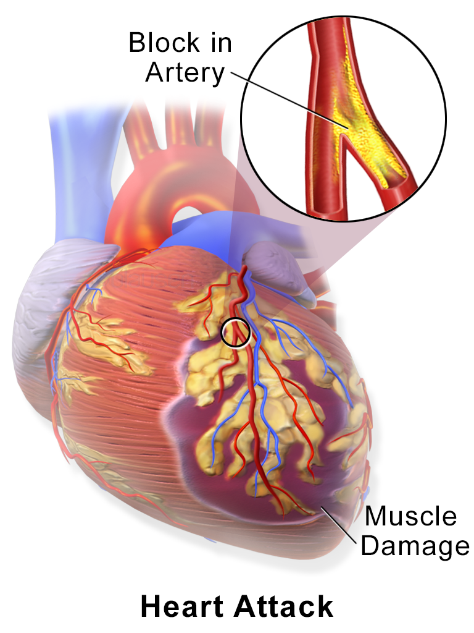

Slide 5
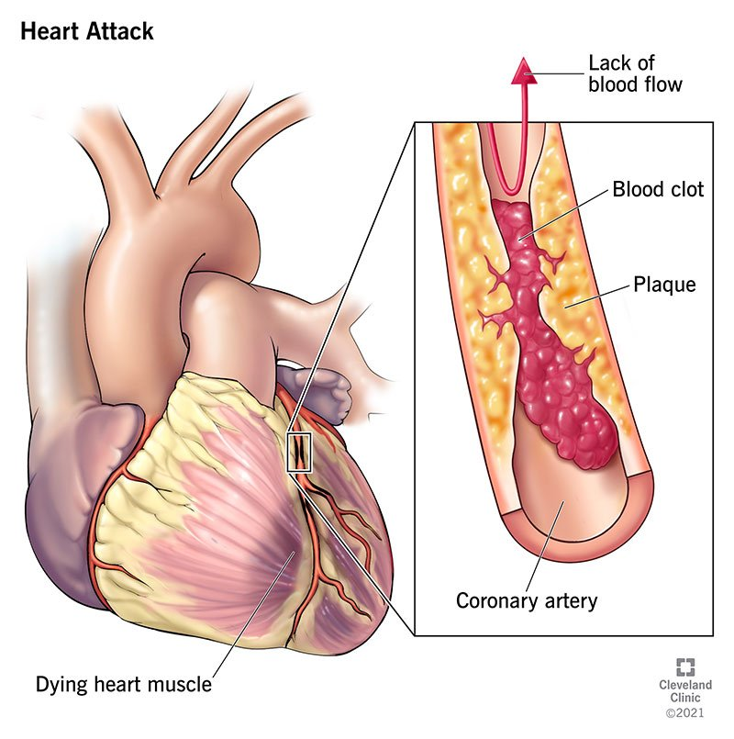

Slide 6
Pathophysiology
• Coronary artery occlusion → ischemia → necrosis
• Affected area loses ability to contract
• Leads to arrhythmia and reduced cardiac output
Notes:
Explain the ischemic cascade.

Slide 7
Types of MI
1. STEMI (ST-Elevation MI)
2. NSTEMI (Non-ST-Elevation MI)
Notes:
Differentiate based on ECG and cardiac enzyme findings.

Slide 8
ECG Role in MI
• Detects ischemia, injury, infarction
• Monitors evolution of infarct
• Guides immediate treatment decisions
Notes:
Highlight ECG as the first-line diagnostic tool.

Slide 9
Typical ECG Changes in MI
1. Hyperacute T waves (early sign)
2. ST elevation (injury)
3. Q waves (infarction)
4. T wave inversion (ischemia)
Notes:
Explain progression of ECG findings.

Slide 10
CHANGES IN ECG IN MI
The ECG findings of an acute anterior myocardial infarction wall include: ST segment elevation in the anterior leads (V3 and V4) at the J point and sometimes in the septal or lateral leads, depending on the extent of the MI. This ST segment elevation is concave downward and frequently overwhelms the T wave.

Slide 11
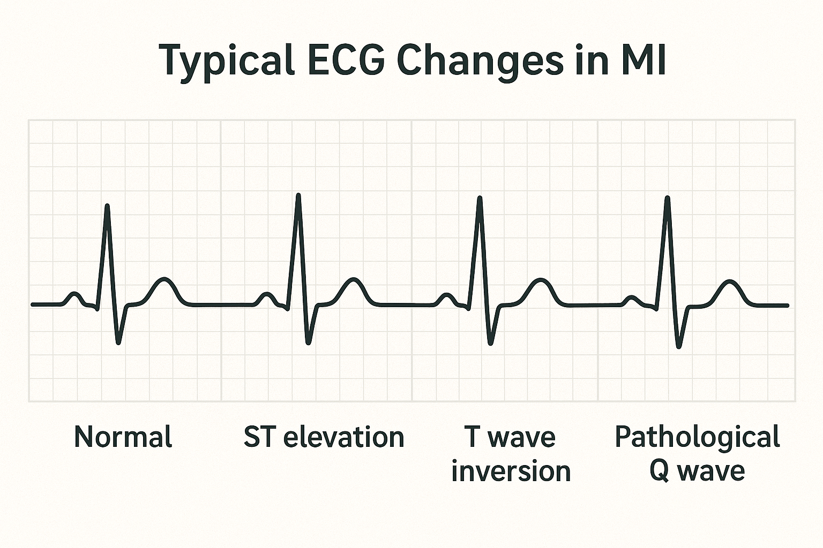

Slide 12
STEMI
• ST elevation ≥1 mm in ≥2 contiguous leads
• Represents full-thickness myocardial injury
• Requires immediate reperfusion (PCI or thrombolysis)
Notes:
Describe STEMI features and urgency.

Slide 13
NSTEMI
• No ST elevation
• ST depression or T wave inversion
• Partial-thickness myocardial damage
• Elevated troponins
Notes:
Differentiate NSTEMI from STEMI on ECG.

Slide 14
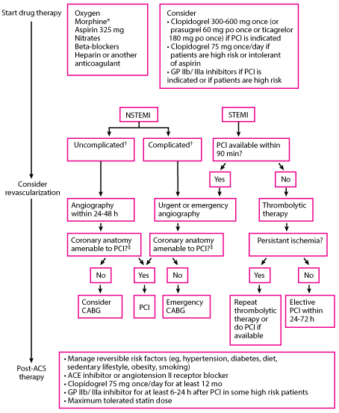

Slide 15
Localization of MI
ECG lead involvement:
• Inferior (II, III, aVF)
• Anterior (V1–V4)
• Lateral (I, aVL, V5–V6)
• Posterior (reciprocal V1–V2 changes)
Notes:
Explain regional MI diagnosis by lead involvement.

Slide 16
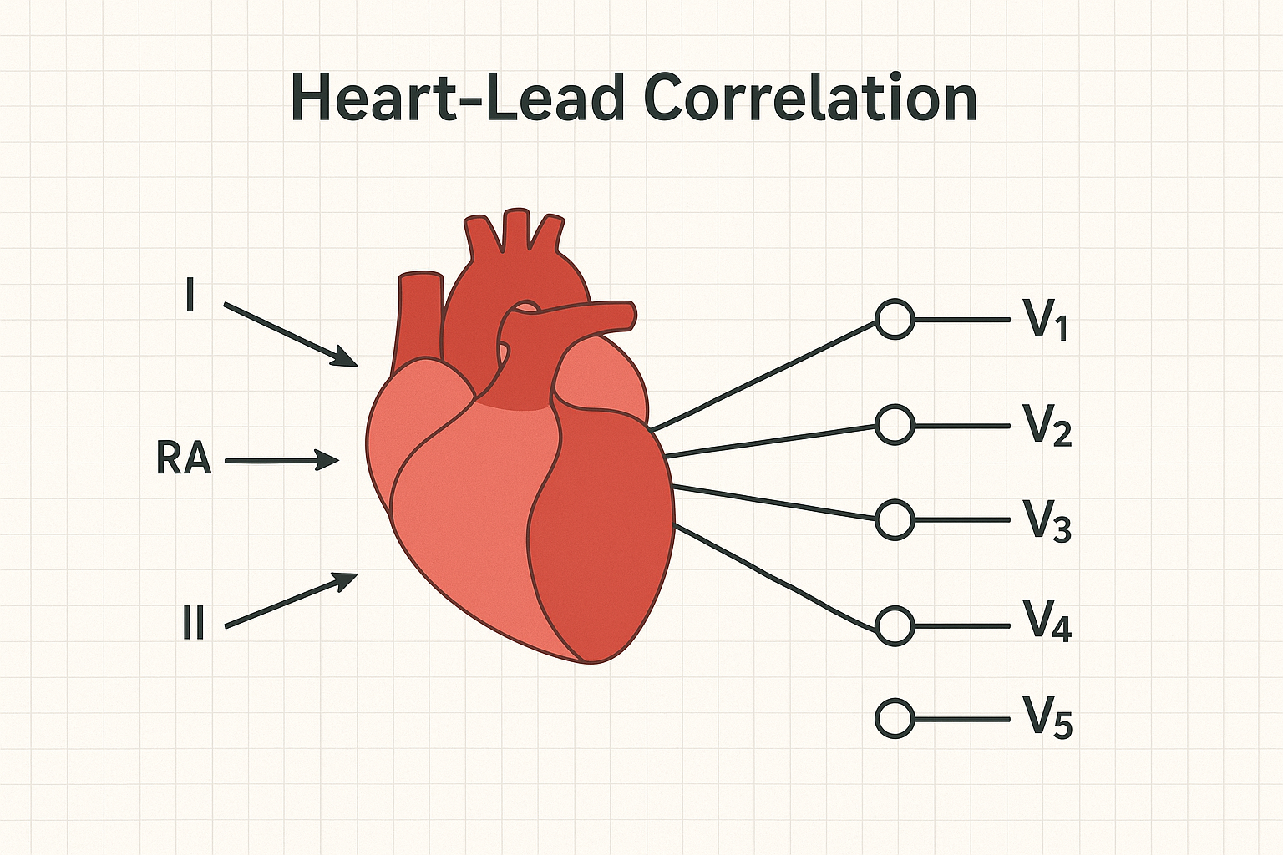

Slide 17
Reciprocal Changes
Opposite ECG changes seen in leads opposite the infarct area (e.g., ST depression in reciprocal leads).
Notes:
Discuss diagnostic value of reciprocal findings.

Slide 18
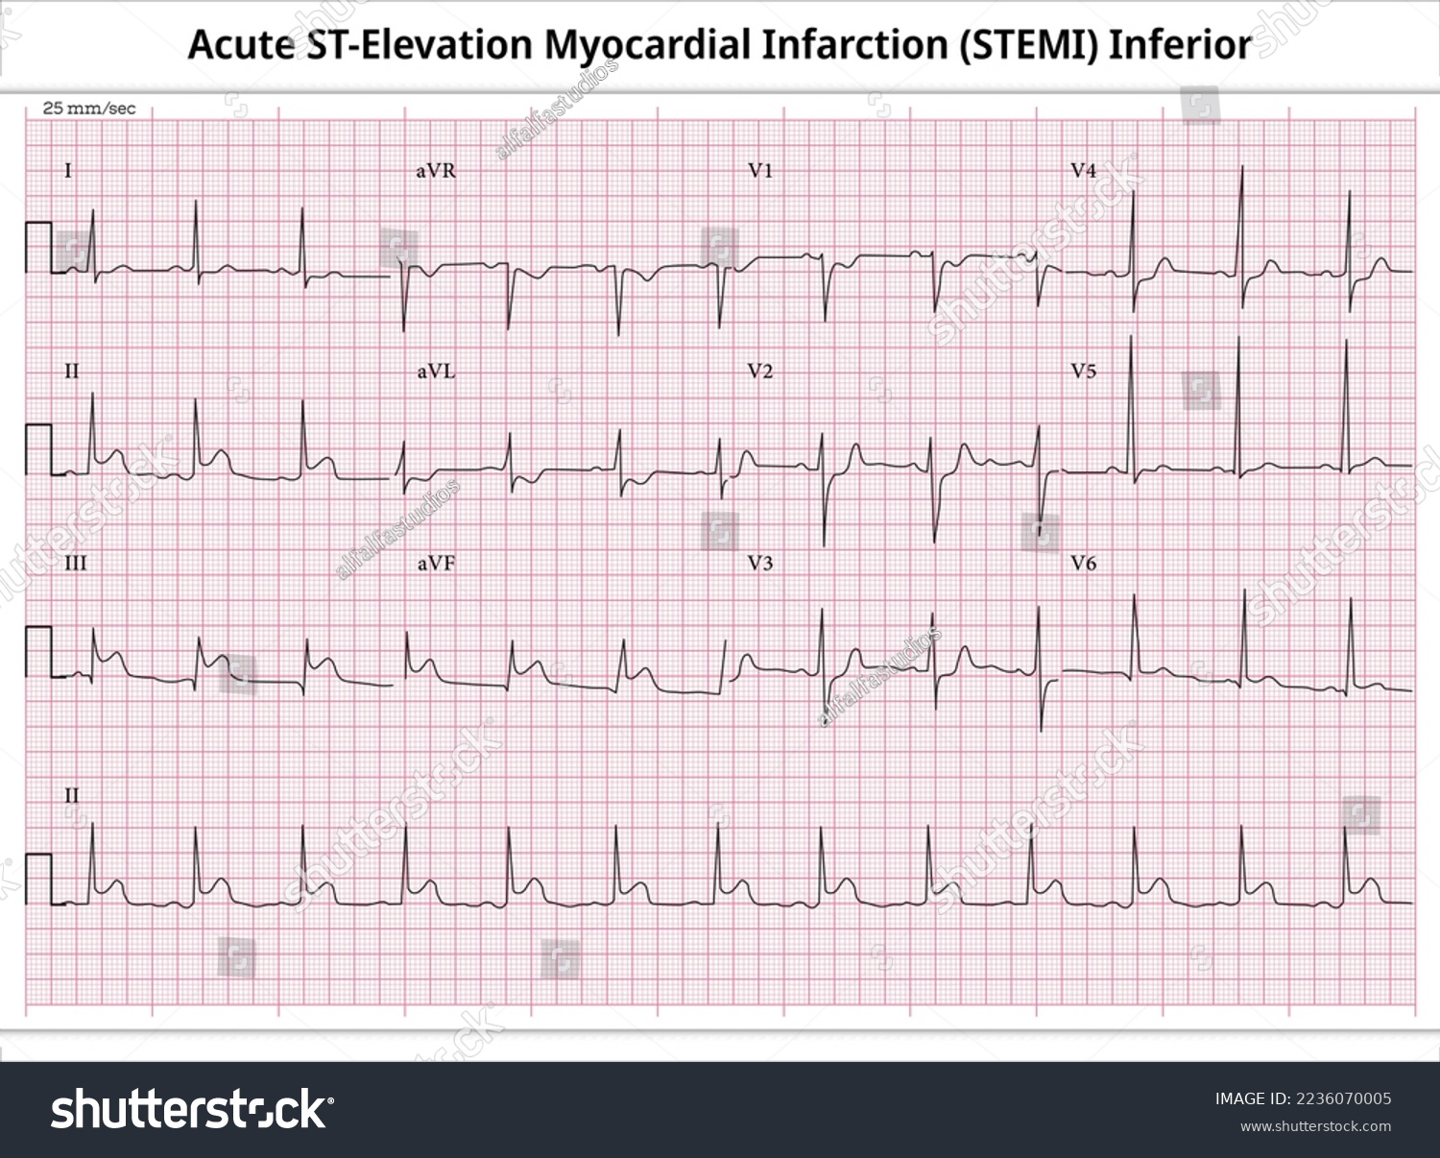
ECG Examples
Inferior MI
Notes:
Show labeled ECG samples for visual learning.

Slide 19
ECG Examples
• Anterior MI
Notes:
Show labeled ECG samples for visual learning.

Slide 20
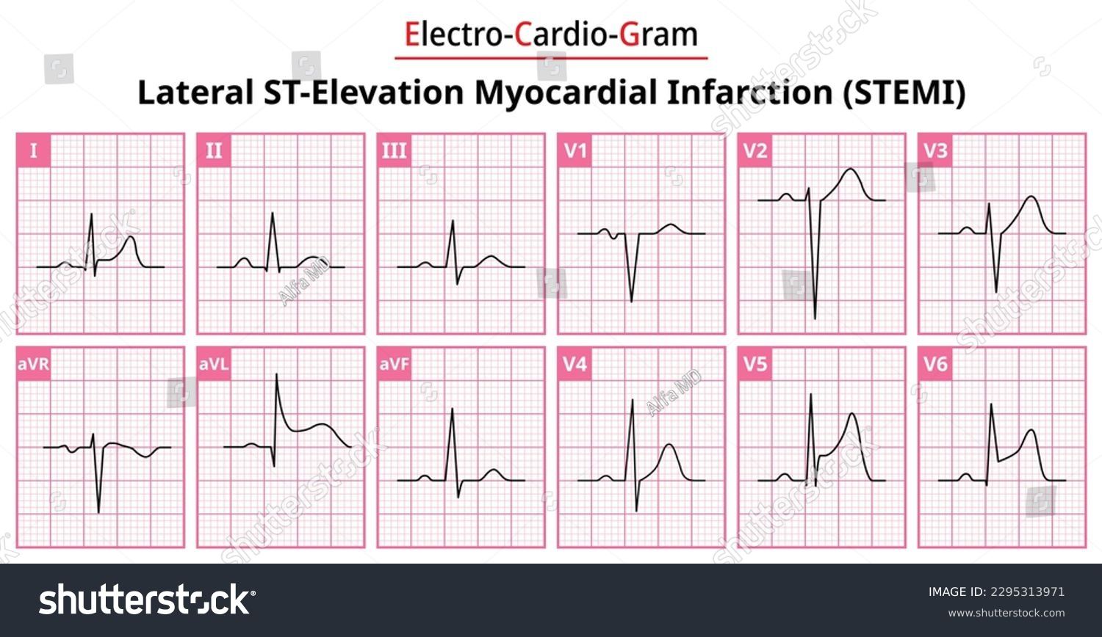
ECG Examples
• Lateral MI
Notes:
Show labeled ECG samples for visual learning.

Slide 21
Complications of MI
• Arrhythmias (VT, VF)
• Heart failure
• Cardiogenic shock
• Myocardial rupture
Notes:
Explain post-MI risks and ECG warning signs.

Slide 22
Clinical Symptoms
• Chest pain radiating to arm/jaw
• Diaphoresis, dyspnea, nausea
• May be silent in diabetics or elderly
Notes:
Emphasize correlation with ECG and biomarkers.

Slide 23
Emergency Management
• ABCs, oxygen, ECG monitoring
• Aspirin, nitrates, morphine
• Reperfusion therapy (PCI preferred)
• Continuous ECG monitoring
Notes:
Outline initial emergency care for MI.

Slide 24
Post-MI ECG Monitoring
• Observe for ST normalization
• Q wave permanence
• Monitor for arrhythmias or reinfarction
Notes:
Discuss serial ECG utility.

Slide 25
Summary
• ECG is essential for rapid MI diagnosis
• Recognize STEMI vs NSTEMI patterns
• Localization by ECG leads aids treatment
• Prompt intervention saves myocardium
Notes:
Summarize and prepare for next module on ischemic heart disease.

Slide 26
ANY QUESTION
?

Slide 27
THANKS

