Slide 1
LIFTING AND MOVING A PATIENT
LESSON -12
BY
OMKAR YADAV
INSP/PH

Slide 2
OBJECTIVES
Three emergency moves and two non-emergency moves for lifting and moving a patient.
Demonstrate the techniques for immobilizing and transporting a patient, using a backboard.
Name five examples of situations that might require you to make an emergency move with a patient.

Slide 3
BODY MECHANICS
Definition: Proper use of your body to facilitate lifting and moving, and to prevent injury.
Incorrectly lifting and carrying equipment or patients could cause injury, and potentially end an EMS career or cause life-long pain. When it comes to lifting follow these basic rules to prevent injuries:-
- Plan your move before lifting an object.
- Use your legs to lift, not your back.

Slide 4
- Keep the weight of the object as close to your body as possible.
- “Stack” – move your body as a vertical unit. Visualize your shoulders as stacked onto your hips, your hips to your feet.
- Reduce the height or distance you need to move an object.

Slide 5
MOVING PATIENTS
How soon should you move the patient?
Must you complete your assessment before moving the patient?
How much time should you spend on spinal protection?

Slide 6
Answer: It depends on the circumstances.
Generally, if there is no threat of injury, provide emergency care and then move the patient. If the scene is potentially unsafe or poses an immediate threat, you may have to move the patient.
Patient-moving techniques can be classified as emergency moves and nonemergency moves.

Slide 7
EMERGENCY MOVES
Make an emergency move only when there is immediate danger to the patient.
Examples of situations which might require you to make an emergency move:-
- Fire or threat of fire – always considered a great threat to patients and rescuers.
- Explosion or threat of explosion (hazardous scene).

Slide 8
- Inability to protect the patient from hazards at the scene.
Unstable building
Rolled over car
Hostile crowd
Hazardous materials (Haz-Mat)
Spilled gasoline
Extreme weather

Slide 9
TYPES OF EMERGENCY MOVES
Shirt drag.
Shoulder or forearm drag.
Other types: i) Blanket drag.
ii) Pick-a-bag carry .
iii) One rescuer crutch .
iv) Cradle carry.
v) Firefighter drag.

Slide 10
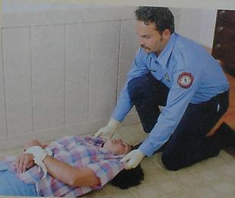
SHIRT DRAG

Slide 11
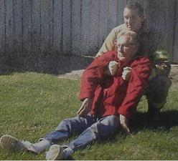
SHOULDER DRAG

Slide 12
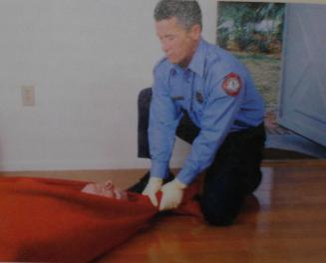
BLANKET DRAG

Slide 13
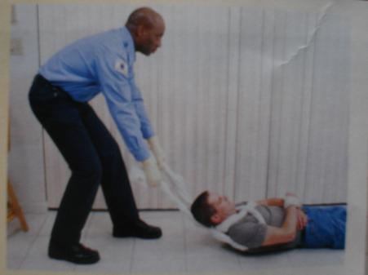
SHEET DRAG

Slide 14
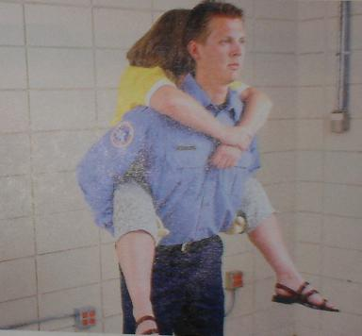
PIGGY BACK CARRY

Slide 15
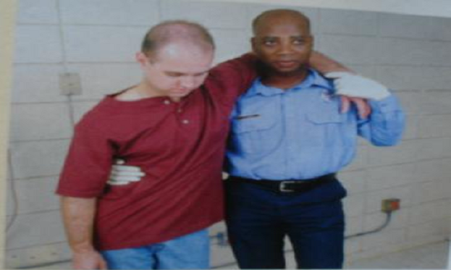
ONE RESCUER CRUTCH

Slide 16
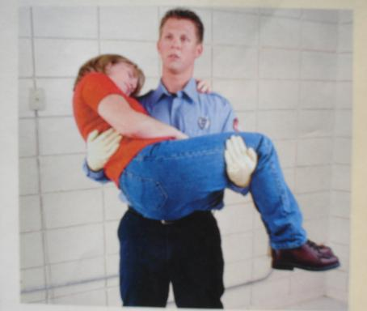
CRADLE CARRY

Slide 17
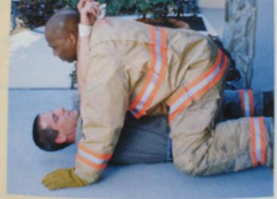
FIRE FIGHTER DRAG

Slide 18
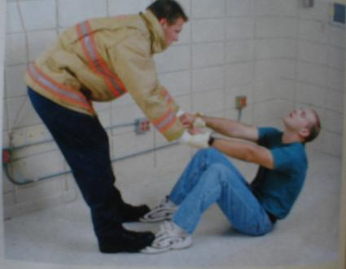
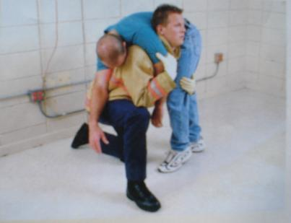
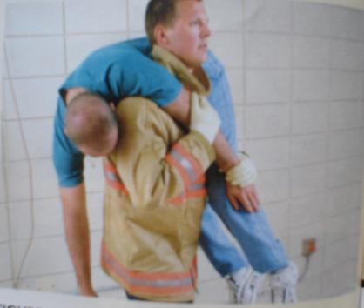
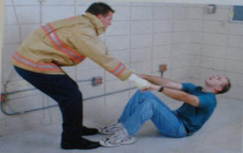
FIRE FIGHTERS CARRY

Slide 19
NON–EMERGENCY MOVES
Where there is no immediate threat to life, the patient should be moved only when ready for transport, using a non-emergency move.
Complete the on-scene assessment and treat the patient first. Prevent additional injury and try to avoid causing discomfort and pain to the patient.

Slide 20
Examples of non-emergency moves:
- Direct-ground/bed lift: This move is difficult if the patient weighs more than 80 kilos, is on the ground or other low surface or is un co-operative. Requires at least three people.
- Extremity lift: Commonly used to move patients from a chair or bed to a stretcher or the floor. Do not use on patients with extremity injuries.

Slide 21
PATIENT-CARRYING EQUIPMENT
Such equipment includes stretchers and other devices designed to carry patients safely to their destination. You should become completely familiar with the use of these devices. They must also know the limitations of the equipment. It is very import to regularly maintain and inspect these devices.
Typical equipment used to move patients includes:
- Wheeled stretchers: some have collapsible undercarriage, usually seen in ambulances or transportation units.

Slide 22
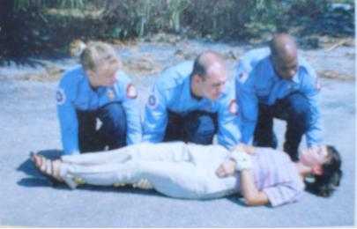
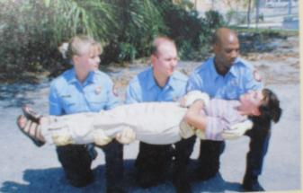
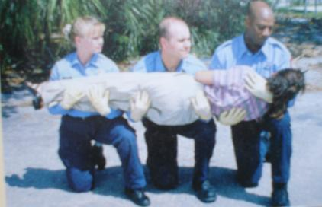
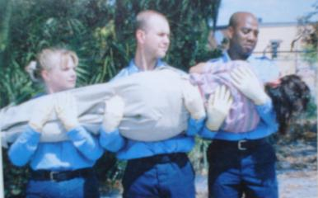
DIRECT GROUND LIFT

Slide 23
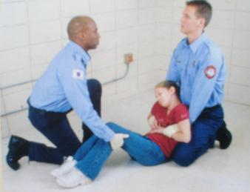
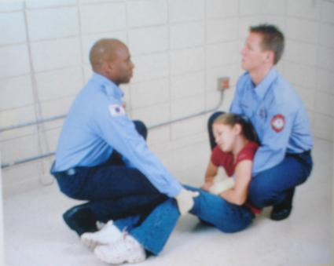
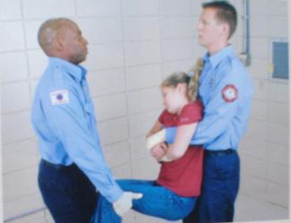
EXTREMITY LIFT

Slide 24
- Lightweight portable stretchers (folding or collapsible).
- Scoop stretcher.
- Vest-type extrication devices.
- Stair chair.
- Basket stretcher.
- Flexible stretcher.
- Draw sheet.
- Backboards: These devices are usually made of splinter.

Slide 25
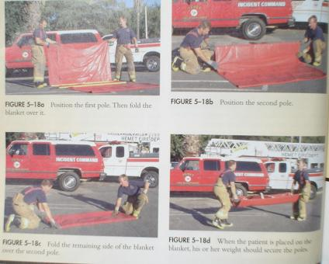

Slide 26
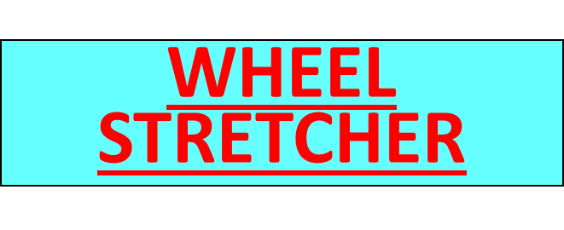
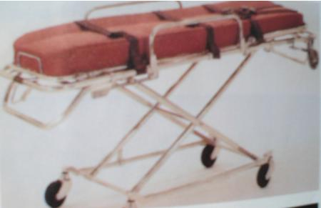

Slide 27
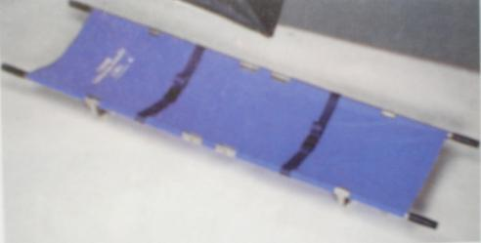
POLE STRETCHER

Slide 28
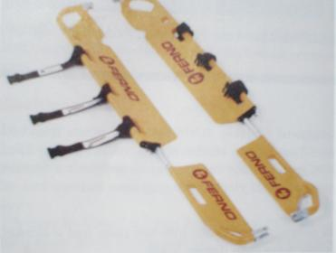
SCOOP / ORTHOPEDIC STRETCHER

Slide 29
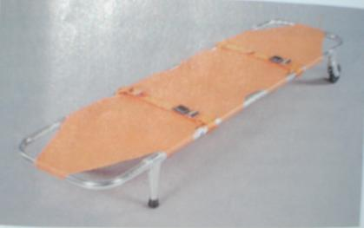
PORTABLE AMBULANCE STRETCHER

Slide 30
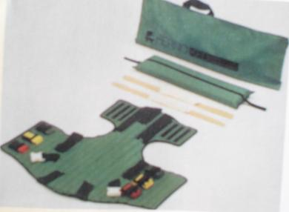
VEST TYPE IMMOBILIZATION DEVICE

Slide 31
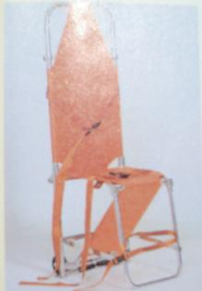
STAIR CHAIR

Slide 32
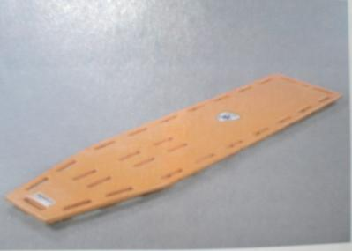
LONG BACK BOARD

Slide 33
These devices are usually made of splinter resistant wood or synthetic material that will not absorb blood.
They usually have handholds or carrying straps. There are two types:–
Long backboard: 6–7 feet long, used for patients found lying down or standing and who must be immobilized.

Slide 34
Short backboard: 3-4 feet long, used primary to remove patients from vehicles when neck or spinal injuries are suspected. The backboard is slid between the patient’s back and the seat. Once secured to the short board and wearing a rigid cervical collar, the patient can be removed from his sitting position in the vehicle to a supine position on the long board. Vest-type devices are often used as a short backboard.

Slide 35
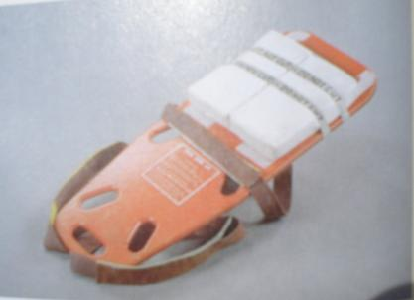
Short Back board

Slide 36
POLE STRETCHER

Slide 37
ANY QUESTION
?

Slide 38
THANKS

