Slide 1
LESSON -11
NERVOUS SYSTEM
BY
OMKAR YADAV
INSP/PH

Slide 2
OBJECTIVES
Upon completion of this lesson, you will be able to:
Introduction to the nervous system
To learn about the structure of a neuron & its parts
Introduction to the Central Nervous System
To learn about the structure & the coverings of brain
To learn details about the parts of brain

Slide 3
6. To learn about the functions of each part of the
brain
7. Introduction to the spinal cord & its important
characteristics
8. To learn about the structure of the spinal cord
9. To learn about the functions of the spinal cord
10.To learn about the various cranial nerves; their
functions & distribution
11.To learn about the autonomic nervous system

Slide 4
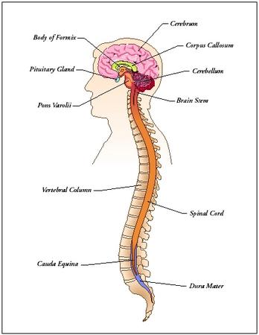
NERVOUS SYSTEM
CEREBRUM
DIAENCEPHALON
CORPUA CALLOSUM
PITUITARY GLAND
CEREBELLUM
PONS
BRAIN STEM
VERTEBRAL COLUMN
SPINAL CORD
CAUDA EQUINA
DURA MATER

Slide 5
NERVOUS SYSTEM
It is a vital system controlling the physiological set-up of the body and responsible for the physical & mental faculties of humans. It consists of the Brain, Spinal cord & various nerves which control the vital functions of the body. It is divided into the central nervous system (consisting of the brain & spinal cord with their corresponding nerves) and the autonomic nervous system.

Slide 6
NEURONS-
They are the basic component of the nervous system and
consist of the nerve cell & the associated nerve-fibre.
‘Neuroglia’ is a special type of connective tissue,
found only in the nervous system, which supports the neurons.

Slide 7
PARTS OF NEURON -
Nerve cell –
Comparatively large cell body
Shape & size may vary according to the position of the
neuron & its function
Clearly defined nucleus
Protoplasm is granular
Cells in the grey matter of the brain & spinal cord
may have several processes called dendrites

Slide 8

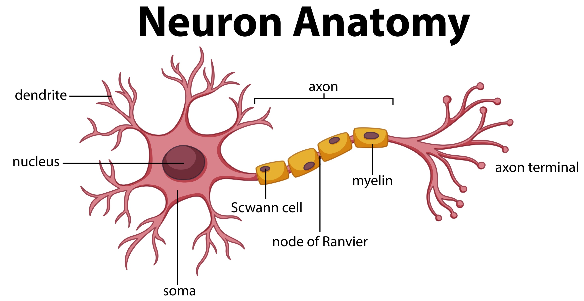

Slide 9
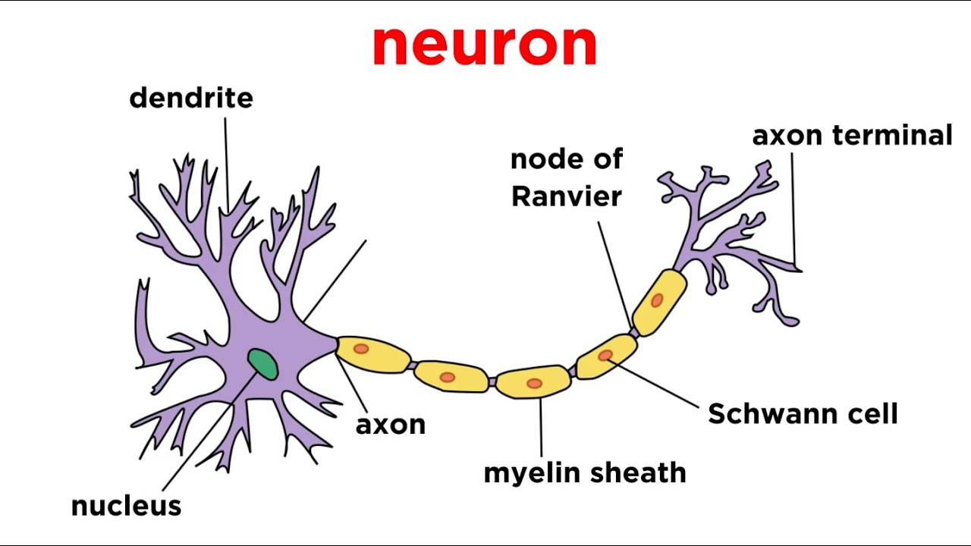

Slide 10
Dendrites –
Dendrites are short branches from the nerve cell,
through which nerve impulses enter the cell
Axon –
It is a single fibre, continuous from the cell to its termination
Vary considerably in length from few mms to several cms
Nerve impulses pass out from the cell through the axons

Slide 11
Neurolemma –
It is a fine, delicate membrane
Covers the myelin sheath
Myelin sheath –
Acts as an insulator for the axon
Speeds up the passage of nerve impulses
Protects the axis cylinder from injury & pressure
Probably, aids in supply of nutrients to the axon

Slide 12
Node of Ranvier –
The myelin sheath is not continuous (absent at intervals of about 1 mm)
Spaces in between the myelin sheath are called nodes of ranvier
It is necessary for the transmission of nerve impulses along medullated fibres

Slide 13
CENTRAL NERVOUS SYSTEM
BRAIN – COVERINGS/PARTS/FUNCTIONS
Also called as the ‘Cerebro-spinal system’
Consists of:
Brain & its nerves
Spinal cord & its nerves
Cerebro-spinal fluid

Slide 14
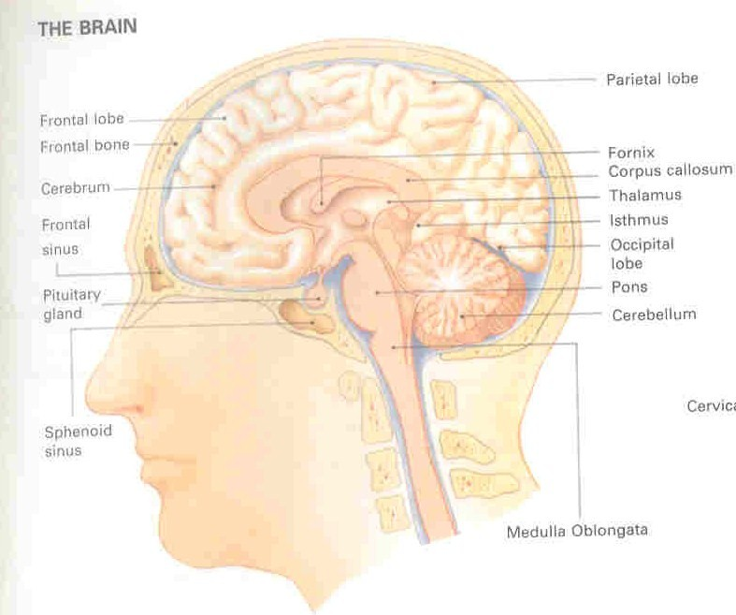
LUMBIC SYSTEM

Slide 15
Situated in the cranial cavity
About 2 kgs in weight
Consists of 2 lobes (hemispheres), connected in the centre
Covered by 3 layers of membranes called ‘Meninges’

Slide 16
  Dura Mater
  Fibrous, outermost layer
  Sickle-shaped fold separates the 2 hemispheres – ‘Faux cerebri’
  Another fold separates cerebrum & cerebellum – ‘Tendorium cerebelli’
  Arachnoid Mater
  Middle layer
  Closely adherent to the dura mater

Slide 17
  Contains the blood vessels supplying the underlying tissue
Sub-arachnoid space lies under the arachnoid layer and contains
cerebro-spinal fluid

Slide 18
NS
↓
↓………………………………………………………………….↓
CNS PNS CONSIST OF SPINAL MIXED AND CRENIAL
BRAIN SENSORY AND MOTOR
SPINAL CORD SOMATIC VOLUNTARY
NERVES VISCERAL AND AUTONOMIC

Slide 19
Nerve | NAME | TYPE | DISTRIBUTION | FUNCTION
I | Olfactory | Sensory | Starts in the nose & passes to the olfactory bulb | Smell
II | Optic | Sensory | Starts in the retina & passes to the geneculate body | Sight
III | Oculomotor | Motor | Arises in midbrain & ends in muscles of the eye | Eye-movements
CRANAL NERVES

Slide 20
IV | Trochlear | Motor | Arises in midbrain & ends in muscles of the eye | Eye-movements
V | Trigeminal | Mixed | Muscles of mastication & mandibular, maxillary & ophthalmic areas | Sensory: Mandibular, Maxillar; ophthalmic Motor: mastication
VI | Abducent | Motor | Arises in the pons & ends in muscle of eye | Eye-movement

Slide 21

VII | Facial | Mixed | Facial muscles & tongue | Sensory: Tongue Motor: Facial muscles (expression)
VIII | Vestibule-cochlear | Sensory | Internal ear | Hearing & balance
IX | Glosso-pharyngeal | Mixed | Tongue & pharynx | Sensory: Taste Motor: Pharynx

Slide 22
X | Vagus | Mixed | Digestive tract | Sensory: Digestive tract Motor: digestive tract secretion /movement
XI | Accesory | Motor | Muscles of pharynx, soft palate & neck | Movements of Soft palate, pharynx & neck
XII | Hypoglossal | Motor | Tongue | Tongue movements

Slide 23
Any Question
Thanks

