Slide 1
ENVIRONMENTAL
EMERGENCIES
LESSON -11
BY
JITENDER YADAV
INSP/PH

Slide 2
OBJECTIVES
Upon completion of this lesson, you will be able to:
List signs and symptoms of heat cramps, heat exhaustion and heat stroke. Describe their management.
List the differentiating features between three heat emergencies.
Explain dehydration and list the causes.
Enumerate the signs and symptoms of dehydration and explain its management.
Cont…

Slide 3
ENVIRONMENTAL EMERGENCIES
Exposure to excessive heat can produce serious health conditions especially in patients not acclimatized to heat

Slide 4
ENVIRONMENTAL EMERGENCIES
Heat cramps
Heat exhaustion
Heat stroke

Slide 5
1) HEAT CRAMPS
Heat cramps consist of pain and muscle spasms that occur when the body loses a large quantity of salt through excessive sweating.
The core temperature of the body is not altered

Slide 6
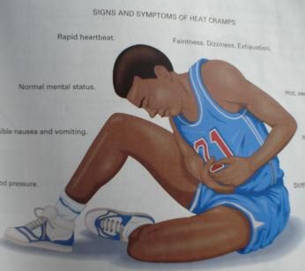
SIGNS AND SYMPTOMS OF HEAT CRAMPS
Severe muscle cramps.
Exhaustion.
Nausea and vomiting.
Periods of fainting.

Slide 7
MANAGEMENT FOR
HEAT CRAMPS
Move the patient to a cool area.
Give the patient water. The patient needs the water more than the salt, Do not delay giving water to look for salt.
Commercial electrolytes or oral rehydration solution (ORS) are the best if patient is conscious; if unconscious do not give anything by mouth; start IV DNS or NS and evacuate the patient.

Slide 8
2) HEAT EXHAUSTION
Heat exhaustion can occur when a person in poor physical condition exerts himself or herself during physical activity in a very hot environment, causing blood flow to be affected.
The body core temperature rises between 37 to 40° C

Slide 9
SIGNS AND SYMPTOMS OF HEAT EXHAUSTION
Rapid, shallow breathing.
Weak pulse.
Cold, clammy, pale skin and mucous membranes, with a lot of sweating.
Weakness.
Dizziness, sometimes leading to fainting.

Slide 10
MANAGEMENT FOR
HEAT EXHAUSTION
Move the patient to a cool place to rest.
Remove or loosen clothing as necessary to cool the patient without causing chills.
Place the patient in a supine position with
legs elevated 20 to 30 cm.
Administer oxygen high flow.
Give water if conscious.
If unconscious do not give anything by mouth; start IV DNS or NS and evacuate the patient.

Slide 11
3) HEAT STROKE
Heat stroke is a very serious life-threatening condition. The body becomes overheated and, in many cases, the patient stops sweating. If left untreated, brain cells will begin to die.
The core temperature of the body will be more than 40° C

Slide 12
SIGNS AND SYMPTOMS OF HEAT STROKE
The hallmark symptom of heat stroke is a core body temperature above 104 F. But fainting may be the first sign.
Other symptoms may include:
Throbbing headache
Dizziness and light-headedness
Lack of sweating despite the heat
Red, hot, and dry skin

Slide 13
Muscle weakness or cramps
Nausea and vomiting
Rapid heartbeat, which may be either strong or weak
Rapid, shallow breathing
Behavioral changes such as confusion, disorientation, or staggering
Seizures
Unconsciousness

Slide 14
MANAGEMENT FOR HEAT STROKE
If you suspect that someone has a heat stroke, immediately call 108 or take the person to a hospital. Any delay seeking medical help can be fatal.
While waiting for the paramedics to arrive, initiate first aid. Move the person to an air-conditioned environment -- or at least a cool, shady area -- and remove any unnecessary clothing.

Slide 15
MANAGEMENT FOR HEAT STROKE
If possible, take the person's core body temperature and initiate first aid to cool it to 101 to 102 F. (If no thermometers are available, don't hesitate to initiate first aid.)
Try these cooling strategies:
Fan air over the patient while wetting their skin with water from a sponge or garden hose.
Apply ice packs to the patient's armpits, groin, neck, and back. Because these areas are rich with blood vessels close to the skin, cooling them may reduce body temperature.

Slide 16

Immerse the patient in a shower or tub of cool water.
If the person is young and healthy and suffered heat stroke while exercising vigorously -- what’s known as exertional heat stroke -- you can use an ice bath to help cool the body.
Do not use ice for older patients, young children, patients with chronic illness, or anyone whose heat stroke occurred without vigorous exercise. Doing so can be dangerous.

Slide 17
How Can Heal Stroke Be Prevented?
When the heat index is high, it's best to stay in an air-conditioned environment. If you must go outdoors, you can prevent heat stroke by taking these steps:
Wear lightweight, light-colored, loose-fitting clothing, and a wide-brimmed hat.
Use sunscreen with a sun protection factor (SPF) of 30 or more.
Drink extra fluids. To prevent dehydration, it's generally recommended to drink at least eight glasses of water, fruit juice, or vegetable juice per day. Because heat-related illness also can result from salt depletion, it may be advisable to substitute an electrolyte-rich sports drink for water during periods of extreme heat and humidity.

Slide 18
Take additional precautions when exercising or working outdoors. The general recommendation is to drink 24 ounces of fluid two hours before exercise, and consider adding another 8 ounces of water or sports drink right before exercise. During exercise, you should consume another 8 ounces of water every 20 minutes, even if you don't feel thirsty.
Reschedule or cancel outdoor activity. If possible, shift your time outdoors to the coolest times of the day, either early morning or after sunset.

Slide 19
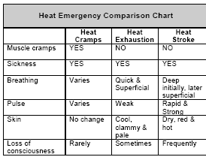

Slide 20
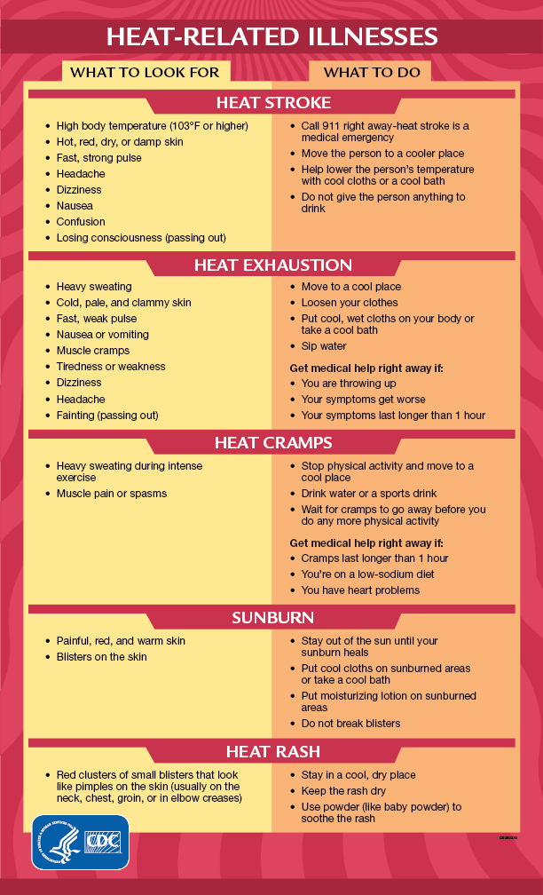

Slide 21
DEHYDRATION
Adult human body consists of 55-60% of body wt as water and it is distributed in various compartments like intracellular (70%), Extracellular (30% approx. 12 L). Of this extracellular water 75% is interstitial and 25% intravascular.
Water enter and leaves the body through the gastrointestinal tract and and is loss through the lungs, the skin and the kidneys

Slide 22
Dehydration occurs when you use or lose more fluid than you take in, and your body doesn't have enough water and other fluids to carry out its normal functions. If you don't replace lost fluids, you will get dehydrated.
Anyone may become dehydrated, but the condition is especially dangerous for young children and older adults.
The most common cause of dehydration in young children is severe diarrhea and vomiting. Older adults naturally have a lower volume of water in their bodies, and may have conditions or take medications that increase the risk of dehydration.

Slide 23
This means that even minor illnesses, such as infections affecting the lungs or bladder, can result in dehydration in older adults.
Dehydration also can occur in any age group if you don't drink enough water during hot weather — especially if you are exercising vigorously.

Slide 24
DEHYDRATION
Dehydration is a state where the body’s extra cellular fluid is lost with or without electrolyte loss.
Causes of ECF Depletion:
From GIT-
Vomiting
Diarrhea
Fistula
Intestinal obstruction

Slide 25
DEHYDRATION
From Kidneys:-
Diabetes Mellitus
Renal Diseases
Drugs like diuretics
From Skin:-
Sweating in hot environment, fever etc
From Kidneys:-
Burns
Ascites
Peritonitis
Acute Pancreatitis

Slide 26
SIGNS AND SYMPTOMS
Excessive thirst.
Concentrated urine & later reduced urine output.
Dizziness or fainting.
Weakness.
Hypotension especially postural hypotension
Loss of skin turgor.
Cont…

Slide 27
SIGNS AND SYMPTOMS
Rapid pulse rate.
Shallow rapid breathing.
Confusion, stupor.
Systolic BP <100 mmHg
Cold extremities and poor capillary return.
Cont…

Slide 28
MANAGEMENT FOR DEHYDRATION
In conditions where loss is expected as in diarrhea, working in hot environment, prophylactic measures with plenty of oral fluids is advised.
If patient is conscious and alert, oral rehydration solution should be given and continued till loss is controlled.

Slide 29
MANAGEMENT FOR DEHYDRATION
In moderate and severe dehydration and patients with altered mental status, IV fluid should be started preferably 0.9% NS and shift patient to hospital care for further evaluation.
Treatment of the underlying cause of dehydration.

Slide 30
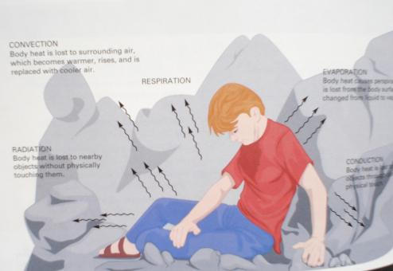
MECHANISMS OF HEAT LOSS
CONVECTION: Body heat lost to the surrounding air which is becomes warmer, rises, and is replaced with cooler air.
RESPIRATION
EVAPORATION
RADIATION: Body heat is lost to nearby objects without touching them
CONDUCTION: through direct physical touch to nearby objects.

Slide 31
What are the 12 signs of dehydration?
Signs of dehydration include:
Headache, delirium, confusion.
Tiredness (fatigue).
Dizziness, weakness, light-headedness.
Dry mouth and/or a dry cough.
High heart rate but low blood pressure.
Loss of appetite but maybe craving sugar.
Flushed (red) skin. Swollen feet. Muscle cramps.

Slide 32
ANY QUESTION
?

Slide 33
THANKS

