Slide 1
ECG Interpretation & Common Dysrhythmia
LESSON -11
By
AMANDEEP KAUR
ASI/ANM

Slide 2
Learning Objectives
By the end of this module, you will be able to:
• Interpret ECG waveforms and intervals accurately
• Recognize common cardiac dysrhythmias
• Differentiate between atrial, junctional, and ventricular rhythms
• Apply interpretation steps systematically
Notes:
Introduce the systematic approach to ECG interpretation.

Slide 3
Introduction
ECG interpretation involves analyzing rate, rhythm, intervals, and morphology to identify normal or abnormal patterns.
Notes:
Brief overview of ECG reading principles.

Slide 4
Systematic Approach
1. Rate
2. Rhythm
3. P waves
4. PR interval
5. QRS duration
6. ST segment and T wave
7. Interpretation summary
Notes:
Emphasize consistency in approach.

Slide 5
Step 1: Rate
Determine heart rate using methods learned previously (300, 1500, or 6-second).
Notes:
Review rate calculation quickly.

Slide 6
Step 2: Rhythm
Assess if the rhythm is regular or irregular using R–R intervals.
Notes:
Regular rhythm indicates stable conduction.

Slide 7
Step 3: P Waves
• Are P waves present?
• Are they uniform?
• Is there a P before every QRS?
Notes:
Explain P wave importance in identifying atrial activity.

Slide 8
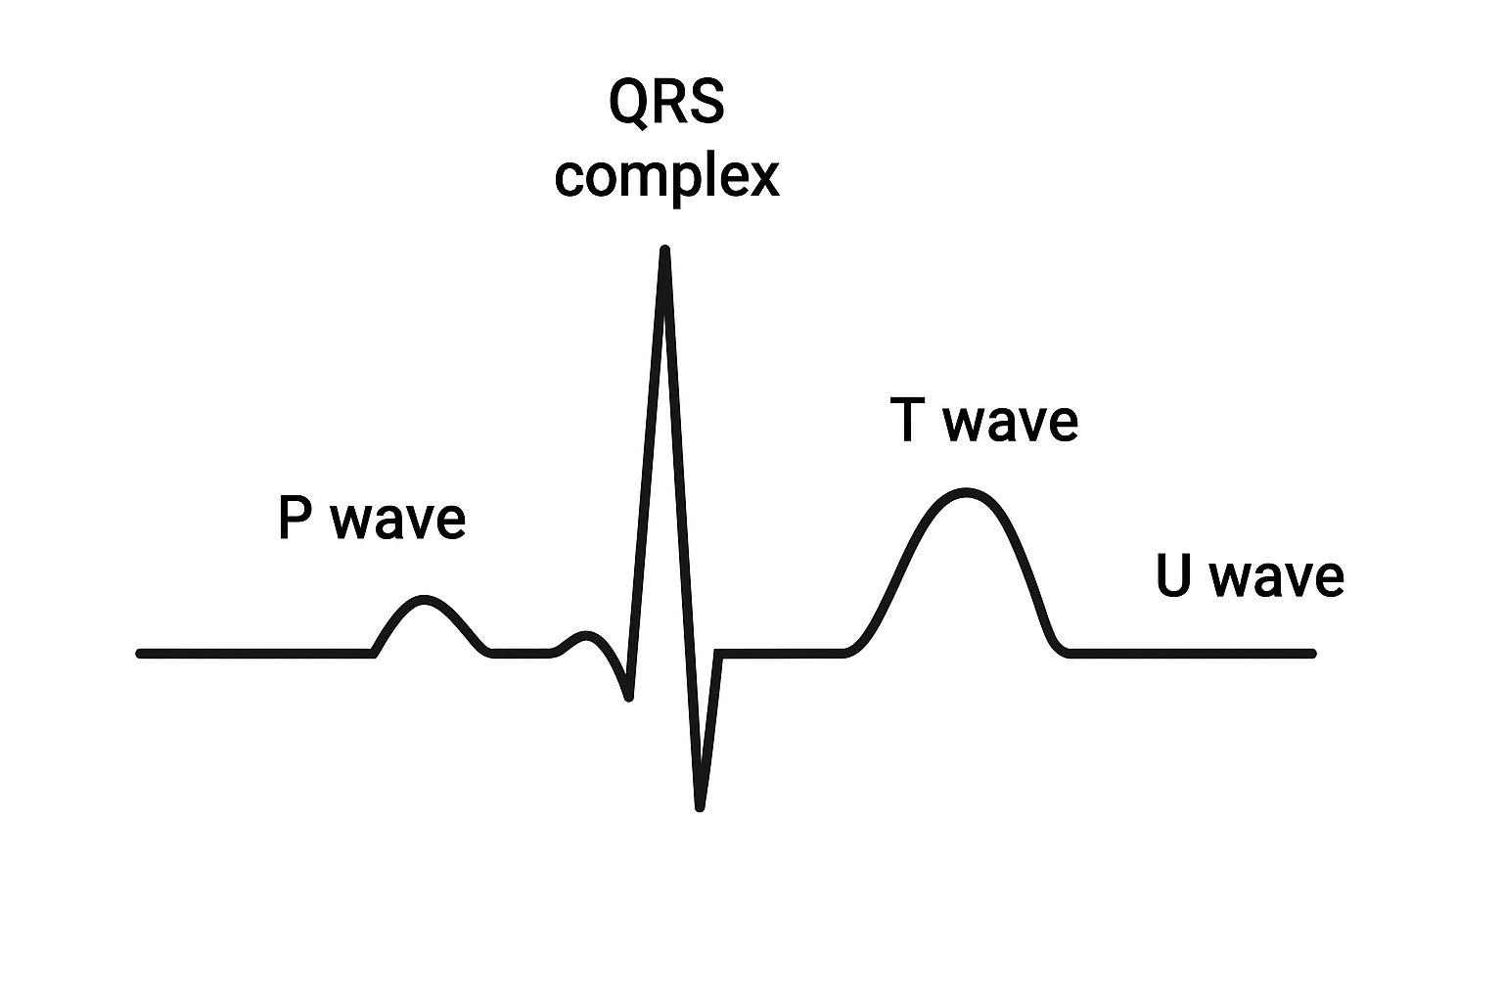
Step 4: PR Interval
• Normal: 0.12–0.20 sec
• Prolonged = AV block
• Shortened = pre-excitation (e.g., WPW)
Notes:
Interpret PR interval findings.

Slide 9
Step 5: QRS Complex
• Normal: ≤0.12 sec
• Wide QRS → bundle branch block or ventricular rhythm
Notes:
Assess for conduction delays.

Slide 10
Step 6: ST Segment & T Wave
• ST elevation → MI
• ST depression → ischemia
• T wave inversion → ischemia or strain
Notes:
Discuss myocardial injury indicators.

Slide 11
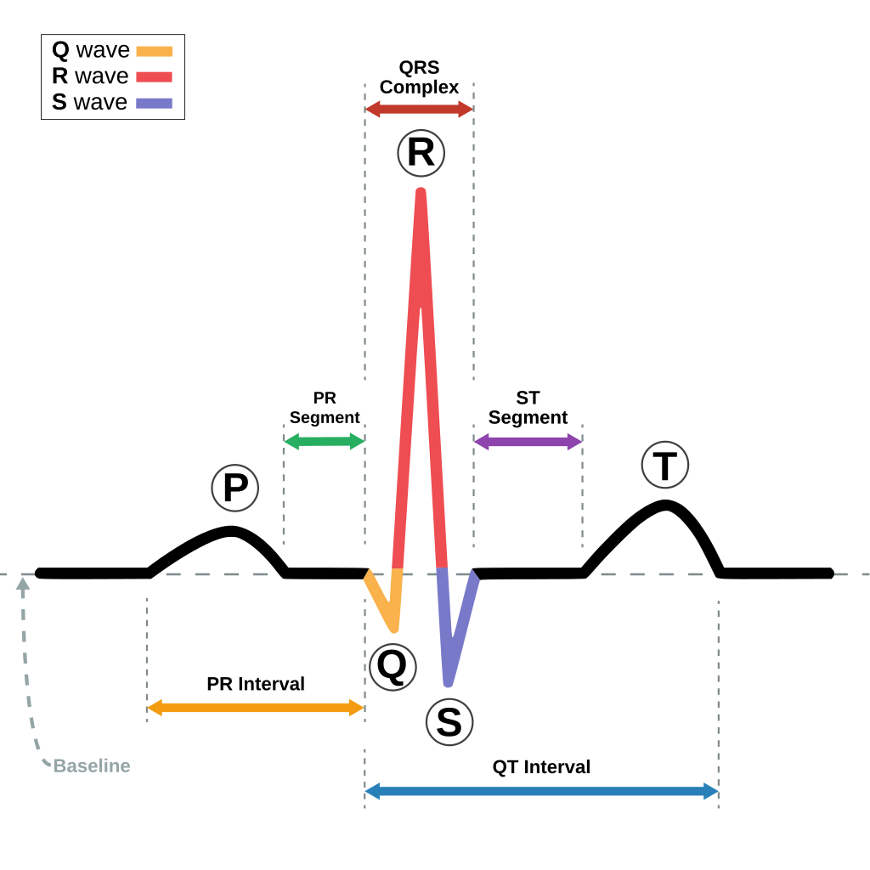

Slide 12
Heart Rate Calculation
Regular Rhythm:
Use 300 rule → 300 / number of large squares between R waves
Irregular Rhythm:
Count number of R waves in 10-sec strip × 6
Normal rate: 60–100 bpm
Bradycardia: < 60 bpm
Tachycardia: > 100 bpm

Slide 13
Rhythm Assessment
Is it regular or irregular?
Is there a P wave before every QRS?
Is the PR interval constant?
Clues to:
Sinus rhythm
Atrial fibrillation
Heart blocks

Slide 14
P Wave and PR Interval
P wave:
Upright in I, II, aVF; < 3 mm tall
Absent or abnormal → atrial issues
PR interval:
Normal: 0.12–0.20 sec (3–5 small boxes)
Prolonged = 1st degree AV block
Shortened → WPW or Lown-Ganong-Levine syndrome

Slide 15
QRS Complex
Duration: ≤ 0.10 sec (≤ 2.5 small boxes)
Widened QRS (>0.12s):
Bundle branch blocks
Ventricular rhythms
Morphology clues for MI, ventricular hypertrophy

Slide 16
Axis Determination
Lead I and aVF method
Normal axis: –30° to +90°
Left axis deviation (LAD): –30° to –90°
Right axis deviation (RAD): +90° to +180°
Quick quadrant method + common causes

Slide 17
ST Segment & T Wave
ST elevation = myocardial infarction
ST depression = ischemia, digoxin
T wave inversion = ischemia, strain
Tall T waves = hyperkalaemia
Evaluate leads with changes for localization

Slide 18
QT Interval
QT interval corrected for heart rate (QTc)
QTc normal:
Men: < 440 ms
Women: < 460 ms
Prolonged QT:
Risk of Torsades de Pointes
Caused by drugs, electrolyte issues, congenital

Slide 19
Common Dysrhythmias Overview
Dysrhythmias are classified as:
• Atrial
• Junctional
• Ventricular
Notes:
Set up following slides for details.

Slide 20
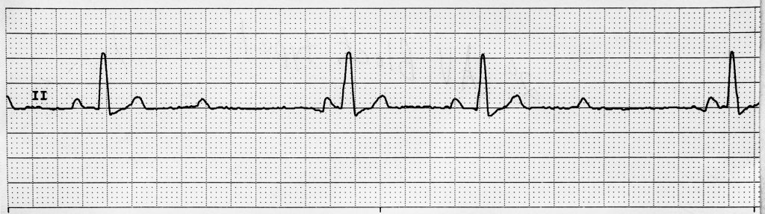
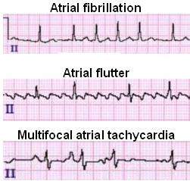
Atrial Dysrhythmias
• Atrial Fibrillation (AF): irregularly irregular, no P waves
• Atrial Flutter: sawtooth F waves
Notes:
Describe atrial rhythm features.

Slide 21
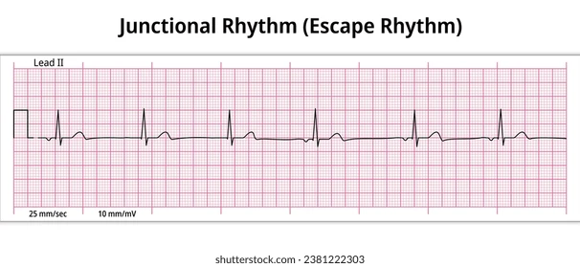
Junctional Dysrhythmias
• Origin near AV node
• Inverted or absent P waves
• Normal QRS
• Rate: 40–60 bpm
Notes:
Explain junctional escape and accelerated rhythms.

Slide 22
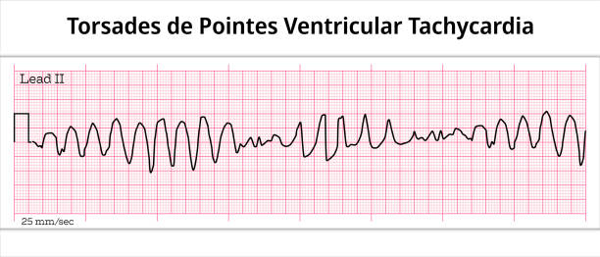
Ventricular Dysrhythmias
• PVC: premature, wide QRS
• VT: ≥3 PVCs in a row
• VF: chaotic, no pulse
Notes:
Highlight life-threatening ventricular rhythms.

Slide 23
Heart Blocks
• First-degree: prolonged PR
• Second-degree: dropped beats (Mobitz I or II)
• Third-degree: complete dissociation
Notes:
Discuss AV conduction abnormalities.

Slide 24
Clinical Significance
• Identify rhythm origin to guide treatment
• Bradyarrhythmias → pacing
• Tachyarrhythmias → antiarrhythmics or cardioversion
Notes:
Link ECG findings to management decisions.

Slide 25
Summary
• ECG interpretation requires a structured approach
• Recognize key rhythm patterns for diagnosis
• Practice and clinical correlation are essential
Notes:
Conclude and prepare for next module on MI interpretation.

Slide 26
ANY QUESTION
?

Slide 27
THANKS

