Slide 1
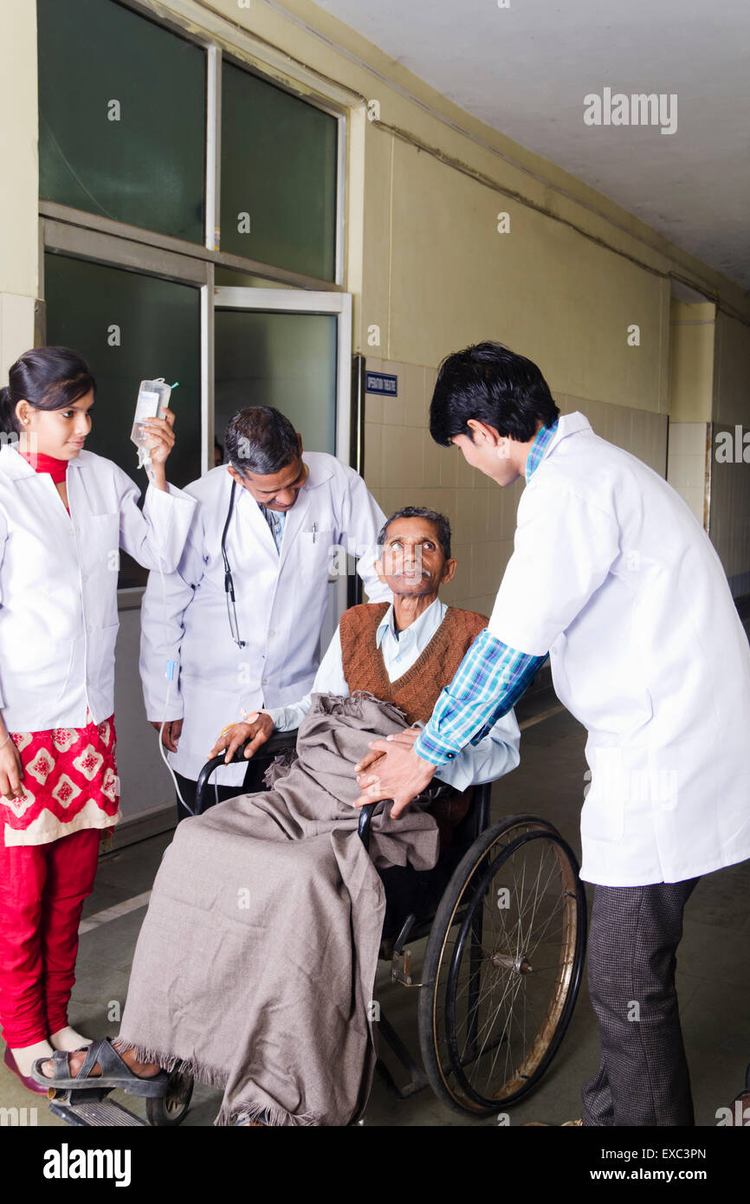
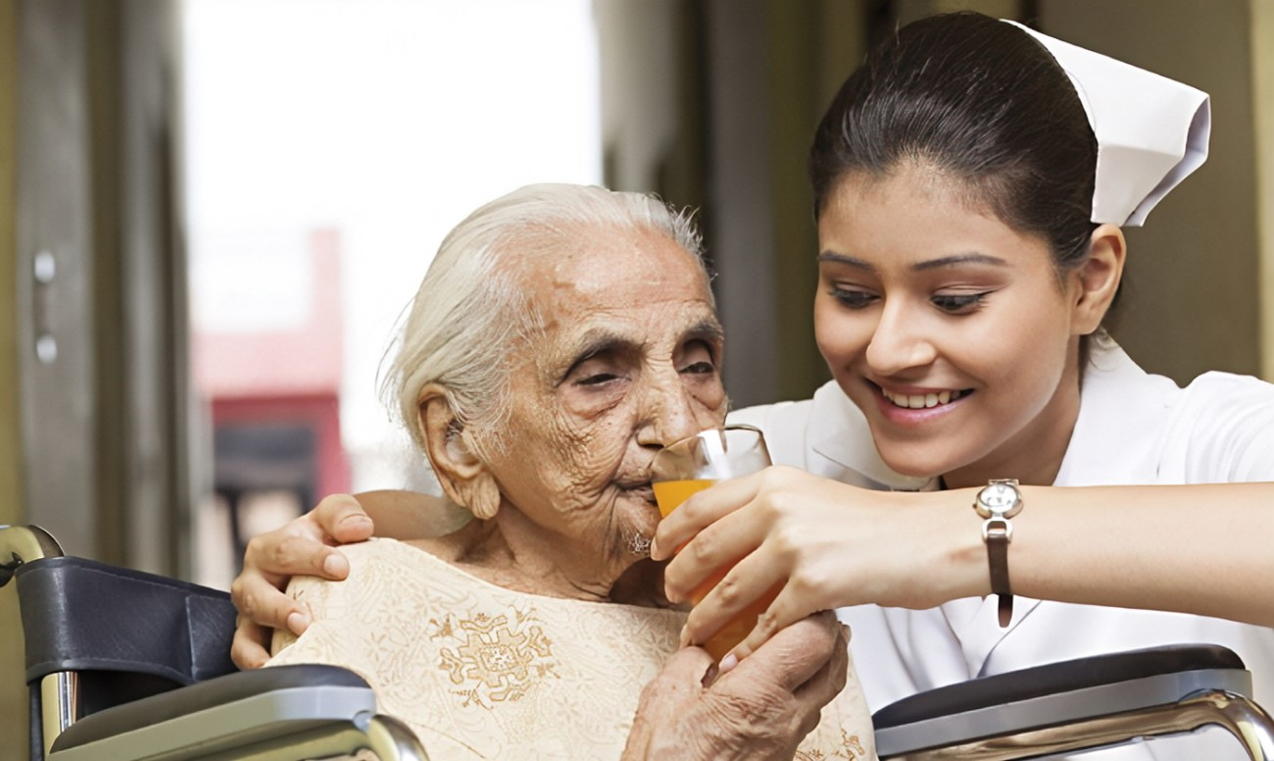
Emergency Care for - General Principles of Patient Stabilization & Safe Transfer
LESSON-10
By
JITENDER YADAV
INSP/PH

Slide 2
OBJECTIVES
• Identify life-threatening conditions in trauma and non-trauma
• Understand and demonstrate the priorities of resuscitation (A,B,C,D,E) in both trauma and non-trauma situation
• Review options for parenteral access in critically ill and injured patients
• Understand the goals and techniques of fluid resuscitation in trauma and non-trauma
• Understand the priorities of wound management in trauma patients
• Understand the importance of inter-facility communication for the safe transfer

Slide 3
INITIAL ASSESSMENT: FOR CRITICALLY ILL
• Vitals signs, initial evaluation, and examination reveal a critically ill patient
• Your goal: stabilization and safe transfer to a higher center for definitive specialty care
• Your priorities: A,B,C,D,E
⚬ A: Airway with oxygenation (Cervical Spine Stabilization in Trauma)
⚬ B: Breathing with adequate ventilation -bronchodilators, steroids, diuretics, ICD
⚬ C: Circulation with Hemorrhage control (H) - IV fluids, blood, Vasopressors ⚬
D: Disability (Neurological Status) ⚬ E: Exposure / Environment

Slide 4
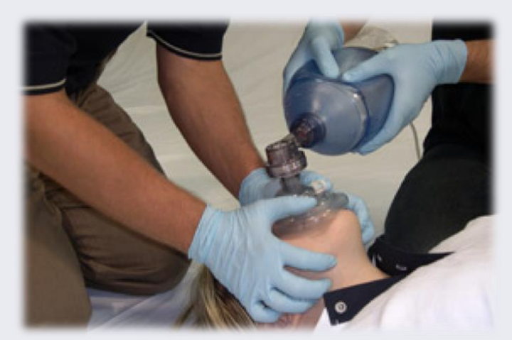
A: AIRWAY
• Patent airway is a high priority
• Unless patient can breathe, they will die
• Without O2 brain hypoxia sets in about 4 minutes
• Simple measures can be live saving
• Some may require advanced airway management (endotracheal intubation / Surgical Airway)

Slide 5
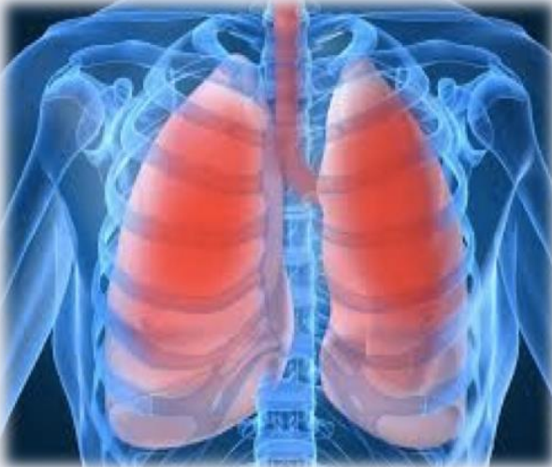
B: BREATHING
Assess breath sounds and respiratory rate
• Is the chest wall moving on both sides?
• Are breath sounds equal bilaterally?
• Are the breath sounds normal?
• Is there adequate air movement?
• Poor oxygenation and/or ventilation?
• Tachypnea?

Slide 6
Conditions with abnormal breathing and are immediately life threatening
• Trauma:
⚬ Tension Pneumothorax / Massive Haemothorax
⚬ Flail chest / Open chest wound
⚬ Circumferential chest burn
• Medical:
⚬ Acute severe asthma
⚬ Respiratory failure
⚬ Pulmonary oedema

Slide 7
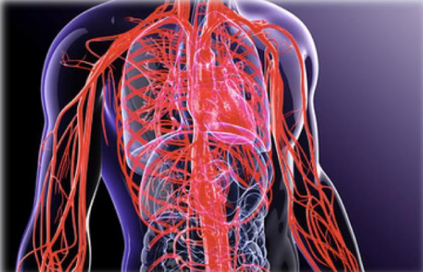
C: CIRCULATION
• Hypertension
⚬ Hypertensive Emergency
⚬ Hypertensive Urgency
• Hypotension
⚬ In small-framed individuals: low BP may be normal
⚬ Medical patients: Goal is to restore normal BP
⚬ Trauma patients:
￭ Goal is to restore perfusion to brain and other vital organs

Slide 8
CIRCULATION: HYPERTENSION (HTN)
Hypertensive Emergency (180/120 mmHg) with end-organ dysfunction
• Cardiac: CHF, angina • Cerebral: Altered mental status, stroke
• Renal: Decreased Urine output
• Pre-eclampsia
Must treat before transfer
Hypertensive Urgency
• No end-organ dysfunction
• Most such patients have HTN chronically for many years
Don’t reverse rapidly
• Cerebral autoregulation: brain has adjusted to high BP
• Rapid correction of BP can lead to stroke
• BP better left high for transfer and gradual treatment

Slide 9
HYPERTENSIVE EMERGENCY: TREATMENT
• SBP should be reduced gently, no more than ~ 20% in 24 hrs
• IV medications preferred for treatment
⚬ Labetalol 10 mg IV, repeat every 15 min to achieve target BP
⚬ Nitroglycerin IV/SL preferred for cardiac symptoms (CHF/MI)
⚬ Do not use sublingual nifedipine as response cannot be controlled
￭ May cause severe drop in BP and stroke
• E.g. Patient presents with cerebral infarction (stroke) and Systolic BP is 220 mmHg
⚬ Reduce SBP to 190 – 200 mmHg in 24 hours
⚬ Further reduction done gradually (days) to prevent worsening of stroke

Slide 10
CIRCULATION: HYPOTENSION
• What are the early indicators of shock?
⚬ Tachycardia ⚬ Increased capillary refill time
⚬ Narrowed pulse pressure (Systolic BP – Diastolic BP)
• What about low BP?
⚬ BP is not a good indicator in early shock (late indicator)
⚬ Early shock can exist with a normal BP
⚬ BP fall is very late/terminal finding in pediatric shock
Shock is easily reversible when it is early, not so easily when it is late: So address it early and aggressively

Slide 11
• IV Fluids: what to use?
⚬ Ringer Lactate or Normal Saline (isotonic)
⚬ Dextran or Haemaccel (Plasma expanders)
⚬ Blood (in trauma)
• Never use Dextrose based IV Fluids(IVF)
⚬ D5W or D5NS
⚬ They are hypotonic and worsen hypotension
• Vasopressors:
⚬ Use if not responding to IVF
⚬ To be used only after adequate infusion of IVF

Slide 12
LOW BLOOD PRESSURE
(<90 Systolic adult)
• Critically ill / injured patients need fluid/blood resuscitation
• First secure Intravenous Line
• 2 large bore cannulas: 16 G (gray), 18 G(green)
⚬ Antecubital fossa preferred
• Intraosseous access: If fail to get IV access

Slide 13
FLUID RESUSCITATION: MEDICAL (NON-TRAUMA)
Goal: To restore circulating volume and tissue perfusion Fluids like Normal Saline and Ringer lactate or colloids
Adults:
• 1 –2+ liters rapid IV bolus normal saline or ringer lactate
• If no response 500 – 1000+ cc colloid fluids can be used
Vasopressors: Only after infusing 30 ml/kg in 3 hours
• After 2-3 liters of NS or RL and if still not responding
• Norepinephrine, dopamine or adrenaline (Needs monitoring) • In heart failure use fluid cautiously: may require vasopressors early

Slide 14
In Children:
• Signs of shock delayed until hypovolemia is severe
• It may be a pre-terminal event for a child
• Normal saline: 20 cc/kg IV bolus
⚬ Reassess and repeat as necessary
• Colloid: 10 cc/kg IV bolus,
⚬ Reassess and repeat as necessary
• Vasopressors: if no response to IV boluses (30 ml/kg in 3 hours)
⚬ Norepinephrine, dopamine or adrenaline

Slide 15
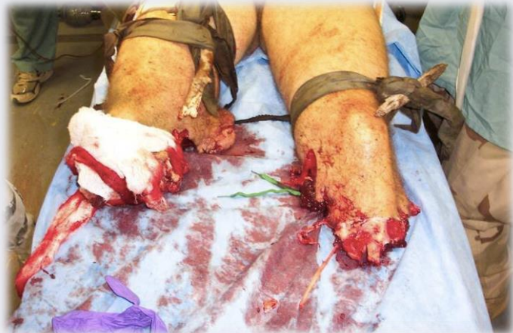
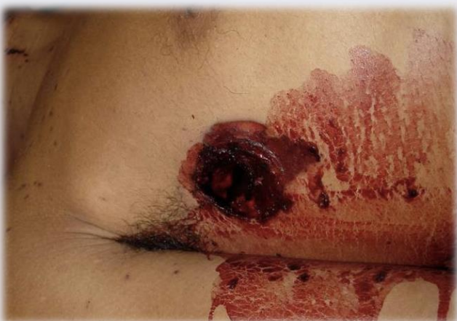
(H): CONTROL CATASTROPHIC LIFETHREATENING HEMORRHAGE
Controlled with Compression: extremity / compressible
Uncontrolled with compression: torso/trunk / incompressible
(H): To be addressed in few seconds to few minutes
Only a surgeon can control internal hemorrhage

Slide 16
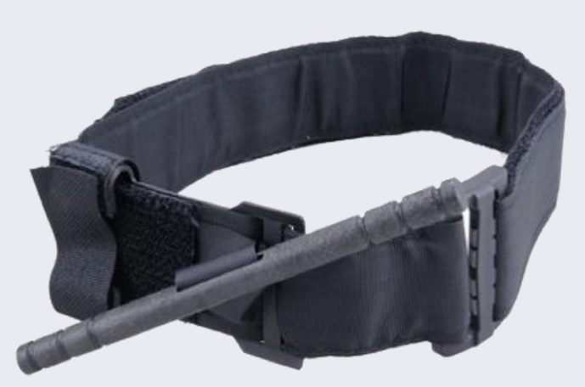
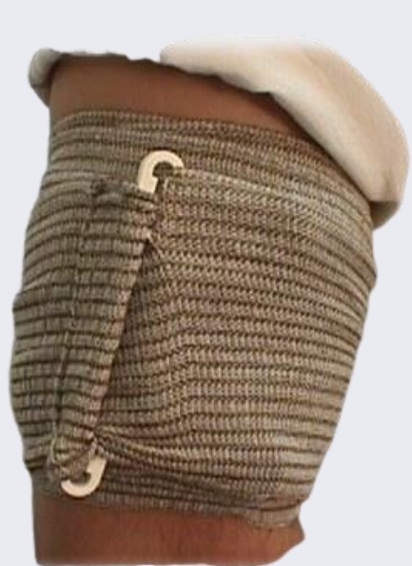
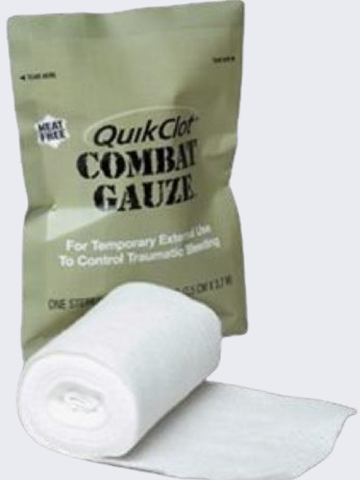
(H): CONTROL MASSIVE HEMORRHAGE
• Direct pressure
• Pressure dressing
• Tourniquet
• Wound packing

Slide 17
HEMORRHAGE
• Traumatic shock
⚬ Goal: To restore perfusion of vital organs
⚬ IVF: Normal saline or Ringer’s lactate 1Litre bolus
⚬ Blood products are ideal and preferred
• IV Fluids, if given in excess cause
⚬ Dilution of clotting factors
⚬ Hypothermia (IVF are cold) → coagulopathy
⚬ “Pops the clot” → Increases bleeding and mortality
• What is our Goal? To restore perfusion: NOT normal BP
⚬ Perfusion to vital organs adequate at SBP 90-100
• Some degree of hypotension allowed: Permissive Hypotension

Slide 18
PERMISSIVE HYPOTENSION IN UNCONTROLLABLE HEMORRHAGE
• Radial pulse: present (SBP >90 mmHg)
⚬ No IV fluid bolus needed
⚬ Place IV line with fluid only at maintenance rate
• Radial Pulse: absent (SBP < 90 mmHg)
⚬ 500-1000 cc Normal saline / RL
⚬ Only administer enough IV fluid/blood to restore the radial pulse (SBP >90)
Transfer to a surgeon as soon as possible Only a surgeon can definitively stop internal bleeding

Slide 19
PERMISSIVE HYPOTENSION: EXCEPTIONS
Head injury
• Brain swells inside hard skull Increased intracranial pressure (ICP)
• Head injuries require normal BP to perfuse injured and swollen brain
• Must maintain cerebral perfusion pressure
Administer enough IV fluids / blood to restore BP to 110 -120 Paediatrics:
• Target a BP that is normal for that age
• Paediatric normal SBP: (2 X age) + 70
• Use 20 cc/kg IV fluid boluses and repeat until BP is normal for age

Slide 20
SIGNS OF ADEQUATE FLUID RESUSCITATION
• Patient looks better
• Improved BP
• Widened pulse pressure
• Decreased pulse rate
• Decreased capillary refill time
• Resolved diaphoresis
• Improved mental status
• Improved urine output
Your patient is now ready for safe transfer!

Slide 21
WOUND MANAGEMENT
• Lacerations and burns can be impressive and distracting ⚬ But they are generally NOT life threatening ⚬ Remember: the priorities are A, B, C, D, E
• Once hemorrhage has been controlled in case of exsanguinating / severe bleeding ⚬ external wounds should simply be covered and dressed
• Wounds and burns should only be addressed AFTER patient is stabilized!
⚬ Dressing, suturing, debriding, etc.
⚬ Wound care can safely be delayed until patient transferred to the next hospital

Slide 22
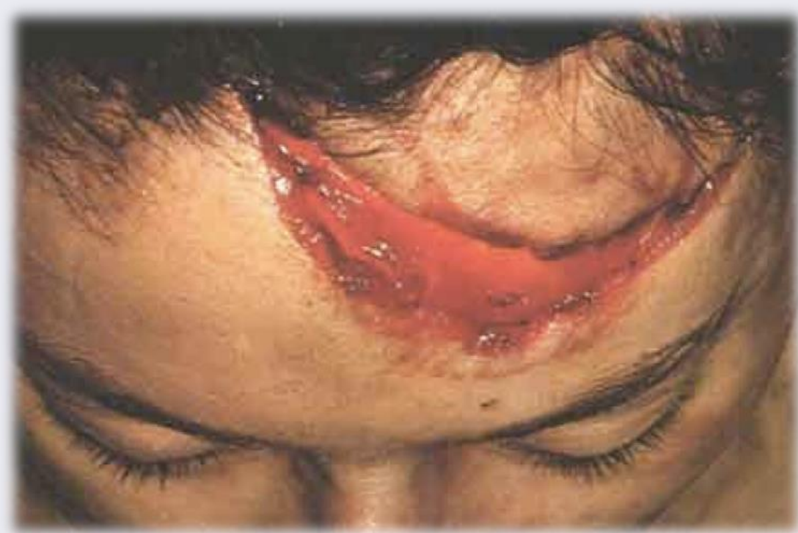
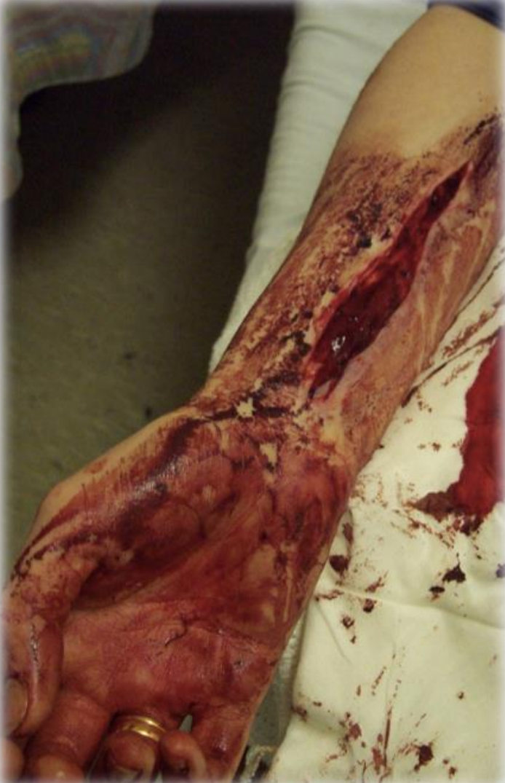
WOUND MANAGEMENT
• Will these kill your patient?

Slide 23
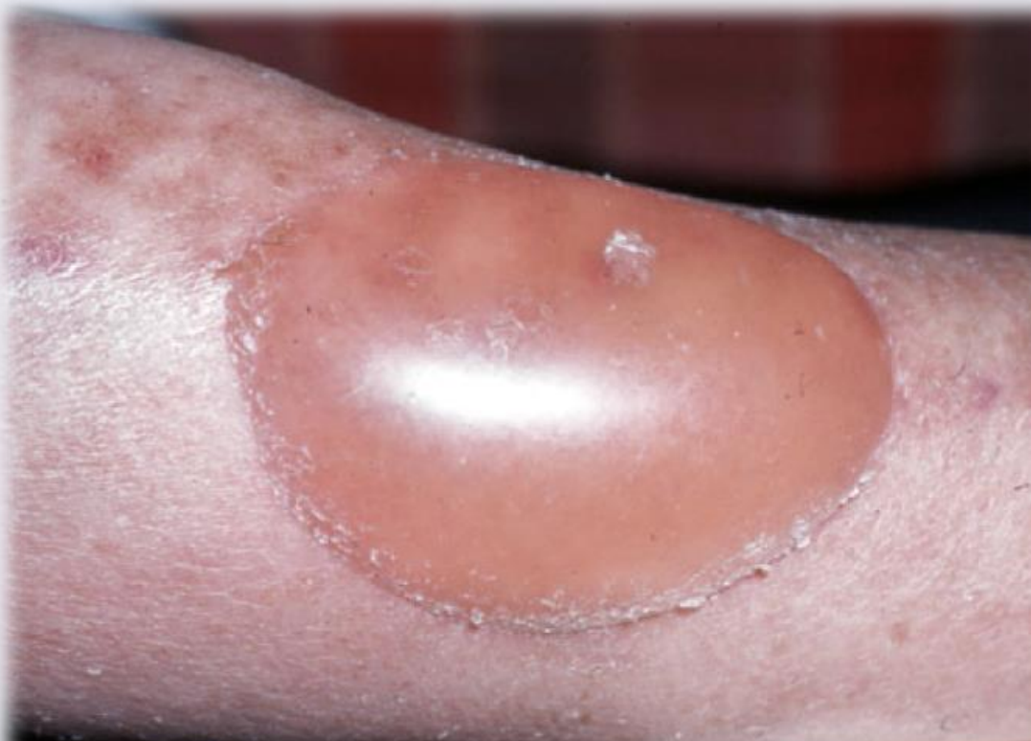
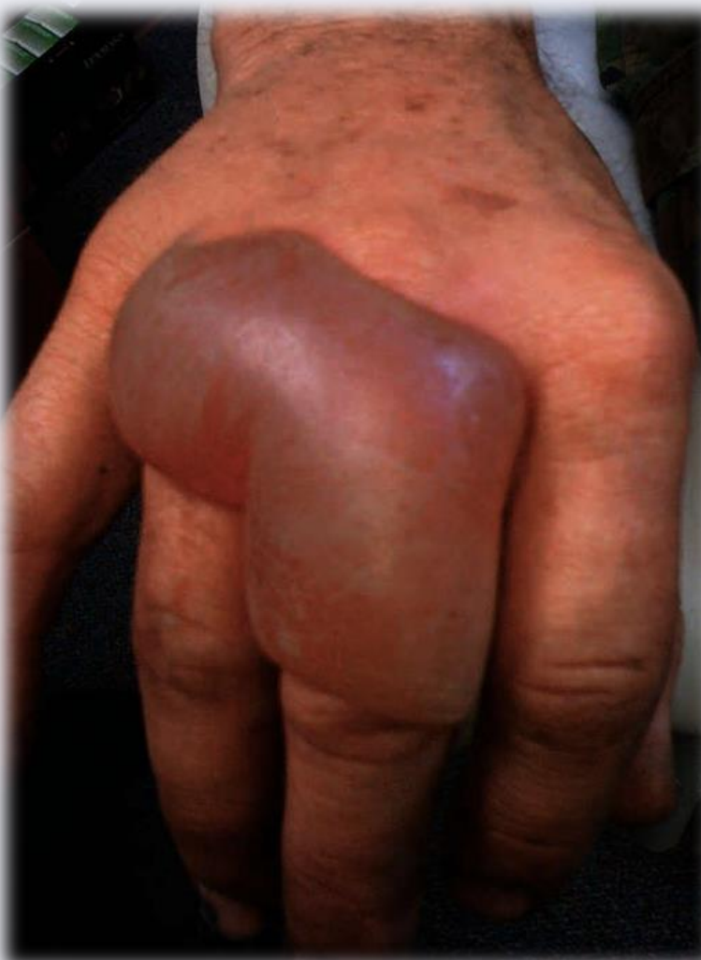
WOUND MANAGEMENT
• Will these kill your patient?

Slide 24
WOUND MANAGEMENT IN CRITICAL ILLNESS
• Resuscitate patient (A,B,C,D,E)
• Control Life threatening Haemorrhage (H) initially, if any
• Cover wound with gauze
• To prevent distraction and protect wound
• Initiate transfer
⚬ If you have time, you may then address wounds
￭ Cleaning, debriding, suturing, dressing
⚬ Dirty or contaminated wounds should NOT be sutured
￭ Simply wash and dress with dry gauze
￭ Suturing contaminated wounds increases infection rate

Slide 25
If septic shock suspected / wounds with high risk of infection
⚬ Give first dose IV antibiotics prior to transfer
⚬ Early antibiotics in sepsis improve outcome
• Broad spectrum antibiotics are preferred: 3rdGeneration Cephalosporins
⚬ Ceftriaxone
⚬ Cefuroxime
⚬ Metronidazole in combination (anaerobic coverage)
• For open fractures:
⚬ Cefazolin A

Slide 26

Communicate with receiving doctor
• Contact the receiving physician directly prior to transfer
• Review: using ISBAR tool
⚬ The patient’s problem and presenting Vital Signs
⚬ The results of your resuscitation and treatment
⚬ The patient’s current status
⚬ Any recommendations from receiving physician for further treatment prior to transfer
⚬ Estimated time of arrival at next facility
• Good communication facilitates care for a critical patient

Slide 27

YOUR REFERRAL COMMUNICATION INCLUDES
• Condition of patient on arrival
• What you diagnosed
• What interventions you performed
• Condition of patient at time of referral
• Why is the patient being referred
• Recommendations:
⚬ From the receiving doctor
⚬ To the paramedic accompanying the patient
⚬ Whom to contact while in transit

Slide 28
COMMUNICATION USING ‘ISBAR
Mr. Babu is brought to the Primary Health Centre with complaints
of chest pain and shortness of breath. After initial management, he needs to be referred to a higher Centre for further treatment and management. You are a clinician calling the tertiary hospital and handing over to a specialist
I -IDENTIFY: Introduce yourself, the patient and identify receiving clinician by confirming names and designation with time and date of conversation.
S Current SITUATION: Describe the situation or concern of your patient. Mr. Babu is a 48-year-old gentleman, who came to the health centre with complaints of chest pain on the left side since today at 10AM. He also complained of shortness of breath. His saturation was 86% in room air and BP was 90/60 mm of Hg. ECG showed inferior ischaemia

Slide 29
B BACKGROUND: Babu is a known hypertensive since the past 5 years
but is on irregular medication and follow up. He has been a beedi
smoker for over 20 years. He has had previous hospital admission due to uncontrolled blood pressure, details of which are not available. He attended with his wife and son who are being sent with him to receiving hospital.
A ASSESSMENT: Airway was patent and patient conscious complaining of central chest pain. Breathing was fast with clear lung fields at RR of 22 per minute, Saturation was 86 % on room air which improved to 98% on 5 litres of O2 through a venti mask. Circulation was unstable with tachycardia of 112 beats per minute and BP of 90/60 mm of Hg. IV access achieved and maintenance dose of Ringer Lactate started. IV Morphine 8 mg was administered for pain along with oral stat doses of Aspirin 300 mg, Clopidogrel 325 mg and Atorvastatin 80 mg. Random Blood Sugar is 106 mg/dL Patient is currently pain free and family has been informed the need for transfer for further definitive care.

Slide 30
R Review / Recommendation: Kindly re-assess the pain, repeat ECG, do routine bloods, chest Xray and keep an eye on the BP. This is a good time to ask for any suggestions and recommendation from the receiving clinician for further treatment prior to transfer. Mention estimated time of arrival to the receiving hospital and details including contact number of the accompanying healthcare/paramedic staff. Attach a written/printed referral letter with all the necessary details to be taken with the patient. You can also forward a copy through electronic means like email/messenger.

Slide 31
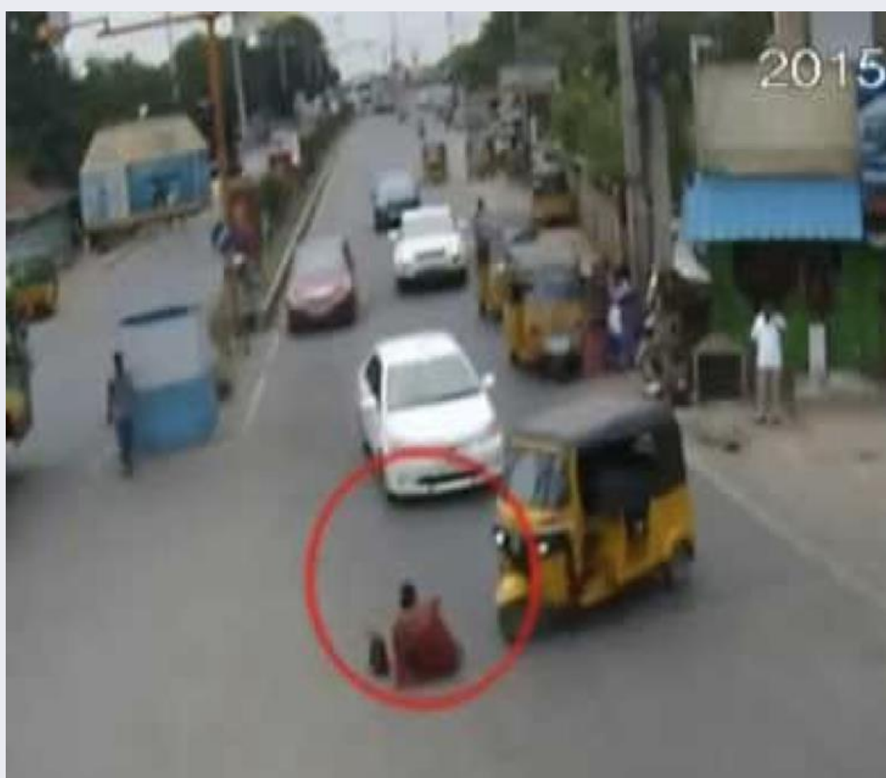
CASE PRESENTATION
• 27 year old female struck by car while walking
• Arrives 20 minutes after accident
• Vital Signs on arrival:
⚬ BP: 90/40
⚬ Pulse: 130
⚬ Respiratory rate: 28
⚬ Temperature: 37 degrees
⚬ Pulse oximeter: 85%
⚬ Mental status: responds to pain only
⚬ Skin color/temperature: pale/cool
⚬ Pulse quality: weak, thready
⚬ Capillary refill: 4 seconds

Slide 32

WHAT IS THIS PATIENT’S STATUS?
• Airway
⚬ Responds to pain only
• From the Airway standpoint:
⚬ Is this patient critical?
⚬ Is this patient unstable?
⚬ Does he need immediate management of the airway to prevent complications?
⚬ Why?

Slide 33

• Breathing
⚬ Respiratory rate: 28
⚬ Pulse oximeter: 85%
• From the Breathing standpoint:
⚬ Is this patient critical?
⚬ Is this patient unstable?
⚬ Does he need immediate management of the breathing to prevent complications?
⚬ Why?

Slide 34
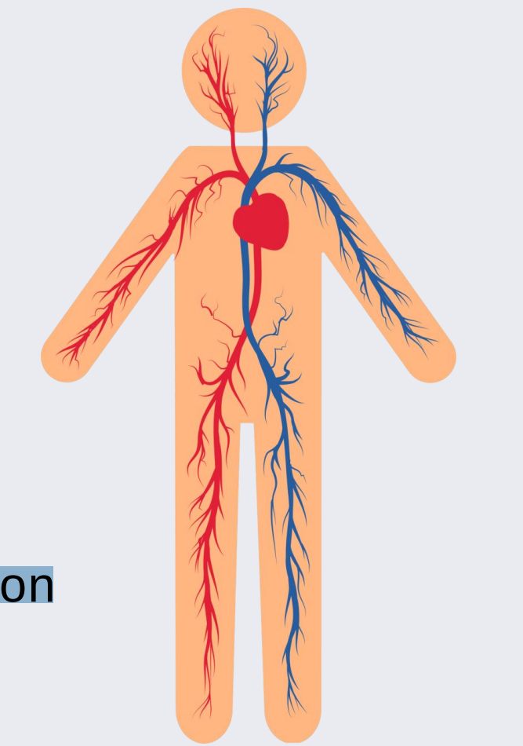
• Circulation
⚬ BP: 90/40
⚬ Pulse: 130
⚬ Diaphoretic
⚬ Slow capillary refill
• From the Circulation standpoint:
⚬ Is this patient critical?
⚬ Is this patient unstable?
⚬ Does he need immediate management of the circulation to prevent complications?
⚬ Why?

Slide 35
WHAT IS THIS PATIENT’S STATUS?
• The patient shows signs of shock: poor perfusion
• Shock in trauma = hemorrhagic shock
• Treatment:
⚬ Stop life threatening hemorrhage, if any
⚬ Secure airway
⚬ Assist breathing
• IV fluids / blood administration
⚬ Splint obvious fractures
• Transfer patient to a surgeon: in better condition than on arrival!
⚬ Use ISBAR Technique

Slide 36

SUMMARY
• Vital Signs are vital
• Abnormal vital signs must be addressed and improved, if possible
• Adjunct vital signs add information
• Focus on the problems, not on causes
• ABCDE evaluation and stabilization is vital

Slide 37
• Aggressive resuscitation prior to transfer is critical for patients
to survive to the next level of care
• Unstable cases must be addressed and improved prior to transfer
• Priorities in resuscitation: ABCDE
• Permissive hypotension in patient with incompressible torso wound
• Exceptions: head injuries and children

Slide 38
• Wound care should be delayed until resuscitation
• Antibiotics should be administered to patients with sepsis prior to transfer
• Communicate directly with receiving physician prior to transfer
⚬ May be helpful to you in selecting the proper management prior to transfer

Slide 39
Thank You

