Slide 1
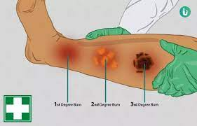
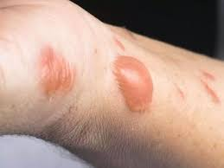
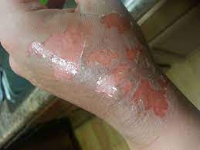
BURNS TREATMENT AND MANAGEMENT
LESSON-10
BY
JITENDER YADAV
INSP/PH

Slide 2
OBJECTIVES
Upon completion of this lesson, you will be able to:
Match the signs and symptoms for each of the three types of burns according to their depth.
Apply the “Rule of Nines” to determine the Total Body Surface Area (TBSA) burnt on a patient when given a specific part of the body.
List three steps for pre-hospital treatment of chemical burns.
List three steps for pre-hospital treatment of electrical burns.
Cont…

Slide 3
CAUSES OF BURNS
Injuries caused by exposure to excessive heat from thermal ,chemical, electrical or radiation.
Thermal: Heat (fire, vapour and hot objects), and cold (freezing and frozen objects).
Chemical: Includes several caustics such as acids and alkalis.
Electrical: Electricity, i.e., House current, lightning.
Radiation: Ultraviolet rays (including sunlight) and radioactive agents.

Slide 4
CLASSIFICATION OF BURNS
Classification by Depth.
Extent of Body Surface Burned.
BURN CLASSIFICATIONS
(BY DEPTH)
Superficial
Partial thickness
Full thickness

Slide 5
Superficial (first-degree) burns:
These involve only the top layer of skin (epidermis).There is a reddening of the skin and some pain and swelling of the area.

Slide 6
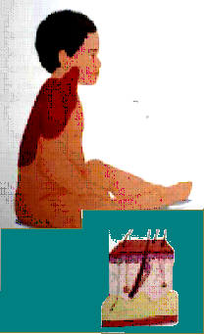
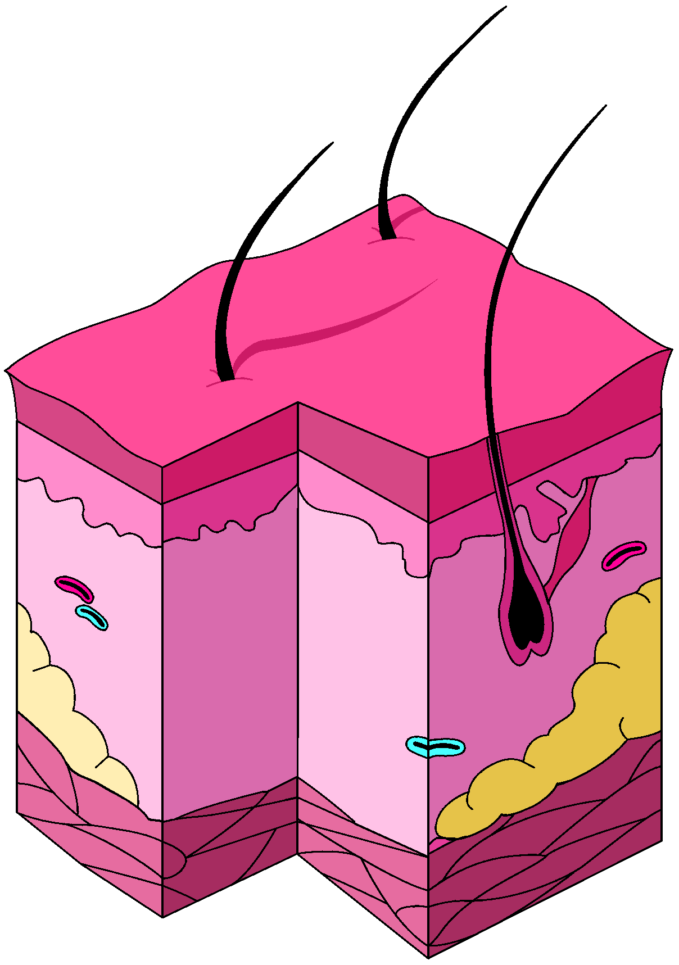
CLASSIFICATION BY DEPTH
SUPERFICIAL(FIRST-DEGREE)
Red skin pain at site
Epidermis

Slide 7
2) Partial thickness (second-degree) burns:
The superficial layer of skin is burned through and the second layer is damaged. This type of burn is painful. There will be swelling and blistering, skin may appear white or red, may be moist and mottled.

Slide 8
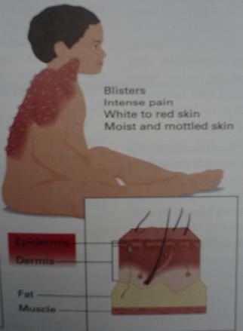
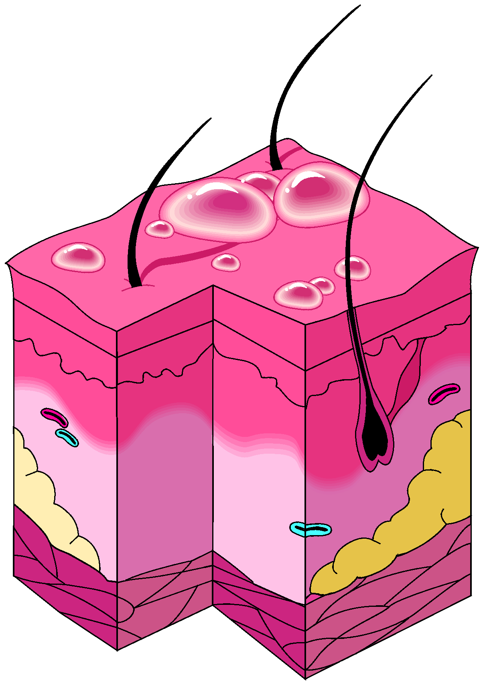
CLASSIFICATION BY DEPTH
PARTIAL THICKNESS
(SECOND DEGREE)
Blisters
intense pain
white to red skin
moist and mottled skin
Epidermis
dermis

Slide 9
3) Full thickness (third-degree) burns:
All the layers of the skin are burnt, including the fatty layer, muscles, blood vessels and nerves, and in some cases the bone.

Slide 10
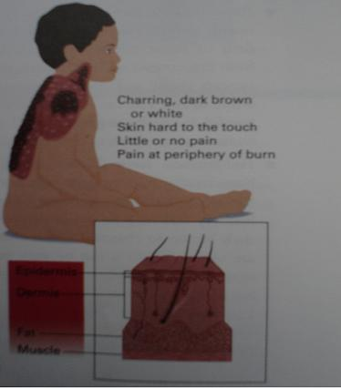
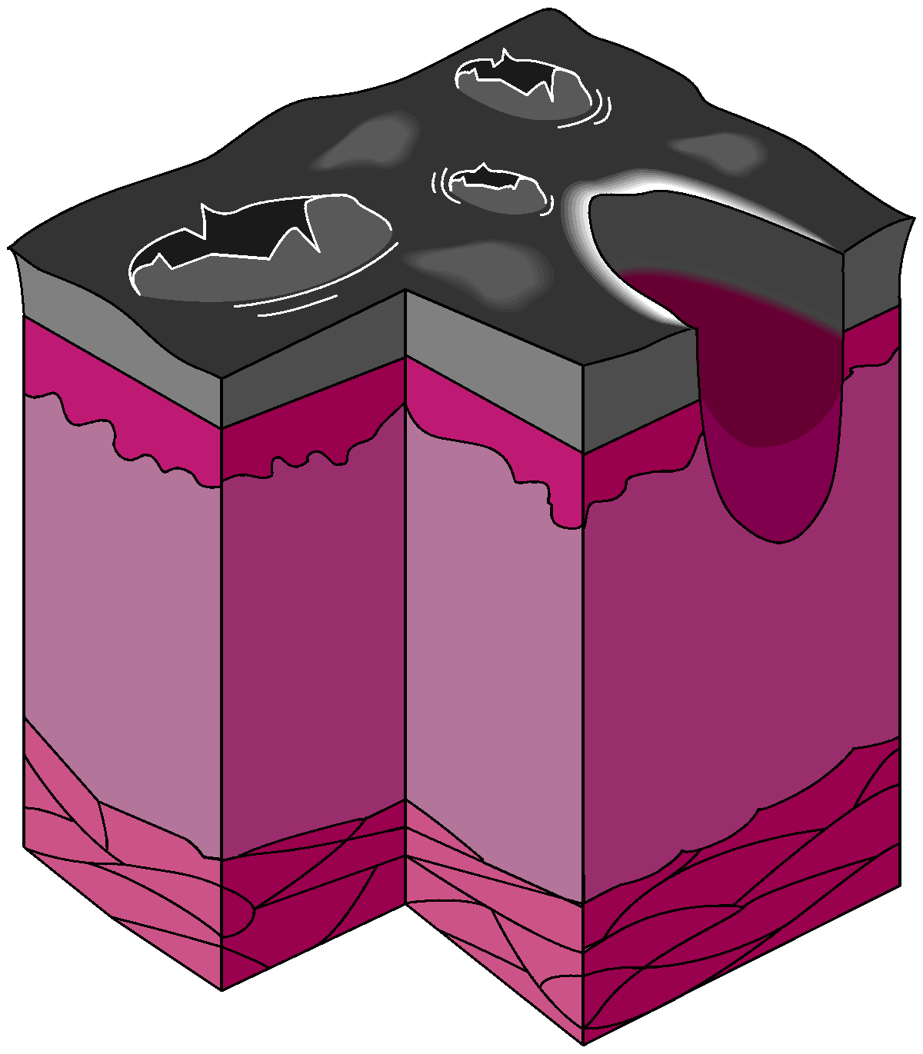
CLASSIFICATION BY DEPTH
FULL THICKNESS
(THIRD DEGREE)
Charring dark brown
or white skin hard to
touch little or no pain
Pain at periphery of burn
Epidermis
Dermis
Fat
Muscle

Slide 11
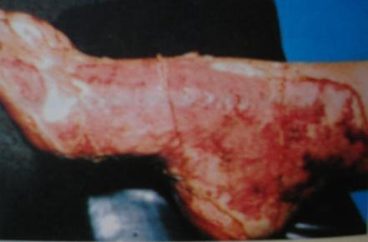
FULL THICK NESS BURN

Slide 12
Rule of Nines
(% Body Surface Area)
Adult Child
Head and neck 09% 18%
Upper extremities 09% each 09% each
Anterior Trunk 18% 18%
Posterior Trunk 18% 18%
Genital 01% incl. in ant. trunk
Lower extremities 18% each 14% each
BSA 100% 100%

Slide 13
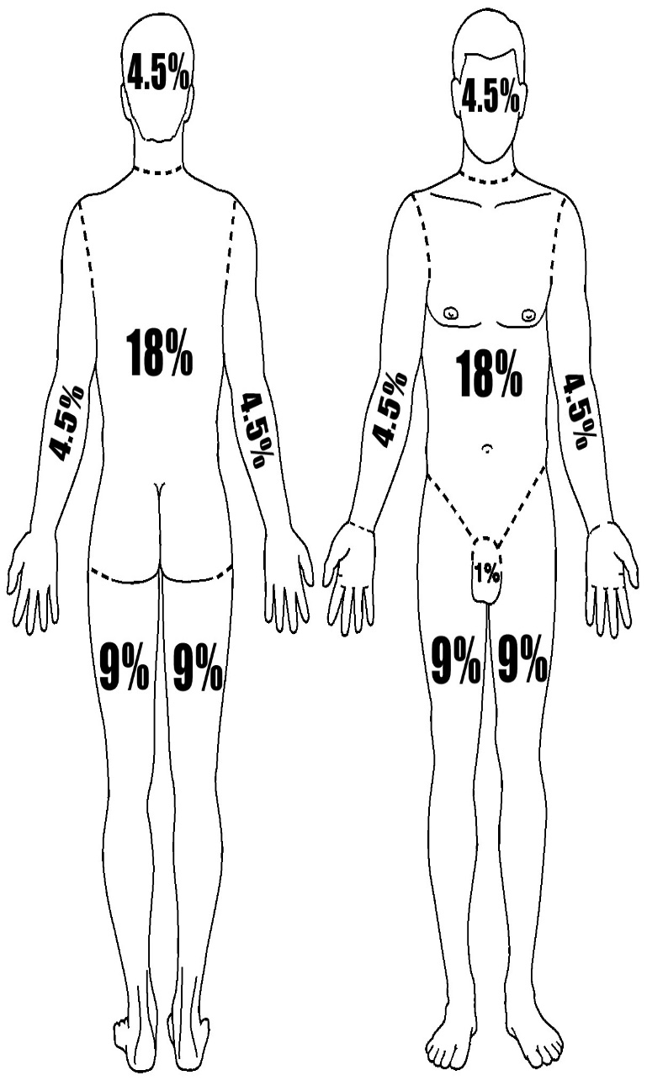
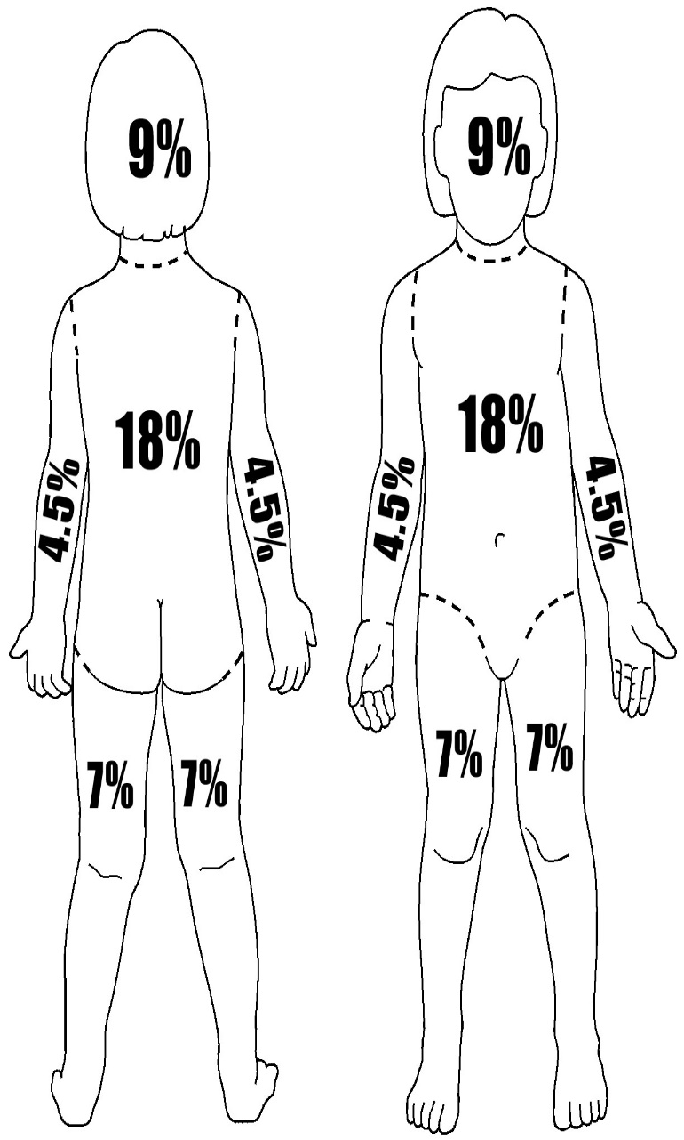
RULE OF NINES
ADULT
CHILD

Slide 14
BURN SEVERITY
The two primary factors considered in rating burn severity
  Body surface area (BSA)
  location of burn.
Burn severity can be rated as follows:
  Minor Burns
  Moderate Burns
  Critical Burns

Slide 15
BURN SEVERITY
 | Minor burns | Moderate burns | Critical burns*
Superficial burns | < 50% | > 50% | -
Partial thickness | 2% - 15% | 15 - 30% | > 30%
Full thickness | < 2% | 2% - 10% | > 10%

Slide 16
ADDITIONAL CONSIDERATIONS
Source of the burn:
–Electrical burns can cause small surface injury while causing severe internal damage.
– Chemical burns as chemicals may remain on the skin and continue burning for an extended period and/or enter the blood stream.
– Radiation burns are usually from nuclear sources.

Slide 17
Body regions burned
Face.
Hands and feet.
Groin, genitalia, buttocks and inner thighs:
Burns around joints.
Other complicating factors:
Patient’s age
Patient’s pre-existing illnesses.

Slide 18
MANAGEMENT OF BURN INJURIES
Stop the burning process.
Remove all smoldering clothing.
Initial assessment.
Oxygen & ventilation.
Determine the severity of burns.
Cover the wound with sterile dressing.
Keep the patient warm & treat for shock.
If your patient’s breathing is inadequate, provide ventilation with supplemental oxygen. Administer oxygen 10-15 L/min.

Slide 19
Determine the severity of burns, using the rule of nines. Any burn involving more than 15% in adults or 10% BSA in children will need fluid replacement. Establish IV access using a wide bore venflon and start Ringer Lactate and maintenance Dextrose Normal Saline. The general formula is total percentage of body surface area burnt x weight in kg x 4 = volume in ml; Half this volume is given in first 8 hours and second half in next 16 hours.
Cover the burns. Use dry sterile dressings or a disposable sterile burn sheet. Do not use grease or fat, ointment, lotion, antiseptic, or ice on the burns. Do not break any blisters. If a burn involves the eye, be sure to cover both eyes. Fingers with second- or third-degree burns require dressing each finger individually.

Slide 20
Keep the patient warm and treat for shock.
Give Inj. Morphine or Inj. Fortwin 1 amp slow IV if available but be careful about respiratory depression.
If burns are moderate or severe and burnt area is more than 5%, refer the patient for hospital care. In minor burns, also start broad spectrum antibiotic like Cap. Ampiclox 500mg 6 hrly, multivitamin with zinc, and anti-inflammatory like T. combi flam (tds) or with serrati peptidase combination

Slide 21
PRE-HOSPITAL TREATMENT FOR CHEMICAL BURNS
Rapid treatment is essential. Below are general guidelines only.
Use universal precautions
Brush off dry chemicals, such as lime powder, before flushing with water.
Rinse the area with water for at least 20 minutes or more. Remove and set aside clothes and jewellery while the patient is being washed off.
Apply a sterile dressing to the affected area and if minor, start oral antibiotic coverage with anti-inflammatory drugs. If major, refer patient to hospital.
Treat for shock.

Slide 22
!!! CAUTION:
If patient is contaminated, wash off the person from a distance to avoid exposing yourself to the chemicals.
MANAGEMENT OF CHEMICAL BURNS TO THE EYES
Rinse the eyes immediately with water for at least 20 minutes. Maintain a flow of water on the affected eye from a faucet (low pressure), bottle, glass or other source. Keep the patient’s eyelid(s) open.
Apply antibiotic ointment or antibiotic drops and refer patient to hospital/specialist care.

Slide 23
MANAGEMENT OF ELECTRICAL BURNS
The more serious problems related to electrical burns are respiratory and/or cardiac arrest, damage to the nervous system and injury to internal organs.
USE UNIVERSAL PRECAUTIONS.
Prolonged CPR should be performed on electrical injury victims as they can remain viable for a longer period than with other types of injuries.
Care for electrical burns is the same as any other type of burn, also using the following specific guidelines for electrical burns.

Slide 24
USE UNIVERSAL PRECAUTIONS.
Perform initial assessment. The electrical current passing through the body often causes cardiac arrest. Partial airway obstruction can also be present due to inflammation of airway tissues.
Evaluate burns and look for at least two burn areas: one will be where the patient made contact with the energy source (often the hand). The other will be where the patient made contact to ground, where the electricity exited the body (often a foot).
Apply a dry, sterile dressing to the burns.
Treat for shock including oxygen administration.

Slide 25
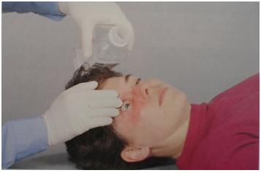
PRE-HOSPITAL TREATMENT FOR CHEMICAL BURN TO EYE
FLUSHING AND RINSING THE EYES IN CHEMICAL BURNS

Slide 26
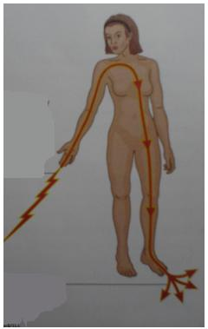
ELECTRICAL BURNS
Respiratory arrest
Cardiac arrest
Electric current severely damages tissue at the point of entry, then proceeds along nerves and blood vessels leaving behind a core of tissue death.
Entrance
Exit point

Slide 27
Prolonged CPR should be performed on electrical injury victims as they can remain viable for a longer period than with other types of injuries.

Slide 28
PRE HOSPITAL TREATMENT FOR ELECTRIC BURN
Perform initial assessment.
Evaluate burns and look for at least two burn areas:
Apply a dry, sterile dressing to the burns.
Treat for shock.

Slide 29
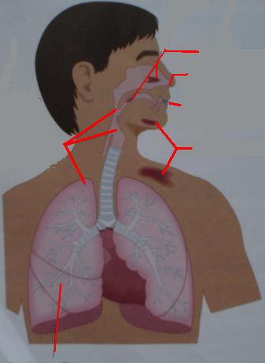
SIGNS AND SYMPTOMS OF INHALATION INJURY
Singed nasal hairs.
Facial and other burns.
Shortness of breath, cough, hoarseness, sooty sputum.
Sooty or smoky smell on the breath.
Respiratory distress, noisy breathing, restricted chest movement.
Cyanosis.
1
4
6
3
2
5

Slide 30
PRE-HOSPITAL TREATMENT FOR INHALATION INJURY
Administer oxygen if needed.
Monitor patient’s airway and breathing.
Be prepared to ventilate.

Slide 31
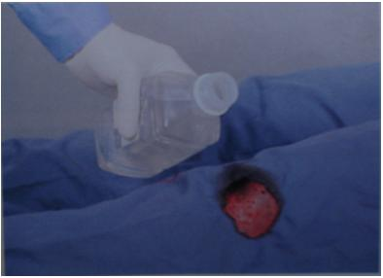

Slide 32
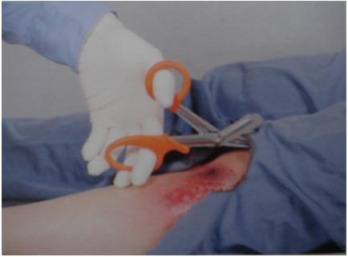

Slide 33
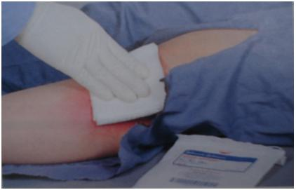

Slide 34
ANY QUESTION
?

Slide 35
THANKS

