Slide 1


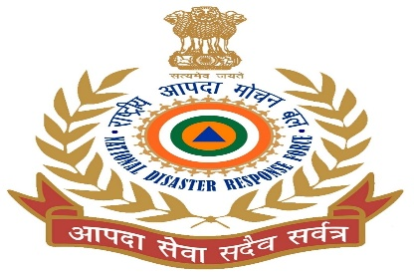


MEDICAL FIRST RESPONDER
OXYGEN THERAPY
PEER | CSSR | INDIA
PPT 2 -

Slide 2

OBJECTIVE:
Five situations in which the use of oxygen is needed.
Describe an oropharyngeal airway, a CPR mask, a bag valve mask
Upon completing this lesson, you will become familiar with :-

Slide 3
OBJECTIVE:
Four key pieces of equipment used in an oxygen delivery system
Humidifier, mechanical suction and suction equipment
Upon completing this lesson, you will become familiar with :-

Slide 4
IMPORTANCE
Human can survive without food for 1 to 2 weeks, without water 1 to 2 days.
But can not survive without oxygen even for a few hours. Brain cell starts dying after 8 to 10 min.

Slide 5
PRESENCE OF OXYGEN
Composition of atmospheric air 78/21/01
Oxygen used in medical needs is colorless and non-combustible.
100% O2 is use in the form of medicine.

Slide 6
WHEN OXYGEN NEEDED
HEART FAILURE/ HEART ATTACK
BLEEDING
POISONING
RESPIRATORY DEFICIENCY
COMPLICATIONS IN CHILD BIRTH

Slide 7
HAZARDS ASSOCIATED WITH OXYGEN USE
FIRE:
Avoid smoking or use of flame near oxygen cylinder.O2 is not combustible, but it does increase the intensity of a fire.
EXPLOSION:
Avoid use of oil/grease around the cylinder.
VALVE DAMAGE :
Dropping of cylinder can make it a projectile path.

Slide 8
OXYGEN DELIVERY SYSTEM
Oxygen cylinder with valve
Low pressure regulator
Flow meter
Appropriate oxygen delivery device

Slide 9
OXYGEN CYLINDER WITH VALVE
Oxygen cylinder used in field is made of seamless(without joint) steel or light weight alloy and filled with pressurized oxygen. It is found in green, grey or black colour combination.
It should be inspected daily and pressure tested annually due to the high pressure (2000-2200psi).

Slide 10
OXYGEN CYLINDER WITH VALVE
After use the cylinder note down the present pressure(psi) on the cylinder.
Valve :
It controls the flow of oxygen and turn the bottle on or off. A typical valve may not work in a different type of cylinder.

Slide 11
MOST COMMON CYLINDER TYPES
All foreign Cylinder D - 350 liters
Cylinder Cylinder E - 625 liters
Cylinder M - 3,000 liters

Slide 12
IN INDIAN SCENARIO
Black colour with white neck cylinders are used in Hospital . Having capacity 100 ltrs, 320 ltrs, 600 ltrs and 720 ltrs.
In present scenario some hospitals are using oxygen pipelines with multiple meters to treat the patients.

Slide 13
LOW PRESSURE REGULATOR AND FLOW METER
Regulator reduces the high pressure from (2000 psi) to 40 - 70 psi.
Flow meters control the flow of oxygen, which is usually administered between 0 to 25 liters per minute.

Slide 14
PRECAUTION WHEN GIVING OXYGEN
Firstly check the outer body surface condition of the O2 cylinder, if found any type of swollen or damage, don’t use.
Check valve of oxygen cylinder is in good condition or not, means the threads of the neck valve is proper or not if found improper or some thread missing then don’t use.

Slide 15
Check the two teeth holes of valve is in good condition
Check the both teeth is good, if found broken or missing then don’t use.
Apply the regulator and check ,needle is working properly or not.

Slide 16
Check flow meter is working properly or not.
Check present pressure in the cylinder.
Install low pressure regulator, flow meter, oxygen delivery pipe, nasal cannula, bag valve mask to the cylinder.

Slide 17
Before administering oxygen to a patient, check once again all installation.
Appropriate delivery of oxygen to a patient is achieved by using a flow meter and regulator. They are usually connected as one piece.

Slide 18
OROPHARYNGEAL AIRWAY
Select proper size.
-Open the patient’s mouth.
-Insert upside down.
-Advance adjunct gently.
-Turn 180 degree.
-Advance until flanges rest
On teeth, then secure it with tape.

Slide 19
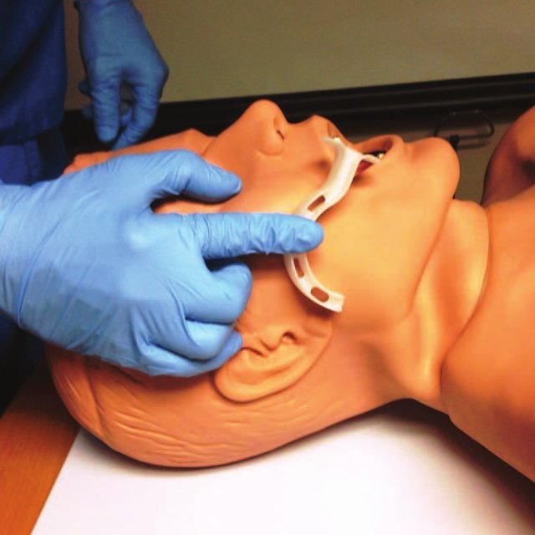
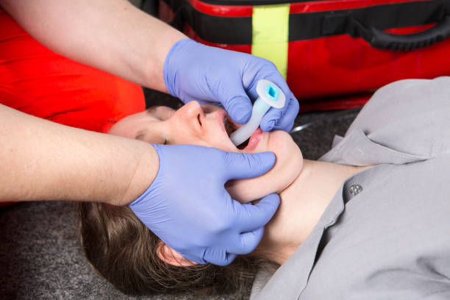
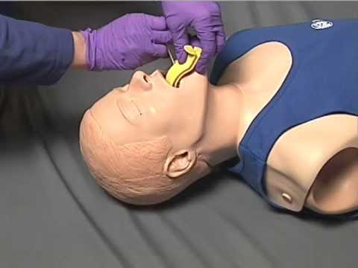
PROCEDURE FOR INSERTING AIRWAY

Slide 20
CPR/POCKET MASK
1)The pocket face mask is designed to aid the rescuer when providing ventilation during CPR.
2)It is made of soft
plastic with or without
oxygen inlet.
3)Its use, avoids direct
contact with the patient’s
Mouth and decreases the
chances of contamination.

Slide 21
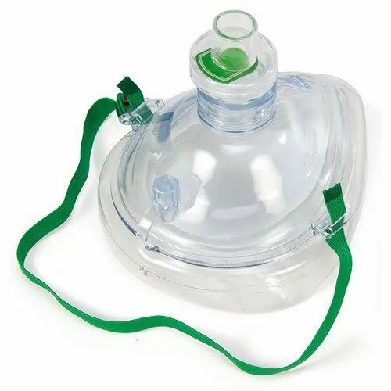
CPR MASK

Slide 22
BAG VALVE MASK
Type of Manual resuscitator.
BVM is a hand held device you squeeze to ventilate a patient.
It comes in adult, child, infant sizes.

Slide 23
HEPA FILTER
High Efficiency Particulate aerosol is a type of air filter.
HEPA filter removes at least 99.97 percent of airborne particles like bacteria & viruses.

Slide 24
NASAL CANNULA
It has two stems for patient’s nostrils.
Mostly used in Hospital set up.
Most patient tolerates it well.
Used to administer low concentration of O2

Slide 25
NASAL CANNULA
Cause nasal mucus membrane to dry at higher flow rates.
Appropriate for patients who cannot tolerate a mask.
Flow Rate 1-6 lpm (24-44% concentration of O2).

Slide 26
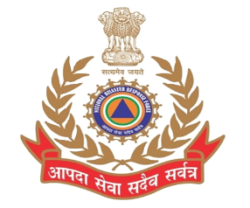
PULSE OXIMETER
To monitor the amount of oxygen carried in the body.
Its display the percent of oxygen in blood and current pulse rate also.

Slide 27
SIMPLE MASK
SFM can deliver higher flow rates than Nasal cannula (6-10 lpm) of 40-60% oxygen.
Both SFM ans Nasal Cannula are described as low flow delivery system.

Slide 28
NON-REBREATHER MASK
Flow rate 12-15 lpm
Concentration 80-90% of O2.
It contains enough O2, so it does not deflate by more than 1/3rd when patient inhales.

Slide 29
HUMIDIFIER
Non breakable jar of water attached to the flow meter. Provide moisture to the dry oxygen.
Must be kept clean. Can become a breeding ground for algae, harmful bacteria and fungal organisms.

Slide 30

MECHANICAL SUCTION
Maintain airway at all time-keep free of blood, vomit, secretions etc.
Suction should be performed rapidly to decrease the chance of blood or other foreign object/matter from moving into the lungs, which may cause pneumonia or complete airway obstruction.
Solid objects as food, teeth etc always not be removed by suction, may use alternate like finger sweep or etc.

Slide 31
SUCTION EQUIPMENT
Suction devices use negative pressure. Manual powered, electrically powered, air powered.
Must have wide bore, thick walls, non-twisting tube to fit a suction catheter.

Slide 32
SUCTION EQUIPMENT
Several disposable catheters should be available , made of either rigid or flexible plastic
Unbreakable collection container with water for rinsing and cleaning
Enough vacuum power and flow to be effective.

Slide 33
KNOWLEDGEOUS POINT
QUES- IF A CYLINDER HAVING 1000PSI OF O2, HOW WE DETERMINE THE TOTAL TIME TO REACH FULLY EMPTY CYLINDER ?
ANS- SUPPOSE THE CAPACITY OF CYLINDER(CC) IS 600 LTRS.
PRESSURE IN CYLINDER(PC) IS 2000PSI.
REMAINING PRESSURE IN CYLINDER(RPC) IS 1000PSI

Slide 34
FOR NASAL CANNULA
FLOW RATE OF O2(FRO) IS 6 lpm, then
TIME TAKEN TO EMPTY CYLINDER= CC X RPC
PC
FRO
CC=600 L
PC=2000 PSI
RPC=1000 PSI
FRO= 6 LPM

Slide 35
REVIEW
Five situations in which the use of oxygen is needed.
Describe an oropharyngeal airway, a CPR mask, a bag valve mask

Slide 36
REVIEW
Four key pieces of equipment used in an oxygen delivery system
Humidifier, mechanical suction and suction equipment

Slide 37
Any Question ?

Slide 38


Thank you

Slide 39
Evaluation
Q1) What is the flow rate of nasal cannula ?
Ans- 1-6 ltr/min
Q2) What is full form of HEPA?
Ans- High Efficiency Particulate Absorber

