Slide 1





MEDICAL FIRST RESPONDER
Childbirth Emergencies
PEER | CSSR | INDIA
PPT 2 -

Slide 2

  List the steps for assessment of the mother.
  List the steps for pre-hospital preparation of the mother.
  List the steps for delivery of a baby.
  List and describe three complications of pregnancy.
  List and describe six complications of delivery.
OBJECTIVES
Upon completing this lesson, you will be able to:

Slide 3
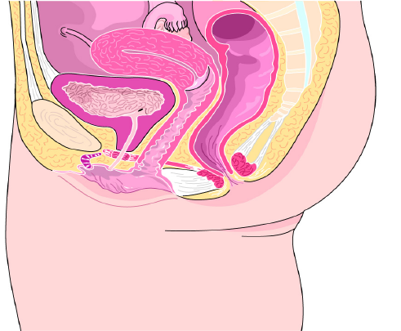
Anatomy of Pregnancy
Cervix
Uterus
Rectum
Symphysis
pubis
Vagina
(birth canal)
Urinary
bladder
Perineum
MFR
PPT 18 -

Slide 4

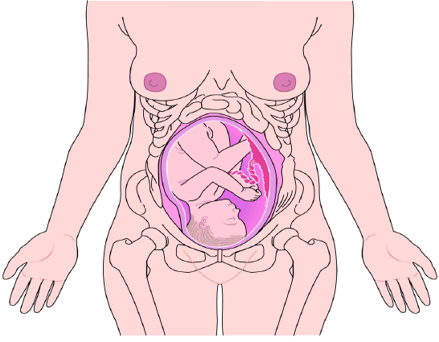
Anatomy of Pregnancy
Placenta
Foetus
Umbilical
cord
Uterus
Amniotic
sac
MFR
PPT 18 -

Slide 5
STAGES
OF
LABOUR

Slide 6
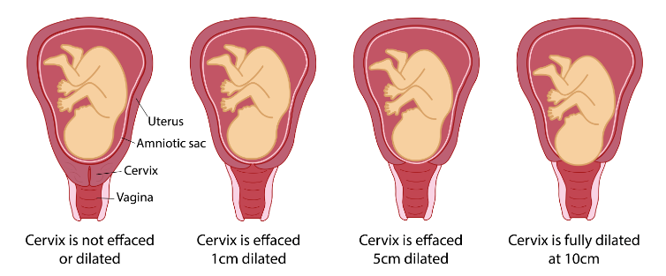
Begin with the mother contraction
First Stage
of Labour- (dilation)
Ends when infant enters birth canal
Longest stage, cervix fully dilated
MFR
PPT 18 -

Slide 7
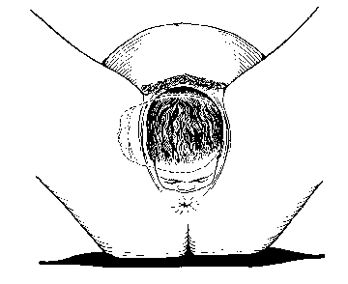
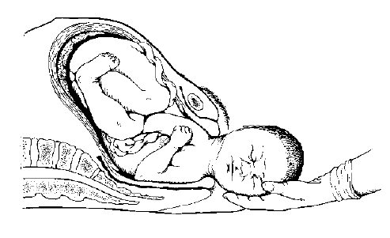
Second Stage
of Labour-(expulsion)
Begins the moment the infant moves into the birth canal
Baby head appear at the opening of the birth canal- crowning
Ends with the birth of infant
Support
baby’s head
MFR
PPT 18 -

Slide 8
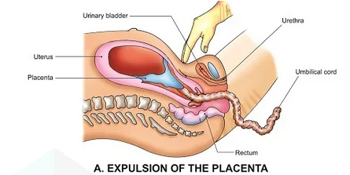
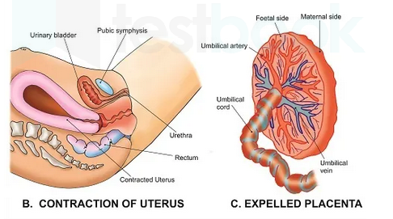
During this stage, the placenta separates from the uterine wall.
Third Stage
of Labour-(placental)
It is usually then spontaneously expelled from the uterus.
MFR
PPT 18 -

Slide 9
PRE-HOSPITAL PREPERATION OF
MOTHER
UNIVERSAL PRECAUTION AND SCENE SECURE
PRIVACY OF THE PATIENT
CONDUCT INITIAL ASSESSSMENT
DETAILS REGARDING PRENATAL CARE, IF ANY.
FIRST PREGNANCY OR OTHERWISE
ASK REG AMNIOTIC SAC
DETERMINE CONTRACTIONS
VISUAL EVALUATION/CROWNING
DETERMINE DLIVERY WILL BE AT SCENE OR THERE IS TIME FOR TRANSPORT TO HELATHCARE CENTRE /HOSPITAL.

Slide 10
UNI VERSAL PRECAUTION AND SCENE SECURE
PRIVACY OF THE PATIENT
ALWAYS GET HELP FROM FEMALE ATTENDANT/HUSBAND
PRE-HOSPITAL PREPERATION OF
MOTHER
HAVE THE MOTHER LIE ON HER BACK AND POSITION HER.
HAVE O.B (OBSTETRICAL) KIT READY AND OPENED.
PLACE CLEAN SHEETS OR TOWEL TO COVER MOTHER
EVALUATE FREQENCY AND DURATION OF CONTRACTION
VISUAL EVALUATION/CROWNING
REASSURE THE MOTHER.ENCOURAGE HER TO KEEP BREATHING SLOWLY AND COM

Slide 11
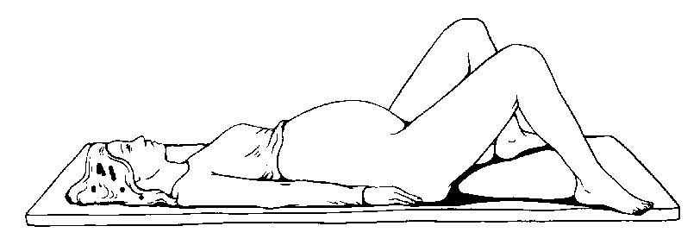
Patient’s position during childbirth
MFR
PPT 18 -

Slide 12

DELIVERY
OF
THE BABY
GENTLE PRESSURE OF PALM TO AVOID EXPLOSIVE DELIVERY. DO NOT PULL THE INFANT.
AMNOITIC SAC HAS NOT BROKEN, TEAR/PINCH WITH YOUR FINGERS.NEVER USE SHARP INSTRUMENTS.

Slide 13
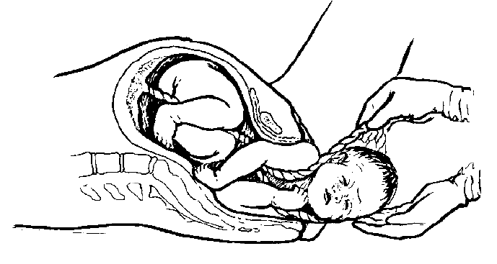
ONLY IF YOU CAN'T DISLODGE , ATTACH TWO CLAMP 7-8CM(3 INCH) APART,THEN CUT BETWEEN THE CLAMP
Remove umbilical cord from around baby’s neck
MFR
PPT 18 -

Slide 14

SUPPORT THE BABY’S HEAD
MFR
PPT 18 -

Slide 15
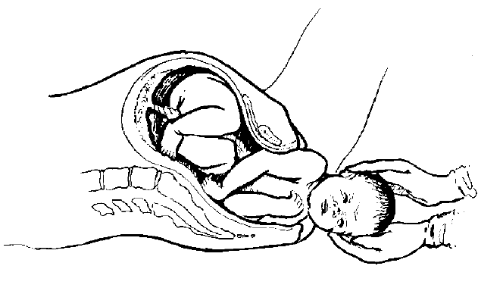
GUIDE THE BABY’S HEAD TO ASSIST IN DELIVERING SHOULDERS
Support the baby through the entire process.
MFR
PPT 18 -

Slide 16
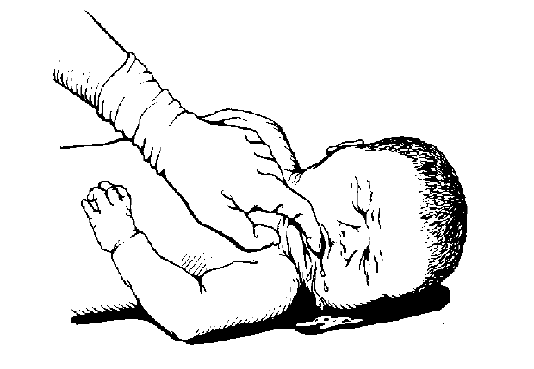
Maintain open airway
MFR
PPT 18 -

Slide 17
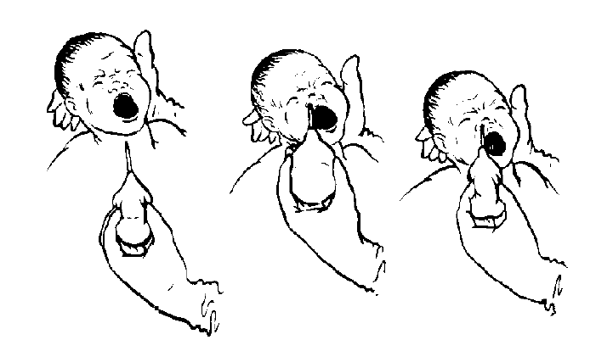
SUCTION NEWBORN’S MOUTH AND NOSE
MFR
PPT 18 -

Slide 18
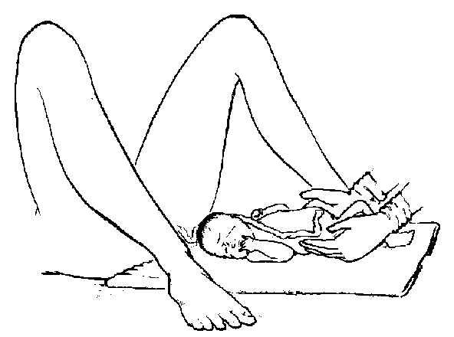
Newborn’s position in preparation to cut umbilical cord
MFR
PPT 18 -

Slide 19
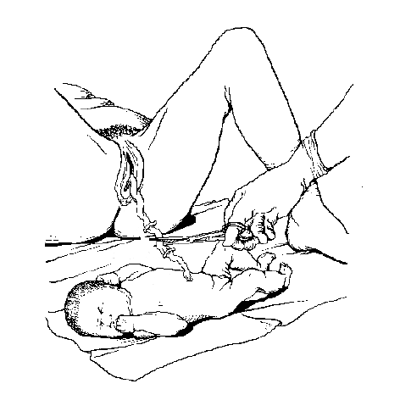
Place second
clamp 8 cms
from first clamp on newborn’s side
Place first clamp
25 cms from
newborn’s umbilicus
Cutting the umbilical cord
MFR
PPT 18 -

Slide 20
NOTE THE EXACT TIME OF DELIVERY
POSITION , DRY AND WRAP THE BABY.
ASSESS THE NEWBORN BREATHING AND OTHER DETAILS.
FILL THE APGAR SCORE

Slide 21
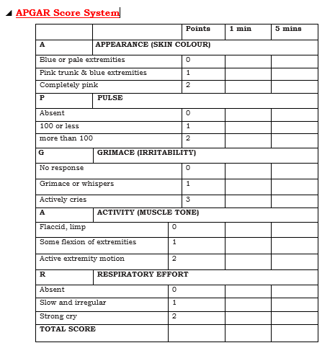
Ideally, scores are taken at one minute and five minutes after birth. If the neonate is not breathing, do not with hold resuscitation for an APGAR score.
Total score indicates the following:
7-10- indicates an active and vigorous newborn that requires routine care.
4-6- indicates a moderately depressed newborn that requires oxygen and stimulation.
0-3- indicates a severely depressed newborn that requires immediate resuscitation efforts.

Slide 22
COMPLICATION OF
PREGNANCY
EXCESSIVE PREBIRTH BLEEDING.
a) Placenta previa
b) Abruptio placentae
2. SPONTANEOUS ABORTION
3. ECTOPIC PREGNANCY

Slide 23
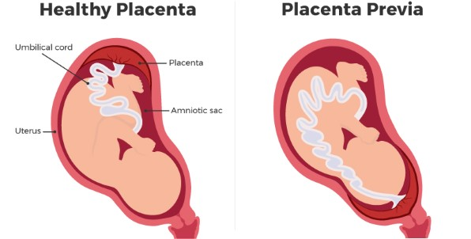
Placenta previa
PPT 18 -18

Slide 24
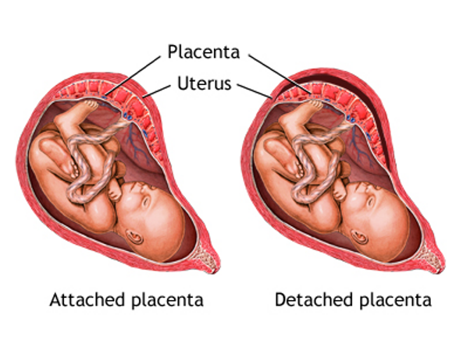
Abruptio placentae
PPT 18 -19

Slide 25
SPONTANEOUS ABORTION
MAY OCCUR BEFORE THE 20TH WEEK OF PREGNANCY.
IF INDUCED NATURALLY, CALLED SPONTANEOUS ABORTION OR MISCARRIAGE.
INDUCED ABORTION /DELIBERATE TERMINATION IS ILLEGAL.

Slide 26
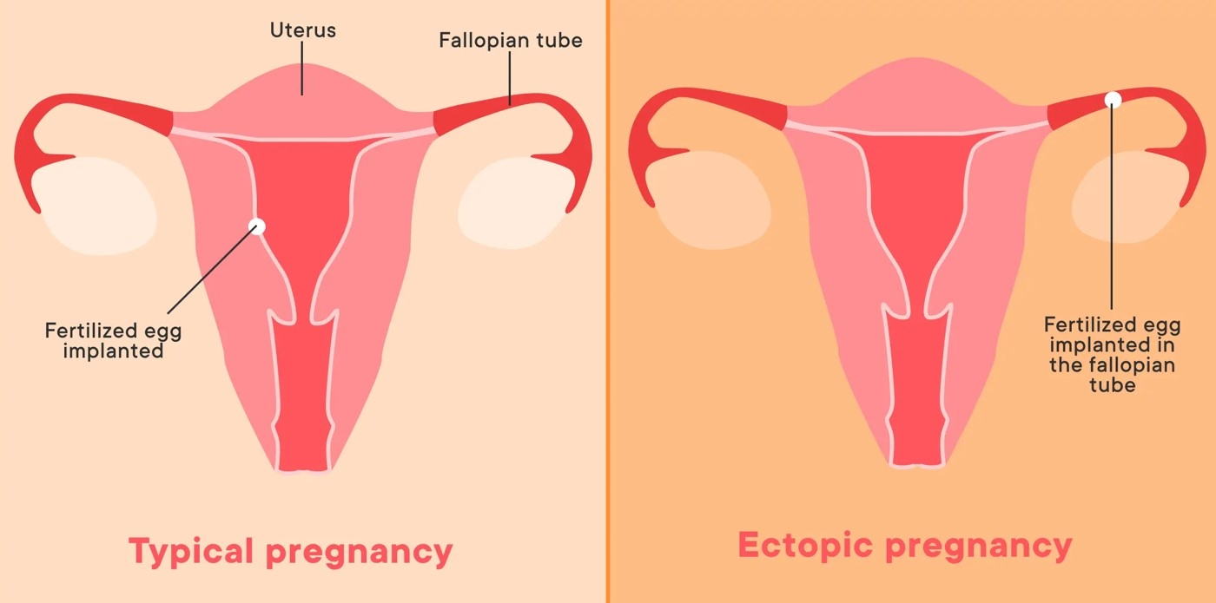
Ectopic Pregnancy
Normal pregnancy
PPT 18 -20

Slide 27
UNBRROKEN AMNIOTIC SAC
BREECH BIRTH
COMPLICATION OF
DELIVERY
PROLAPSED UMBILICAL CORD
LIMB PRESENTATION
MULTIPLE BIRTH
PREMATURE BIRTH
STILL BIRTH

Slide 28
If the amniotic sac (water bag) has not broken, tear it or pinch it open with your fingers
Pull it away from the newborn’s mouth and head
Do not delay this process. Never
use a sharp instrument!
UNBROKEN AMNIOTIC SAC (WATER BAG)

Slide 29
This type is the most common abnormal delivery.
A breech birth involves a buttocks-first or both-feet-first delivery.
In addition, there is an increased risk or a prolapsed umbilical cord.
Whenever possible, the mother should be transported to a hospital immediately for birth.
Breech Birth

Slide 30
This is a situation in which the umbilical cord presents first (common in breech births) and is squeezed between the vaginal wall and the head of the baby.
This may cause oxygen supply to the baby to be totally interrupted.
If, upon viewing the vaginal area, you see the umbilical cord presenting, the cord is prolapsed.
Prolapsed Umbilical Cord

Slide 31
A limb presentation is a situation in which a single leg, an arm and a leg together, or an arm and shoulder, present first.
This is often accompanied by a prolapsed umbilical cord.
Limb presentations cannot be delivered in the pre-hospital setting.
Position the mother on her back with pelvis elevated, provide oxygen per local protocol and transport immediately.
If prolapsed cord is present, apply treatment as discussed previously.
Limb Presentation

Slide 32
Twins are delivered the same way as single babies
In fact, since twins are smaller, delivery is often easier.
Multiple birth may occur if the other’s abdomen is unusually large before, or remains large after, delivery.
If labour contractions continue (usually within 10 minutes) after the first birth, thenext delivery may be imminent.
Multiple Births

Slide 33
BABY LESS THAN 2.5 KG
BORN BEFORE THE 36TH WEEK
HEAD IS PROPORTIONATELY LARGER THAN THE REST BODY
SUSCEPTIBLE TO INFECTION.
PREMATURE BIRTH

Slide 34
DIE IN THE WOMB HOURS, DAYS OR WEEKS BEFORE
BABY MAY BE BORN IN CARDIAC OR PULMONARY ARREST BUT MAY SURVIVE WITH RESUSCITATION.
STILL BIRTH

Slide 35
Review
  List the steps for assessment of the mother.
  List the steps for pre-hospital preparation of the mother.
  List the steps for delivery of a baby.
  List and describe three complications of pregnancy.
  List and describe six complications of delivery.
Now, you will be able to:

Slide 36
ANY QUESTION?

Slide 37


THANK YOU

Slide 38
EVALUATION
Q1) EXCESSIVE PREBIRTH BLEEDING IS KNOWN AS ?
Ans.

