Slide 1





MEDICAL FIRST RESPONDER
SOFT TISSUE INJURIES
PEER | CSSR | INDIA
PPT 2 -

Slide 2

OBJECTIVES
Two steps to treat a closed wound
Six steps to treat an open wound.
Pre-hospital treatment for eye, ear and neck injuries.
Pre-hospital treatment of abdominal and genital injuries.
Upon completion of this lesson you will be able to define and demonstrate well about-

Slide 3
OBJECTIVES
Demonstrate the use of
dressings and bandages to
control bleeding .
Pre-hospital treatment for the
following--
a) Impaled object in the eye or
cheek
b) Bleeding neck injuries
Upon completion of this lesson you will be able to define and demonstrate well about-

Slide 4
SOFT TISSUE INJURY
INJURY TO THE SKIN, MUSCLE, NERVES AND BLOOD VESSELS.

Slide 5
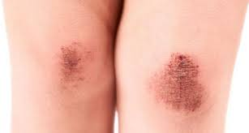
CLOSED WOUND
INJURY TO THE SOFT-TISSUE BENEATH UNBROKEN SKIN

Slide 6
SIGN AND SYMPTOMS OF CLOSED WOUND
SWELLING
TENDERNESS
DISCOLOURATION
POSSIBLE DEFORMITY

Slide 7
PHT OF CLOSED WOUND
Use universal precautions and secure the scene—
Apply “RICE” method
Monitor the patients and check vital sign
Treat for shock
Transport the patient to the EMS as soon as possible.

Slide 8
OPEN WOUND
A Soft Tissue-Injury Resulting In Breaking Of The Skin.

Slide 9
TYPES OF OPEN WOUNDS
Scratches and Abrasions
Lacerations-Regular and Irregular
Penetrations and Puncture Wounds
Avulsions
Amputations
Crushing injury
Gunshot wounds
Impaled object

Slide 10
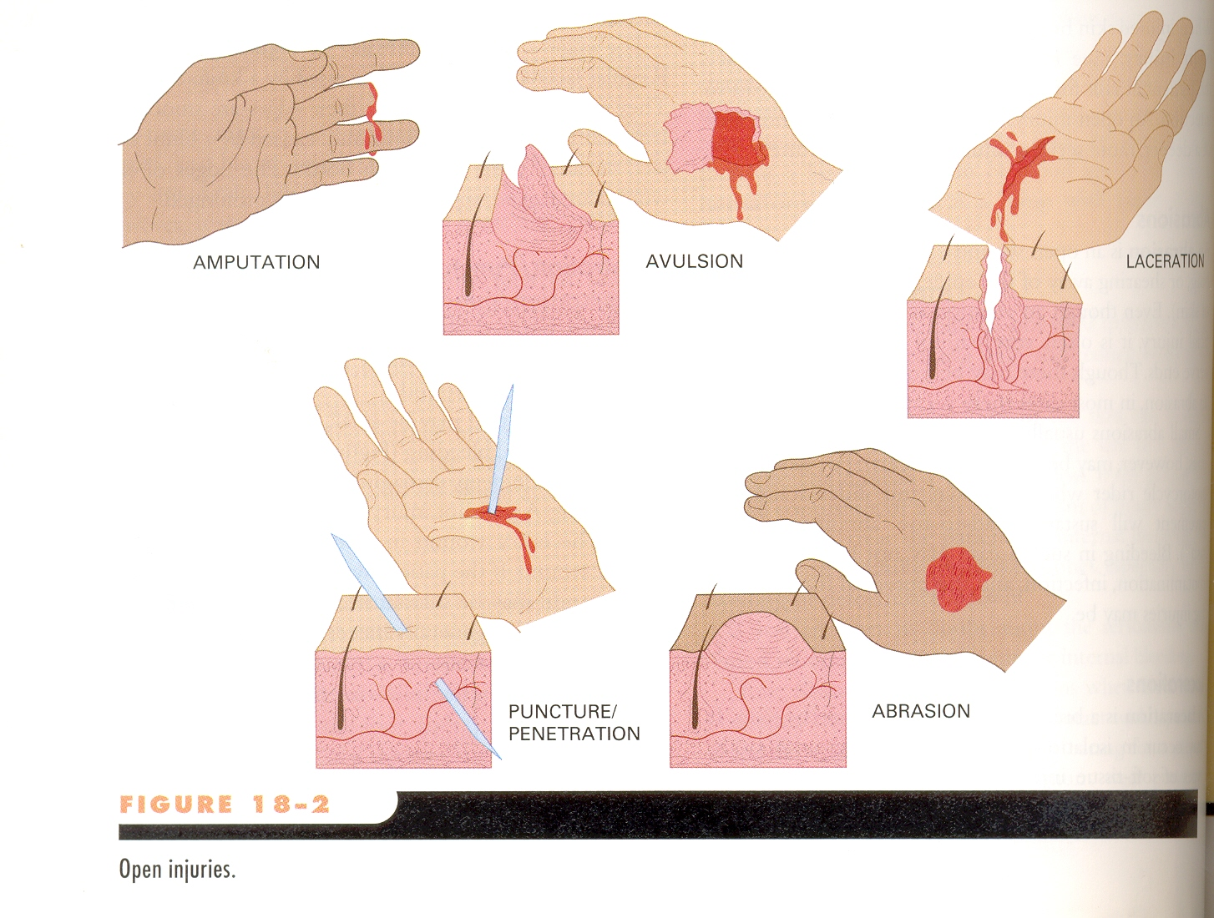
OPEN INJURIES

Slide 11
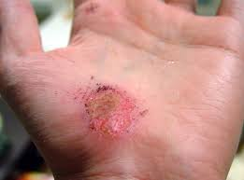
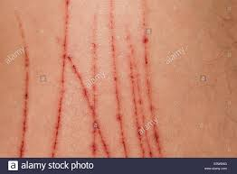
SCRATCHES AND ABRASIONS

Slide 12
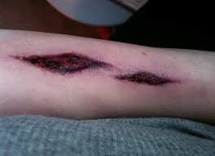
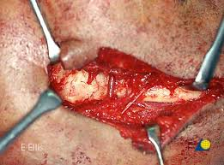
LACERATION

Slide 13
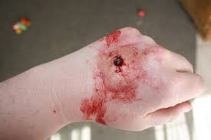
PUNCTURE WOUND

Slide 14
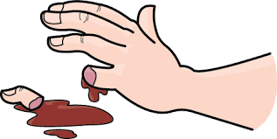
AMPUTATION

Slide 15
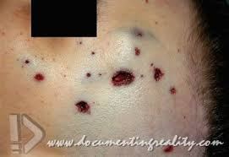
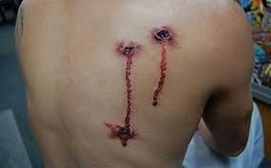
GUNSHOT WOUND

Slide 16
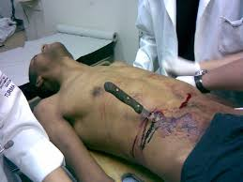
IMPALED OBJECT

Slide 17
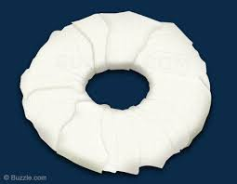
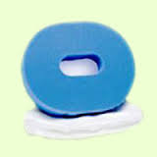
DOUGHNUT TYPE RING PAD

Slide 18
PHT OF OPEN WOUND
Use universal precaution and secure the scene—
Remove or cut the cloth by the help of trauma scissor from open wound area.
Control bleeding by the help of direct pressure and use pressure points also if needed.
Prevent from contamination.

Slide 19
PHT OF OPEN WOUND
Applying dressing and bandage
Cover the patient from cloth.
Treat for shock
Transport the patient to the EMS as soon as possible.

Slide 20
DRESSING
Any material used to cover a wound that helps control bleeding and also aids in the prevention of additional- contamination.

Slide 21
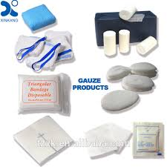

Slide 22
BANDAGE
ANY MATERIAL USED TO HOLD A DRESSING IN PLACE.

Slide 23
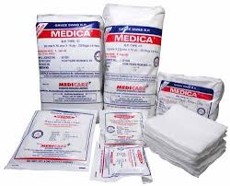
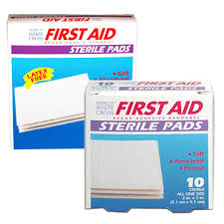
STERILE GUAGE PAD

Slide 24
OCCLUSIVE DRESSING
Any water-resistant material (plastic or waxed paper) that is applied to a wound to prevent the entry of air and loss of moisture from internal organs.

Slide 25
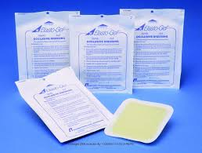

Slide 26
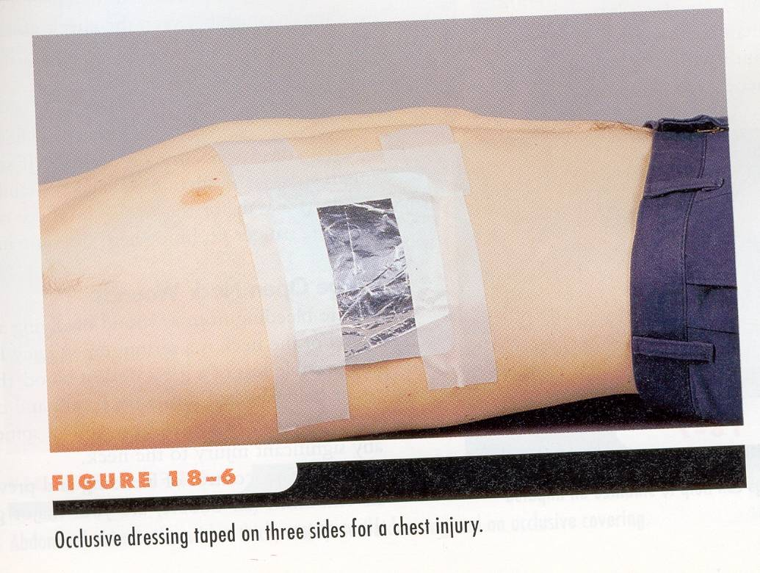

Slide 27
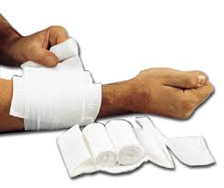
BULKY DRESSING
Multiple stacked dressings made to form single dressing 2-3 cm thick, such as a thick sanitary napkin or any similar material

Slide 28
APPLYING DRESSINGS AND BANDAGES
Control bleeding
Apply the dressing using asceptic technique.
Cover the wounds completely

Slide 29
APPLYING DRESSINGS AND BANDAGES
Ensure that the dressing and the bandages are firm, flexed and comfortable but not so tight as to affect circulation
Ensure there are no loose ends that can get caught
Avoid covering the fingertips

Slide 30
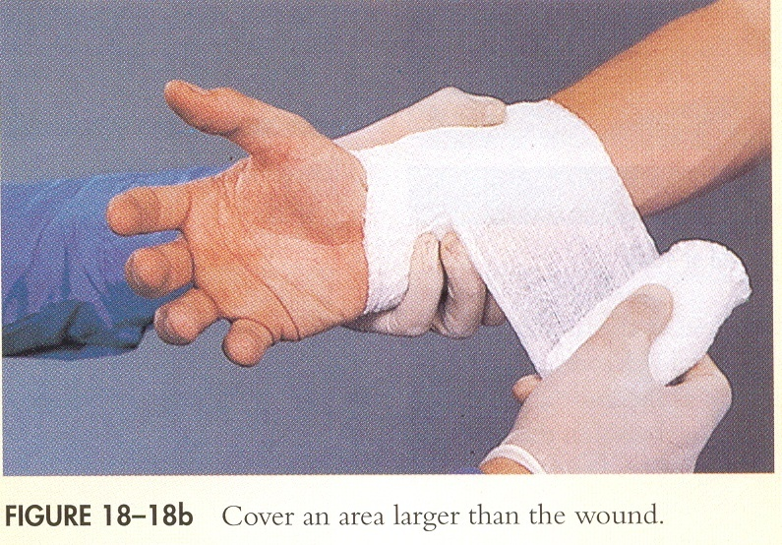

Slide 31
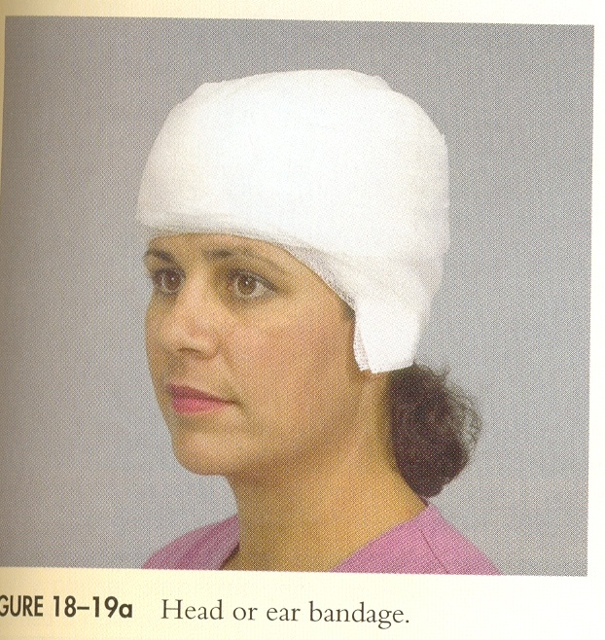
Head or Ear bandage

Slide 32
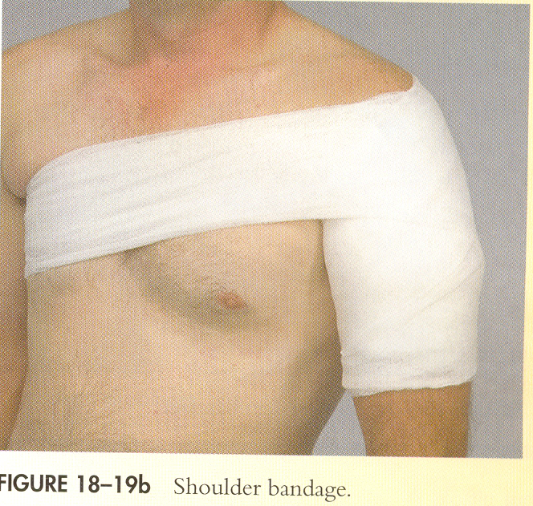
Shoulder bandage

Slide 33
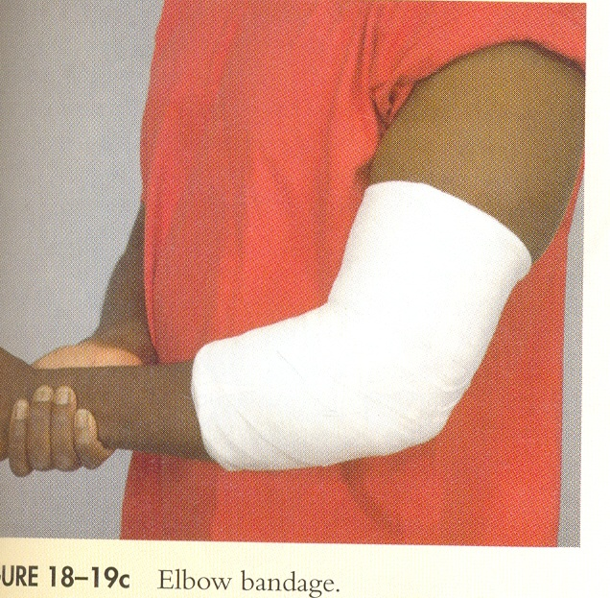
Elbow bandage

Slide 34
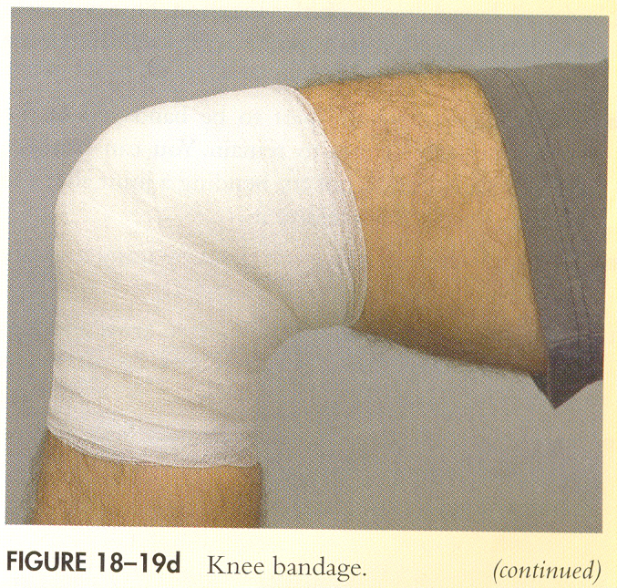
Knee bandage

Slide 35
WOUND TO THE EYE
Close the BEST ONE EYE to restrict the movement of injured eye.
Close the best one eye to the unconscious patient before dressing to secure the BLINDNESS of the patient.
Apply the cup or card board to the EXTRUDED EYE patient and never try to enter that eye in same place.

Slide 36
WOUNDS TO THE EAR
Never probe the ear
Never pack it to stop bleeding from the ear canal
Place a loose, clean dressing across the opening to absorb the fluids
Do not apply pressure

Slide 37
INJURIES TO THE NECK
Visible lacerations or other wounds can produce massive bleeding.
Difficulty in speaking: loss of voice
Airway obstructions can occur without foreign bodies in mouth.

Slide 38
INJURIES TO THE NECK
Tracheal deviation
Deformities and depressions
Immobilize the patient if you suspect a spinal injury

Slide 39
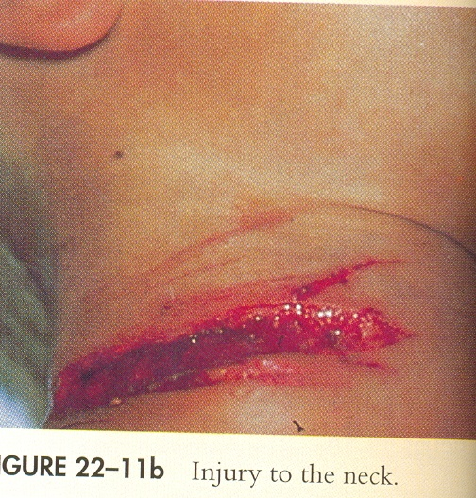

Slide 40
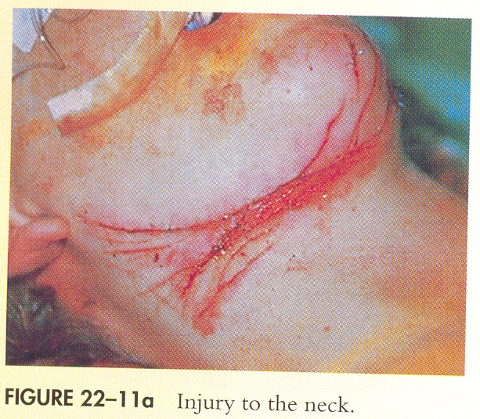

Slide 41
PHT FOR NECK INJURIES
If there is bleeding from a neck wound, apply slight to moderate pressure with an occlusive dressing. Tape down all edges of the dressing to form an airtight seal, to avoid air embolism.
For patient without spinal injury, place patient on left side with a 15-degree incline (head lower), if possible.
If an object is impaled in the neck, stabilise it in place with bulky dressings. Do not remove it.
Treat for shock.

Slide 42
ABDOMINAL INJURY SIGNS AND SYMPTOMS
Pain or cramps in the abdominal area local or diffuse
Guarding the abdomen or lying down in fetal position
Tenderness of the abdomen
Signs of shock
Rigid, tense or distended abdomen

Slide 43
ABDOMINAL INJURY SIGNS AND SYMPTOMS
Mild discomfort progressing to intolerable pain
Deep penetrating pain in the pelvis or lower back
Pain radiating to a shoulder or both shoulders
Vomiting blood: bright red or like coffee grounds
Blood in the stool: bright red or tarry black

Slide 44
PRE HOSPITAL TREATMENT FOR ABDOMINAL INJURIES
Use universal precautions and secure the scene. Be alert for patient vomiting.
Cover all open wounds
Do not replace exposed internal organs. Cover them with thick , moist sterile dressing. Keep exposed area warm by placing a dressing or towel over the occlusive dressing

Slide 45
PRE HOSPITAL TREATMENT FOR ABDOMINAL INJURIES
Do not remove impaled objects stabilize them with bulky dressing
Constantly monitor vital signs
Place patient supine with legs in most comfortable position
Treat for shock
Transport the patient as soon as possible

Slide 46
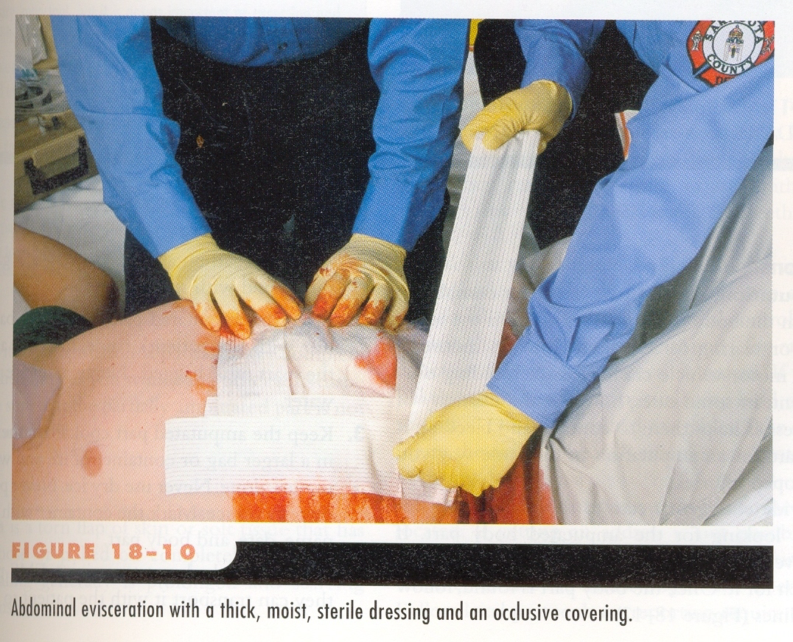

Slide 47
INJURIES TO GENITALS
PRE HOSPITAL TREATMENT FOR WOUNDS TO GENITALIA
Wounds To The Genitals Should Be Treated The Same As Any Other Wounds. However, Special Care And Attention Should Be Given To Protect The Patient’s Privacy

Slide 48
ANY QUESTIONS?

Slide 49


THANK YOU

Slide 50
Define soft tissue injury?
Bulky dressing thickness is?
Ice apply for …min in one hour?
Water resistant dressing known as…?
EVALUATION

