Slide 1

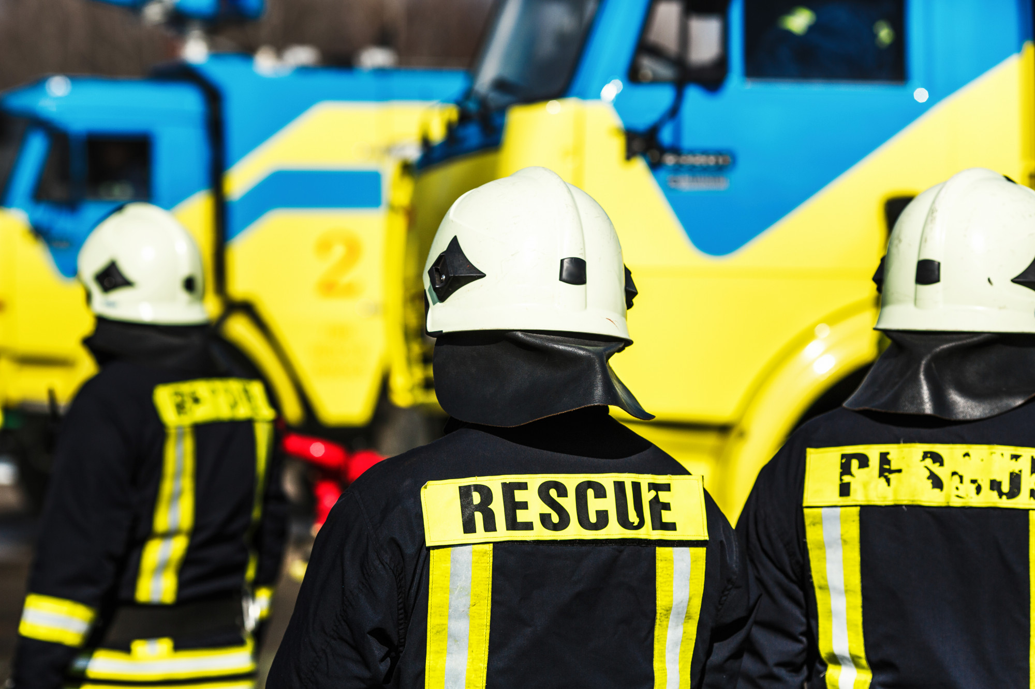

LESSON 5
Operational Safety

Slide 2
Upon completing this lesson, you will be able to:
1
List at least five dangers a rescuer
faces in a CSSR operation.
Identify unsafe actions and unsafe conditions.
Identify the CSSR Course safety rules.
OBJECTIVES
2
3

Slide 3
Upon completing this lesson, you will be able to:
4
Identify the four parts of a CSSR safety plan and briefly describe each one.
Describe the purpose of the Safety Briefing and list its eight components.
OBJECTIVES
5

Slide 4
CSSR Operational Safety
After the Mexico City earthquake in 1985 almost as many rescuers were killed as there were victims of
the actual earthquake.
PPT 5 -

Slide 5
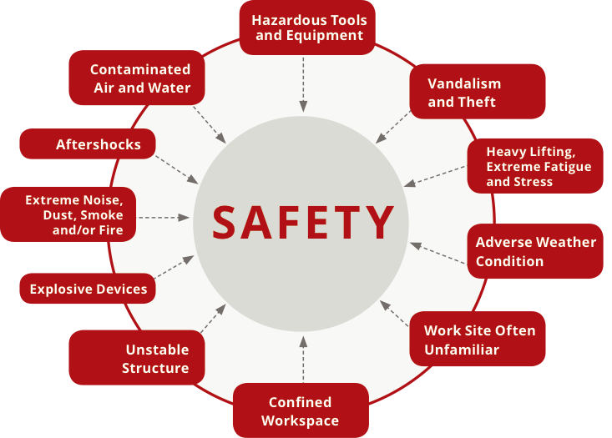
Factors Affecting Safety

Slide 6
Unsafe Actions
and Conditions
Unsafe Actions
Unsafe Conditions

Slide 7
Practice areas
Personal Protective Equipment (PPE)
Hygiene
Safety Officer
Group safety
Course Safety Rules

Slide 8
Whistle signals
      Stop: —
      Evacuate: •••
      Continue: — •
Course Safety Rules

Slide 9
Safety Zone
EMS
Fire extinguishers
Drinking water
Course Safety Rules

Slide 10
Maintenance
Rotations
Trash
Smoking and drinking
Course Safety Rules

Slide 11
Weather conditions
Safety markings
Team safety
Safety violations
Miscellaneous
Course Safety Rules

Slide 12
Preparation
Activation and mobilisation
Operations
Deactivation and demobilisation
Post-mission activities
CSSR Mission Phases

Slide 13
Safety Officer
The Safety Officer has the authority to alter, suspend or terminate activities involving an imminent hazard to personnel.
PPT -

Slide 14
Safety Officer Categories
1
2
3
Overall
Site-specific
Special Hazards
PPT -

Slide 15
Safety Plan
L
C
E
S
Lookouts
Communication
Escape routes
Safe zones
PPT -

Slide 16
Chain of Command
Identifying the Safety Officer
Safety Plan (LCES)
Communication Plan
Safety Briefing Components

Slide 17
Medical Plan
Rehabilitation Plan
Special hazards
General safety message
Safety Briefing Components (Cont.)

Slide 18
Upon completing this lesson, you are now able to:
1
List at least five dangers a rescuer
faces in a CSSR operation.
Identify unsafe actions and unsafe conditions.
Identify the CSSR Course safety rules.
REVIEW
2
3

Slide 19
Upon completing this lesson, you are now able to:
REVIEW
4
Identify the four parts of a CSSR safety plan and briefly describe each one.
Describe the purpose of the Safety Briefing and list its eight components.
5

Slide 20
ANY QUESTION ????
PPT-20

Slide 21
Q. What are Whistle signals.
Ans:-
      Stop: —
      Evacuate: •••
      Continue: — •
EVALUATION

Slide 22
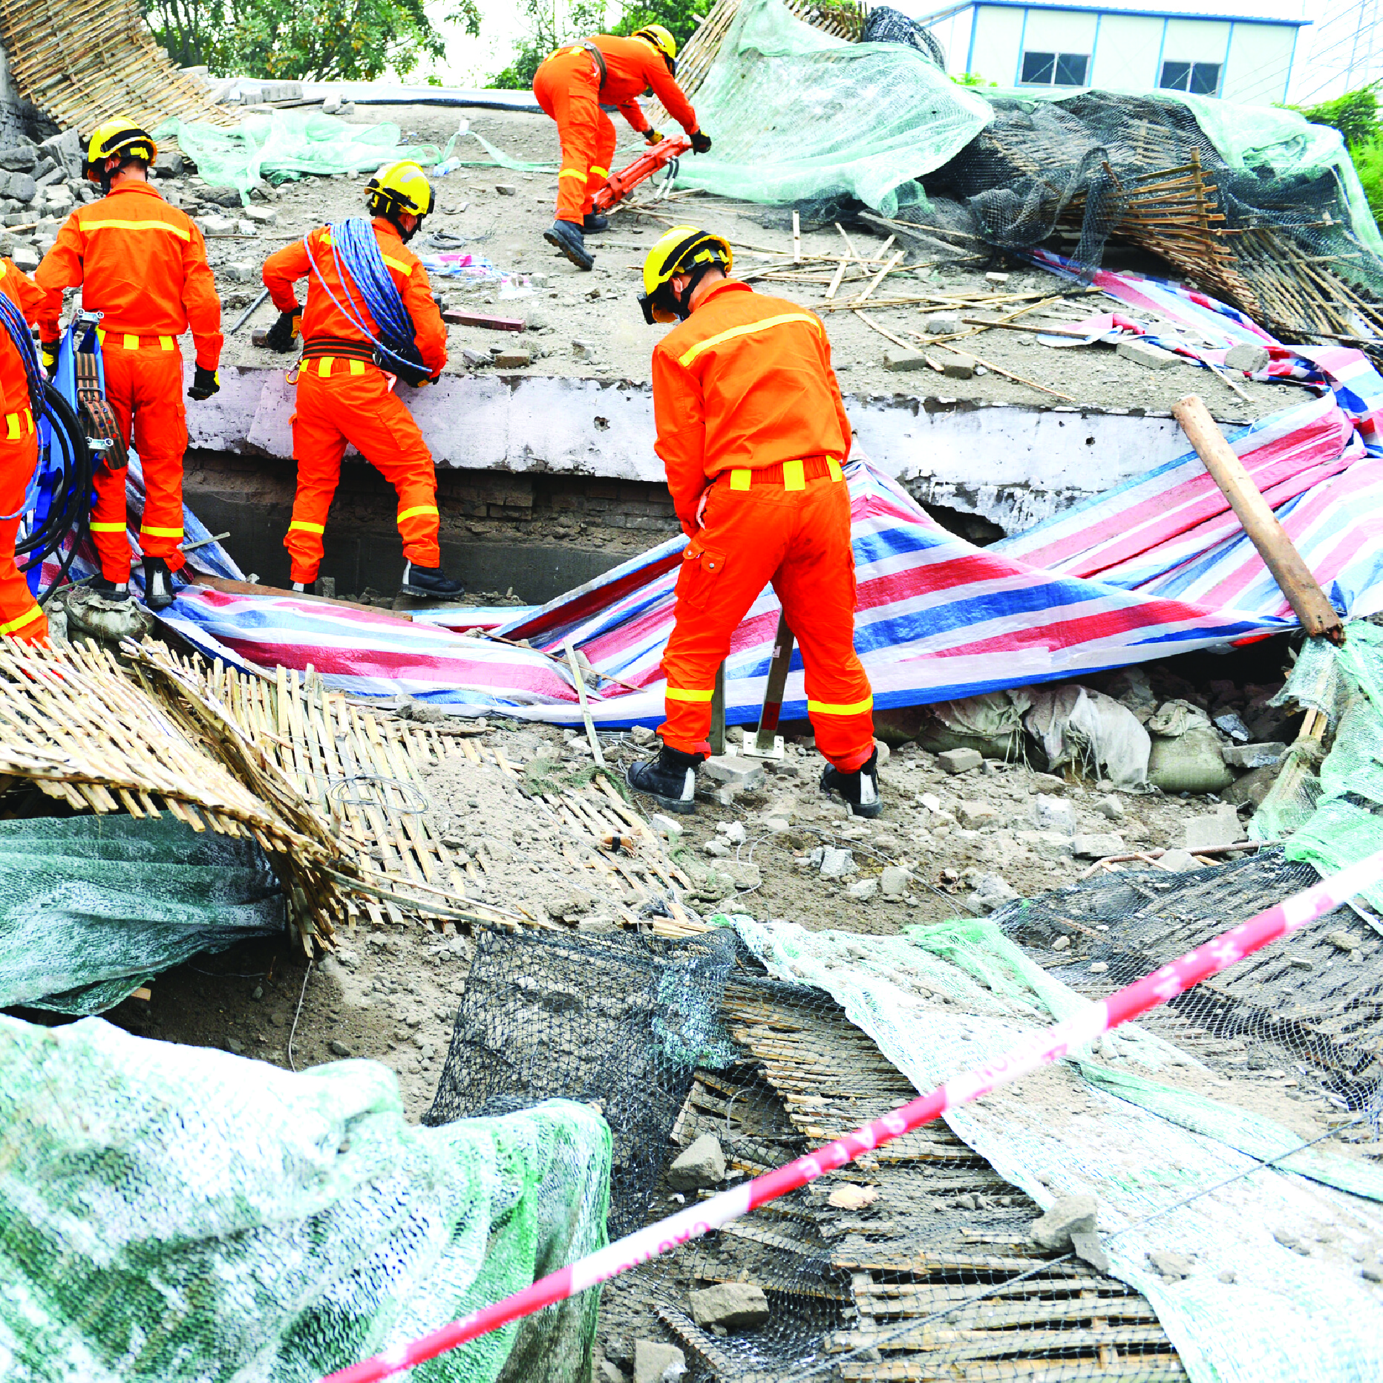
THANK YOU

