Slide 1


SEARCH AND LOCATION TECHNIQUES

Slide 2





SEARCH AND LOCATION TECHNIQUES
PEER | CSSR | INDIA
PPT 2 -

Slide 3
OBJECTIVE
List and describe the steps for searching and locating.
Define void space and identify probable locations in the four basic collapse patterns.
Describe the modes ,types and patterns of conducting a search.
List and describe the steps for searching and locating.
Define void space and identify probable locations in the four basic collapse patterns.

Slide 4
SURVIVAL RATE

Slide 5
A set of techniques and procedures whose purpose is to obtain a response or indication of the presence of live victims in a void space within a collapsed structure
SEARCHING AND LOCATING

Slide 6
SEARCH SQUAD

Slide 7
Personal protective equipment.
Personal supplies (unassisted for12 hours).
Marking supplies : paint,chalk,markers.
Communication devices.
Warning and alert devices: mega phone, whistle, flag…..etc.
Reconnaissance and vision side Binocular ,camera, Flashlight.
BASIC EQUIPMENT FOR PHYSICAL SEARCH

Slide 8
Compile and analyse information.
Secure the scene.
Inspect and evaluate the structure.
Rescue surface victims.
Make markings on the structure(INSRAG-international search & rescue advisory group) if needed.
STEP TO SEARCH AND LOCATE

Slide 9
7. Create a diagram of structure , refer to hand-out.
Select search area.
9. Select search method. Conduct an appropriate search where potential victims are more.
10. Analyse results and re-evaluate.
11. Confirm potential victim location.
12. Pre-hospital treatment of victim
STEP TO SEARCH AND LOCATE

Slide 10
Structurally resistant areas:
Basements
Elevator
Bathrooms
Inside hallways
Concrete walls
POSSIBLE LOCATION OF VOID SPACE

Slide 11
Hasty search (primary & quick):
Rapid detection of victims
Scene assessment
Set priorities
SEARCH MODALITIES

Slide 12

Extensive search (Grid /Secondary)
Conducted in a methodical manner to
pin point the exact location of victim.
A thorough, Systematic search
Allows for the use of resources, alternate search

Slide 13
SEARCH METHODS
Physical search
Canine search
Technical search

Slide 14
“We are rescuers – make some noise so we can hear you!!”
HAILING METHOD
Silence is essential

Slide 15
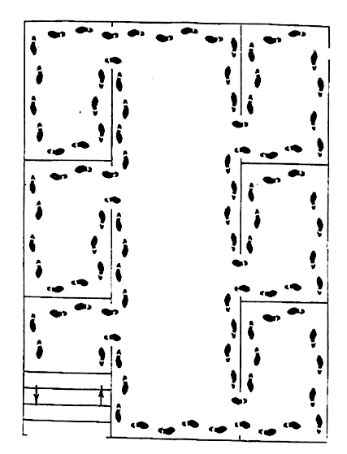
“Go right, stay right.”
PHYSICAL SEARCH PATTERNS
FOR INTERIOR SPACE
Multiple Rooms

Slide 16
LARGE OPEN AREA LINE SEARCH

Slide 17
Requires highly trained personnel Specialized equipment for sound , video ,vibration etc.
Technical search equipment's classified in two ways :Visual search instruments electronic listening devices.
TECHNICAL SEARCH

Slide 18
a) Water Proof Function
b) Rechargeable Battery pack 30 min for fully charged condition.
c) Can be operated with the cable probe which connect top camera head and optional extension
able cable (20 m, 30 m & 50 m) .
d) It helps to locate victims through inspection
holes made on structures to confirm the exact location of lying victims before breaching the structure to gain access.
EQUIPMENT FEATURES

Slide 19
Help to vibration movement in smoke, dust in collapse building.
To conducted the primary search and secondary search.
It has two communicated ways system.
EQUIPMENT FEATURES

Slide 20
LD3 Display interface-consisting six sensor channel bars.
Power :rechargeable battery.
Sensor : two sensor 1) seismic sensor.
2)acoustic sensor.
Cable : six cable each cable 10 meter length .
Vibrated detected range: 10 meter each sensor.
TECHNICAL SPECIFICATION

Slide 21
Helps to locate victims in Smoke filled, dark and High temperature conditions.
The life detector is used disaster search, security search and Mine rescue.
Helps to locate victims through obstacles.
Finds only living people.
Fast and efficient response.
EQUIPMENT FEATURES

Slide 22
Precautions during a search:
Never make inappropriate comments the victim should hear
You are the first person the victim is able to communicate
Identify language barriers
Identify yourself as a rescuer, confidence and calmness in your voice.
VICTIM MANAGEMENT

Slide 23
Name
Age
Trapped time
Hydration status
Temperature.
OBTAIN FOLLOWING

Slide 24
REVIEW
List and describe the steps for searching and locating.
Define void space and identify probable locations in the four basic collapse patterns.
Describe the modes ,types and patterns of conducting a search.
List and describe the steps for searching and locating.
Define void space and identify probable locations in the four basic collapse patterns.
Describe the modes , types and patterns of conducting a search.

Slide 25
ANY
QUESTION?

Slide 26



THANK YOU

Slide 27
QUE:- Multiple room checking side we follow which principle ?
ANS:-GO R8 STAY R8.
EVALUATION

