Slide 1


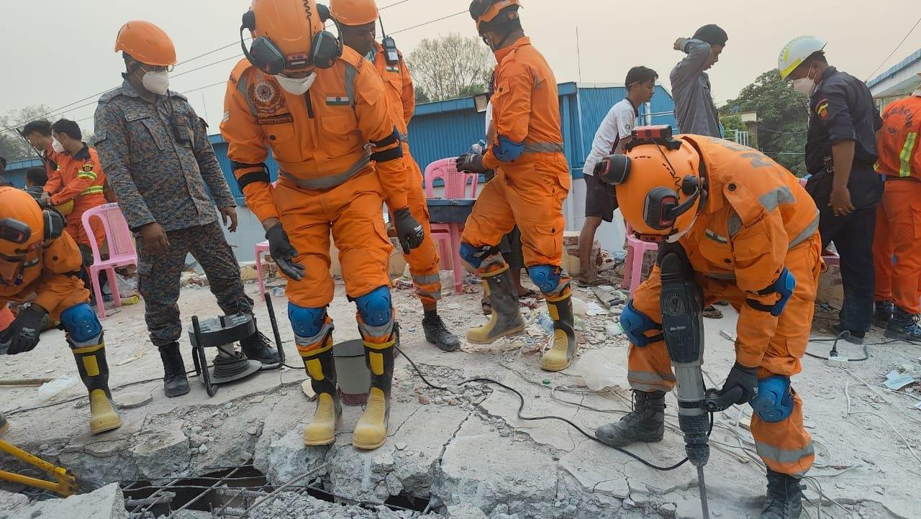
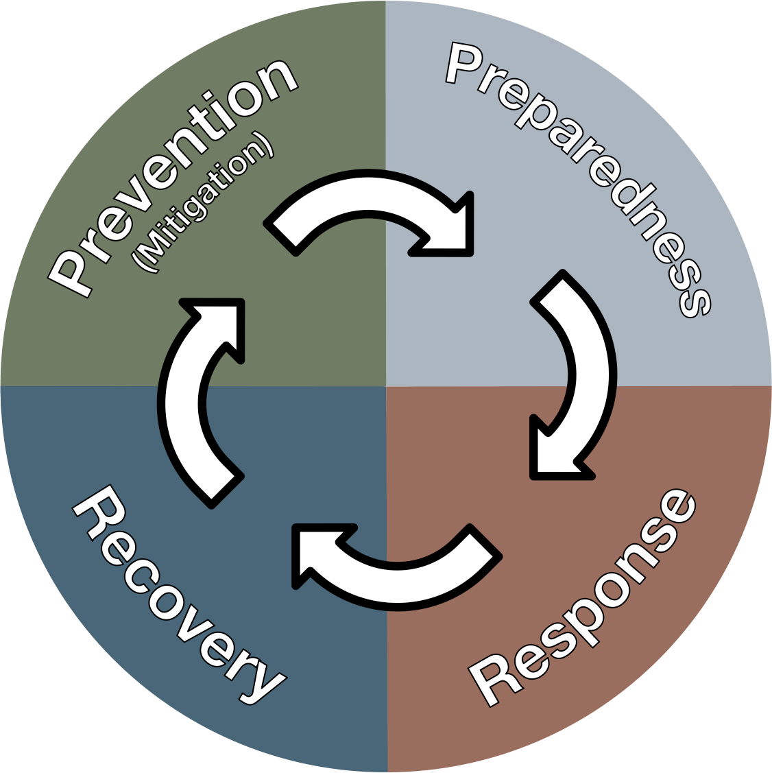
DISASTER MANAGEMENT ORIENTATION
LESSON 07
Introduction to NDRF and Its role in Disaster
NDRF | DMO | INDIA
PPT 7- 1

Slide 2
OBJECTIVES
Upon completing this lesson, you will be able to:
1
About historical aspect of raising of NDRF
Aquent with composition and organizational structure of NDRF
Get the overview of NDRF response team structure and equipment
2
3

Slide 3
OBJECTIVES
Upon completing this lesson, you will be able to:
4
Know about 04 important roles of NDRF and their execution
Understand the type and importance of training in NDRF
Get the overview of operational engagement and achievement
5
6

Slide 4
RAISING OF NDRF
DM Act was passed by Parliament on 26th Dec’ 2005
Chapter –VIII, Sec-44(1) of DM Act provides for creation of National Disaster Response Force for specialist response to a Disaster
The Members of the Force have been taken on deputation from elite Central Armed Police Forces
PPT 7 -

Slide 5
RAISING OF NDRF
National Disaster Response Force (NDRF) was raised on 19th January 2006 with 08 Bn
Presently it has
16 Bn
Presence at 68 locations including 28 Regional Response Centre (RRCs) and 24 Tactical pre-positioning locations (TPLs)
CONT.
PPT 7 -

Slide 6
NDRF: Composition
NDRF has 16 Operational Battalions.
Each Bn has a strength of 1149 personnel.
Each Bn has 18 self-contained Search & Rescue teams.
28 Regional Response Centers( RRCs).
Each team comprises of specialist manpower viz. Engineers, Paramedics, Technician, Electrician and dog squads.
PPT 7 -

Slide 7
Organization
Director General
Inspector General
Financial Advisor
DIG East & NE Zone
DIG Training
DIG North Zone
DIG (ADM, Estt. & Works)
DIG (West central Zone)
DIG (Ops, Comn. & IT, PRO)
DIG South & South Central Zone /
(Director NDRF Academy)
03 Bn NDRF
Mundali (OD)
DIG
Prov./ Proc. And R&D
01 Bn NDRF
Guwahati (AS)
07 Bn NDRF
Bhatinda (PB)
06 Bn NDRF
Vadodara (Guj)
02 Bn NDRF
Kolkata (WB)
13 Bn NDRF
Sambha (J&K)
08 Bn NDRF
Ghaziabad (UP)
04 Bn NDRF
Arakkonam (TN)
09 Bn NDRF
Bihta (Bihar)
14 Bn NDRF
Mandi (HP)
11 Bn NDRF
Varanasi (UP)
05 Bn NDRF
Pune (MH)
12 Bn NDRF
Itanagar (AP)
15 Bn NDRF
Haldwani (UKD)
16 Bn NDRF
Najafgarh (Delhi)
10 Bn NDRF
Vijayawada(AP)

Slide 8
Location and AOR of NDRF Units
Location of NDRF Bn | Area of Responsibility (State Wise)
1 Bn NDRF Guwahati (Assam) | Assam (24 Districts), Meghalaya, Mizoram & Tripura.
2 Bn NDRF Haringhata (WB) | Sikkim & West Bengal.
3 Bn NDRF Mundali (Odisha) | Odisha & Chhattisgarh.
4 Bn NDRF Arakkonam (TN) | Andaman & Nicobar Islands, Kerala, Lakshadweep, Puducherry & Tamil Nadu.
5 Bn NDRF Pune (MH) | Goa & Maharashtra.
6 Bn NDRF Vadodara (Gujarat) | Daman & Diu, Dadar & Nagar Haveli, Gujarat & Rajasthan.

Slide 9
Location and AOR of NDRF Units
Location of NDRF Bn | Area of Responsibility (State Wise)
7 Bn NDRF Bhatinda (Punjab) | Chandigarh, Punjab, Haryana
Bn Ghaziabad (Up) | Western UP (33 districts) Madhya Pradesh (5 districts)
9 Bn NDRF Bihta (Patna) | Bihar, Jharkhand
10 Bn NDRF Vijaywada (AP) | Andhra Pradesh, Telangana, Karnataka
11 Bn Varanasi (UP) | Madhya Pradesh (47 Districts) Uttar Pradesh (42 Districts)
12 Bn Doimukh (Arunachal Pradesh) | Assam (09 Districts), Arunachal Pradesh, Manipur, Nagaland
CONT.

Slide 10
Location and AOR of NDRF Units
Location of NDRF Bn | Area of Responsibility (State Wise)
13 BN NDRF (J&K) | Jammu & Kashmir and Ladakh
14 BN NDRF (Himachal Pradesh) | Himachal Pradesh
15 BN NDRF (Uttarakhand) | Uttarakhand
16 BN NDRF (NCT of Delhi) | NCT of Delhi
13 BN NDRF (J&K) | Jammu & Kashmir and Ladakh
14 BN NDRF (Himachal Pradesh) | Himachal Pradesh
CONT.

Slide 11
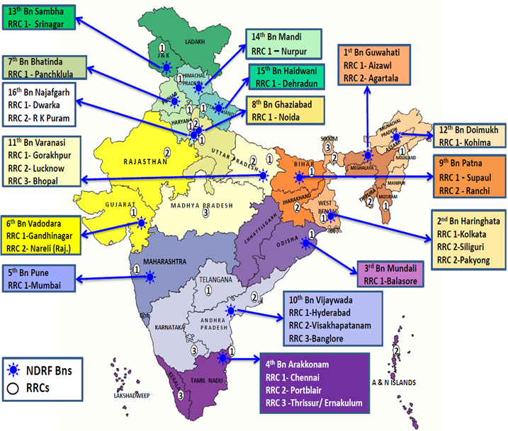

Slide 12
Team Commander
Inspector
NDRF: Search & Rescue (SAR) Team
Team 2-IC/OPS Officer
Sub-Inspector
SAR SUB TEAM
A
(6)
SAR SUB TEAM
B
(6)
SAR SUB TEAM
C
(6)
SAR SUB TEAM
D
(6)
ADM. SUPPORT TEAM
(7)
DOG SQUAD
(3)
MEDICAL SUP TEAM
(2)
TECH SUPPORT
(6)
1-SI
5-CONST
1-HC
5-CONST
1-SI
5-CONST
1-HC
5-CONST
3-CONST
(HANDLERS)
2-DOG
2-PARA
MEDICS
2-COMN
(SI+HC)
2-STRUC-ENGR(SI)
1-TECHNICIAN
1-ELECTRICIAN
1-HC
2-SUPPORT STAFF
(1 FOLLOWER,1-CONST)
4-SECURITY (1-HC/ 3-CONST)
TEAM STR=44+3 (Drivers)
TOTAL=47

Slide 13
Team Commander (Inspector)
NDRF: CBRN Team
Info. Officer
(SI/Comn)
Deputy Team leader (SI)
Safety Officer (SI/Eng)
Tech Support Team (6)
1- SI/Comn
1-HC/Comn
2 SI/ENG
1 HC/Tech
1 HC/ Electrn
Detection and Assessment cum Evacuation
(6)
SI-1
CT-5
Rescue and Evacuation Team- A
(6)
2-HC
4-CT
Rescue and Evacuation Team – B
(6)
2-HC
4-CT
Decon Team
(6)
SI-1
CT-5
Adm. Support Team
(10)
Medical Unit
5-P/MED

Slide 14
NDRF : Strengths
Trained and capable in the following disciplines –
CSSR (Collapsed Structure Search & Rescue)
MFR (Medical First Response)
CBRN emergency response
Flood Disasters
Mountain Search & Rescue
Canine and Technical Search
Animal disaster response
PPT 7 -

Slide 15
NDRF: EQUIPMENT
Each NDRF Bn is equipped with 310 State-of-the-Art equipment–
CSSR (Earthquake) – 124 equipment
Water Rescue/ Diving – 12 equipment
Mountaineering/ High-Altitude Rescue – 16 equipment
Medical First Response – 112 equipment
CBRN Emergencies – 46 equipment
PPT 7 -

Slide 16
ROLE OF NDRF
Relief, Rescue, Evacuation Operations
Pre-positioning Of Teams
Handle A Range Of Difficulties
Response
Preparing Professional Rescuers
Upgrading Skills
Training to Sister Agencies
Latest Equipments and Improvisation
Upgrading Technology
Coordination with Early Warning Elements
Training
Capacity Building
FamEx
School Awareness
Mock Drills
Community Training and exercises
Community Awareness

Slide 17
NDRF: Capacity Building Programmes
First Aid (Soft issues Injuries, Musculoskeletal injuries, CPR, Snake Bites)
Lifting and moving victims during Earthquakes
Earthquake Safety Tips
Water Emergencies (Improvising floating Aids, Dry rescue techniques & Wet rescue techniques)
Incident Response System (IRS) and Triage
PPT 7 -

Slide 18
NDRF: Community Awareness Programme
First Aid (Soft issues Injuries, Musculoskeletal injuries, CPR, Snake Bites)
Lifting and moving victims during Earthquakes
Earthquake Safety Tips
Water Emergencies (Improvising floating Aids, Dry rescue techniques & Wet rescue techniques)
Swatch Bharat Abhiyan (Hygiene Sanitation)
PPT 7 -

Slide 19
NDRF: Mock Exercise
NDRF conducted Mock Exercise with the following Stakeholders –
NDMA
SDMAs
Indian Railways
Delhi Metro
Various MAH Units/PSUs
Schools and Colleges
Airport Authority of India
PPT 7 -

Slide 20
NDRF: Regional Cooperation
Exercise on the Delivery of Assistance (ASSISTEX)
South Asian Annual Disaster Management Exercise (SAADMEx)
ASEAN Regional Forum Disaster Relief Exercise
Bay of Bengal Initiative for Multi-Sectoral Technical and Economic Cooperation
Joint Exercise of SCO Members
PPT 7 -

Slide 21
NDRF: Training
BASIC COURSES
TEAM LEVEL OR COLLECTIVE TRAINING
ADVANCED COURSE
DAILY OR ROUTINE TRAINING
SPECIALISED COURSE

Slide 22
NDRF: Training
Medical First Responder (MFR)
Collapsed Structure Search & Rescue (CSSR)
Chemical Biological Radiological & Nuclear (CBRN)
Mountain Search & Rescue
Aquatic Disaster Response Course (ADRC)
Under Water Diving

Slide 23
NDRF: Training
Heli-Slithering
Avalanche Rescue Training
Incident Response Training (IRS)
Advance trauma Life Saving (ATLS)
Advanced Trauma Care for Nurses (ATCN)
Disaster Psycho-Social Care
Gender Sensitization

Slide 24
S No. | Particular | Nos
1 | Total numbers of Operations conducted | 8,406
2 | Human lives rescued by NDRF | 1,59,350
3 | Human lives evacuated by NDRF | 86,7,158
4 | Dead Bodies retrieved in connection with various disasters. | 7,858
5 | Livestock evacuated by NDRF | 19,445
6 | Familiarization exercises conducted by NDRF | 3,054
NDRF Operational Achievements

Slide 25
S No. | Particular | Nos
1 | Total numbers of Operations conducted | 8,406
2 | Human lives rescued by NDRF | 1,59,350
3 | Human lives evacuated by NDRF | 86,7,158
4 | Dead Bodies retrieved in connection with various disasters. | 7,858
5 | Livestock evacuated by NDRF | 19,445
6 | Familiarization exercises conducted by NDRF | 3,054
NDRF Operational Achievements

Slide 26
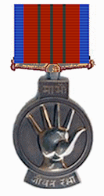
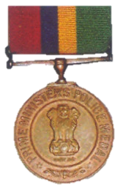
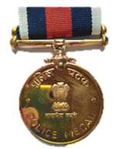

Honours & Awards
Police Medal for
Gallantry
Jeevan Raksha Padak
Prime Minister Life Saving Medal
Union Home Minister’s Special Operation Medal
40
8
9
10

Slide 27
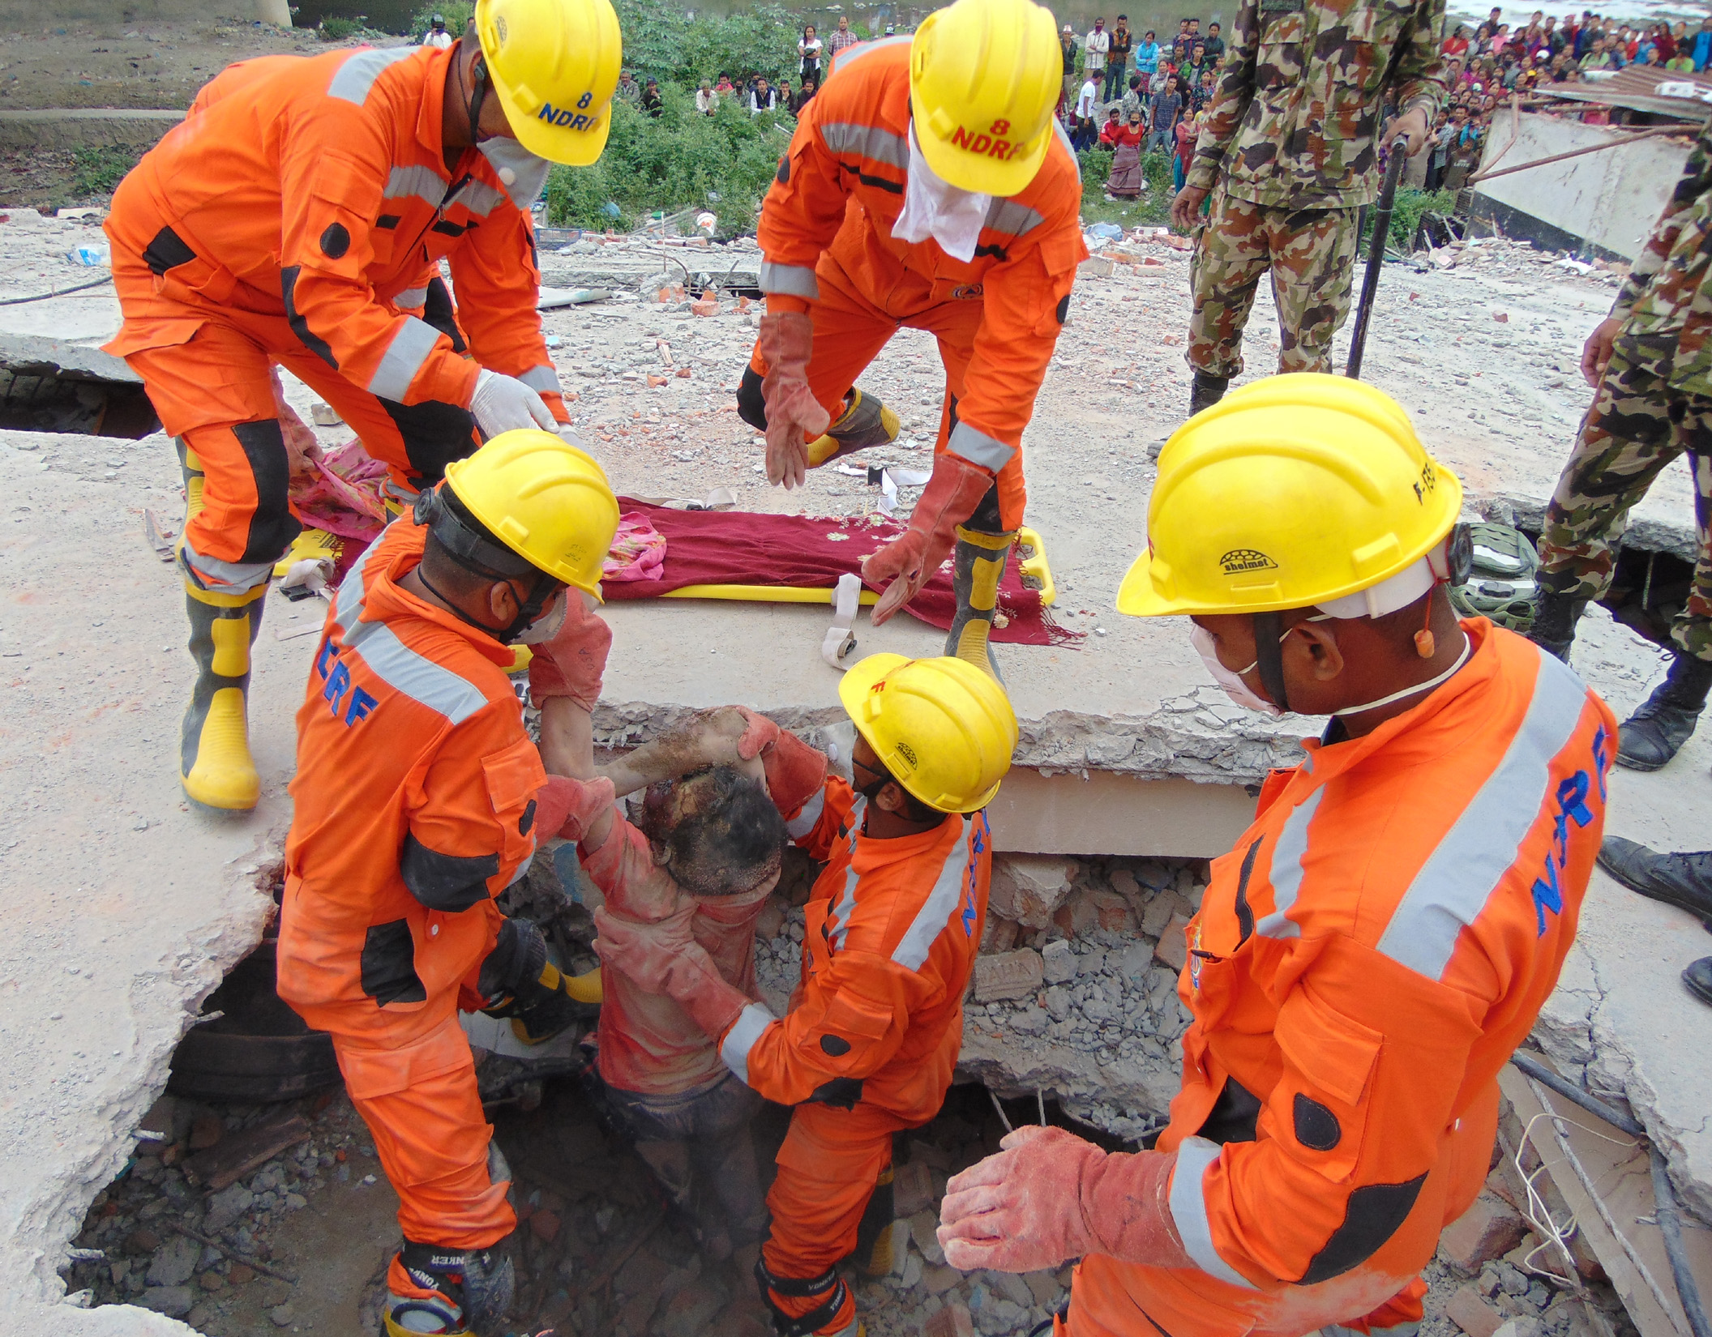

THANK YOU

