Slide 1


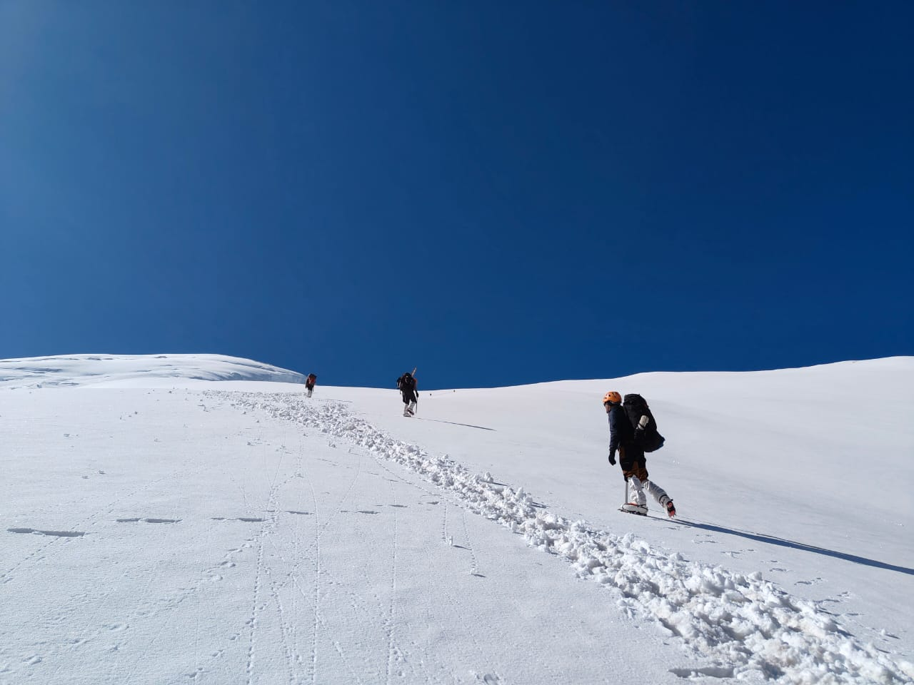

High Altitude Rescue Operation and Expedition Planning
Presented By:-
Prem Kr Negi

Slide 2


OBJECTIVES
What is High Altitude rescue operation, Risk and Challenges?
Team Composition & Essentials equipment's.
High Altitude Rescue Procedure.
Mountaineering Expedition Planning, Team preparation, logistics planning, Safety and Risk Management.
1
Upon completion of this lesson, you will be able to :-
2
3
4

Slide 3


High Altitude environments provides extreme challenges.
Rescue operations above 5500 mtrs (18000 ft) are complex.
Requires specialized training, planning and equipment.
Coordination between expedition teams and rescue agencies is critical.
Introduction

Slide 4
Rescue Operations conducted above 2500 mtrs, where low oxygen, extreme weather and terrain makes evacuation difficult.
What is High Altitude Rescue Operations.

Slide 5
Low Oxygen (Hypoxia)
Extreme Cold Temperature
Unpredictable weather
Avalanches and rockfalls
Glacier Crevasses
Difficult Terrain
Limited Communication and Resources
Dehydration and Sun Exposure
Altitude Illness (Hape & Hace)
High Altitude Environmental Risk and Challenges

Slide 6
Acute Mountain Sickness (AMS)
HAPE (High Altitude Pulmonary Edema)
HACE ( High Altitude Cerebral Edema)
Falls/Fractures
Frostbite & hypothermia.
Common Emergencies in High Altitudes

Slide 7
Team Leader
High Altitude climbers (advance Mountaineering Course Qualified personnel.
Medical Officer
Communication Rep.
Logistics support and HAPs.
Suggested strength -10 to 15.
Rescue Team Composition for High Altitude Rescue

Slide 8
Ropes, harness, carabineers, Jumar
Stretcher/Sked
GPS, Maps, Radio Sets/ISAT.
Medicines and oxygen Cylinders.
Cold Weather Gears.
First Aid & emergency drugs.
High Altitude tents, utensils & Ration
Essential Rescue Equipment’s and stores

Slide 9
Situation Assessment
Ensure team Safety
Acclimatized rescuers
Location of Casualty
Extrication (Using Various techniques)
First Aid (Prevent further heat loss)
Evacuation- Foot, Rope & Helicopter.
Location of night camping.
Continuous monitoring.
Rescue Procedure

Slide 10
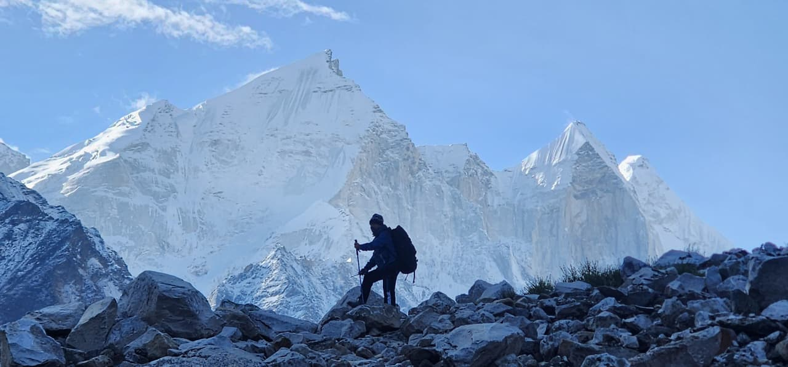
Planned and organized attempt by a group of climbers to ascend a mountain or peak Hight altitude or difficult terrain.
Mountaineering Expedition

Slide 11
Summit achievement.
Safety of Team members.
Team coordination and leadership.
Skill development.
Risk Management
Environmental Protection.
Rescue and Emergency Preparedness.
Aim & objective

Slide 12
Important factors in Peak selection-
Difficulty level, Altitude of the peak, Weather condition, accessibility, Terrain and Technical challenges, Safety and rescue possibilities, permission and regulation.
Selection of Peak

Slide 13
Climbing permit from IMF.
Forest and Wild Life permission
Inner Line permit/Restricted area permit.
Environmental Clearance
Local Administration permit.
Insurance and rescue permission
Communication permission.
Permissions Required

Slide 14
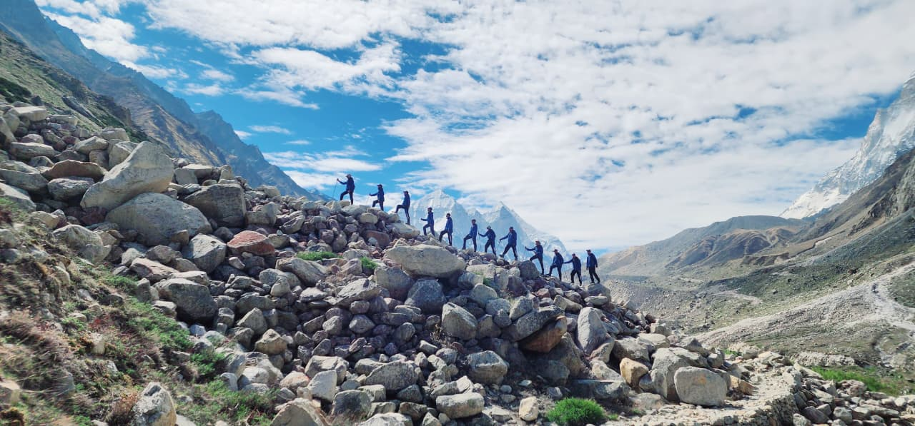
Climbing Route includes-
Safest and most practical path.
Study of Terrain features like glaciers, ridges, snow slops, rock faces, and crevasses.
Camp Locations (Camp-1, camp-ii, camp –iii, summit camp etc.)
Climbing Route

Slide 15
Expedition itinerary includes-
Approach march
Base Camp establishment
Acclimatization climbs
Load Ferrying
Camp establishment
Summit attempt
Descent.
Itinerary of Expedition

Slide 16
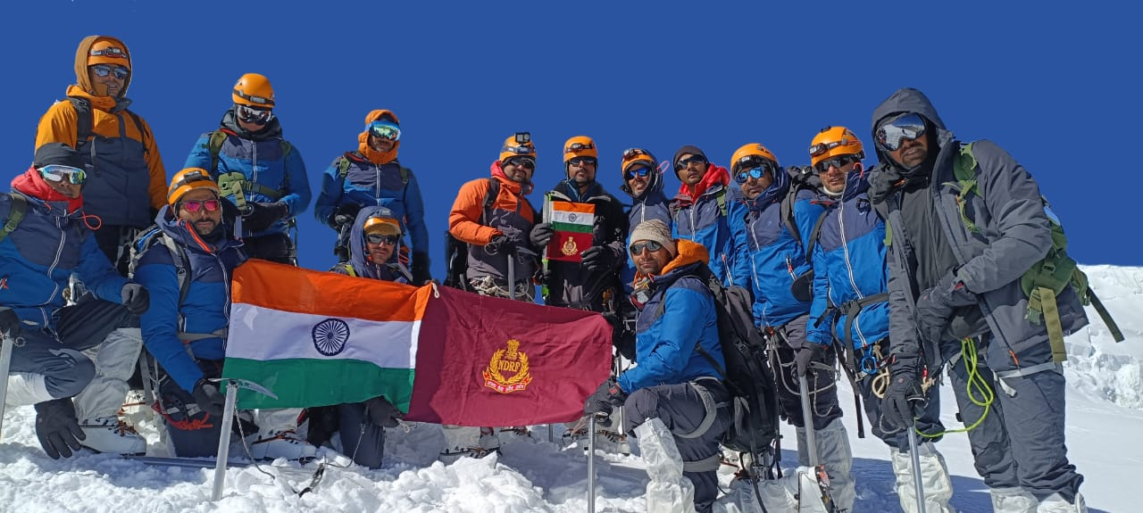
15 to 25 members depending upon the size and difficulty of the expedition.
Expedition leader-01
Deputy Leader-01
Climbers-6 to 10
High Altitude Support Team- 4 to 8
Medical Officer/Medic-02
Cook and Kitchen Staff-02
Communication -01 to 02.
Selection Team and composition

Slide 17
Transportation Plan-
Approach Phase (Home to Base Camp)
Road Transport-Truck/buses for team & equipment.
Jeeps and 4x4 in Hilly Terrain.
Trek Phase( Road Head to Base Camp)
Movement By- Team Members & Porters/mules (load carriers)
Climbing Phase ( Base Camp-Summit)
No Vehicles.
Load carried by-Climbers & High altitude porters (HAPs).
Transportation of Team members & Stores

Slide 18
10 to 15 days pre training to check the fitness and technical aspects of climbers.
15 days pre training for acclimation and fitness at High altitude region.
Pre Training and Selection of team members

Slide 19
Mountaineering equipment for each climbers.
Mountaineering equipment's combined for team.
Personal clothing including snow clothing.
Ration- on per day per head calculation.
Tantage- High altitude tents
Camping equipment's.
Utensils.
Medicines.
Hygiene items
Misc items.
Requirement of Equipment, clothing & stores.

Slide 20
Sources of Hiring-
Local mountaineering agencies.
Experience porter communities (e.g. Sherpa, Ladakhi, Kinnauri )
Govt. approved agencies/mountaineering institute
Selection criteria
Physically fit, Experience, technical skills.
Wages and benefits-
Fixed daily wages as per local govt. norms.
Food & accommodation, clothing & equipment (if not self owned) Insurance (life & accidents)
Equipment Responsibilities-
Load ferry, route opening, camp establishment, assisting climbers during summit push, supporting rescue/evacuation if required.
Hiring of HAP

Slide 21
Food and fuel calculation.
Equipment load and distribution.
Transport (Road+ porter+ animal+ heli )
Communication Set Up
Logistics Planning

Slide 22
Budget estimates- Total cost required to conduct the mountaineering expedition.
Main components of budget
Travel expenses
Food and ration
Hiring of equipment
Permission and fees
Wages/Allowances
Communication and rescue
Medical & Insurance
Misc.
Budget

Slide 23
Financial protection and security to all team members against risks such as injury, illness, disability or death during the expedition.
Types of Insurance Required-
Life Insurance
Personal Accident Insurance
Medical Insurance
Evacuation Insurance
Equipment Insurance
Insurance of each team members

Slide 24
A qualified doctor and a paramedic, equipped with adequate medical supplies and a HAPO bag, will remain with the team at all times.
In the event of serious illness, the affected climber will be evacuated by team members.
An ambulance may be stationed at the nearest roadhead as a backup measure.
Helicopter evacuation support will be available at all times for high-altitude medical emergencies.
Climbers will be divided into two rope teams.
At any given time, one rope team will attempt the summit while the other remains on standby as a rescue team.
Casualty evacuation and contingency plan

Slide 25
Weather Forecast- IMD
Avalanche Zones
Crevasse Risk
Emergency Helipads and Routes. .
Risk Assessment

Slide 26
Debriefing of team members.
Submission of Expedition report
Equipment Check and Maintenance
Medical Check up.
Environmental Responsibilities
Financial settlements and submission of bills.
Submission of report to HQ NDRF and IMF.
Post Expedition
Actions

Slide 27
OBJECTIVES
What is High Altitude?
Major Risks in High Altitude.
Principals of High Altitude Rescue equipment.
Rescue planning steps, and Equipment’s.
Mountaineering Expedition Planning, Team preparation, logistics planning, Safety and Risk Management.
1
Now you are able to:-
2
3
4

Slide 28



THANK YOU

