Slide 1




LESSON 9
Haemorrhage and Shock
Photo Credit: Freepik
PPT 9 -
MFR | INDIA
PPT 9 - 1

Slide 2

OBJECTIVES
Upon completing this lesson, you will be able to:
1
List three methods of controlling external hemorrhage.
List ten signs and symptoms of shock.
2
PEER | MFR | INDIA
PPT 9 -

Slide 3
OBJECTIVES
Upon completing this lesson, you will become familiar with:
3
List the five steps for pre-hospital treatment of shock.
List the three steps for pre-hospital treatment for internal haemorrhage.
4
PEER | MFR | INDIA
PPT 9 -

Slide 4
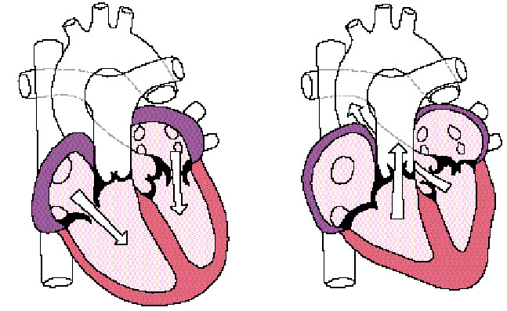
Heart Circulation
Aorta
Pulmonary
veins
Pulmonary
arteries
Left
Atrium
Left
Ventricle
Right Atrium
Vena Cava
Right Ventricle
PEER | MFR | INDIA
PPT 9 -

Slide 5
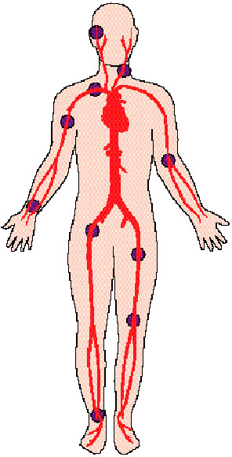
Carotid
Pulse Locations
Brachial
Radial
Femoral
Dorsalis Pedis
PEER | MFR | INDIA
PPT 9 -

Slide 6
Perfusion
The circulation of blood throughout an organ.
PEER | MFR | INDIA
PPT 9 -

Slide 7
Shock
Failure of the circulatory system to provide adequate oxygenated blood supply throughout the body (inadequate tissue perfusion).
PEER | MFR | INDIA
PPT 9 -

Slide 8

Photo Credit: Freepik
PEER | MFR | INDIA
PPT 9 -

