Slide 1
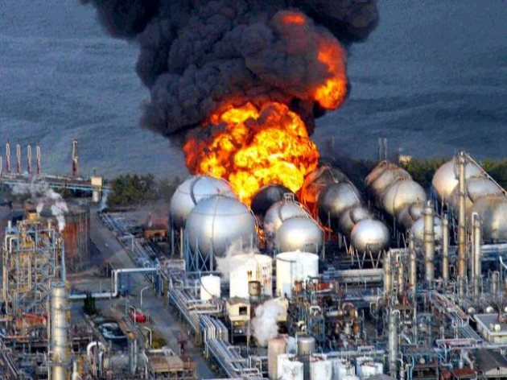





CASE STUDY OF FUKUSHIMA
Presented By:- Amit Kumar, AC

Slide 2
Where is Fukushima Daiichi Nuclear power plant.
Information about Fukushima nuclear power plant.
Reason of the accident.
Daily event of the accident.
Effects on alive.
Effects on social life.
Effects on environment.
Conclusion
OBJECTIVES
Upon completion of this lesson you will be able to:

Slide 3
FUKUSHIMA NUCLEAR POWER PLANT
Japan Have 05 major I-Land.
1. Hokkaido
2. Honshu
3. Shikoku
4. Kyushu
5. Okinawa
In Above 05 I-land Fukushima Nuclear Power Plant Located in Honshu I-Land

Slide 4
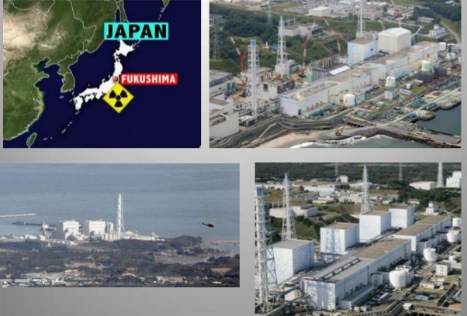
FUKUSHIMA NUCLEAR POWER PLANT

Slide 5
INFORMATION ABOUT FUKUSHIMA NUCLEAR POWER PLANT
Fukushima nuclear power plant start constructed in | 25th of July 1967
Fukushima nuclear power plant commission date | 26th of march 1971
Total Number of Plant | 06
At the time of accident number of reactor in working Condition | Reactor no 1-3
Condition of remaining Reactor 4-6 | Shutdown due to maintenance
Type of Reactor | BWR
De-commission Date | 11th March 2011
Operated by | Tokyo electric power company

Slide 6
REASON OF THE ACCIDENT
On March 11, 2011, a massive 9.0 magnitude Earthquake and powerful tsunami slammed the north-eastern region of Japan.
Huge seismic activities knocked out the power at the Fukushima Nuclear Power Plant,
Due to Tsunami about 15 meters high tidal waves appear near Fukushima Nuclear plant and all power supply and cooling system with backup generators of active reactor are failed.
This triggered a series of hydrogen explosions and released dangerously high levels of radioactive particles into the atmosphere.

Slide 7
REASON OF THE ACCIDENT
The Japanese government declared a nuclear emergency.
The worst nuclear crisis in Japanese history, and decided to evacuate 430,000 residents within twenty kilometres of the plant to various relocation centres. These natural events caused extensive damage to coastal communities.
Due to this Nuclear disaster about 5178 deaths and 8913 missing persons (National Police Agency of Japan , 2014).

Slide 8
ACCIDENT CAUSE
11/03/2011, 2:46 p.m. local time near the Japanese island of Honshu was an Earthquake and Tsunami (TOHOKU )of 9.0 on the Richter scale.
The quake had an impact on section of north-east coast of Japan where they are located a series of nuclear power plants (NPP).

Slide 9
EVENT DISCRIPTION 11.03.2011
Units 4-6 in shut down status for periodic maintenance and refueling
Units 1-3 were stopped automatically after the quake
Reactor buildings and the containment successfully resist to the earthquake
All reactor were disconnected from the external AC supply
Backup sources (diesel generators) started

Slide 10
EVENT DISCRIPTION 11.03.2011
At approximately one hour after the earthquake tsunami hit the site
destroyed fuel tanks of the diesel generators
flooded the diesel generator building
(10m protection wall was not sufficient)
Mobile generators were sent to the site in a short time but they ran out of fuel
Hydrogen Explosion Unit 1
Evacuation of population from the area of 20km Daiichi NPP and 10km Daina NPP (approx. 200 000 person
On-site radioactivity increased

Slide 11
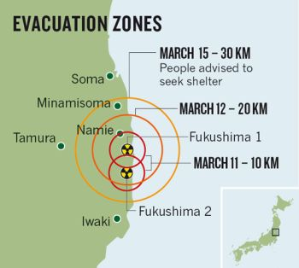
EVACUATION ZONES

Slide 12
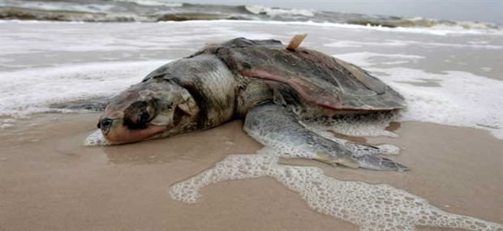
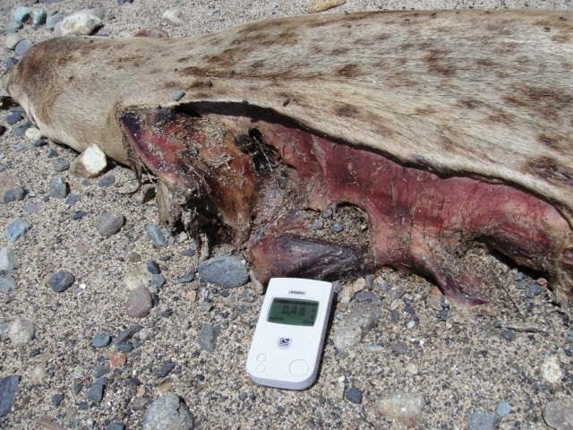
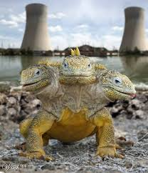

EFFECT ON MARINE LIFE AND ANIMALS

Slide 13

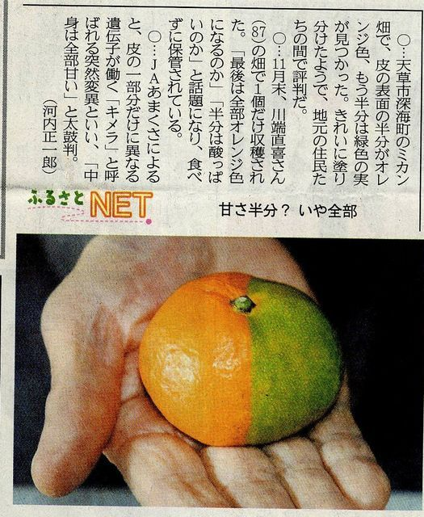

EFFECT ON PLANTS

Slide 14
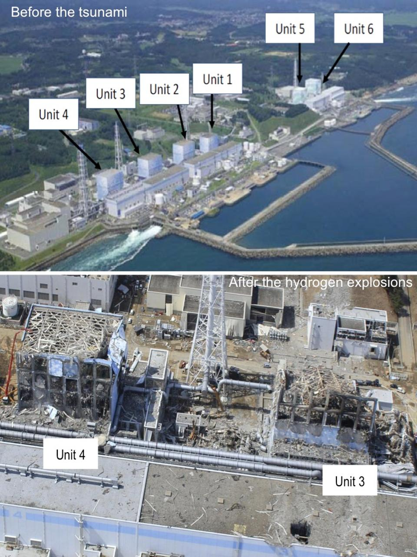
BEFORE AND AFTER

Slide 15


Where is Fukushima Daiichi Nuclear power plant.
Information about Fukushima nuclear power plant.
Reason of the accident.
Daily event of the accident.
Effects on alive.
Effects on social life.
Effects on environment.
Conclusion
REVIEW

Slide 16

ANY QUESTION?

Slide 17


1. When Fukushima Nuclear Power plant commissioned?
Ans- 26th of March 1971
2. When Fukushima disaster was occurred?
Ans- 11 March 2011
EVALUATION

Slide 18



THANK YOU

