Slide 1


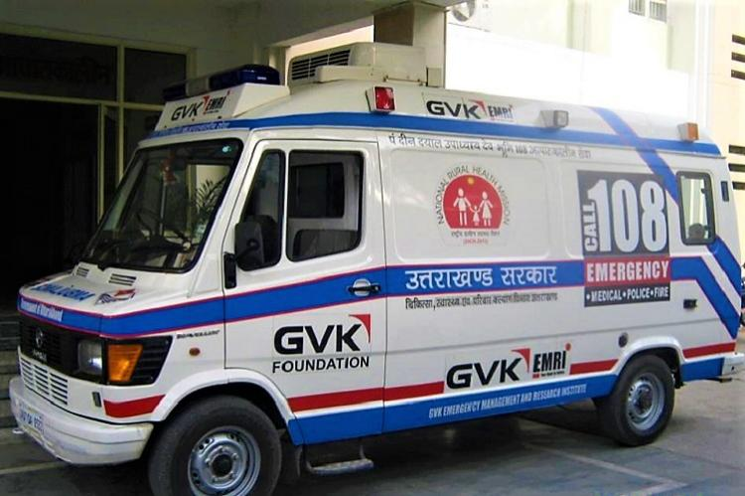

MEDICAL FIRST RESPONDER
LESSON 2
EMS and the Medical First Responder
PPT 2 -
PPT 2 - 1

Slide 2
OBJECTIVES
Upon completing this lesson, you will be able to:
1
  Describe the emergency medical services (EMS) system in the area you reside.
  List six duties and/or responsibilities of the medical first responder (MFR).
2
PPT 2 -

Slide 3
OBJECTIVES
Upon completing this lesson, you will become familiar with:
3
  Define negligence and give an example as it relates to EMS.
  Define abandonment and give an example as it relates to EMS.
  Define implied consent and expressed consent.
4
5
PPT 2 -

Slide 4

Emergency Medical Services System (EMS)
A network of resources linked together for the purpose of providing emergency care and transport to victims of sudden illness or injury.
PPT 2 -

Slide 5
Sample EMS Flowchart
Community
EMS Dispatcher/
Control Room
EMI /
In house
Fire Service
Rescue Groups
Fire Dept.
Hospital Centre
PEER | MFR | INDIA
PPT 2 -

Slide 6
Sample EMS Flowchart
Community
EMS Dispatcher
Fire Dept.
Red Cross
Rescue Groups
Hospital Centre
PPT 2 -

Slide 7

Medical First Responder
The first person on the scene of an incident with emergency medical care skills, typically trained at the most basic EMS level.
PEER | MFR | INDIA
PPT 2 -

Slide 8

Ensure your safety and the safety of your crew, the patient, and bystanders
Gain access to the patient
Assess the patient to identify life-threatening problems
Alert additional EMS resources
Provide care based on assessment
Duties of
the MFR
PEER | MFR | INDIA
PPT 2 -

Slide 9
Assist other EMS personnel
Participate in record-keeping and data collection as received
Act as liaison with other public safety workers
Perform patient packaging and preparation for movement and transport
Duties of
the MFR
PEER | MFR | INDIA
PPT 2 -

Slide 10
Actions that are legally allowed by the MFR when providing patient care.
Scope of Care
PEER | MFR | INDIA
PPT 2 -

Slide 11
Duty to Act
The contractual or legal obligation on the MFR to provide care.
PEER | MFR | INDIA
PPT 2 -

Slide 12
Discontinuing emergency medical care without making sure that another health care professional with equal or better training has taken over.
Abandonment
PEER | MFR | INDIA
PPT 2 -

Slide 13
Failure to provide the expected standard of care, causing injury or death of the patient.
Negligence
PEER | MFR | INDIA
PPT 2 -

Slide 14
To solicit and receive pre-hospital care
Confidentiality regarding personal information and condition
To pursue legal recourse for acts of negligence, abandonment, and/or violations of confidentiality
Rights of
the Patient
PEER | MFR | INDIA
PPT 2 -

Slide 15
In some situations, the patient has the right to refuse care. The patient may be required to sign a refusal form in the presence of a witness
Rights of
the Patient
PEER | MFR | INDIA
PPT 2 -

Slide 16
Consent assumed on the part of an unconscious, confused or seriously injured patient or, for a minor patient that cannot make decisions.
Implied Consent
PEER | MFR | INDIA
PPT 2 -

Slide 17
Permission obtained from every responsive, competent adult patient before providing emergency care.
Expressed Consent
PPT 2 -

Slide 18
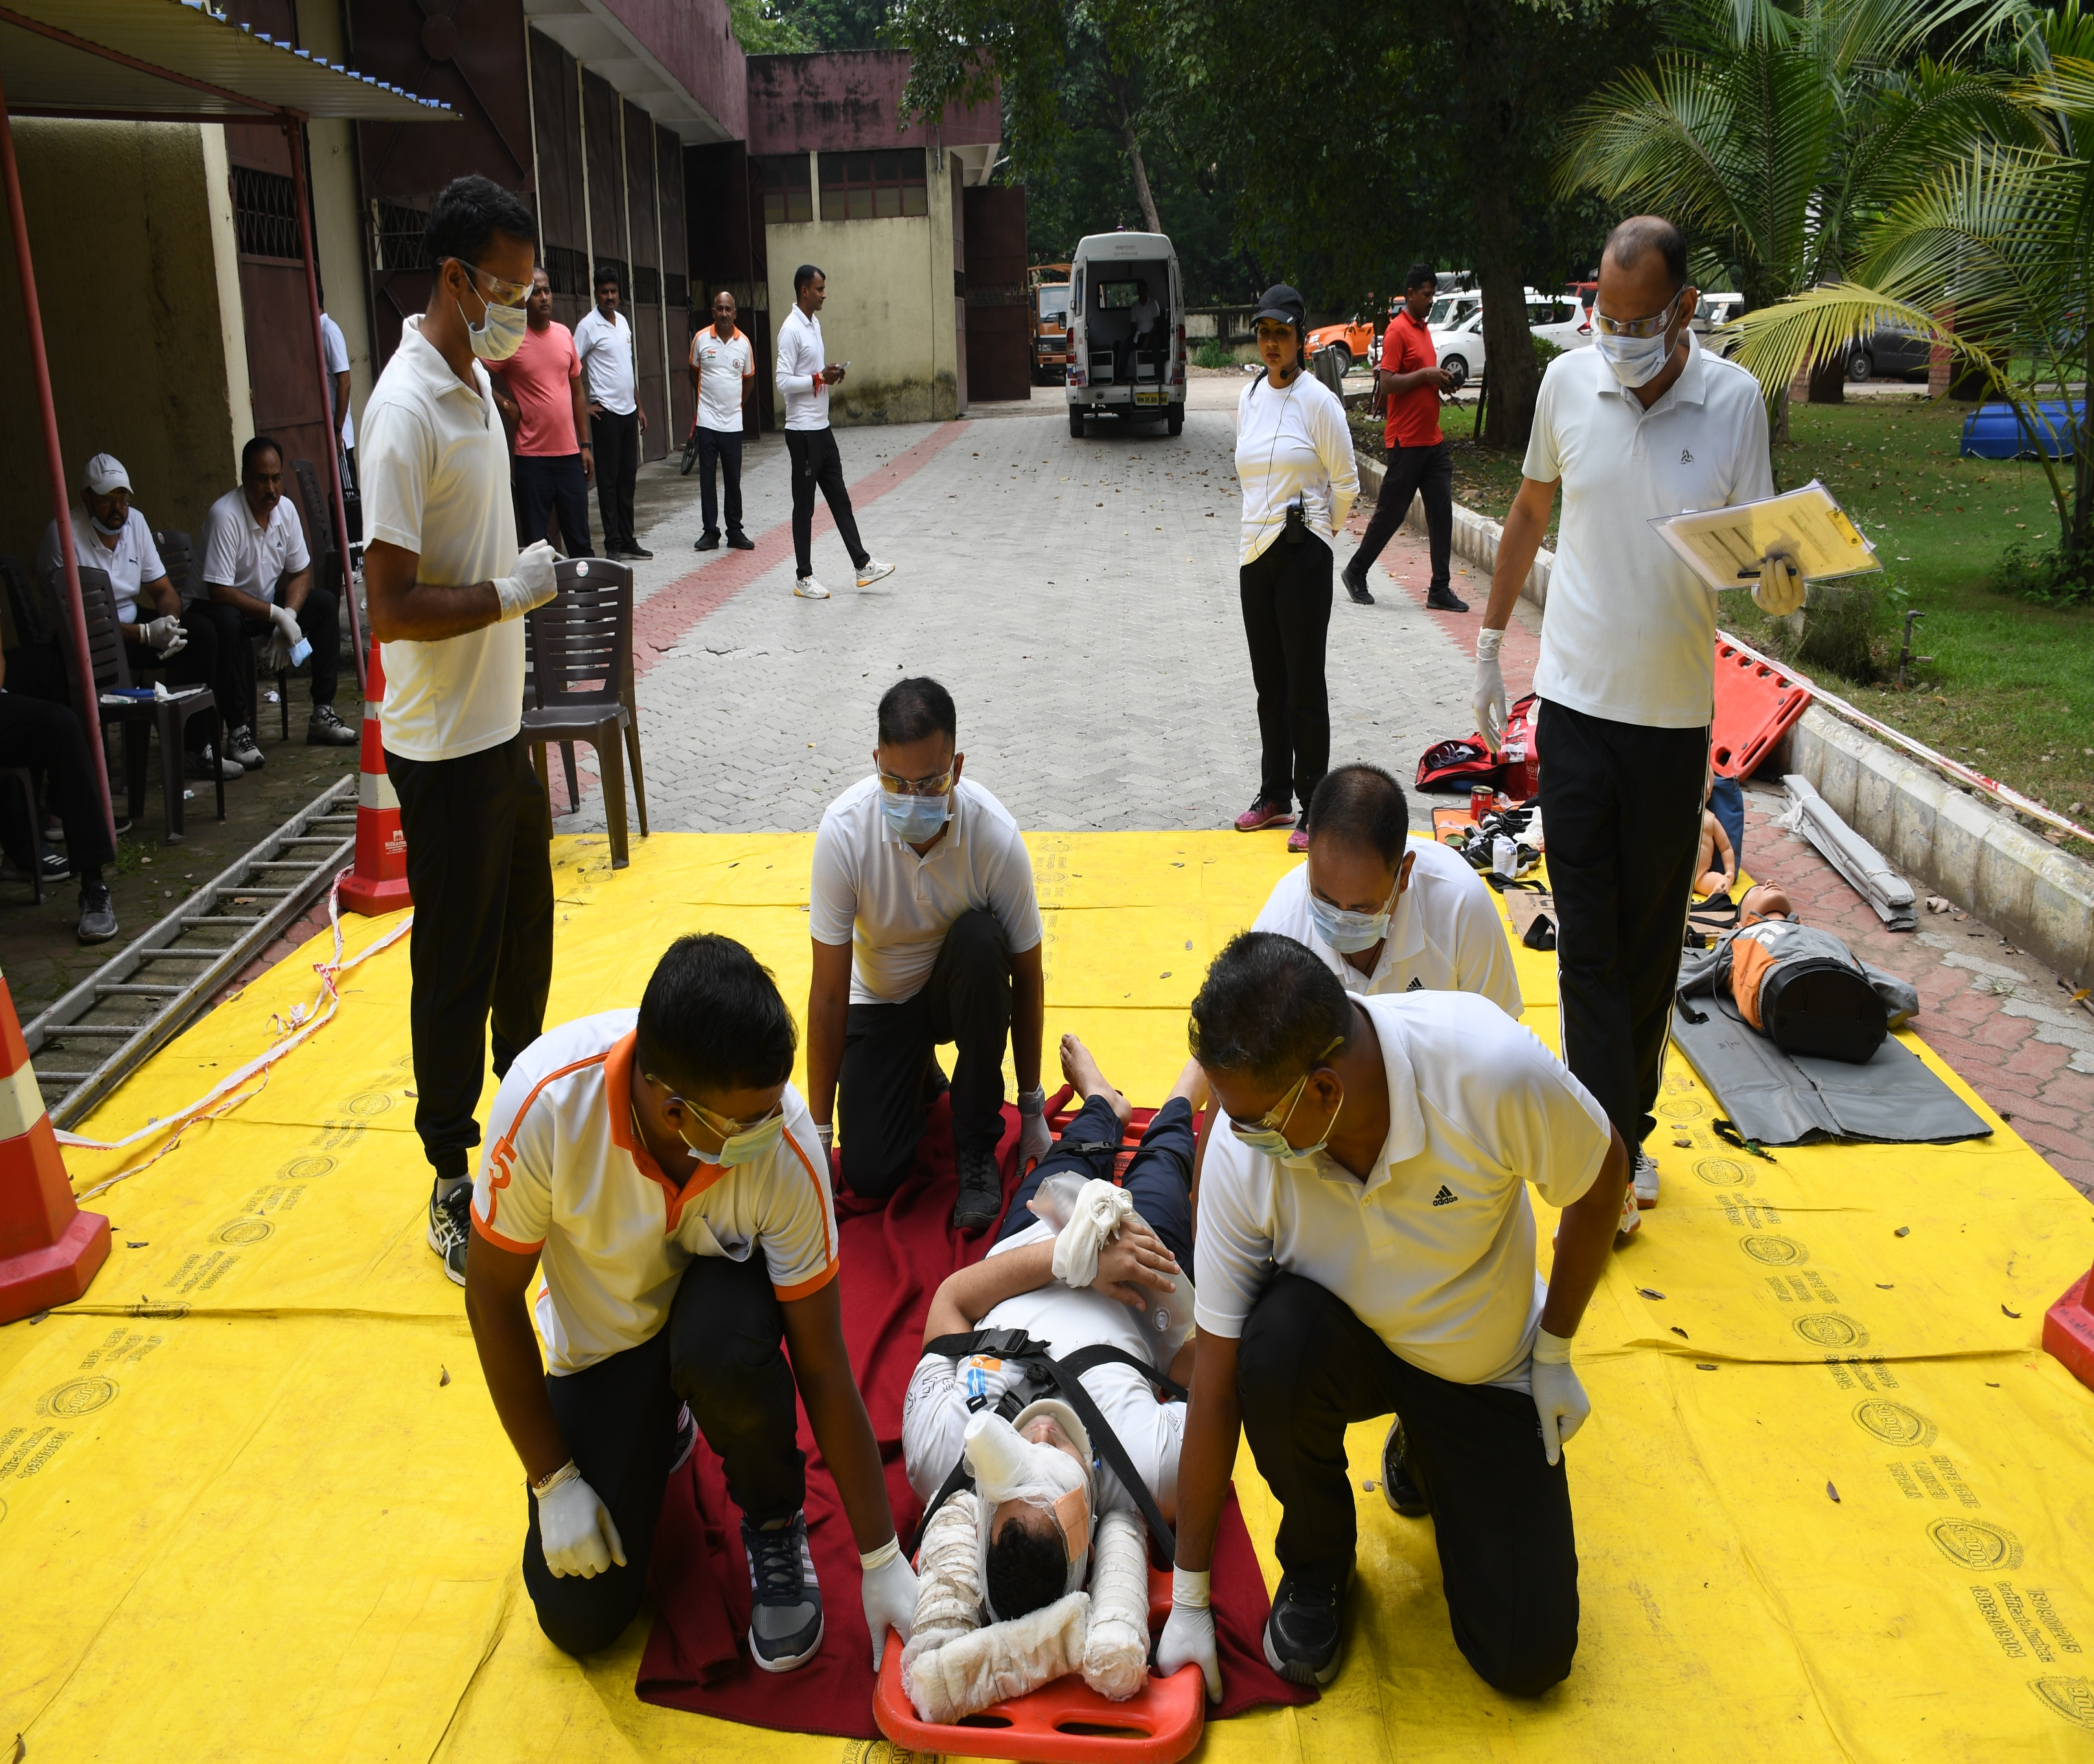

PEER | MFR | INDIA
PPT 2 -

