Slide 1


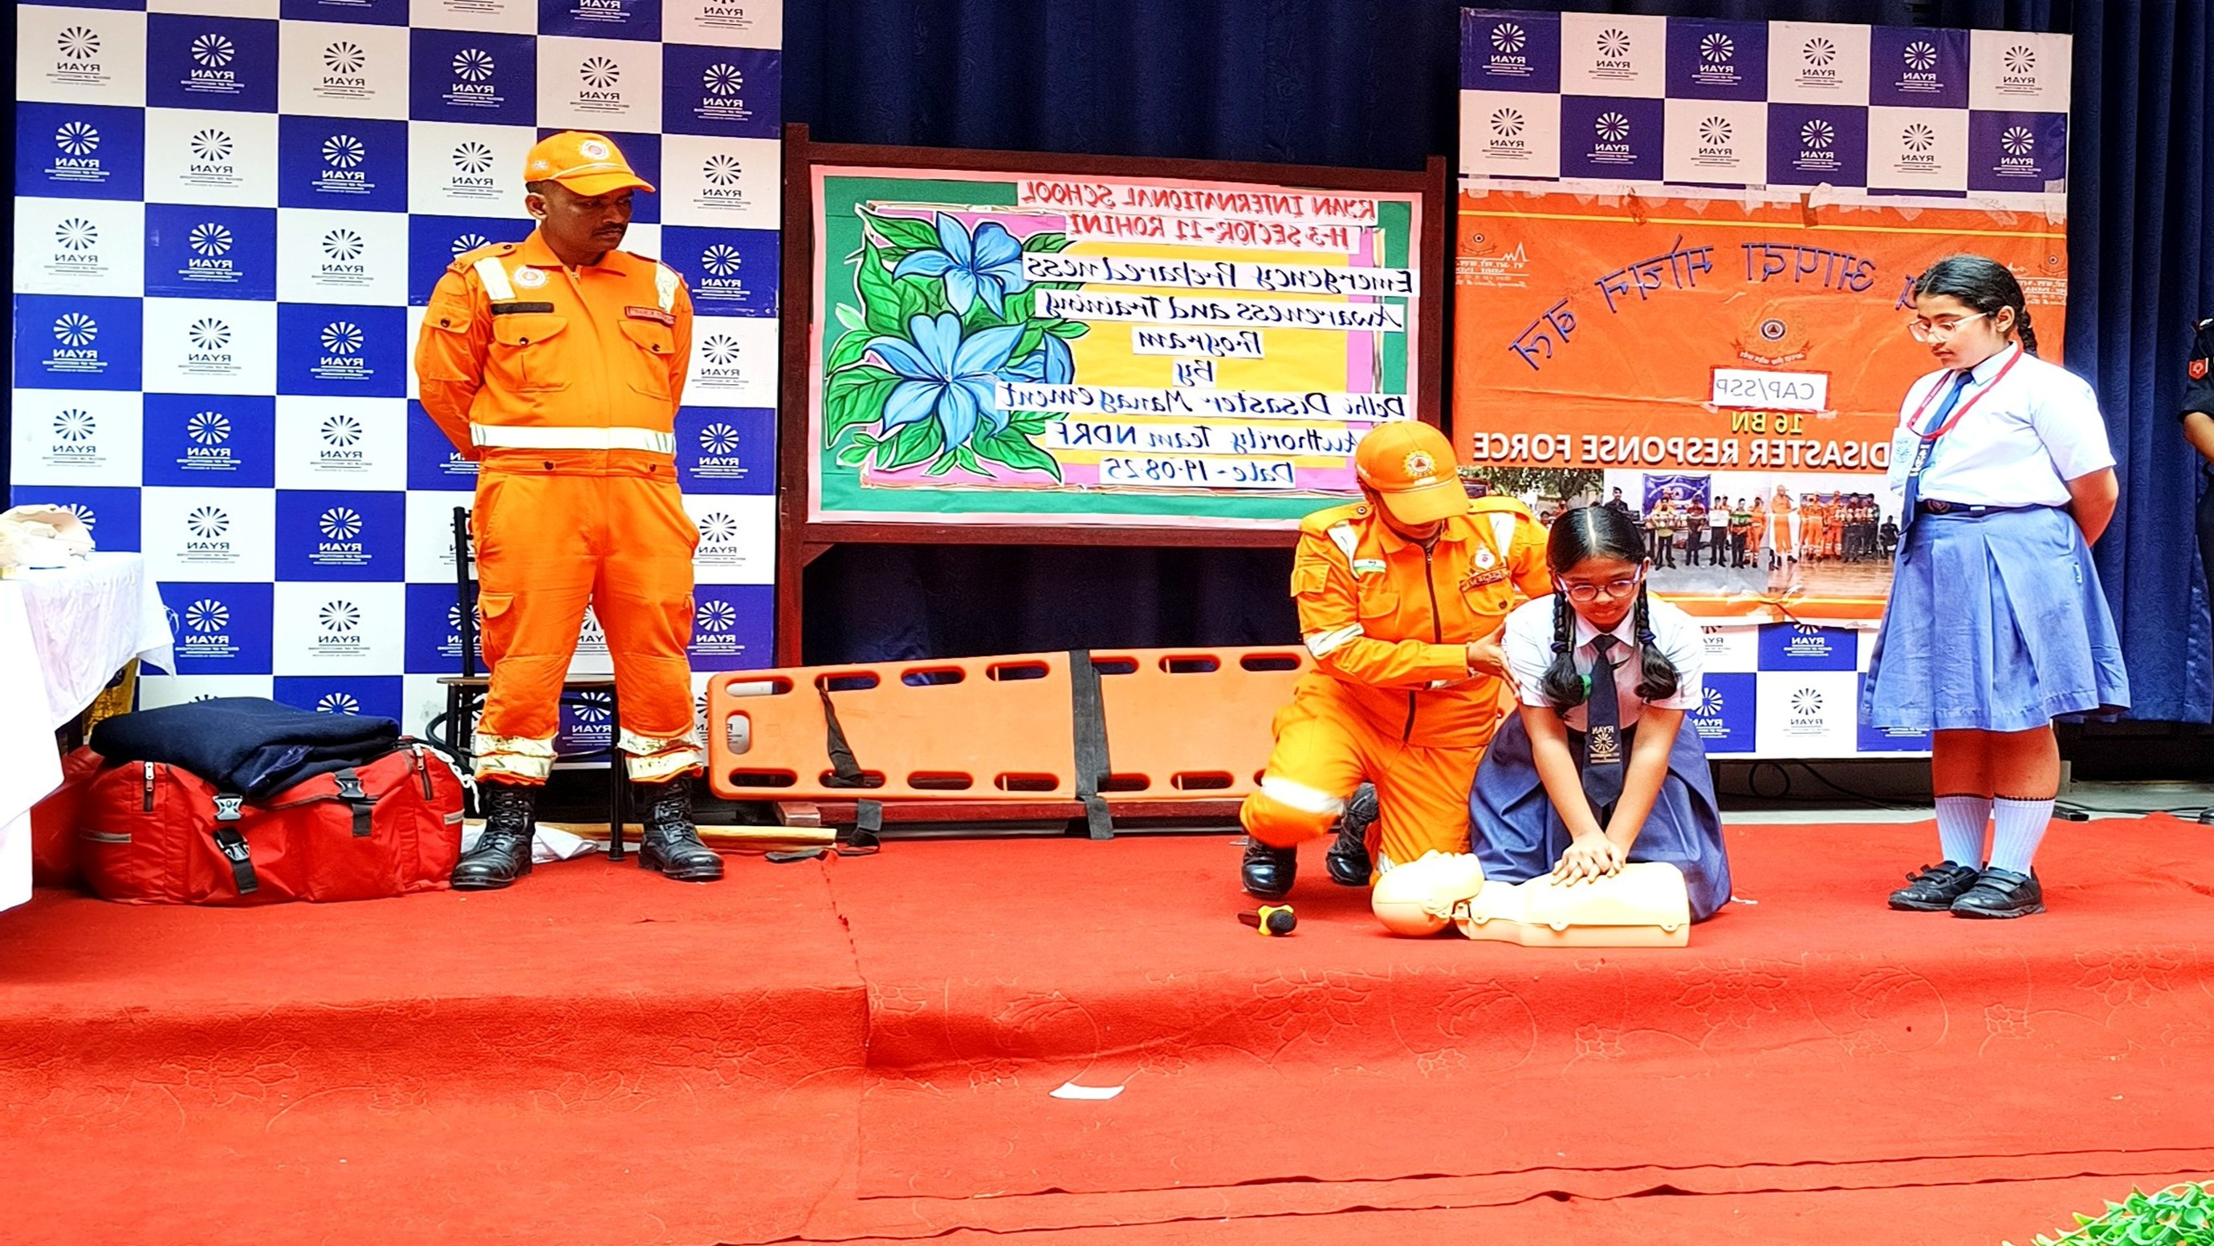
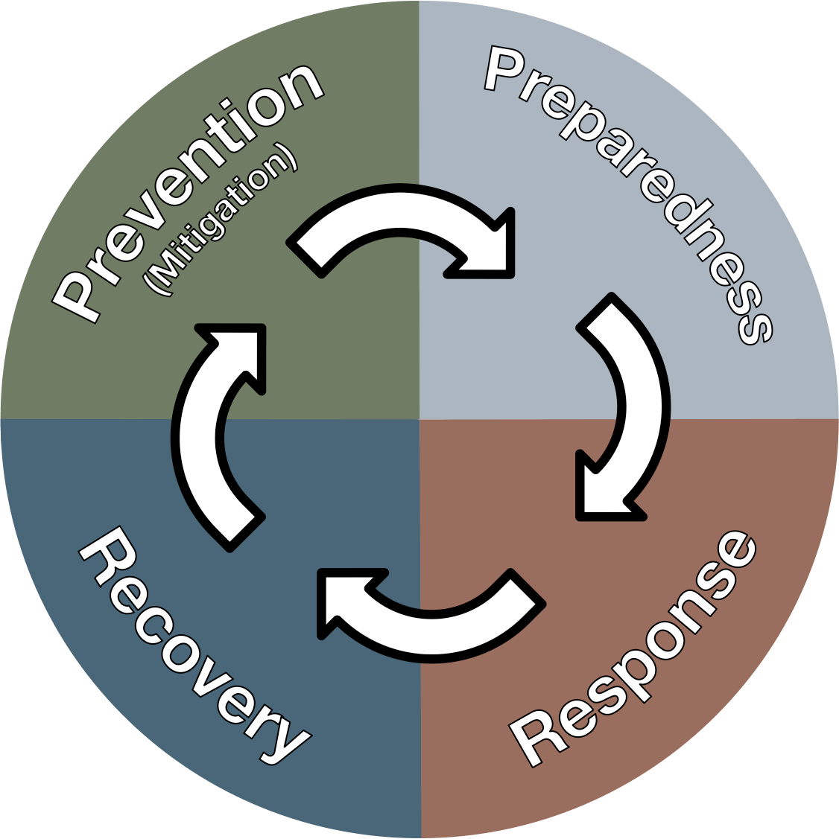
DISASTER MANAGEMENT ORIENTATION
LESSON 04
Concept of School Safety
NDRF | DMO | INDIA
PPT 4 - 1

Slide 2
OBJECTIVES
Upon completing this lesson, you will be able to:
1
  Acquaint with Aims of School Safety.
  Know about direct and indirect effect of disaster on schools
  Know about National Policies and Instrument on School Safety
2
3

Slide 3
OBJECTIVES
Upon completing this lesson, you will be able to:
4
  Know about 10 preparatory steps for school safety
  Know About structure and role of School Disaster Management Committee
  Know about 09 phases of school safety drills
5
6

Slide 4
AIM OF SCHOOL SAFETY
To ensure that the safety of the students and the staff is maintained during an emergency
Raising disaster awareness in school community
Hazard Vulnerability Risk and Capacity analysis
Facility and resource mapping

Slide 5
AIM OF SCHOOL SAFETY
CONT.
Constitution and training of ‘School Disaster Management Committee’ and task forces
Establishing alert mechanism
Strengthening local disaster risk management structures
Preparing school disaster management plan

Slide 6
AIM OF SCHOOL SAFETY
CONT.
Organizing mock drills
Psycho-social support for children during disasters.
Consideration of disability and gender-based needs
Periodic review and regular updating of SDMP
School safety audit

Slide 7







History of Disasters in School
In Dabwali (Haryana) about 200 students, killed in school fire.
1995
2001 Bhuj Earthquake, Killed 971 students and 31 teachers.
2001
02
Kumbakonam, Tamilnadu, Fire tragedy, killed 94 children.
2004

Slide 8

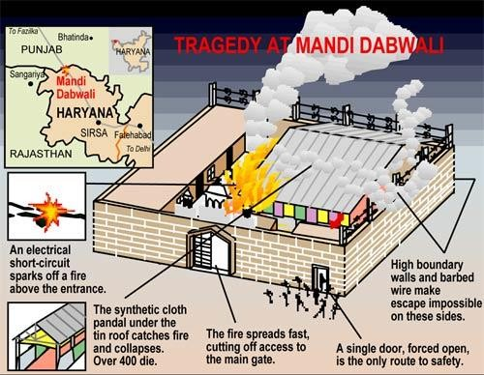

Slide 9


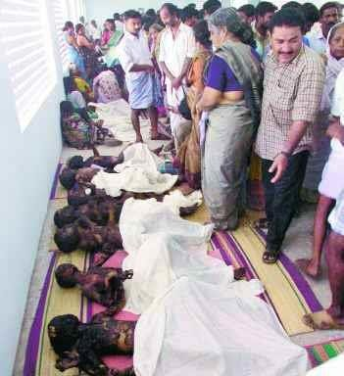
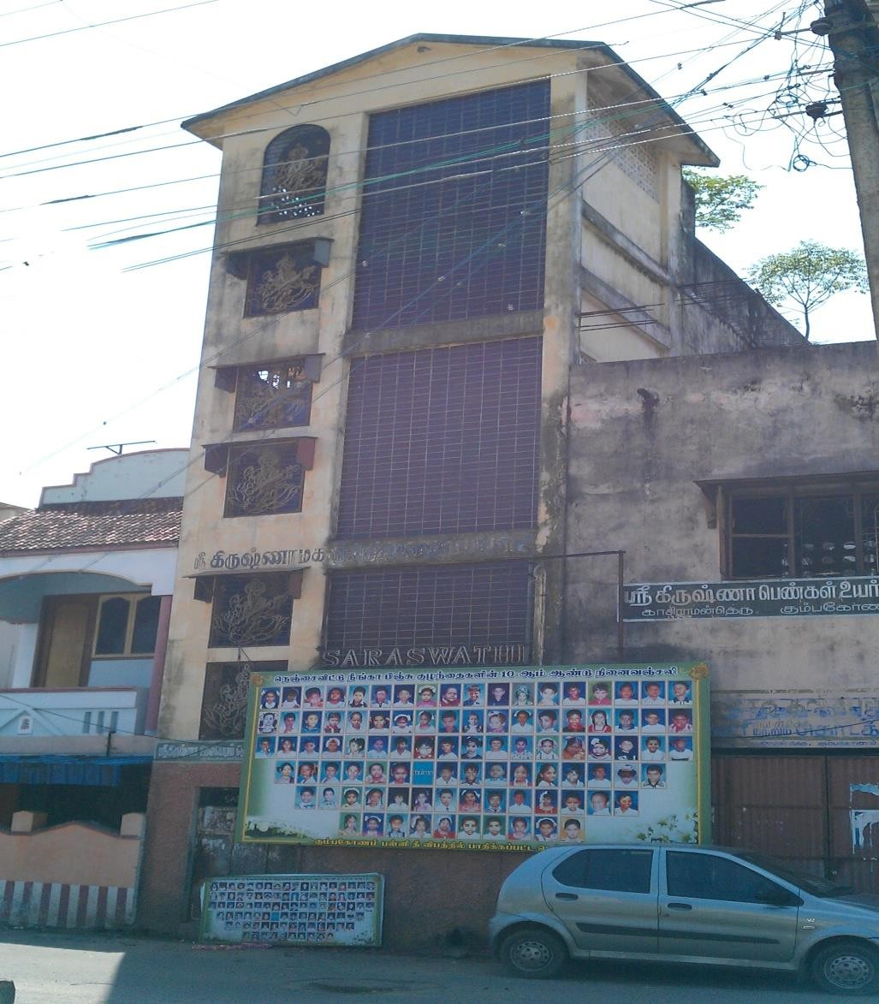

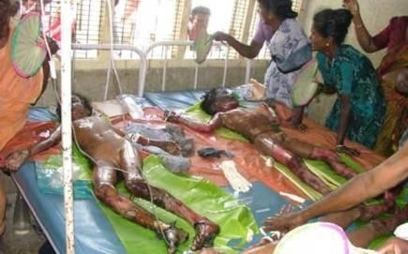
Kumbhakonam Fire Tradegy

Slide 10
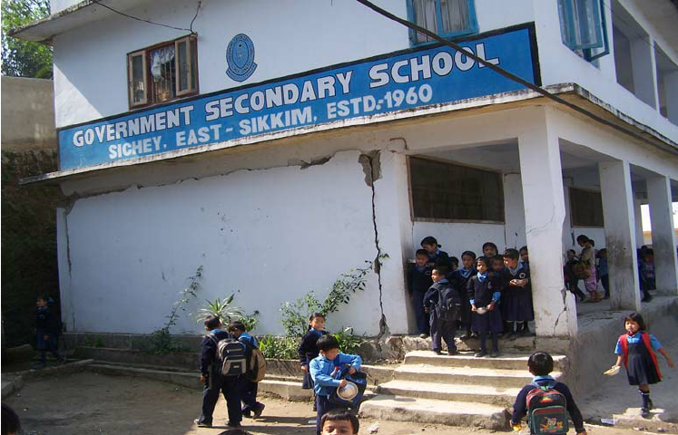
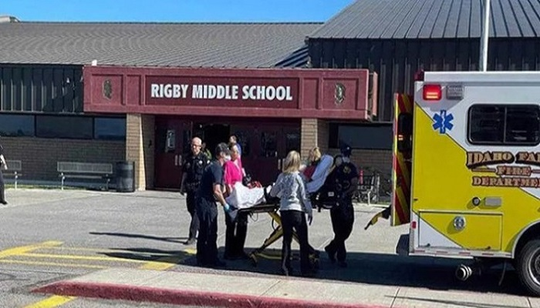
Effect of Disaster on School
Damaged school building
Direct effects
Injured students and staff

Slide 11
Indirect effects
Loss of trust in education
Decrease in education quality
Psycho social impacts
Increased dropout rates
Increased stress
Effect of Disaster on School
Indirect effects

Slide 12
Psychosocial impacts
Psychological Impact (Insecurity & Fear)
Schools closed & Shelters
Drop out rate may Increase
Suspension or disruption of education

Slide 13
NATIONAL POLICY INSTRUMENTS
National Disaster Management Act (2005)
National Policy on Disaster Management (NPDM) 2009
National Policy on Education (NPE)
Right to Education Act 2009
National School Safety Policy Guidelines
PPT 4 -

Slide 14
Supreme court verdict: 2004
All the educational institutions to have DM Plans in place.
Institutions seeking affiliation need to have DM Plans in place.
All new educational institutions need to adhere to building codes.
Retrofitting of existing buildings.
Fire safety measures in schools
PPT 4 -

Slide 15
Supreme court verdict: 2004
Training of schoolteachers and other staffs
School building specifications (RCC Roof, staircases, ventilation)
NDMA Guidelines must be implemented in letter and spirit
DEO/BEO to be a "Nodal officer" to ensure strict compliance
CONT.
PPT 4 -

Slide 16
Right to Education Act - 2009
RTE Act 2009 guarantees free and compulsory education to all the children in the country till the age of 14.
The Act sets minimum norms and standards with regard to location and quality of schools.
One of the key standards is in relation to access to “All Weather Buildings.”
PPT 4 -

Slide 17
Preparedness for School Safety
Composition of team and its roles and responsibilities
Constitution of sub -teams and identification of roles
Resource Inventory
Mechanism for alerting students and teacher
Map with evacuation plan in place
PPT 4 -

Slide 18
Preparedness for School Safety
Annual calendar for conducting various preparedness
Action plan for conducting mock drills
Steps for updating of DM Plan
Earthquake drill / fire / Chemical accident drill
Capacity building and training
CONT.
PPT 4 -

Slide 19
structure for a School Disaster Management Committee
(SDMC)
PRINCIPAL
VICE PRINCIPAL
EDUCATION OFFICER/
DEPUTY EDU. OFFICER OF ZONE
4 STUDENTS
NCC
NSS
S&G
HEADBOY/
HEAD GIRL
REPRESENTIVE OF RELIEF
REVENUE
DM DEPT
DIST. ADM
MUNICIPAL CORPORATION
FIRE SERVICE
FROM NEAREST FIRE STATION
POLICE
HEALTH DEPARTMENT
PARENTS TEACHER ASSOCIATION PRESIDENT
WARDEN FROM CIVIL DEFENCE

Slide 20
School Disaster Management Committee (SDMC)
Disaster Awareness Team
Awareness Group
Warning and Information Dissemination Team
Activity and Event Organizing Team
School Disaster Management Committee
Evacuation Team
Search and Rescue Team
First Aid Team
Response Group
Site Security Team
Principal
(Chief of SDMC)
Fire Safety Team
Bus Safety Team

Slide 21
Roles and Responsibilities of SDMC
Help school in preparation & evaluation of DM Plan
Look into structural safety of school
Work out financial aspects of preparedness & mitigation measures.
Arrange conduct of Mock Exercises on various types of disaster twice a year.
During disaster, help in coordinating various groups and teams
PPT 4 -

Slide 22
SCHOOL DM PLAN
Playground
School canteen
Laboratories & Library
Class rooms in the school building
Social mapping

Slide 23
School DM Plan
Identification of safe places in the school
Senior section
Alternative staircases/ routes to be identified
SCHOOL DM PLAN
Safe and alternate route Mapping

Slide 24
School DM Plan
Identification of safe places in the school
Senior section
Alternative staircases/ routes to be identified
Safe and alternate route Mapping

Slide 25
DISASTER MANAGEMENT TEAMS
Composition
Teacher in charge of Disaster Management.
Art & Craft Teacher.
Drama & Music Teacher.
1-2 parents (working with media/NGO)
1-2 students (good speaker & creative).
Disaster Awareness Group
PPT 4 -

Slide 26
DISASTER MANAGEMENT TEAMS
Roles
Obtain IEC materials posters, pamphlets, simple tips on do's and don'ts in different disasters, street plays and "Nukkad nataks“
Conduct awareness generation activities
Organize demonstrations
Posters, bulletin boards, exhibitions etc.
Disaster Awareness Group
PPT 4 -

Slide 27
DISASTER MANAGEMENT TEAMS
Composition
Disaster management teacher
Art and Craft teacher Music teacher
Prefects/ active students
ACTIVITY/EVENT ORGANISING TEAM
PPT 4 -

Slide 28
DISASTER MANAGEMENT TEAMS
Roles
Organizing road show/ cycle rally
Drawing competition on disaster situation.
Quiz competition
Mock Drills/ simulation exercise.
Cultural programmes
ACTIVITY/EVENT ORGANISING TEAM
PPT 4 -

Slide 29
DISASTER MANAGEMENT TEAMS
Composition
Computer Teacher
Geography Teacher
Teacher with electronic background.
1-2 parents (working with IMD)
4-6 students ( who can operate VHF sets).
Warning & Information Dissemination Team
PPT 4 -

Slide 30
DISASTER MANAGEMENT TEAMS
Roles
Monitor & taking regular updates from TV/Radio/Internet
Inform management/principal of any disaster/ emerging disaster situation.
Disseminate information on main Notice Board and circulate in class rooms
Warning & Information Dissemination Team
PPT 4 -

Slide 31
DISASTER MANAGEMENT TEAMS
Composition
All class teachers.
Class monitors & hall monitor.
Prefects.
DISASTER RESPONSE GROUPS
PPT 4 -

Slide 32

DISASTER MANAGEMENT TEAMS
Roles
Duck, cover & hold at first sign of earthquake.
Evacuate in an orderly manner, in buddy system, with monitor leading & teacher bringing the last buddies along designated evacuation route.
DISASTER RESPONSE GROUPS
PPT 4 -

Slide 33
DISASTER MANAGEMENT TEAMS
Composition
Sports/PT teacher
NCC/Scouts & Guides Teacher.
Fire Services representative
CD Trainer.
1-2 parents (from uniformed forces)
Able bodied students
Search & Rescue Team
PPT 4 -

Slide 34
DISASTER MANAGEMENT TEAMS
Roles
Check every room in the building (visually & physically)
Start search and rescue
Report location of injured to first aid team,
Look for obvious structural problems/damages as sweep made through buildings/floors and report to Administrator/person responsible.
Search & Rescue Team
PPT 4 -

Slide 35
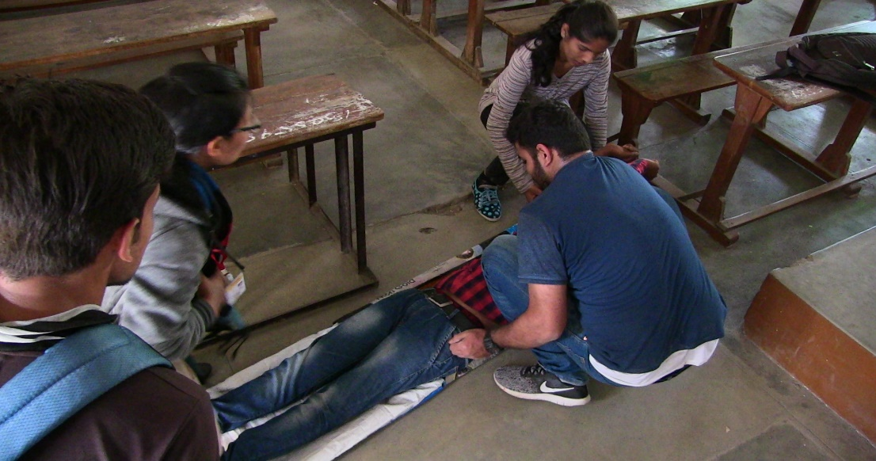

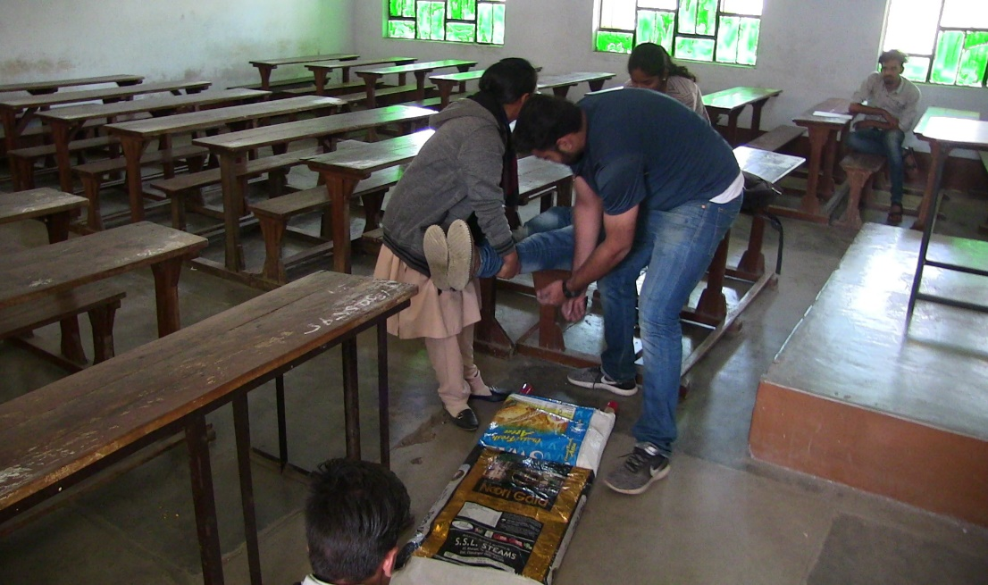

Slide 36
DISASTER MANAGEMENT TEAMS
Composition
School doctor.
School Nurse.
St. John/Red Cross volunteers.
Civil Defence Volunteers.
1-2 parents (doctors)
Students trained in first aid/ who have taken biology.
First Aid Team
PPT 4 -

Slide 37
DISASTER MANAGEMENT TEAMS
Roles
Administer first aid and record all cases & treatment.
Accompany search & rescue teams during search.
Help in evacuating seriously injured.
Aid the physically handicapped.
First Aid Team
PPT 4 -

Slide 38
DISASTER MANAGEMENT TEAMS
Composition
Teachers (2)
1-2 parents (from fire services/ Defence/
Paramilitary services/Civil Defence)
Students
Fire safety Team
PPT 4 -

Slide 39
DISASTER MANAGEMENT TEAMS
Roles
Make sure fire extinguishers are in working condition and placed on right way.
Look for condition which may cause a fire. i.e loose wire, Gas and fuel drum
Extinguish fire, if it occurs.
Switch off utilities
Alternative exit route and store must be clear
Fire safety Team
PPT 4 -

Slide 40
DISASTER MANAGEMENT TEAMS
Composition
School security staff
Teacher (1 numbers)
Students (2 numbers)
Site Security Team
PPT 4 -

Slide 41
DISASTER MANAGEMENT TEAMS
Roles
Control entry/ Exit point.
Crowd control
Control on students
Control traffic flow in the campus.
Site Security Team
PPT 4 -

Slide 42

DISASTER MANAGEMENT TEAMS
Composition
Teacher (traveling in respective buses).
Student getting down at last stop.
One senior most student in bus.
Transport Safety Team
PPT 4 -

Slide 43
DISASTER MANAGEMENT TEAMS
Roles
Pull over to side of road, if possible, in open.
Ensure special need students are assisted.
Assist giving first aid to injured students.
Establish communication with school Control Room
Transport Safety Team
PPT 4 -

Slide 44
Training of School Disaster Management Teams
First aid
Fire fighting
Search & rescue
Search & rescue

Slide 45
Phases of School Safety Drills
Phase 1: Alarm
Phase 2 : Response
Phase 3 : Evacuation
Phase 4: Assembly
Phase 5: Action by search & rescue team
Phase 6: First aid
Phase 7: Head Count
Phase 8: Evaluation
PPT 4 -

Slide 46

Alerting Device in School
Installation of siren
Public announcement system
Alarm
School bell

Slide 47
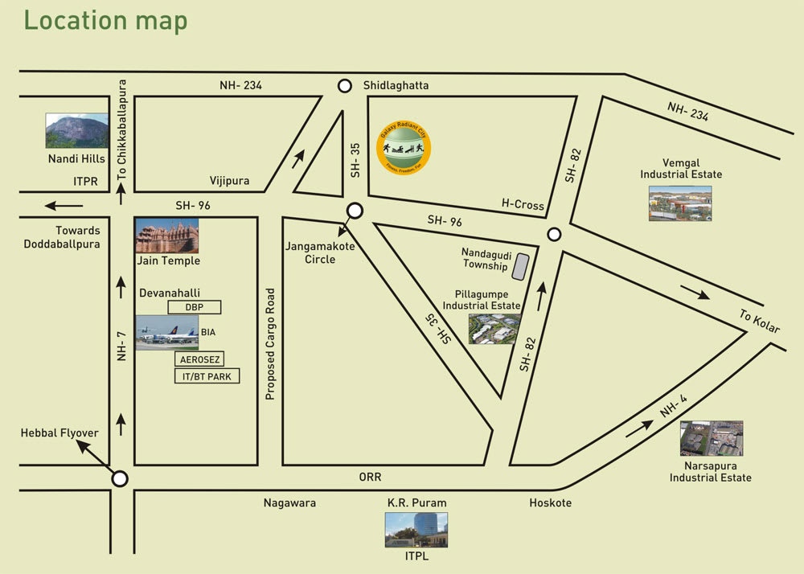
Mapping of School
Evacuation routes map
Resources map
Vulnerability map
Safe places map

Slide 48
Resource Inventory
Listing of resources available inside the school
Identification and listing of resources outside the school within vicinity of One/Five Kilometers
Nearest hospitals/police station/fire station/Rescue teams

Slide 49
Important Points School Safety
Display the Dos & Don'ts and Evacuation Plan of your school building with safe and unsafe places.
Every class must be oriented & a movie on mock drill should be shown.
Observers should be located at danger places to prevent any injury
All Students & staff members must be aware about assembly point & warning sign for drills.
PPT 4 -

Slide 50
Important Points School Safety
Each classroom should be checked for damaged benches & other furniture which may harm students during drill.
Identify safe & danger zone in school
Evacuation plan for students, teachers & other staff
Specific instructions on what to do during disaster and after disaster
CONT.
PPT 4 -

Slide 51
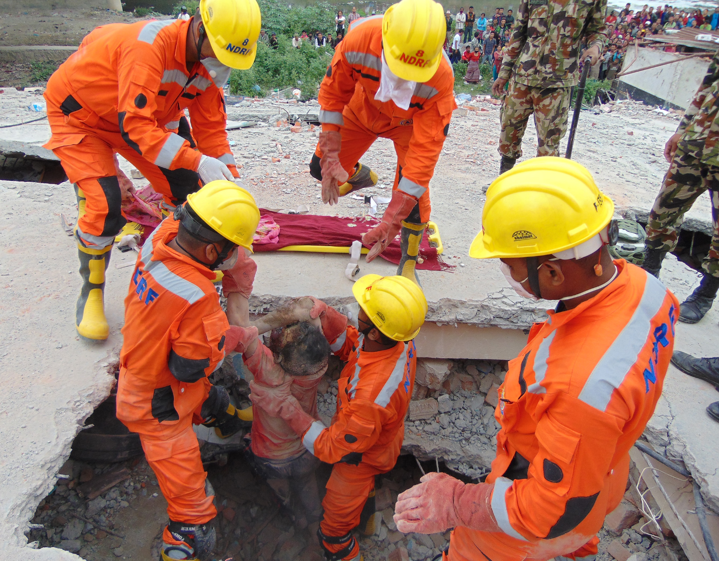

THANK YOU

