Slide 1
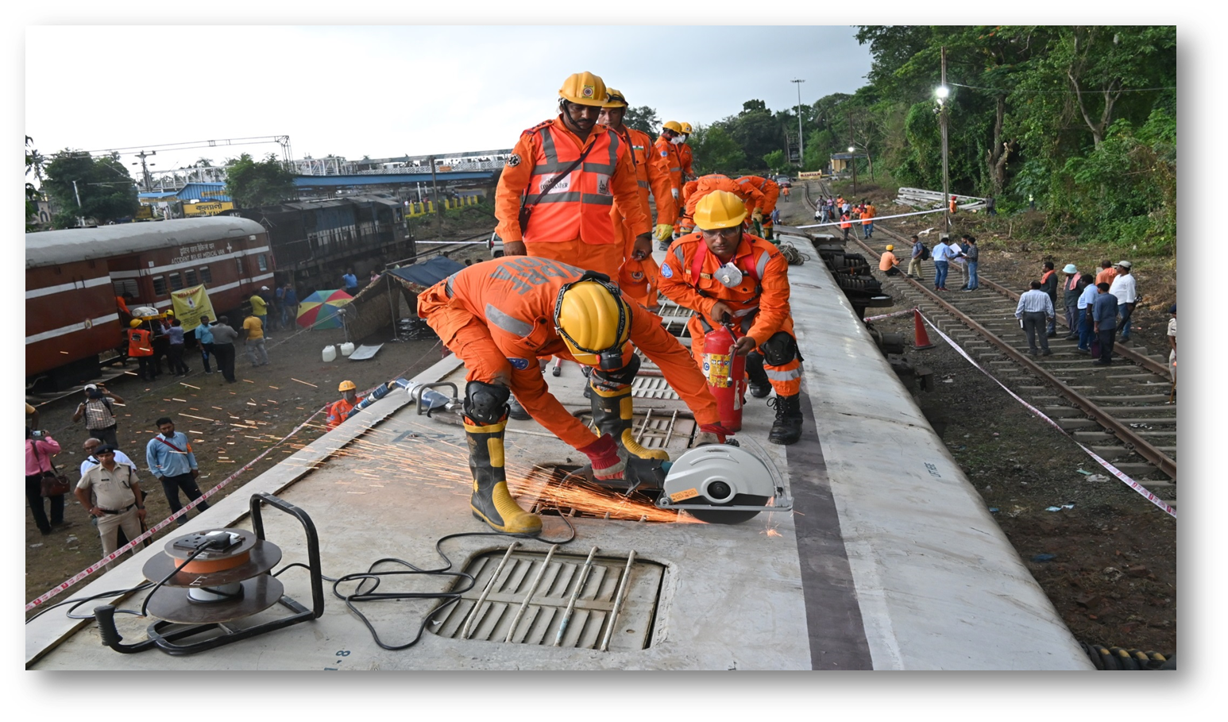


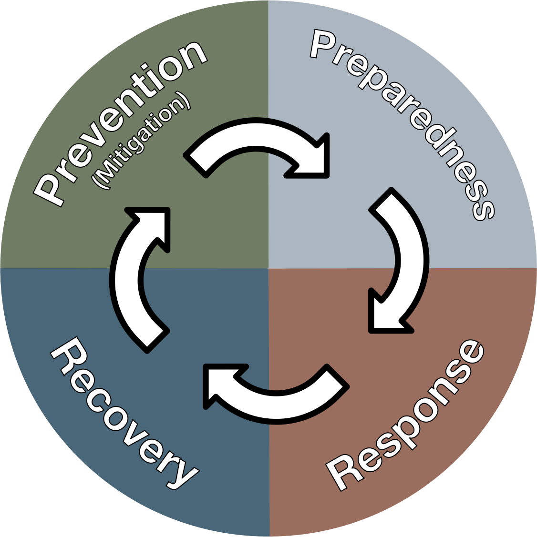
DISASTER MANAGEMENT ORIENTATION
LESSON 03
Concept of mock exercise
NDRF | DMO | INDIA
PPT 3 - 1

Slide 2
OBJECTIVES
Upon completing this lesson, you will be able to:
1
  Understand the concept and purpose of Mock Exercise.
  Know 03 key steps for conduct of Mock Exercise
  Know 04 important aspects of planning of Mock Exercise
2
3

Slide 3
OBJECTIVES
Upon completing this lesson, you will be able to:
4
  Know 04 important aspects of conduct of Mock Exercise
  Know the important Points to be kept in mind during conduct of Mock Exercise
5

Slide 4
Mock Exercise
A mock exercise, also known as a simulation or drill, is a planned and controlled activity that mimics a real-life scenario or emergency situations to test and evaluate an organization's response, preparedness, and readiness.

Slide 5
purpose of mock exercise
Test emergency response plans and procedures
Identify gaps and weaknesses in current plans and procedures
Train personnel on their roles and responsibilities
Improve communication and coordination among teams and stakeholders and highlight the roles and responsibilities of various Stakeholders
PPT 3 -

Slide 6
purpose of mock exercise
Enhance decision-making and problem-solving skills
Reduce response times and improve overall efficiency
Build confidence and familiarity with emergency procedures
To generate public awareness by involvement of Local Authorities
To identify the gaps
CONT.
PPT 3 -

Slide 7
Steps for Conduct of Mock Exercise
STEP-I: Coordinating Conference
STEP-II: Tabletop Exercise (TTEx)
STEP-III: Full-scale exercise

Slide 8
Planning and Preparation
Define objectives and scope
Identify Rescuer and roles
Develop scenario and injects
Establish evaluation criteria

Slide 9
Conducting the Mock Exercise
Brief participants and explain rules
Start the exercise and simulate scenario
Monitor and evaluate response
Provide feedback and guidance

Slide 10
Debriefing and Evaluation
Review response and identify areas for improvement
Discuss lessons learned and best practices
Documentation and recommendations
Action plan for improvements

Slide 11
Mock Exercise: important Points
Incident Response System (IRS) of local Govt should be made applicable in the response mechanism
Emergency Response Center (EOC) of the Local Govt should be made functional
Proper functioning of Base of Operation, Staging Area, BMS (Base Medical Station) should be made functional
PPT 3 -

Slide 12
Mock Exercise: important Points
Fail-safe safety and security measures are required to be adopted in letter and spirit
Medical component of the NDRF team should be fully equipped and accompanied by at least one Medical Officer
The creation of scenario should be based upon the geographical location and probable hazard and vulnerability of the target area or community
CONT.
PPT 3 -

Slide 13
Mock Exercise: important Points
Selection of most suitable site for the Mock Exercise
Efforts to be made to implement the disaster management plan of the local Govt
Adequate banners and signage
Adequate independent observers
Self-assessment by the stakeholder
CONT.
PPT 3 -

Slide 14
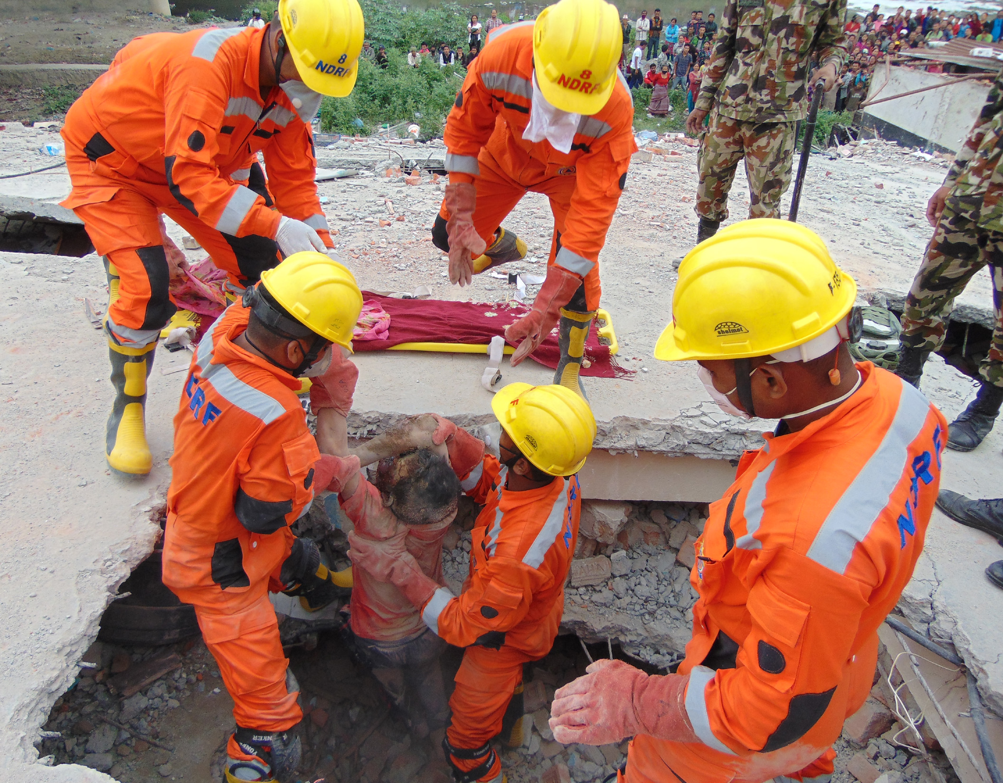

THANK YOU

