Slide 1
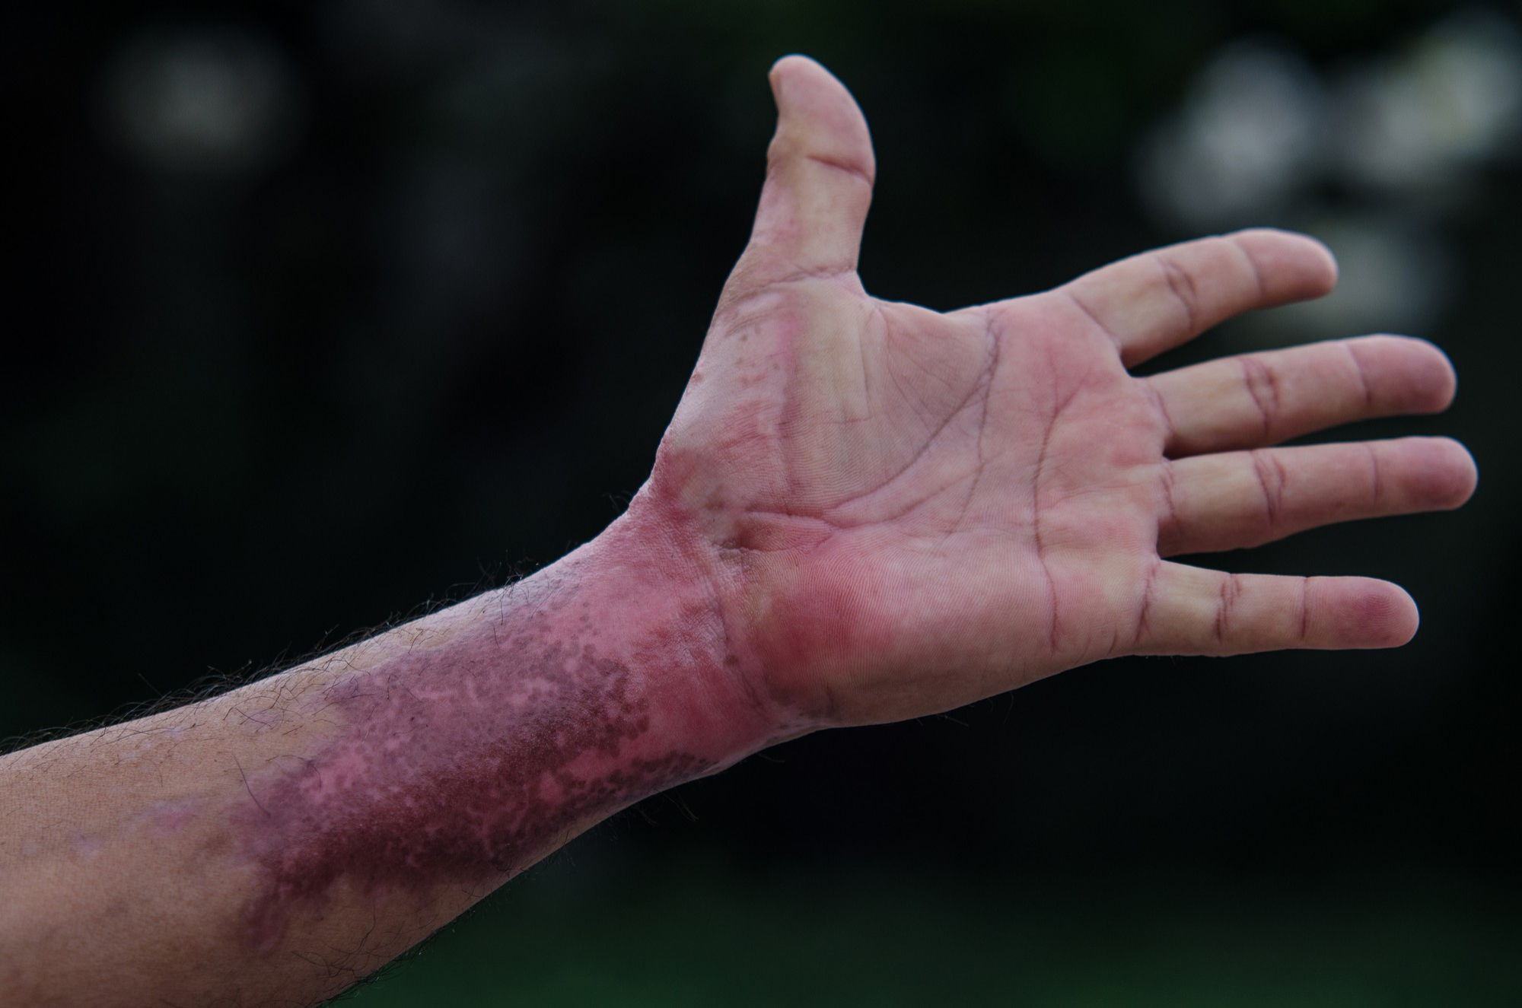



LESSON 13
Burns and Environmental Emergencies
Photo Credit: Freepik
MFR | INDIA
PPT 13 -

Slide 2

OBJECTIVES
Upon completing this lesson, you will be able to:
1
  Match the signs and symptoms for each of the three types of burns according to their depth.
  Apply the “Rule of Nines” to determine the Total Body Surface Area (TBSA) burnt on a patient when given a specific part of the body.
2
PEER | MFR | INDIA
PPT 13 -

Slide 3
OBJECTIVES
3
Upon completing this lesson, you will become familiar with:
  List three steps for pre-hospital treatment of chemical burns.
  List three steps for pre-hospital treatment of electrical burns.
  List three signs and symptoms of heat cramps, heat exhaustion and heat stroke and describe pre-hospital treatment for each.
4
5
PEER | MFR | INDIA
PPT 13 -

Slide 4
OBJECTIVES
6
  List four signs and symptoms of lightening injuries and describe pre-hospital treatment
  List three signs and symptoms of both mild and severe hypothermia and list six steps for pre-hospital treatment.
  List three signs and symptoms of frostbite and three steps for pre-hospital treatment.
Upon completing this lesson, you will become familiar with:
7
8
PEER | MFR | INDIA
PPT 13 -

Slide 5
Burns
Injuries caused by exposure to excessive heat from thermal, chemical, electrical or radiation.
PEER | MFR | INDIA
PPT 13 -

Slide 6
Burn Classifications
(By depth)
Superficial - I degree
Partial thickness - II degree
Full thickness - III degree
PEER | MFR | INDIA
PPT 13 -

Slide 7
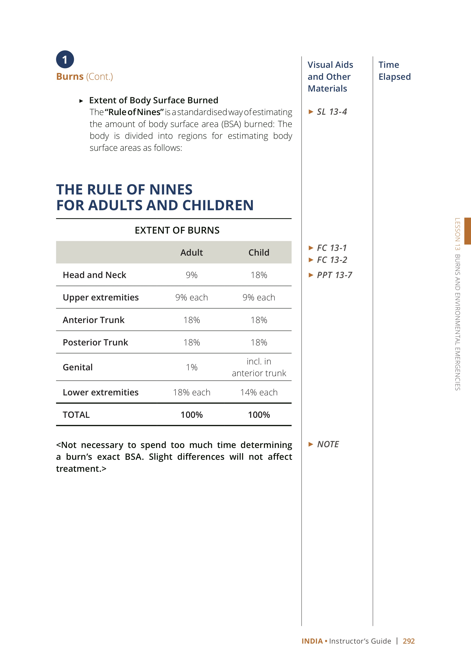
Rule of Nines
(% Body
Surface Area)
PEER | MFR | INDIA
PPT 13 -

Slide 8
Inhalation Injury
Signs and Symptoms
Singed nasal hair
Burns to the face
Specks of soot in the sputum
Sooty or smoky smell on the breath
Respiratory distress
PEER | MFR | INDIA
PPT 13 -

Slide 9
Inhalation Injury
Cont.
Signs and Symptoms
Hoarseness, cough, or difficulty speaking
Restricted chest movement
Cyanosis
PEER | MFR | INDIA
PPT 13 -

Slide 10
Heat Cramps
Signs and Symptoms
Severe muscle cramps
Exhaustion
Nausea
Periods of fainting
PEER | MFR | INDIA
PPT 13 -

Slide 11
Heat Exhaustion
Signs and Symptoms
Rapid, shallow breathing
Weak pulse
Cold, clammy and pale skin
Weakness
Dizziness
PEER | MFR | INDIA
PPT 13 -

Slide 12
Heat Stroke
Signs and Symptoms
Deep, rapid breathing
Rapid pulse fluctuating in strength
Dry, hot skin
Dilated pupils
Loss of consciousness
Convulsions or muscular tremors
PEER | MFR | INDIA
PPT 13 -

Slide 13
Lightening Injuries
Signs and Symptoms
Loss of conscience
Loss of circulation
Loss of respiration
Disorientation
Superficial burns
PEER | MFR | INDIA
PPT 13 -

Slide 14
Mild Hypothermia
Signs and Symptoms
Chills
Drowsiness
Rapid breathing, slow pulse
Loss of vision
Sluggish pupils
Uncontrollable shivering
PEER | MFR | INDIA
PPT 13 -

Slide 15
Severe Hypothermia
Signs and Symptoms
Extremely slow breathing
Extremely slow pulse
Unresponsiveness
Fixed, dilated pupils
Rigid extremities
PEER | MFR | INDIA
PPT 13 -

Slide 16

Photo Credit: Freepik
PEER | MFR | INDIA
PPT 13 -

