Slide 1
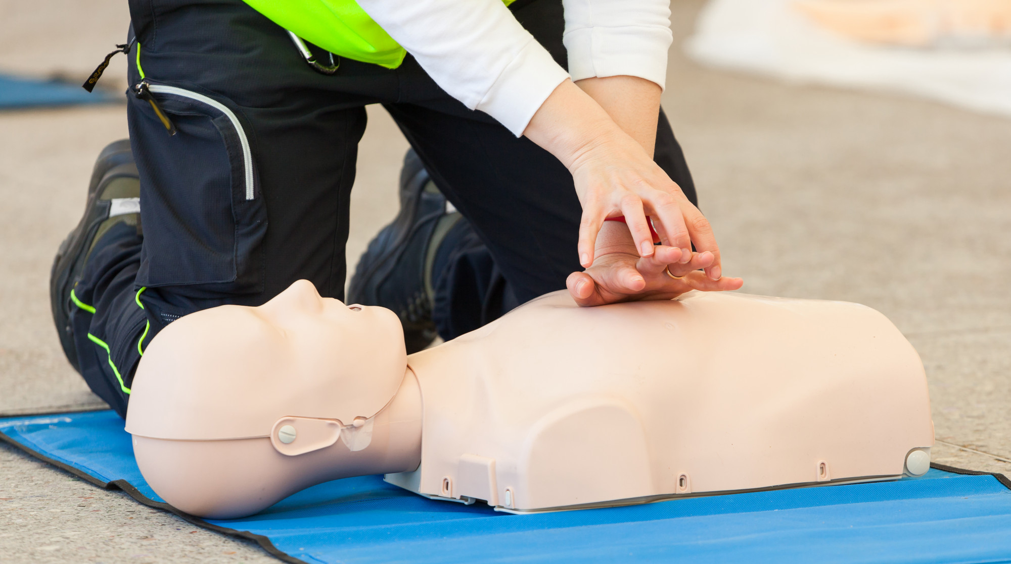



LESSON 7
Basic Life Support (BLS) and Cardiopulmonary Resuscitation (CPR)
Photo Credit: Freepik
PPT 7 -
MFR | INDIA
PPT 7 - 1

Slide 2

OBJECTIVES
Upon completing this lesson, you will be able to:
1
  Demonstrate rescue breathing for adults, children and infants using a mannequin, with and without foreign body airway obstruction.
  Describe and demonstrate CPR in adults, children, and infants using a mannequin.
2
PEER | MFR | INDIA
PPT 7 -

Slide 3
OBJECTIVES
Upon completing this lesson, you will become familiar with:
3
  Describe and demonstrate two-rescuer CPR for adults.
  List two causes of partial or total upper airway obstruction.
4
PEER | MFR | INDIA
PPT 7 -

Slide 4
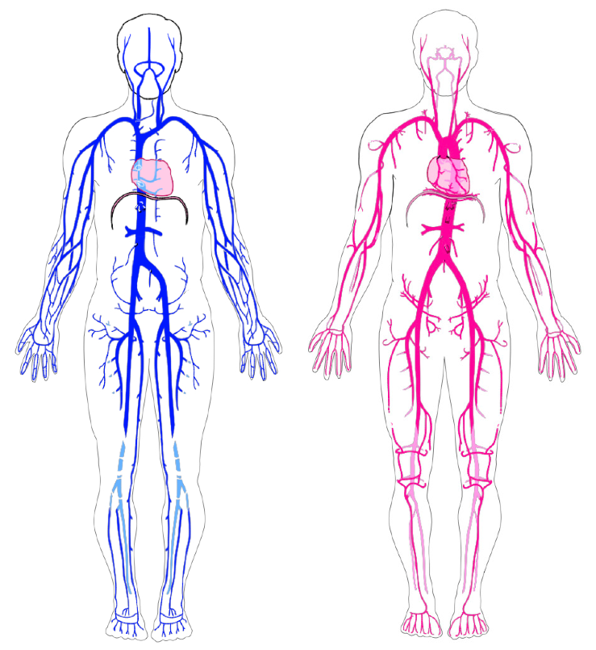
Circulatory System
PEER | MFR | INDIA
PPT 7 -

Slide 5
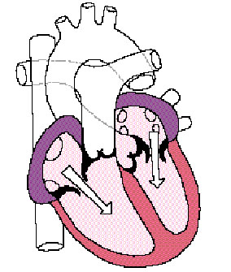
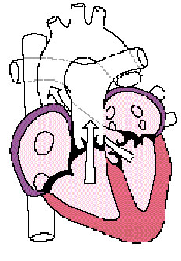
The Heart
Aorta
Superior Vena Cava
Pulmonary
Artery
Left
Atrium
Right
Atrium
Left
Ventricle
Inferior
Vena Cava
Right
Ventricle
PEER | MFR | INDIA
PPT 7 -

Slide 6
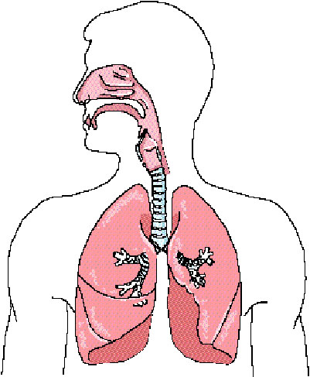
The Respiratory System
Nose
Pharynx
Mouth
Epiglottis
Laryngopharynx
Trachea
PEER | MFR | INDIA
PPT 7 -

Slide 7
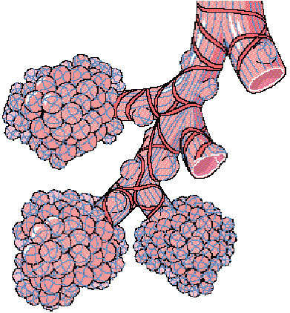
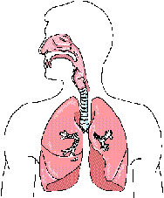
The Respiratory System
Alveoli
PEER | MFR | INDIA
PPT 7 -

Slide 8
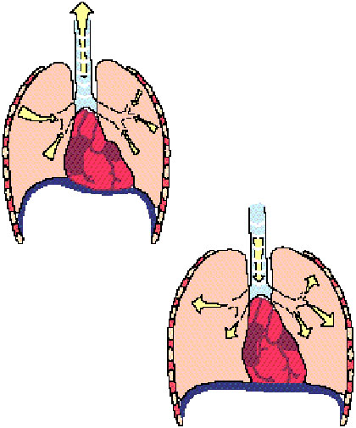
How Respiration Works
PEER | MFR | INDIA
PPT 7 -

Slide 9
Clinical Death
Occurs when a patient is in respiratory arrest (not breathing) or in cardiac arrest (heart not beating).
The patient has a period of 4 to 6 minutes to be resuscitated without brain damage.
Clinical death can be reversed.
PEER | MFR | INDIA
PPT 7 -

Slide 10
Biological Death
The moment the brain cells begin to die.
Biological death cannot be reversed.
PEER | MFR | INDIA
PPT 7 -

Slide 11
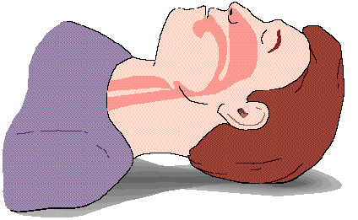
Causes of Airway Obstruction
Tongue
Epiglottitis
Foreign Body
Tissue damage
Illness
PEER | MFR | INDIA
PPT 7 -

Slide 12
Partial Airway Obstruction
Weak, ineffective cough
High-pitched noise when inhaling
Increased respiratory difficulty and may clutch at the throat
Cyanosis (bluish discoloration of the skin and mucous membranes)
PEER | MFR | INDIA
PPT 7 -

Slide 13
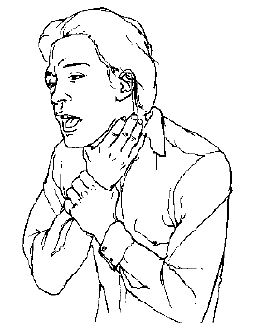
Complete Airway Obstruction
Universal Sign
A patient with complete foreign body airway obstruction will not be able to speak and may grasp at his/her throat.
PEER | MFR | INDIA
PPT 7 -

Slide 14

Photo Credit: Freepik
PEER | MFR | INDIA
PPT 7 -

