Slide 1
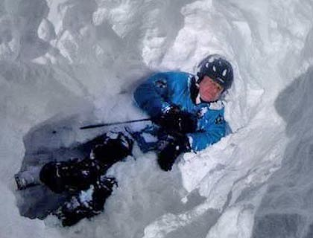
AVALANCHE RESCUE
14 BN NDRF

Slide 2
OBJECTIVE
Introduction of Avalanche Rescue.
Equipments for Avalanche Rescue.
Types of Avalanche Rescue.
Rescue by the Team Members.
Rescue by the Special Rescue Team.
Conclusion
Review

Slide 3
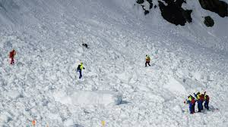
INTRODUCTION OF AVALANCHE RESCUE
Movement of soft, packed or mix snow from slope due to triggering by number of means accompanied by large amount of wind and sound causing every thing washed away along with in its way is called avalanche.
Avalanche rescue involves locating and retrieving people who have been buried in Avalanches.

Slide 4
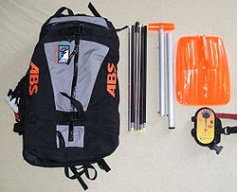
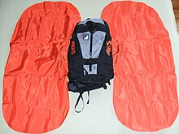
EQUIPMENTS FOR AVALANCHE RESCUE
Avalanche cords
Beacons
Probes
Shovels
Avalanche airbags

Slide 5
EQUIPMENTS FOR AVALANCHE RESCUE
Recco rescue system
The Recco system is used by organised rescue services around the world. The Recco system is a two-part system where the rescue team uses a small hand-held detector. The detector receives a directional signal that is reflected back from a small, passive, transponder called a reflector that is included into outerwear, boots, helmets, and body protection. Recco reflectors are not a substitute for avalanche beacons. The Recco signal does not interfere with beacons. In fact, the current Recco detector also has an avalanche beacon receiver (457 kHz) so one rescuer can search for a Recco signal and a beacon signal at the same time.
Avalung
Recently, a device called an Avalung has been introduced for use in avalanche terrain. The device consists of a mouth piece, a flap valve, an exhaust pipe, and an air collector. Several models of Avalung either mount on one's chest or integrate in a proprietary backpack.
During an avalanche burial, victims not killed by trauma usually suffer from asphyxiation as the snow around them melts from the heat of the victim's breath and then refreezes, disallowing oxygen flow to the victim and allowing toxic levels of CO₂ to accumulate. The Avalung ameliorates this situation by drawing breath over a large surface area in front and pushing the warm exhaled carbon dioxide behind. This buys additional time for rescuers to dig the victim out.

Slide 6
EQUIPMENTS FOR AVALANCHE RESCUE
Other devices
More backcountry adventurers are also carrying Satellite Electronic Notification Devices (SEND) to quickly alert rescuers to a problem. These devices include the SPOT Messenger, Emergency Position-Indicating Radio Beacon (EPIRB) or Personal Locating Beacons (PLBs) containing the Global Positioning System (GPS). This device can quickly notify search and rescue of an emergency and the general location (within 100 yards), but only if the person with the EPIRB has survived the avalanche and can activate the device. Survivors should also try to use a mobile phone to notify emergency personnel. Unlike the other devices mentioned above, the mobile phone (or satellite phone) provides two-way communications with rescuers.

Slide 7
TYPES OF AVALANCHE RESCUE
Self-rescue is the process where victims caught in an avalanche escape by either digging themselves out, or after the snow melts. Self-rescue is rare as the victim is usually "entombed" by the snow and unable to move at all. However, if the avalanche is small, or the victim is buried near the surface, or the avalanche debris is soft, victims may be able to dig themselves out.
Companion rescue is when victims are rescued by other members of their group.
Organized rescue- The process when professional and volunteer rescue teams become involved. In case of organized rescue, the first teams travel fast and light to locate and uncover buried victims. These teams carry basic rescue equipment, including rescue dogs and A.V.detectors and emergency-care gear. These rescuers are generally not equipped for prolonged operations.

Slide 8
COMPANION RESCUE
If you witness an avalanche burial:
Observe the victim's progress and if possible mark the point of entry and point at where the victim was last seen.
Check for further avalanche danger.
Make a QUICK SEARCH of the debris surface.
  LOOK for any signs of victims
  LISTEN for any sounds
  PROBE the most likely burial spots
Make a SYSTEMATIC SEARCH, probing the debris with axes or poles.
Send for help.
KEEP SEARCHING until help arrives.
REMEMBER YOU ARE THE BURIED VICTIM'S ONLY REAL CHANCE OF LIVE RESCUE , Although survival chances decline rapidly with duration of burial, they do not reach zero for a long time.

Slide 9
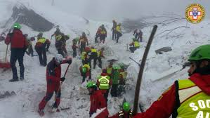
COMPANION RESCUE

Slide 10
ORGANIZED RESCUE
Avalanche search
This techniques for searching with avalanche transceiver, probes and for digging for different burial depths.
Part 1- Using an avalanche Cord.
Part 2- Using an avalanche Prove.
Part 3- Using AVD.
Part 4- Using sniper Dog.
Part 5- Deep digging.

Slide 11
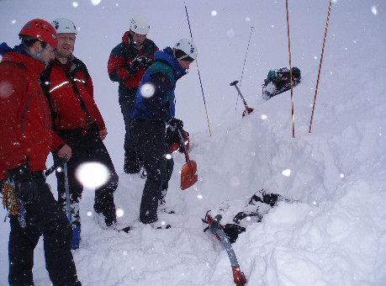
ORGANIZED RESCUE

Slide 12
SEARCH USING AN AVALANCHE CORD
An avalanche cord is 20-25 meter long and about 3.5 mm thick. It is usually made of red cotton with direction arrows positioned at meter intervals, each with the length marked in meter, and 10 cm long loops. It is wound into a ball. The climber ties the loop with the 1-metre mark (arrow against himself) around his waist. If there is a risk of avalanches he throws the ball out and pulls the avalanche cord along the snow behind him. If he is buried by an avalanche, there is a relatively good chance that part of the avalanche cord will be visible on top of the avalanche slide, thanks to its length. Rescuers can determine from the direction arrows, in which direction and how many meters they must dig and are then able to follow the cord to the victim.

Slide 13
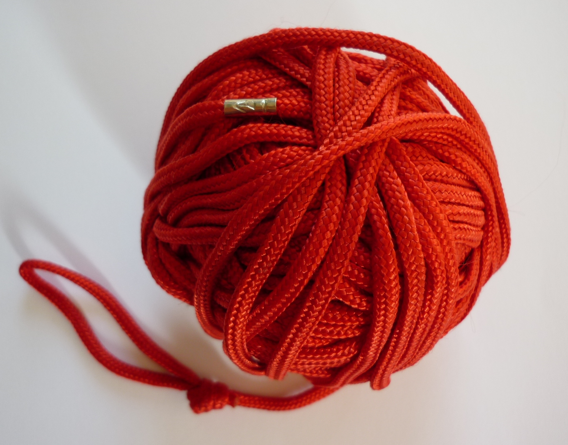
SEARCH USING AN AVALANCHE CORD

Slide 14
SEARCH USING AN AVALANCHE PROBE
Probing is a continuation of the search that began with a visual search for clues and proceeded through the transceiver search.
There are three types of probing: transceiver probing, spot probing, and probe line probing.
A probe that hits a human body, or a backpack, has a slightly springy, "boingy" feel. Don't press too hard. Your job is to locate rather than perforate. Branches can also have a springy feel. A probe that hits skis, a boot, or a snowmobile has a much different feel. As you would expect, rocks have a hard feel and can make a clicking sound. Ice layers can have a "sticky" feel where the tip of the probe is momentarily held by the ice. If you are unsure whether your probe is contacting the victim, probe several times around your initial probe hole to gauge the size and "feel" of the object.
When you find the victim with your probe, leave it in place and begin shoveling. It is important that you leave your probe in place so you dig in the correct location. The probe is also a good reminder to not stand on top of the victim.

Slide 15
SEARCH USING AN AVALANCHE PROBE
Transceiver probing, sometimes called pinpointing, takes place after completing a transceiver fine search. It is an important step to confirm that you are in the correct location before you begin digging.
Spot probing involves probing high-probability areas. It is used when the victim doesn't have an avalanche transceiver or when their transceiver has stopped transmitting. High-probability areas include near clues, uphill of catchments areas, in depressions, near the toe of the avalanche, downhill of the point last seen, etc.
During spot probing, it is advisable to not probe deeper than 1.5 meters (5 feet). Surviving such a deep burial is extremely unlikely; it is a better use of your time to search more locations.
A probe line search is appropriate when the victim cannot be located using a transceiver or by other readily available means. A probe line requires a large number of rescuers and is a slow process. It is usually considered a recovery, rather than a rescue, technique. Probe lines are typically instigated by professional rescuers.
A probe line involves a row of rescuers repeatedly inserting avalanche probes into the snow and then advancing. It is an effective albeit slow way to search an avalanche.
Probe line searching is often called "organized probing," but your probing should always be organized regardless of whether there is one person or 20.

Slide 16
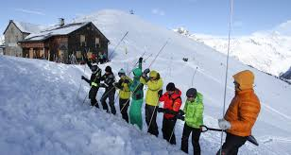
SEARCH USING AN AVALANCHE PROBE

Slide 17
SEARCH USING BY A.V.D.
Avalanche Victim Detector (AVD) is also known as Avalanche Transceiver. These are small, compact radios used to identify avalanche burial sites. They transmit electromagnetic signals that are picked up by another transceiver on the receive mode.
AVD works in two modes ie receiving and transmit or search mode.
(a) Transmit mode. AVDs are carried by all the persons moving through an avalanche prone area. Before moving across a slope where an avalanche is expected, AVDs are set on transmit mode. In case somebody gets buried in the avalanche then the AVDs of rescue party can detect the signals of AVD buried with the victim and the individual can be rescued.
(b) Receiving mode (Search mode). AVD carried by the rescue team are kept on receiving mode. In receiving mode as soon as AVD picks up the signal, the approximate distance and direction appears on the display. The no of burials within the range of the AVD is also displayed on the screen. An AVD can detect a victim buried 20 m deep in snow in a radius of 50 m.

Slide 18
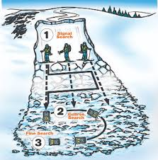
SEARCH USING BY A.V.D.

Slide 19
SEARCH USING BY SNIPER DOG
During an emergency avalanche situation, rescue dogs will use their impressive sense of smell to locate humans under the snow.
In fact, some rescue dogs that specialize in avalanche situations can smell people that are under 15 feet of snow.
Rescue dogs are usually accompanied by human search team that will take the dog to the last known site of the victim then allow the dog to search around and attempt to detect them through smell.
Dogs can typically search an area that spans 2.5 acres in around 30 minutes. For humans, it would take several hours and around a dozen people to effectively and thoroughly search such a large area of land.

Slide 20
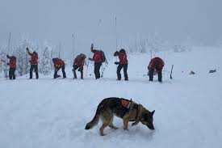
SEARCH USING BY SNIPER DOG

Slide 21
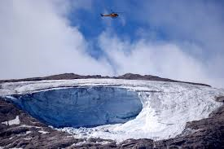
SEARCH USING BY DIGGING
Real incidents have occurred in which shoveling strategy made the difference between life and death. Educators have adopted two prevailing techniques: “strategic shoveling” and the “v-shaped conveyor method,” with various hybrid approaches in between.

Slide 22
CONCLUSION
Anyone who enjoys winter recreation and ventures beyond carefully managed environments needs to be both avalanche aware and rescue ready. Because getting caught in an avalanche is rare, you don’t need to be paranoid, but you and your trip mates do need to be prepared because your best—and often only—chance of survival is the rescue skills of backcountry companions.

Slide 23
REVIEW
Introduction of Avalanche Rescue.
Equipments for Avalanche Rescue.
Types of Avalanche Rescue.
Rescue by the Team Members.
Rescue by the Special Rescue Team.
Conclusion.

Slide 24
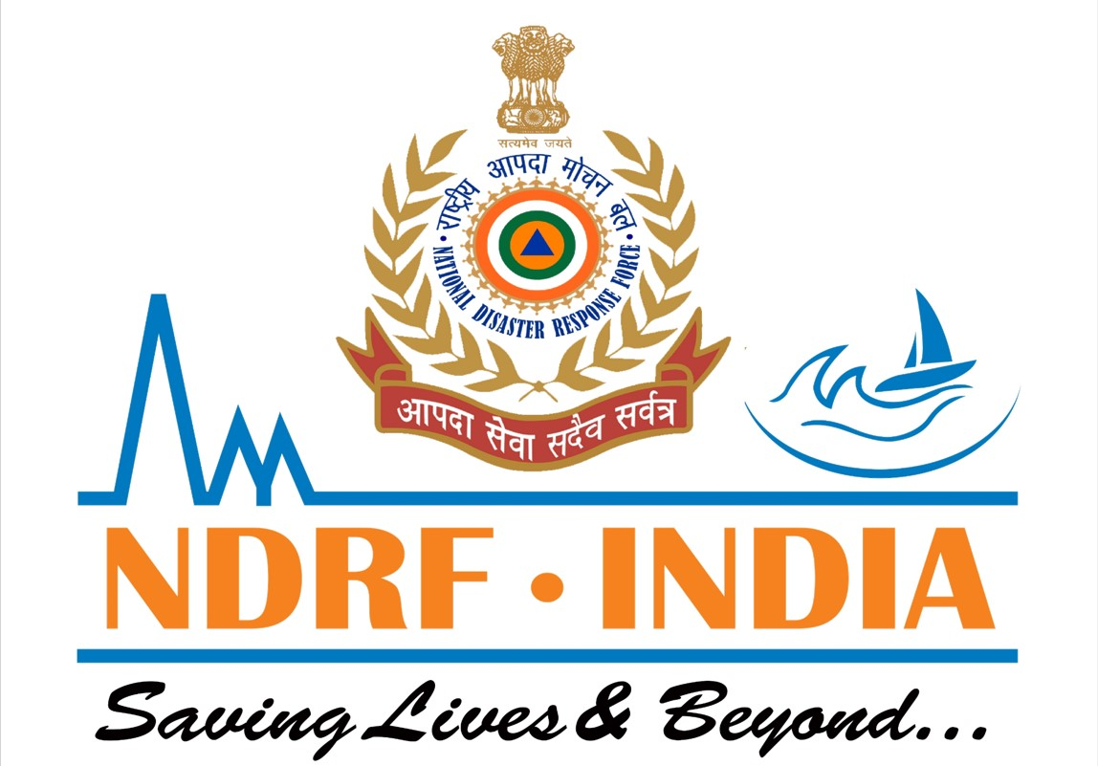
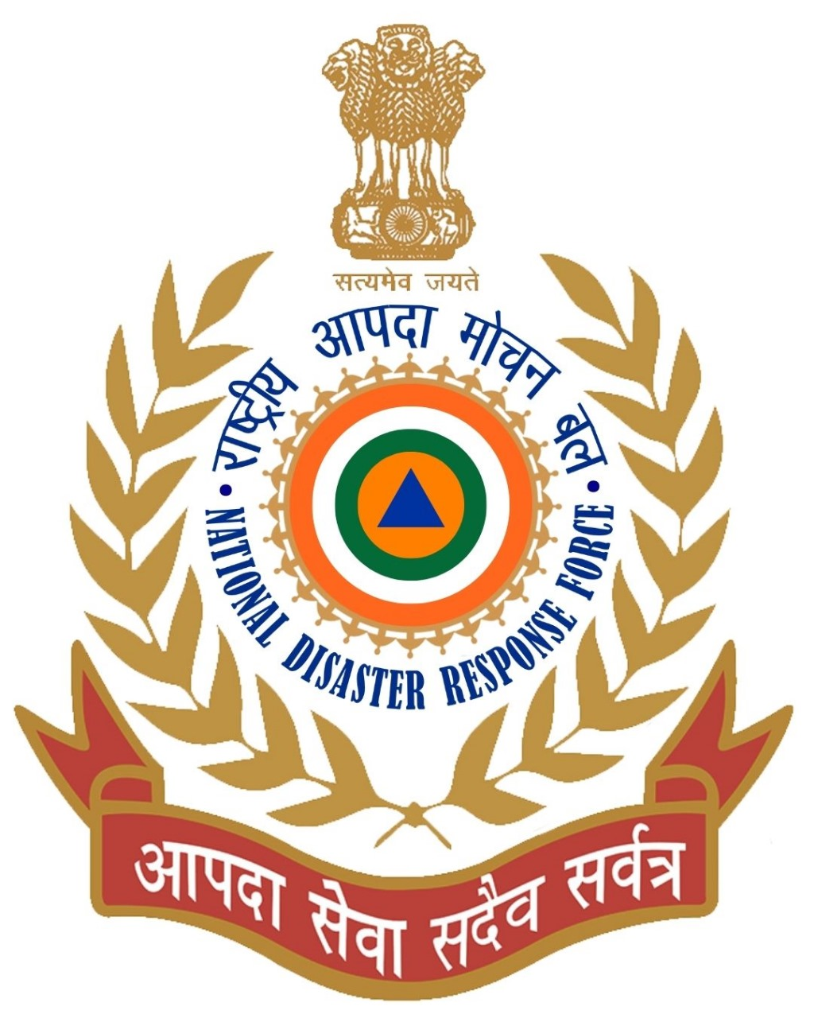
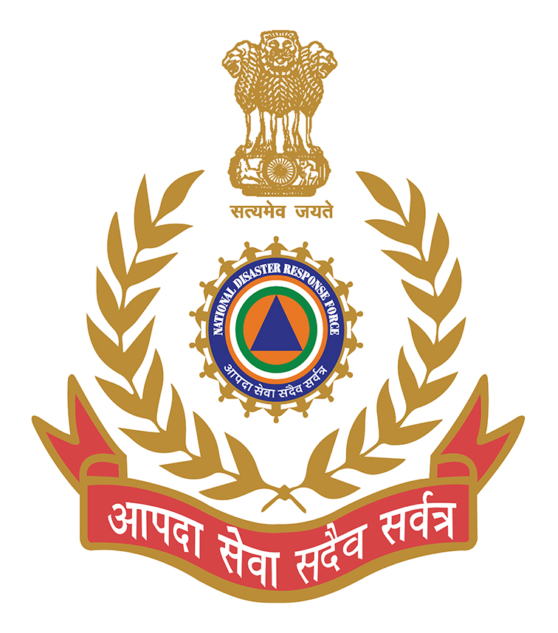
THANK YOU

