Slide 1
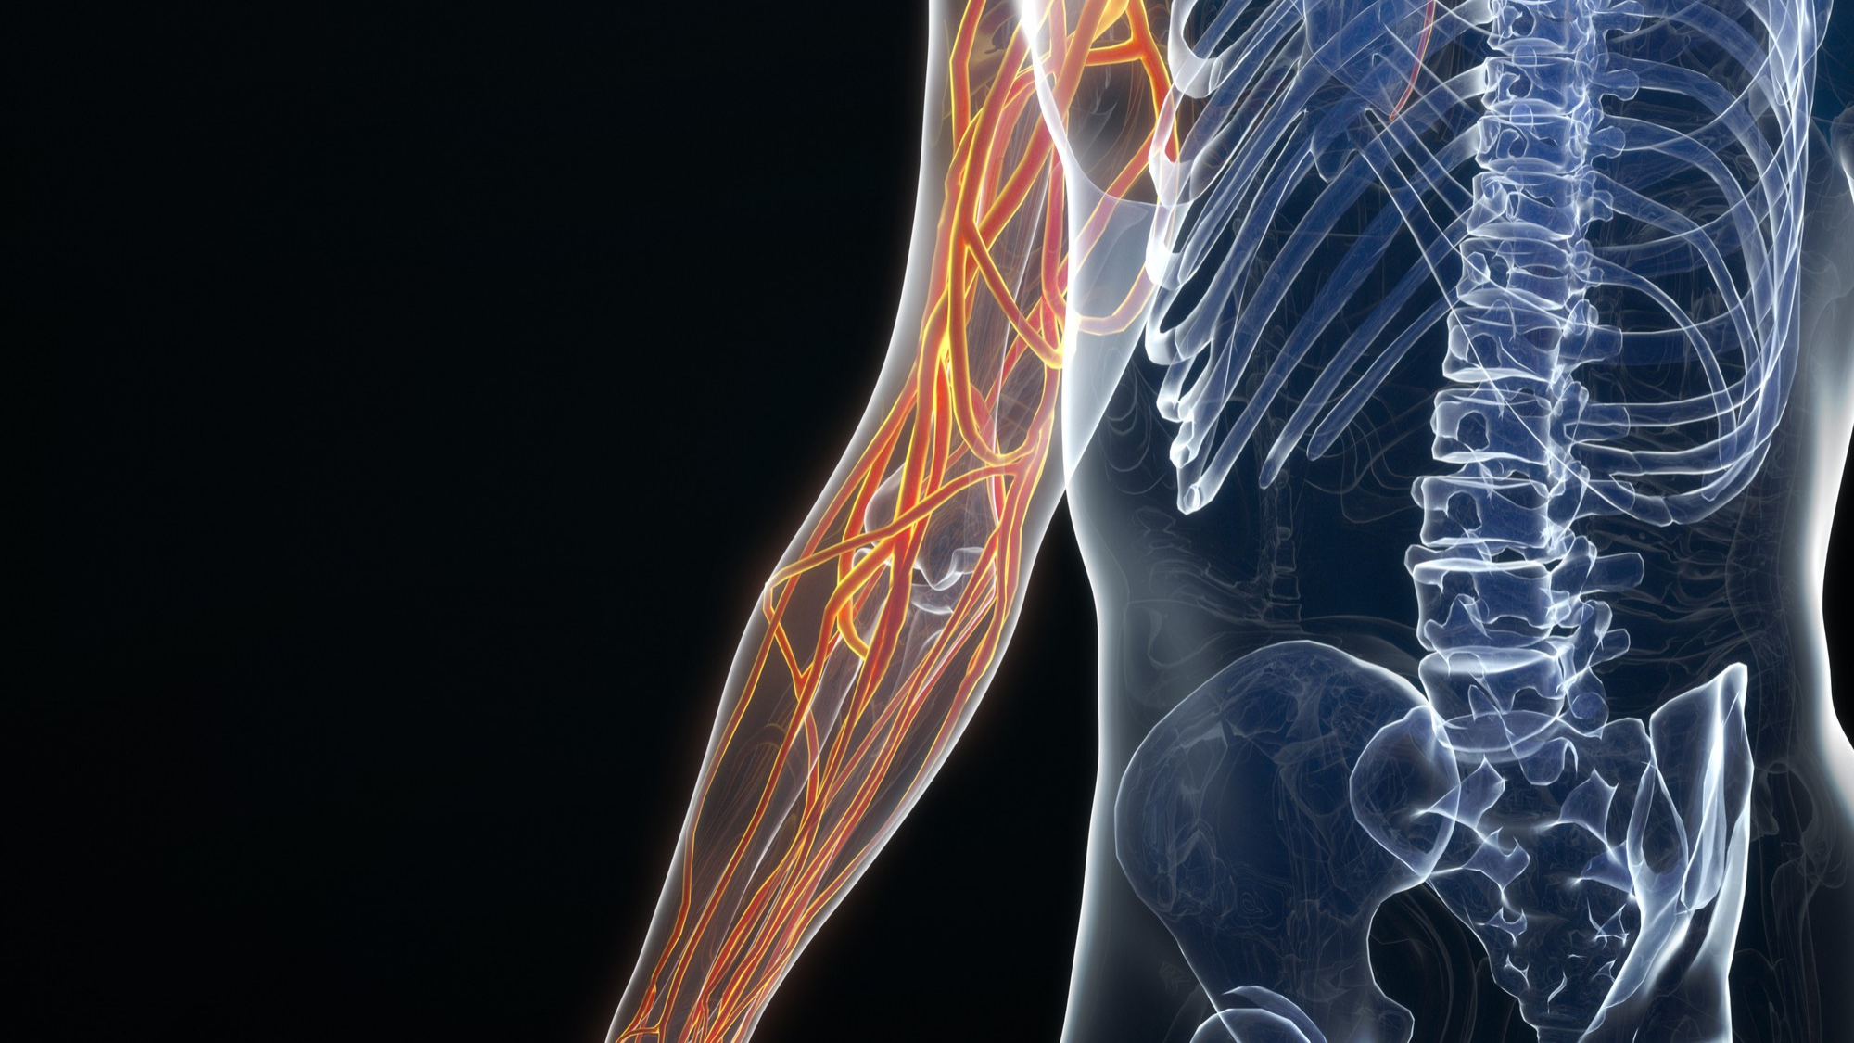



LESSON 5
Anatomical References
Photo Credit: Freepik
PPT 5 -
MFR | INDIA
PPT 5 - 1

Slide 2

OBJECTIVES
Upon completing this lesson, you will be able to:
1
Define anatomical position.
Identify and describe the three anatomical planes.
Identify the five regions of the human body.
2
3
PEER | MFR | INDIA
PPT 5 -

Slide 3
OBJECTIVES
Upon completing this lesson, you will become familiar with:
4
List the five body cavities and the organs they contain.
Describe the location of a wound on a patient using anatomical references.
5
PEER | MFR | INDIA
PPT 5 -

Slide 4
OBJECTIVES
Upon completing this lesson, you will be able to:
6
Name the four abdominal quadrants.
Identify and label the main internal organs located in each abdominal quadrant.
7
PEER | MFR | INDIA
PPT 5 -

Slide 5
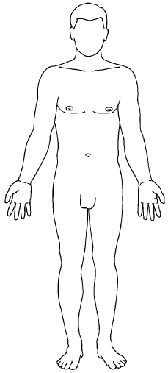
Anatomical Position
PEER | MFR | INDIA
PPT 5 -

Slide 6

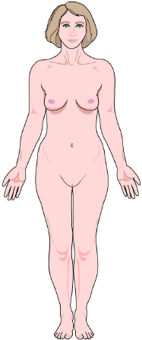
Anterior
Posterior
Right
Left
Conventional References
Proximal
TRANSVERSE
PLANE
Superior
Distal
Inferior
Proximal
Distal
FRONTAL PLANE
MEDIAL PLANE
PEER | MFR | INDIA
PPT 5 -

Slide 7
Positional Terms
Prone:
Lying face down, on the stomach
Supine:
Lying face up, on the back
PEER | MFR | INDIA
PPT 5 -

Slide 8
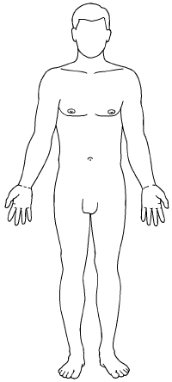
Head
Body
Regions
Neck
Upper
extremities
Trunk
Lower
extremities
PEER | MFR | INDIA
PPT 5 -

Slide 9
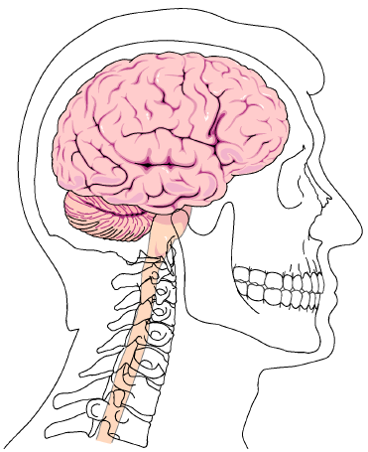
Head and Neck
Skull
Face
Neck
PEER | MFR | INDIA
PPT 5 -

Slide 10
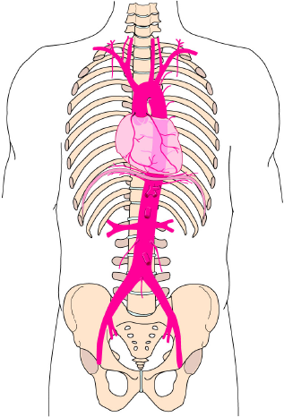
Trunk
Thorax
Abdomen
Pelvis
PEER | MFR | INDIA
PPT 5 -

Slide 11
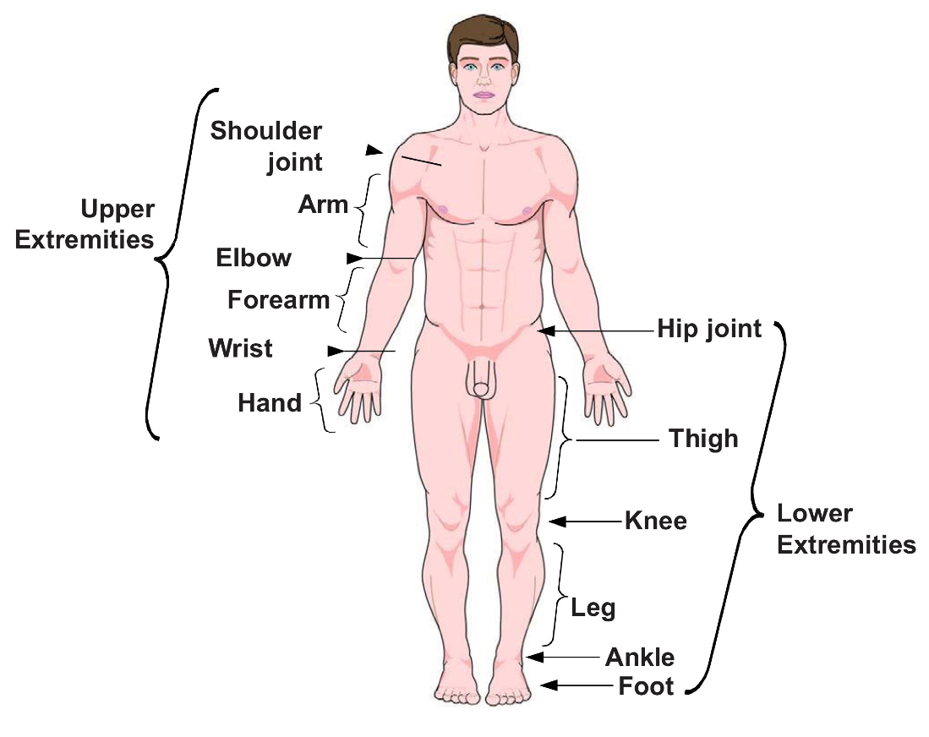
Upper and Lower Extremities
PEER | MFR | INDIA
PPT 5 -

Slide 12

Cranial Cavity
PEER | MFR | INDIA
PPT 5 -

Slide 13
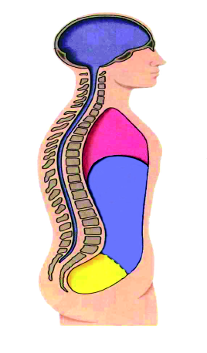
Thoracic
Thoracic, Abdominal and Pelvic Cavities
Abdominal
Pelvic
PEER | MFR | INDIA
PPT 5 -

Slide 14
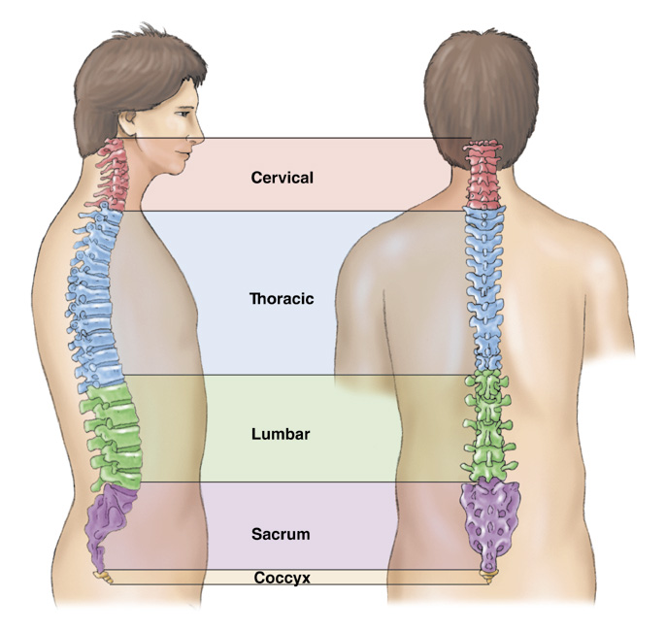

Spinal Cavity
PEER | MFR | INDIA
PPT 5 -

Slide 15
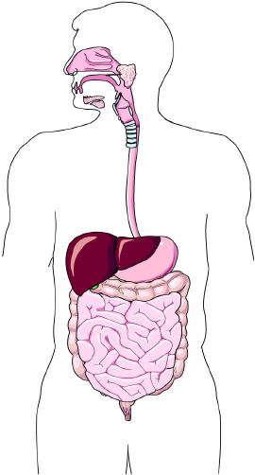
Abdominal Quadrants
Liver
Liver
Stomach
Large intestine / colon
Large intestine / colon
Small Intestine
Small Intestine
Right Upper Quadrant
Left Upper Quadrant
Right Lower Quadrant
Left Lower Quadrant
Large intestine / colon
Large intestine / colon
Small Intestine
Small Intestine
PEER | MFR | INDIA
PPT 5 -

Slide 16
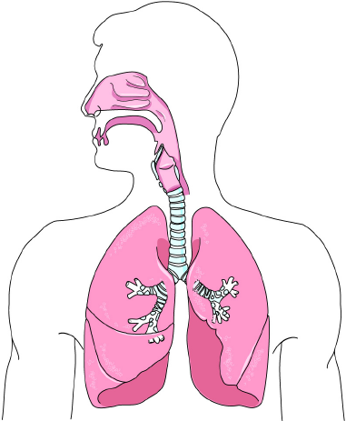
Respiratory System
Pharynx
Epiglottis
(oropharynx and
nasopharynx)
Larynx
Lungs
Trachea
Right main
bronchus
Left main
bronchus
PEER | MFR | INDIA
PPT 5 -

Slide 17

Digestive System
Mouth
Oesophagus
Stomach
Large intestine
Liver
Small intestine
Anus
PEER | MFR | INDIA
PPT 5 -

Slide 18
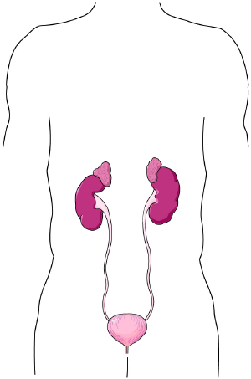
Urinary System
Kidneys
Ureters
Urinary bladder
Urethra
PEER | MFR | INDIA
PPT 5 -

Slide 19
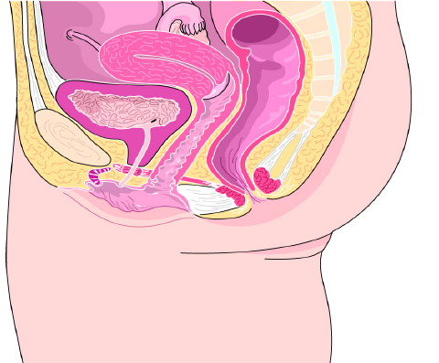
Fallopian Tube
Female Reproductive System
Ovary
Uterus
Vagina
External
genitals
PEER | MFR | INDIA
PPT 5 -

Slide 20
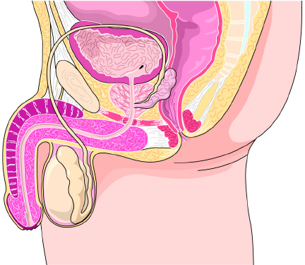
Seminal duct
Male Reproductive System
Penis
Testes
PEER | MFR | INDIA
PPT 5 -

Slide 21
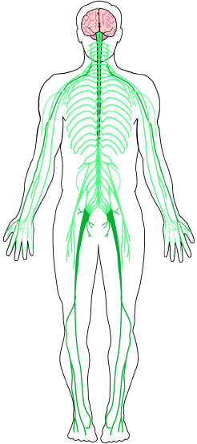
Brain
Central nervous system
Nervous System
Spinal cord
Peripheral
nervous
system
PEER | MFR | INDIA
PPT 5 -

Slide 22
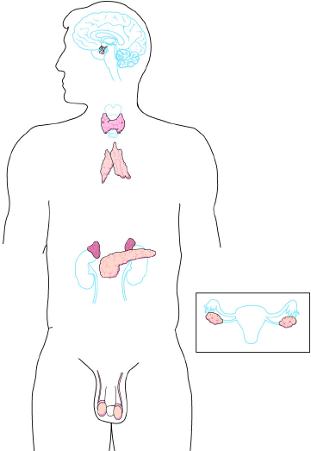
Pituitary
Endocrine System
Thyroid
Adrenals
Testes
(male)
Ovaries
(female)
PEER | MFR | INDIA
PPT 5 -

Slide 23
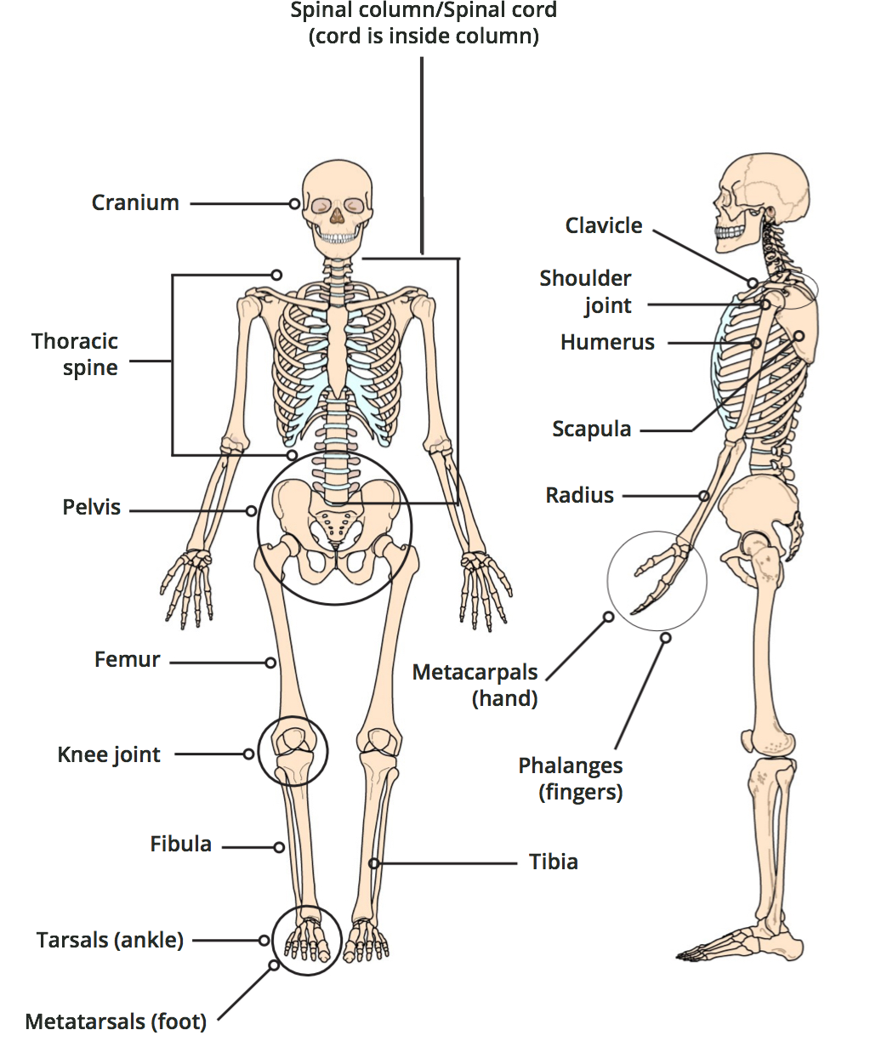
Skeletal System
PEER | MFR | INDIA
PPT 5 -

Slide 24
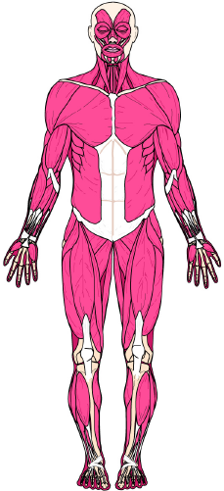
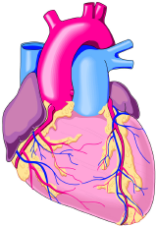
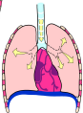
Major Muscle Types
Cardiac muscle
Smooth muscle
Skeletal muscle
PEER | MFR | INDIA
PPT 5 -

Slide 25
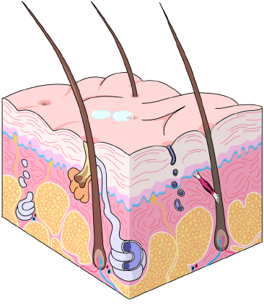
The Skin
Skin surface
Epidermis
Dermis
PEER | MFR | INDIA
PPT 5 -

Slide 26

Photo Credit: Freepik
PEER | MFR | INDIA
PPT 5 -

