Slide 1

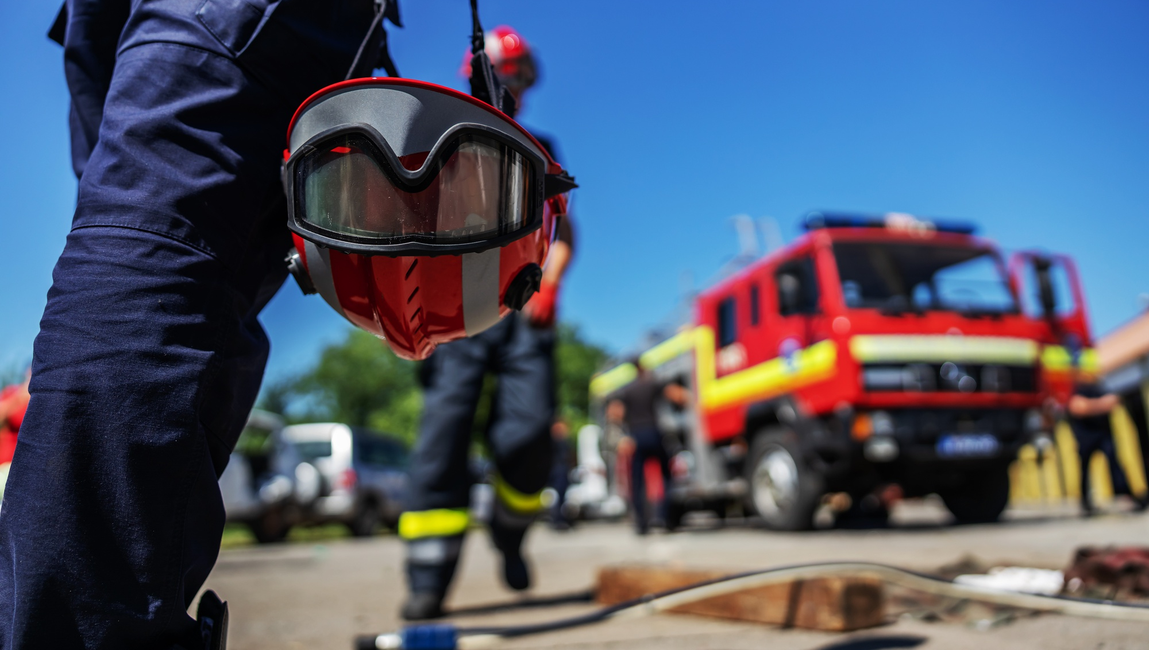





MANAGING PRACTICAL STATIONS AND EXERCISES
Photo Credit: Freepik
Presented By:- Sohel Lakhani. DC
PPT 2 -
PEER | CSSR | INDIA
PPT 2-1

Slide 2


OBJECTIVES
Upon completing this lesson, you will be able to:
1
Describe the general guidelines to follow in practical stations and exercises that part of various CSSR Course lessons.
Follow the specific instructions indicated for each practical station or exercise, as noted in each corresponding lesson assigned.
2
PPT 2 -

Slide 3
OBJECTIVES
Upon completing this lesson, you will be able to:
Demonstrate the standards and instructions to follow during the presentation of practical exercise.
3
PPT 2 -

Slide 4
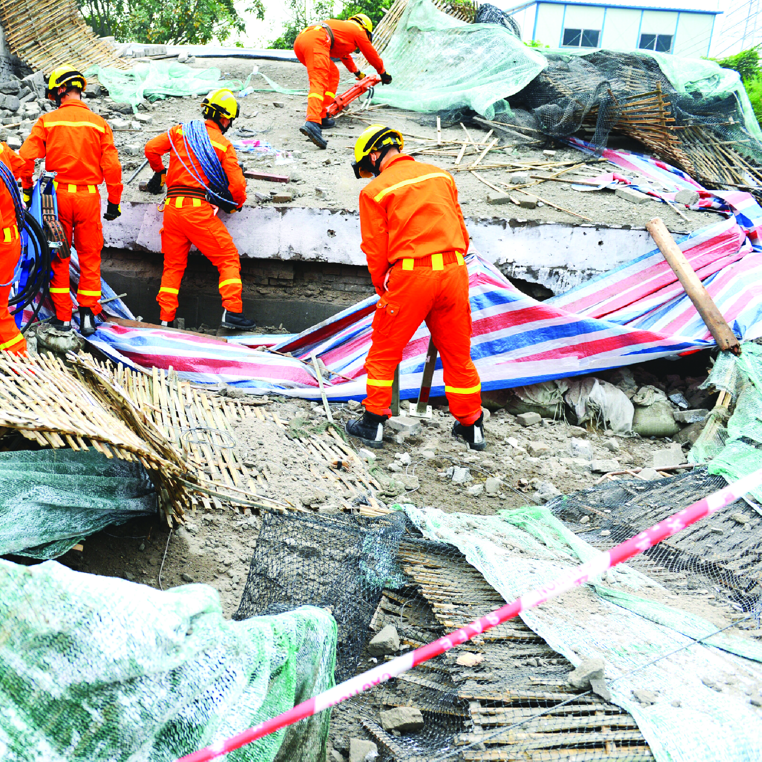



Slide 5


THANK YOU

