Slide 1







CSSR COURSE REVIEW
Photo Credit: Freepik
Presented By:- Sohel Lakhani, DC
PPT 2 -
PEER | CSSR | INDIA
PPT 2-1

Slide 2


OBJECTIVES
Upon completing this lesson, you will be able to:
1
In a group session, review questions and issues regarding the key points of each lesson in the CSSR Course, using the corresponding lesson plan in the Instructor’s Guide.
PPT 2 -

Slide 3
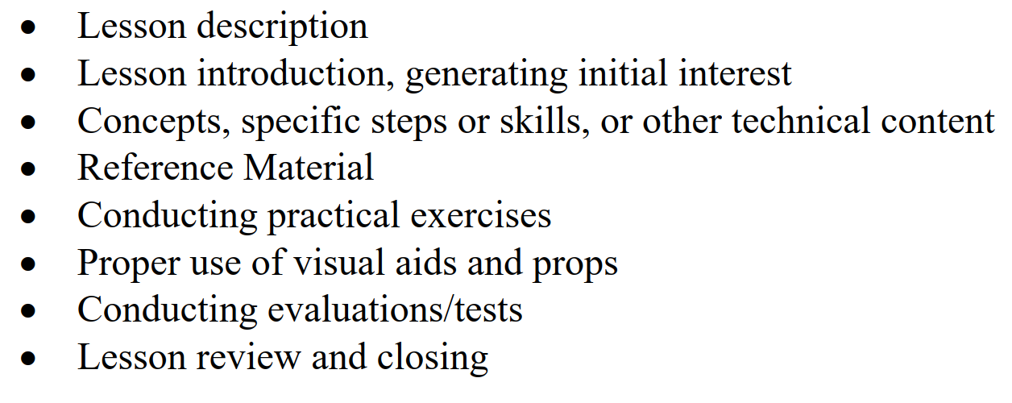
SEQUENCE OF PROCEEDINGS
PPT 2 -

Slide 4
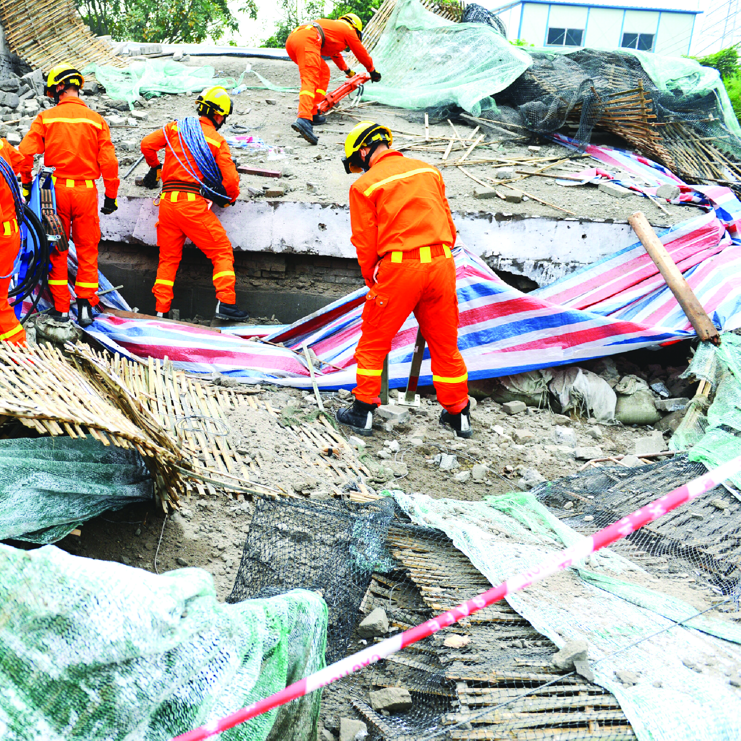



Slide 5


THANK YOU

