Slide 1







How to prepare and present a CSSR Lesson
(using ig)
Photo Credit: Freepik
Presented By:- Sohel Lakhani. DC
PPT 2 -
PEER | CSSR | INDIA
PPT 2-1

Slide 2


OBJECTIVES
Upon completing this lesson, you will be able to:
1
Describe five components of lesson plan and three sequence of criteria
Describe the structure and use of CSSR course.
Use the document titled “Guide to Preparing and Presenting a Lesson”.
2
3
PPT 2 -

Slide 3
OBJECTIVES
Upon completing this lesson, you will be able to:
Use a CSSR Lesson Plan during a presentation.
4
PPT 2 -

Slide 4
COMPONENTS OF A LESSON
Introduction
Development
Review/feedback
Evaluation/testing
Closing
PPT 2 -

Slide 5
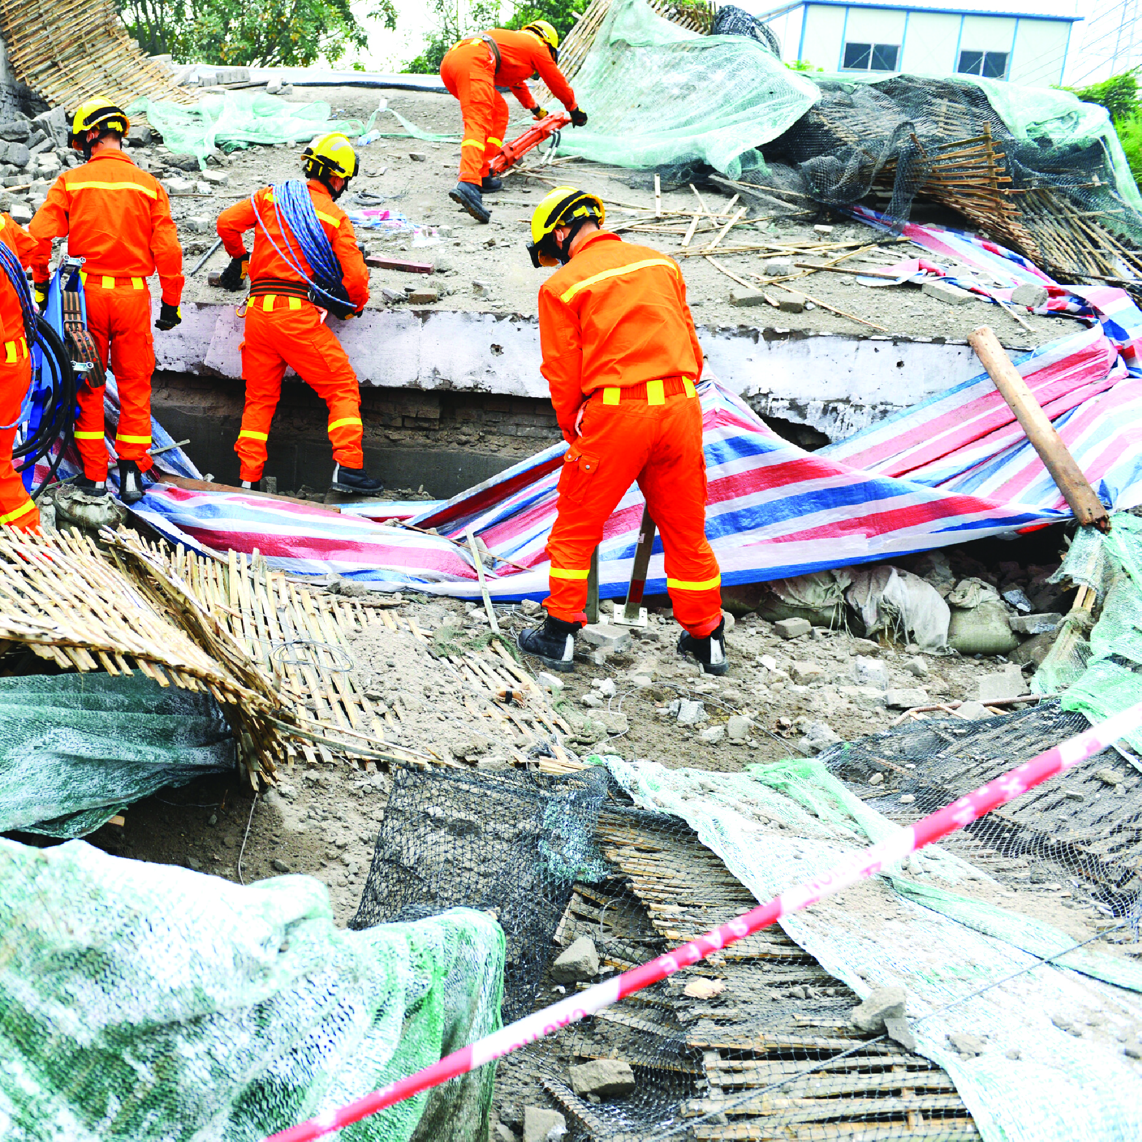



Slide 6


THANK YOU

