Slide 1








PRINCIPLES OF
ADULT LEARNING
Photo Credit: Freepik
PPT 2 -
PEER | CSSR | INDIA
PPT 2-1

Slide 2


OBJECTIVES
Upon completing this lesson, you will be able to:
1
Explain the basic principles of adult learning, based on the Workshop Pre-Work you completed.
PPT 2 -

Slide 3
LEARNING
A relatively permanent change in behaviour that occurs as a result of acquiring new information, skills or attitudes from or through an experience.
PPT 2 -

Slide 4
TYPES OF LEARNING
Cognitive
Psychomotor
Affective
PPT 2 -

Slide 5
MOSLOW’S
HIERARCHY OF NEEDS
PPT 2 -

Slide 6
FACTORS THAT AFFECTS ADULT LEARNER
Positive
Preparation
Practice
Goals, objectives and standards
PPT 2 -

Slide 7
FACTORS THAT AFFECTS ADULT LEARNER
Negative
Fear or anxiety
Discomfort
Frustration
PPT 2 -

Slide 8
INDIVIDUAL DIFFERENCES AMONGST ADULTS
Age.
Previous experiences.
Subcultures.
PPT 2 -

Slide 9
DIFFICULT LEARNING BEHAVIOURS
How can we help them?
Daydreamer
Uninterested
Slow learner
Disruptive
Timid
Others…
PPT 2 -

Slide 10
OBJECTIVES
After completing this lesson, you are able to:
1
Explain the basic principles of adult learning, based on the Workshop Pre-Work you completed.
PPT 2 -

Slide 11
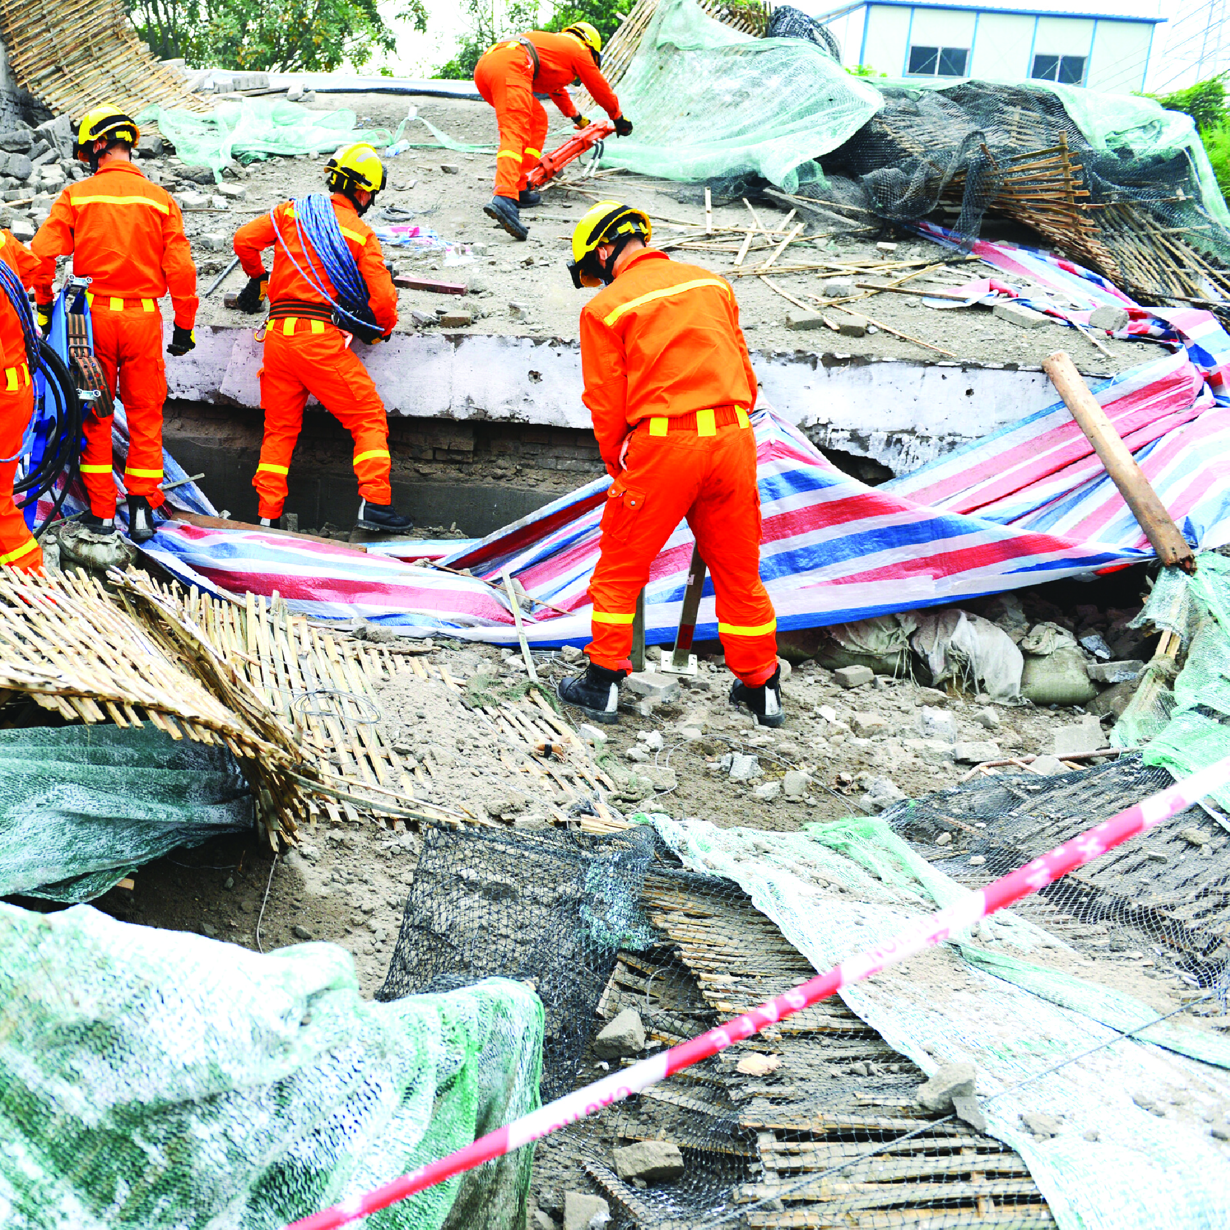



Slide 12

THANK YOU

